Slide 1

Predicting USA Share of Total Box Office Revenue
Maddy O’Brien Jones

Slide 2

The Question
What influences whether a movie is more successful in the USA or abroad?
Notes:
Budget? Genre? Rating? Country?

Slide 3

Selenium
Scraping genre pages of IMDB
Collecting movie-specific codes

Slide 4

BeautifulSoup
IMDB
Basic information
Budget and revenue
The Numbers (supplementary)
Budget and revenue

Slide 5
Feature Selection
Numerical
USA gross box office revenue
International box office revenue
Budget
Year
Runtime
User rating
Ratings count
Categorical
MPAA rating
Director
Country
Language
Genre
Notes:
NO LINEAR RELATIONSHIPS FOUND IN EDA

Slide 6
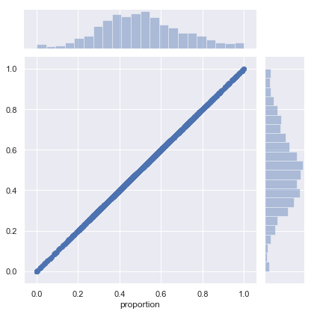
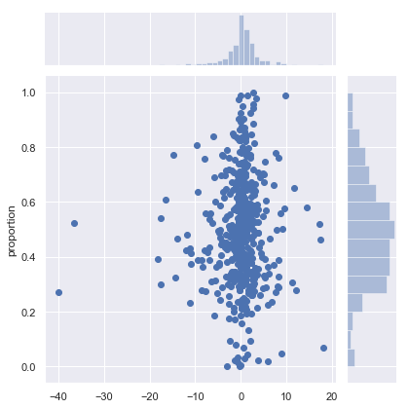
Linear and Polynomial Regression
Best performing model was simple linear regression
Overfitting problems
Residuals for each were normally distributed
Notes:
Linear: .274 to -30 septillion
Poly2: .636 to -7 septillion
Poly3: 1.0 to -1818
Ridge poly3: .935 to -4.89
Lasso poly3: .193 to .066
3rd degree polynomial unregularized – initial R2 was 1.0
Poly2: Chris Columbus (Harry Potter, Home Alone), David Fincher (Gone Girl, The Social Network)
Poly3: Long action movies and highly rated romantic comedies
Ridge predicted long romantic movies and highly rated crime movies would do well
Lasso predicted movies like Ghostbusters and Splash would perform well

Slide 7
Decision Tree Models
Best performing model was Random Forest
Issues with overfitting but performed relatively better
Residuals normally distributed
Notes:
Rf: .907 to .277
-USA gross, budget, ratings_count,year,runtime,rating,USA,comedy,adventure
GBM: .999 to .109
-ratings count, budget, runtime, user rating, year, comedy, horror

Slide 8
Predictors
Linear/polynomial
Runtime
Crime, romance, comedy
Ratings count
User rating
Decision tree models
USA gross
Budget
Ratings count
Year
Runtime
User rating
Comedy, horror
USA

Slide 9
Conclusions
Year and genre relatively important
Linear models relied more on categorical features
Decision tree models relied more on numerical features
More data and features necessary to build optimal model

