Slide 1

Predicting USA Share of Total Box Office Revenue
Maddy O’Brien Jones

Slide 2

The Question
What influences whether a movie is more successful in the USA or abroad?

Slide 3

Selenium
Scraping genre pages of IMDB
Collecting movie-specific codes

Slide 4

BeautifulSoup
IMDB
Basic information
Budget and revenue
The Numbers (supplementary)
Budget and revenue

Slide 5
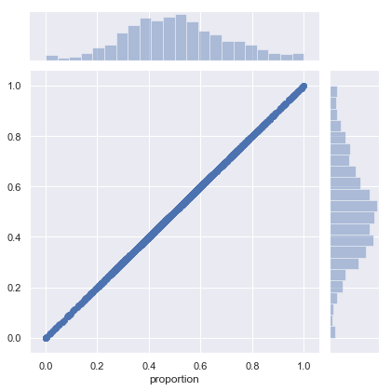
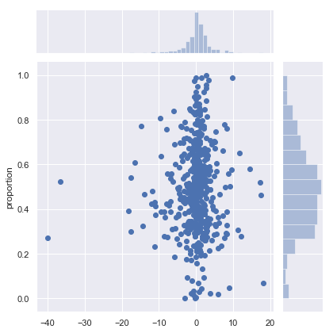
Linear and Polynomial Regression
Best performing model was simple linear regression
Overfitting problems
Residuals for each were evenly distributed

Slide 6
Decision Tree Models

Slide 7
Looking Forward
More features
Trying different models
More data
Data is mostly American/English-language movies
Data is likely incomplete

