Slide 1
AI-Driven Sales Forecasting & Anomaly Detection using Power BI
PowerBi project
Madhesh PR - 727723EUIT119

Slide 2

Business
Problem
Retail organizations often rely on reactive reporting, which only explains past performance.
This creates challenges:
No visibility into future sales trends
Difficulty detecting unusual sales patterns
Delayed business decision-making
Goal:
Use AI-powered analytics in Power BI to enable predictive and proactive decision-making.

Slide 3
Dataset
Overview
Dataset Type: Retail sales transactions
Key Fields:
Date
Product Category
Quantity
Price per Unit
Total Amount
Customer Demographics
Purpose:
Analyze historical sales, detect patterns, and generate future forecasts.

Slide 4

1. Data Fetching
  Imported dataset into Power BI Desktop.
2. Data Cleaning
  Corrected data types
  Removed inconsistencies
  Created date hierarchy
3. Data Modeling
  Created measures and KPIs
  Built relationships and aggregations
4. Data Visualization
  Line charts for trends & forecasting
  AI anomaly detection visuals
  KPI cards and Smart Narratives
Steps Taken

Slide 5

Tools Used
Power BI Desktop — Data visualization & AI analytics
DAX (Data Analysis Expressions) — Measures & KPIs
AI Forecasting & Anomaly Detection — Predictive insights
Smart Narratives — Automated business summaries

Slide 6
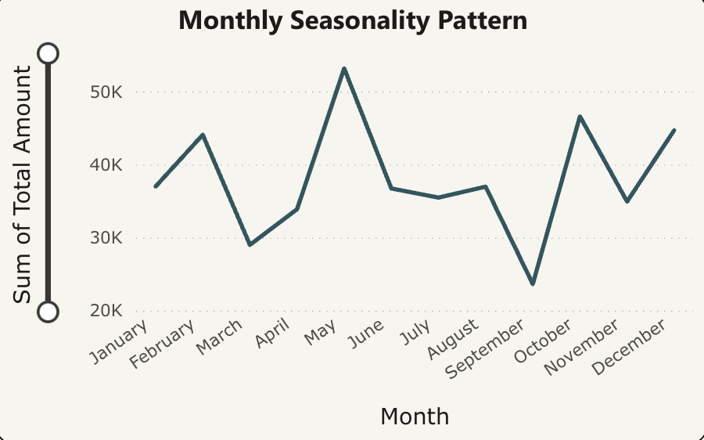
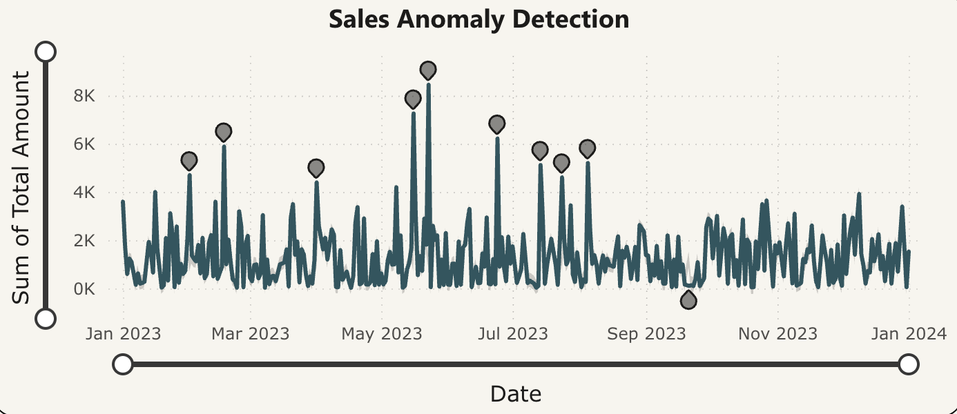
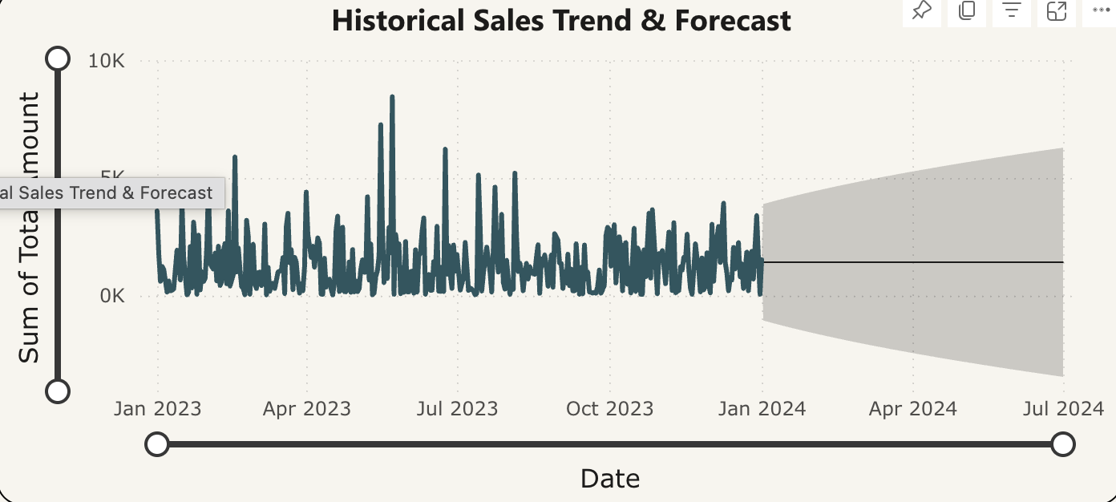
Findings
(Questions → Insights → Visuals)
Caption
Caption
Caption

Slide 7

Increase inventory before peak seasons
Focus marketing on high-performing categories
Investigate sudden sales drops to reduce risk
Use AI forecasting dashboards for continuous planning
Recommendations

Slide 8
Dashboard Screenshots

Slide 9
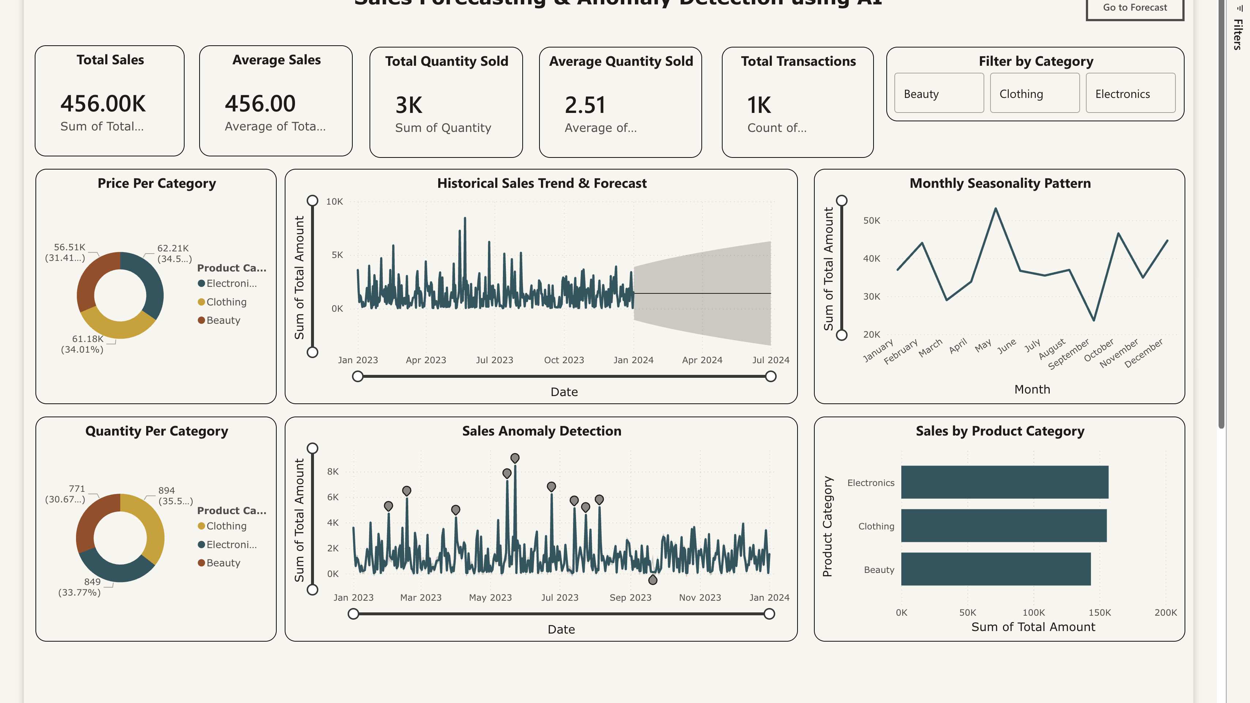

Slide 10
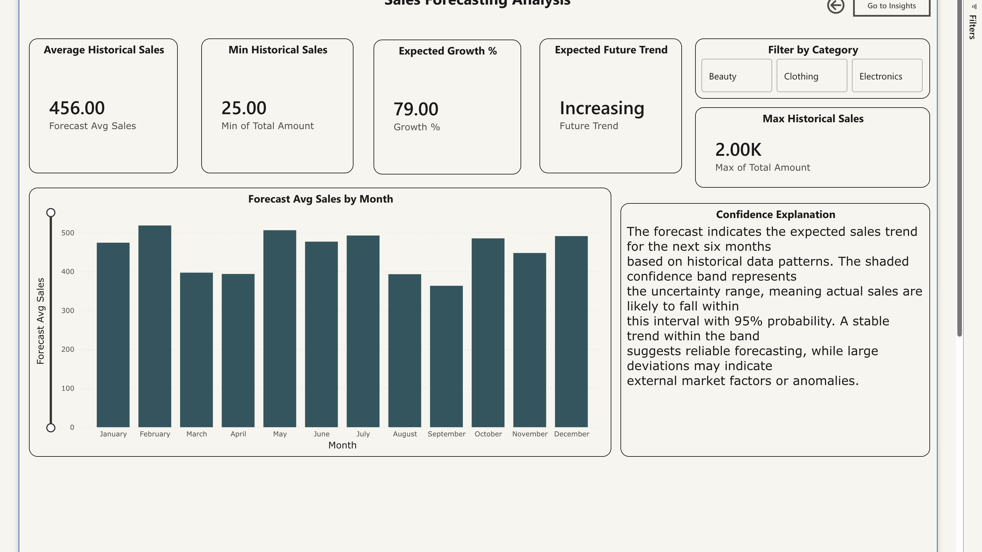

Slide 11
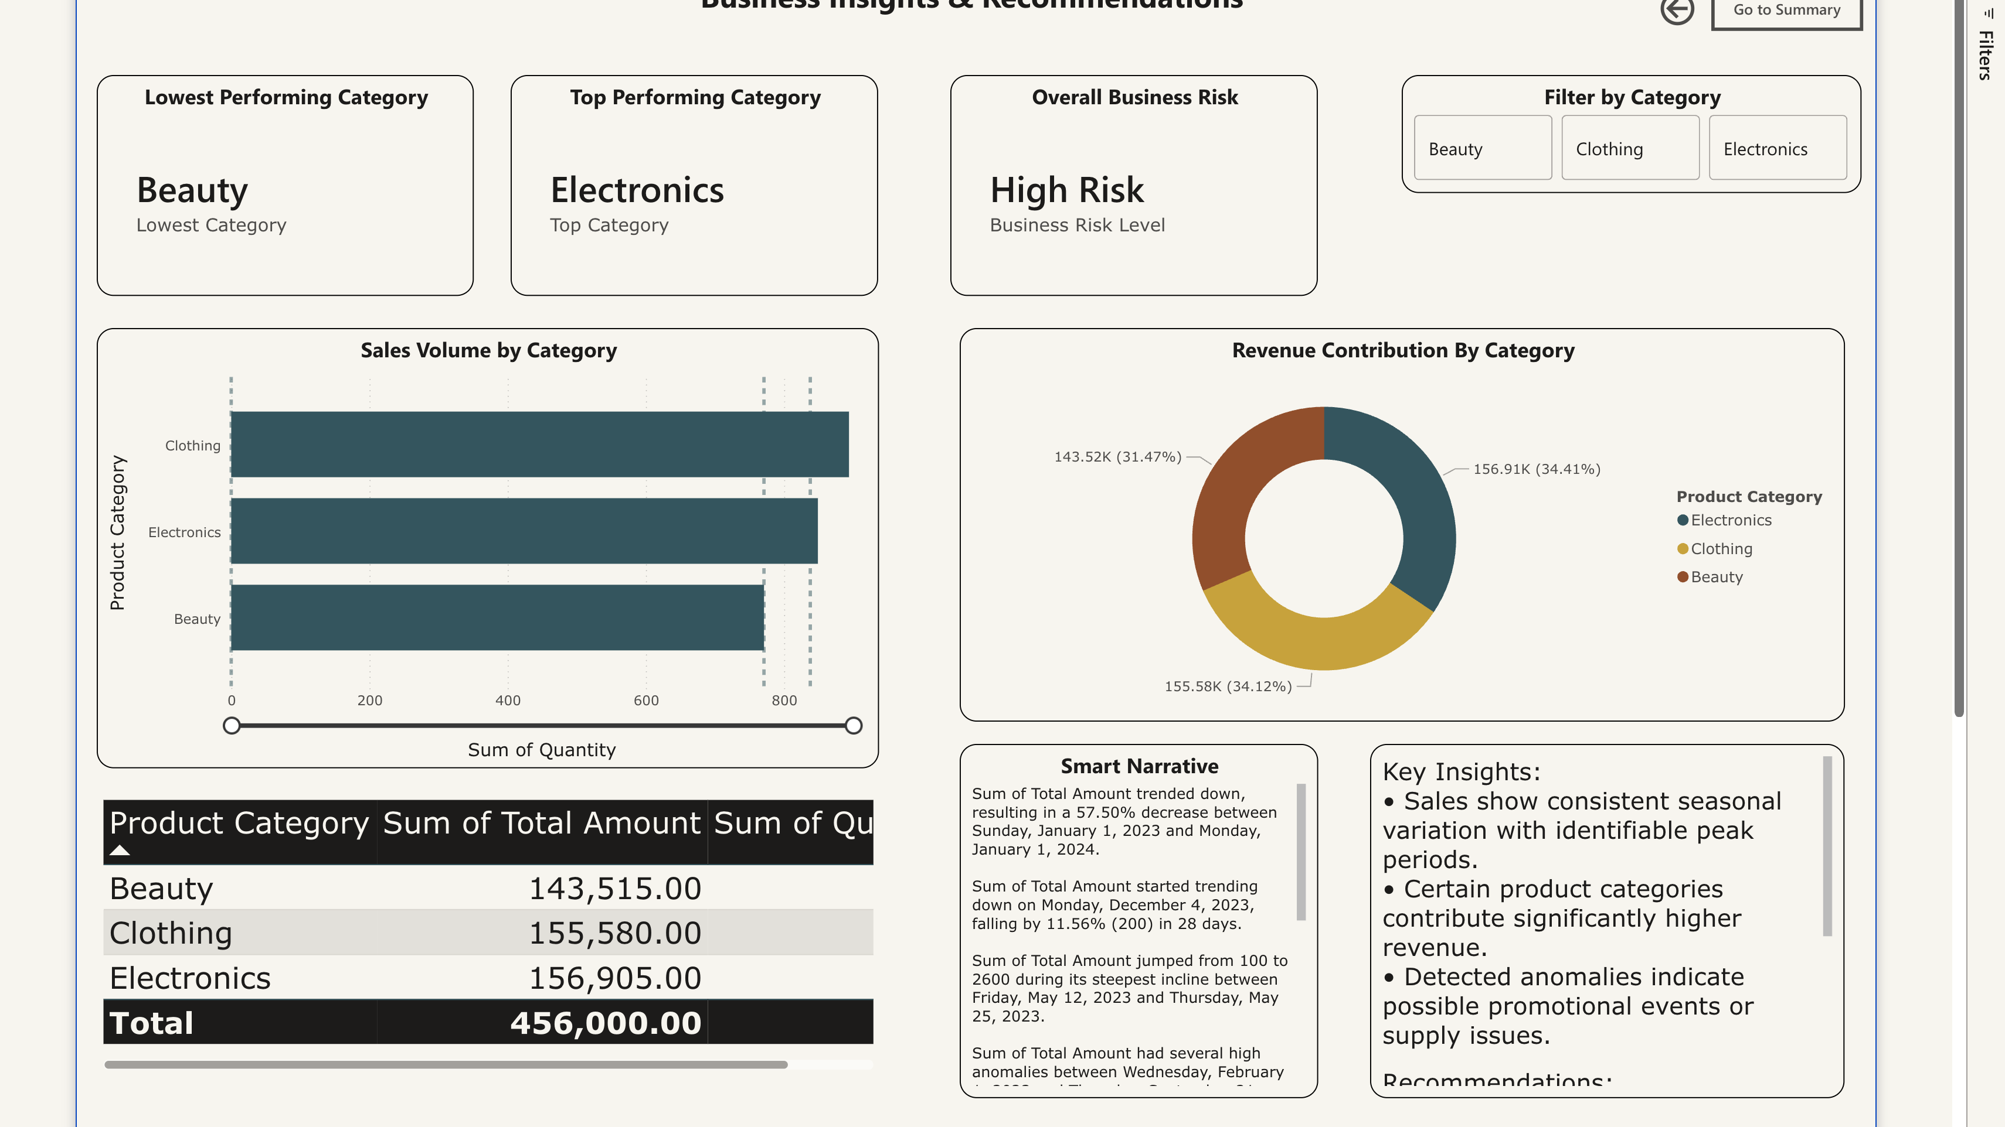

Slide 12
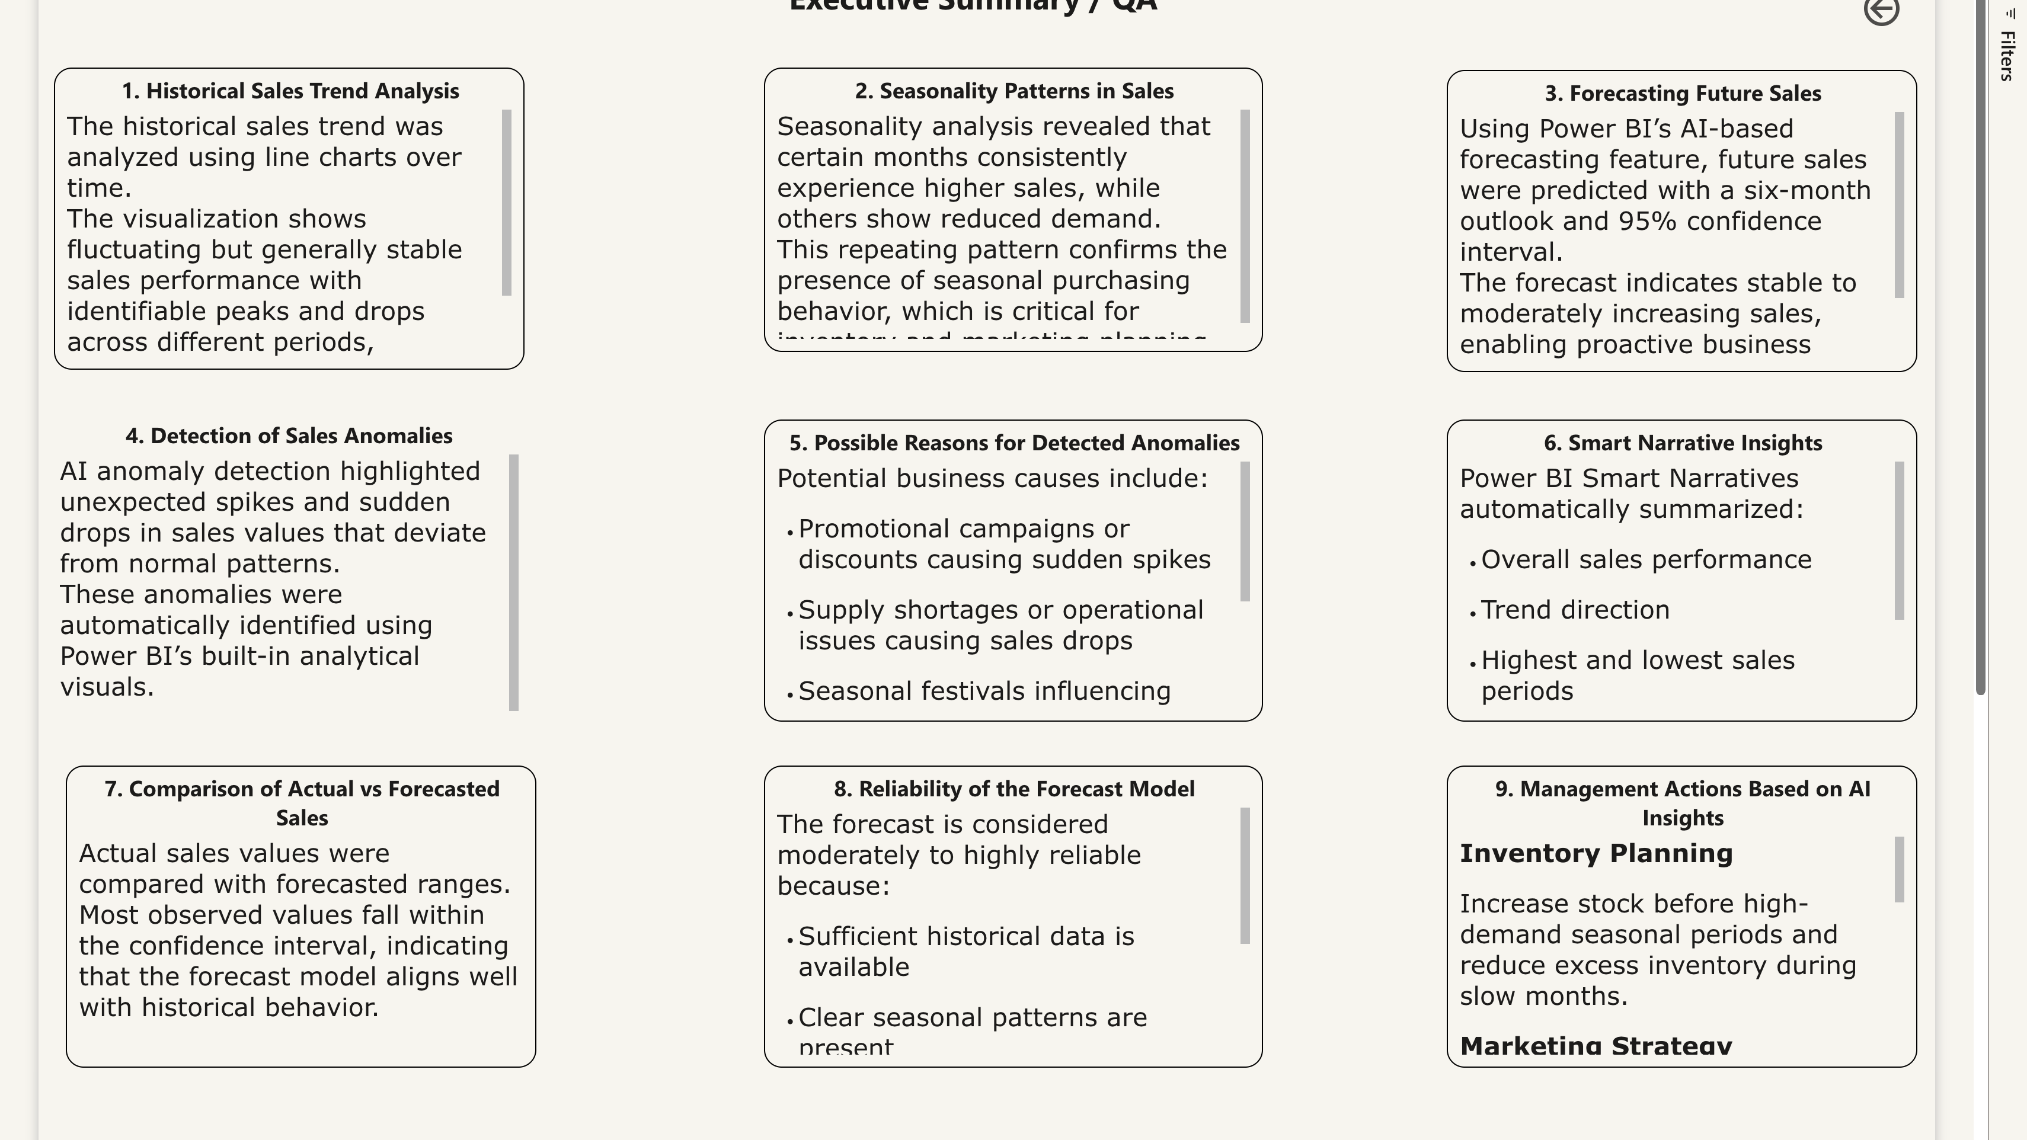

Slide 13
Thank You

