Slide 1


INSY 442 Data Analysis and Visualization
Excel Refresher
Prerequisite review: MGCR 331 Excel component
Week 1 · Self-review before new content

Slide 2
This Review
Module 1
References & Basic Math
Logic & IF Functions
Descriptive Statistics
Conditional Functions
Module 2
Preparing & Cleaning Data
Building Clean Models
XLOOKUP & PivotTables
What-If Analysis
Financial Functions
Date & Text Functions

Slide 3
References & Basic Math
Relative vs. absolute, operators, SUM to SUMPRODUCT

Slide 4
Relative vs. Absolute References
A reference tells Excel which cell to use. The $ sign decides what stays fixed when you copy the formula.
Reference type | Example | What happens when copied
Relative reference | =B2 | Column and row both change
Absolute reference | =$B$2 | Column and row both stay fixed
Absolute column | =$B2 | Column stays fixed; row changes
Absolute row | =B$2 | Column changes; row stays fixed
Shortcut
Press F4 (Windows) or ⌘T (Mac) while editing a reference to cycle through $ options.

Slide 5
Mixed References: Lock One Direction
=$B2 → column locked
Type =$B2 in E10, copy down one row → E11 shows =$B3.
Copy E10:E11 to the right: every column still points at column B.
=B$2 → row locked
Type =B$2 in B7, copy right and down.
Every row still points at row 2; only the column letter changes.
Memory tip
Whatever sits right after the $ stays put. $B2: B stays, the number moves. B$2: 2 stays, the letter moves.

Slide 6
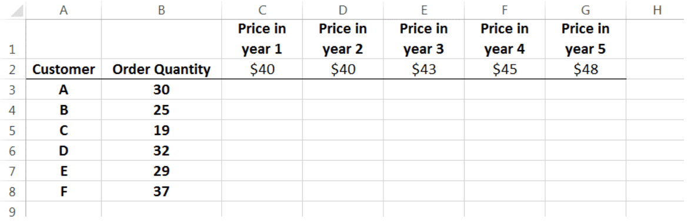
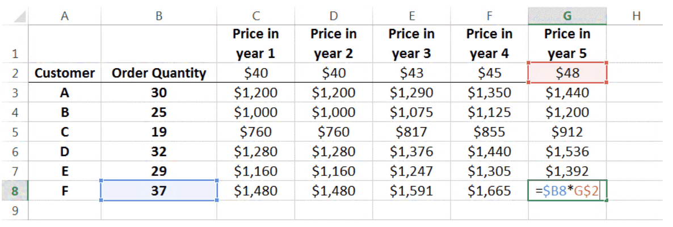
Example: Order Quantity × Price
Build a grid of order cost = quantity × price for each year.
  Order quantity: fix column B, let rows change → $B3
  Price: fix row 2, let columns change → C$2
Formula in C3: =$B3*C$2
Write it once, then drag across and down. Every cell stays correct.

Slide 7
Basic Math Operators
Symbol | Usage | Example | Result
+ | Addition | =3+3 | 6
- | Subtraction | =5-1 | 4
/ | Division | =5/1 | 5
* | Multiplication | =5*5 | 25
^ | Exponentiation (5²) | =5^2 | 25
( ) | Parentheses set the order of operations | =5*(2+3) | 25

Slide 8
Common Math Functions
Functions are predefined formulas. Type = then the function name, then its arguments in parentheses.
Function | Use | Arguments | Example | Result
SUM | Addition | At least one number | =SUM(2,3,2,6) | 13
PRODUCT | Multiplication | At least one number | =PRODUCT(2,3) | 6
SQRT | Square root | One number | =SQRT(4) | 2
EXP | e raised to a power (e²) | One number | =EXP(2) | 7.3891…
LN | Natural log | One number | =LN(10) | 2.3025…

Slide 9
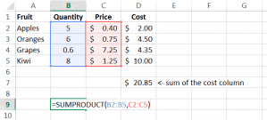
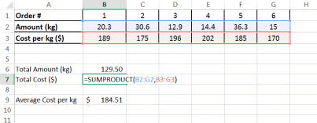
SUMPRODUCT
=SUMPRODUCT(array1, [array2], [array3], …)
Multiplies matching items in ranges of equal size, then adds up the products.
Example: =SUMPRODUCT({2,3,4},{10,20,5})
  (2 × 10) + (3 × 20) + (4 × 5) = 100
Typical use: total cost = Σ (quantity × unit price) without a helper column.

Slide 10
Logic & IF Functions
Comparisons, AND / OR, IF and nested IF

Slide 11
Logical Statements
A logical statement compares two values and returns TRUE or FALSE.
You can put math on either side: =5*5>20 → TRUE, because Excel first works out 5 × 5 = 25.
Logical statement | Result
=37=40 | FALSE
=37<40 | TRUE
=37>40 | FALSE

Slide 12
Logical Operators
Symbol | Usage | Example | Result
= | Equal to | =7=3 | FALSE
> | Greater than | =5>3 | TRUE
>= | Greater than or equal to | =3>=3 | TRUE
< | Less than | =6<3 | FALSE
<= | Less than or equal to | =7<=7 | TRUE
<> | Not equal to | =7<>8 | TRUE

Slide 13
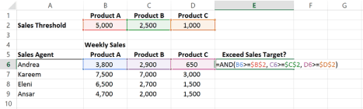
AND and OR
AND(logical1, [logical2], …)
TRUE only if all statements are true.
OR(logical1, [logical2], …)
TRUE if any statement is true.
Function | Example | Result
AND | =AND(3=3, 2<8) | TRUE
OR | =OR(3>=5, 7<=1) | FALSE
Did each sales agent beat the target for every product?

Slide 14


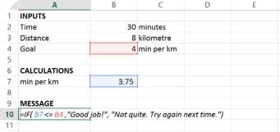
IF
=IF(logical_test, [value_if_true], [value_if_false])
Lets you choose the output for each case: one result if the test is TRUE, another if it is FALSE.
Press Enter →
IF returns 1 because 37 < 40 is TRUE.

Slide 15
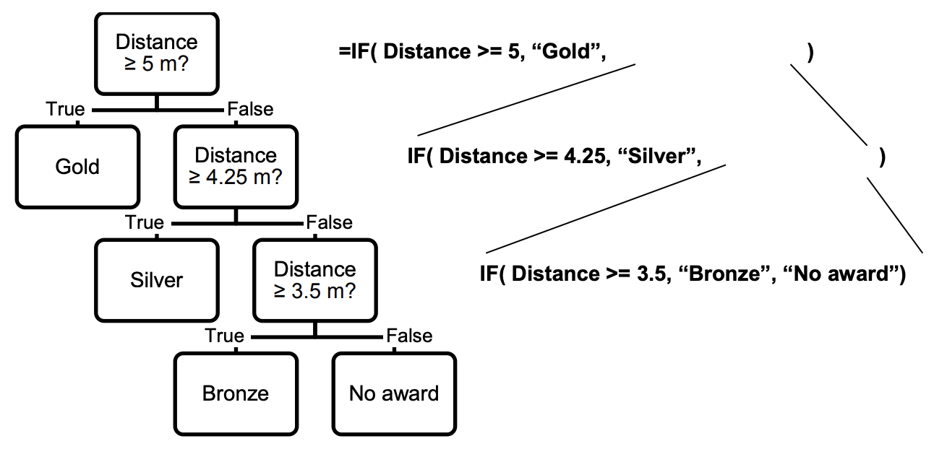
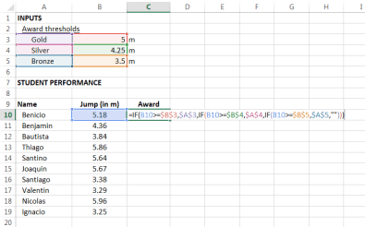
Nested IF
Put an IF inside the value_if_false of another IF to handle three or more outcomes.
Excel checks the tests in order and stops at the first TRUE.
  =IF(D>=5,"Gold", IF(D>=4.25,"Silver", IF(D>=3.5,"Bronze","No award")))

Slide 16
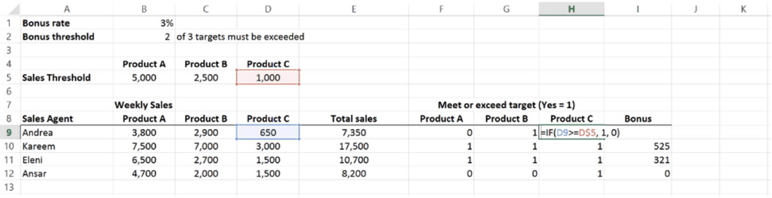
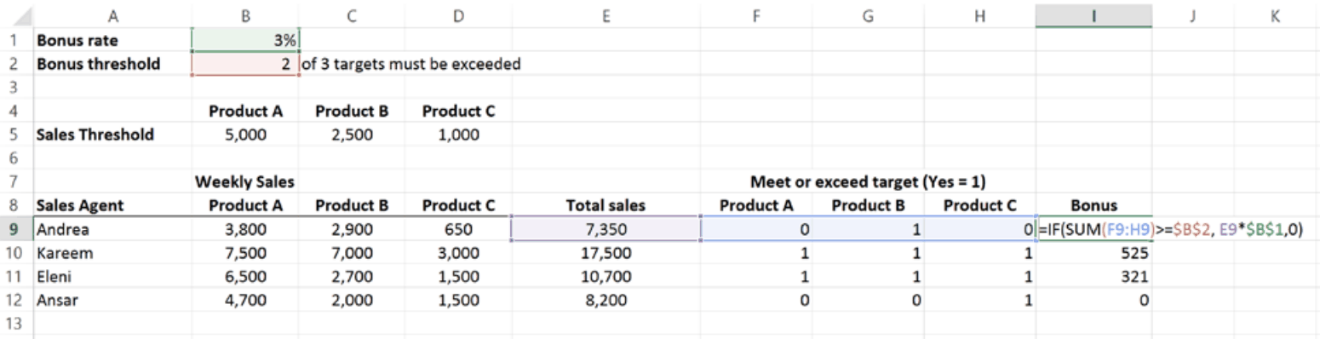
Nested IF: Examples

Slide 17
Descriptive Statistics
Range, central tendency, spread, relationships

Slide 18
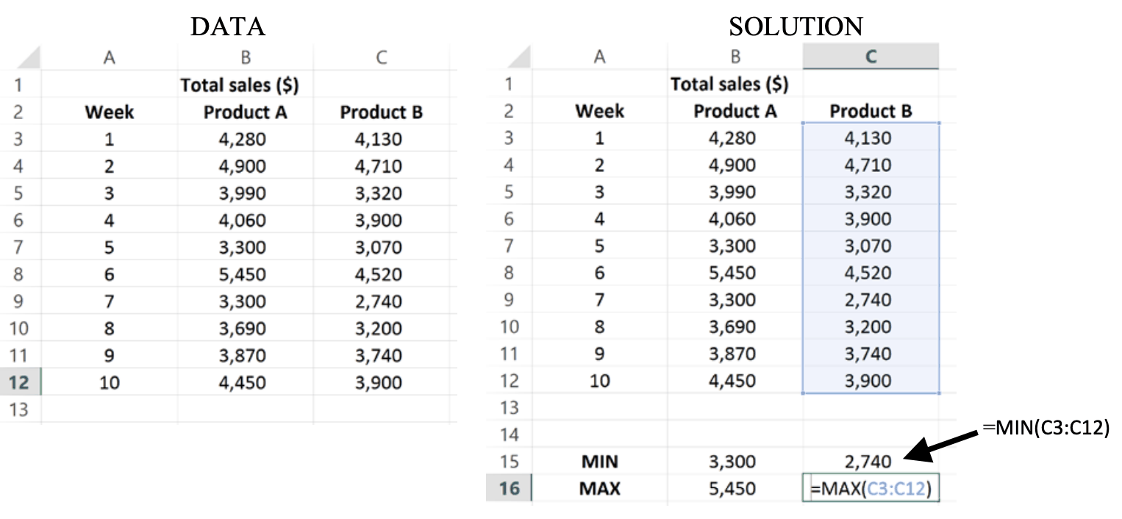
Describing the Range of the Data
COUNT(value1, …)
Counts cells that contain numbers.
COUNTA(value1, …)
Counts all non-blank cells, numeric or not.
MIN(number1, …)
Returns the smallest number.
MAX(number1, …)
Returns the largest number.

Slide 19
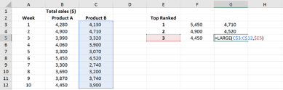
SMALL and LARGE
SMALL(array, k)
  Returns the kth smallest value. k = 1 gives the minimum, k = 2 the second smallest.
LARGE(array, k)
  Returns the kth largest value. k = 1 gives the maximum.
Example: find the top three sales weeks for Products A and B.

Slide 20
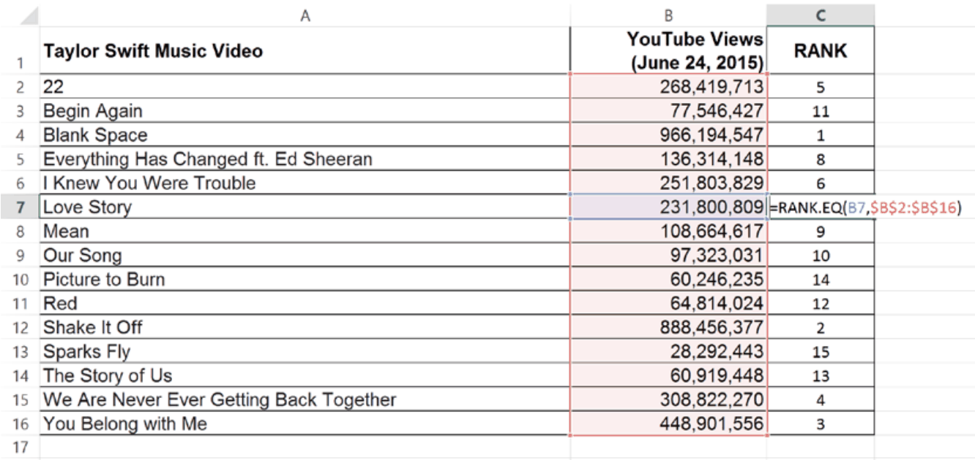
RANK.EQ
RANK.EQ(number, ref, [order])
Returns the rank of a number within a list.
  order: 0 or omitted = descending (default); 1 = ascending
MIN, MAX, SMALL, LARGE: give the value at a rank.
RANK.EQ: gives the rank of a value.

Slide 21
RANK.EQ vs. RANK.AVG: Handling Ties
Sue and Angela are tied for second place. How do they get ranked?
RANK.EQ (most common)
Same rank for everyone in a tie.
Sue = 2, Angela = 2, and nobody gets 3.
RANK.AVG (less common)
Average rank for everyone in a tie.
Sue = 2.5, Angela = 2.5.

Slide 22
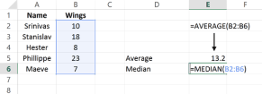
Central Tendency: AVERAGE and MEDIAN
AVERAGE(number1, …)
  Arithmetic mean of the numbers.
MEDIAN(number1, …)
  The middle value: half the observations are lower, half are higher.

Slide 23
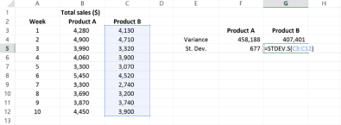

Spread: VAR.S and STDEV.S
VAR.S(number1, …)
  Variance of a sample.
STDEV.S(number1, …)
  Standard deviation of a sample.
Sample-based. Each has a population version ending in .P (VAR.P, STDEV.P).

Slide 24
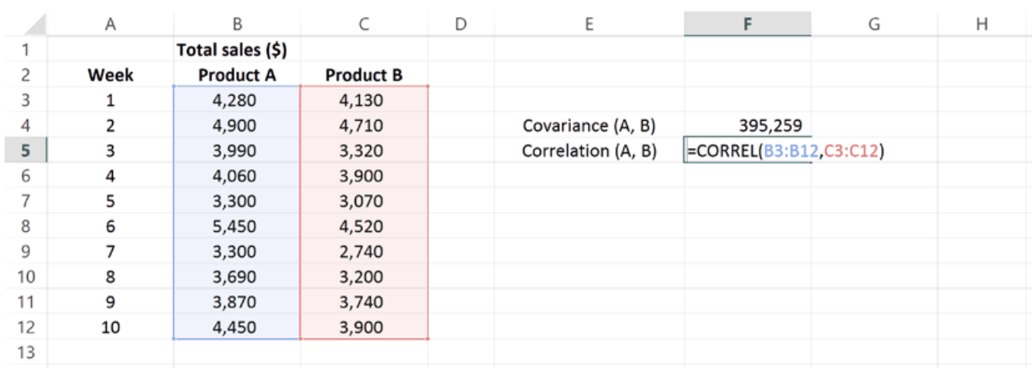
COVARIANCE.S and CORREL
COVARIANCE.S(array1, array2)
  How two variables move together. Hard to interpret: its units depend on both variables.
CORREL(array1, array2)
  Correlation on a fixed −1 to +1 scale with no units, so it is easier to compare.

Slide 25
Conditional Functions
COUNTIF(S), SUMIF(S), AVERAGEIF(S)

Slide 26
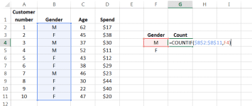
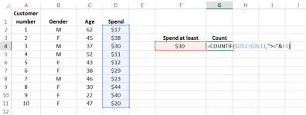
COUNTIF
COUNTIF(range, criteria) counts cells in a range that meet one condition.
  Default test is "equal to" (e.g., = 5 or = A6). Inequalities work too, e.g. ">=30".

Slide 27
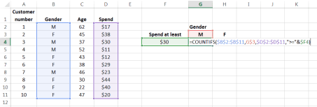
COUNTIFS
COUNTIFS(criteria_range1, criteria1, [criteria_range2, criteria2], …)
  Counts cells that meet all conditions. Every criteria range must be the same length.

Slide 28
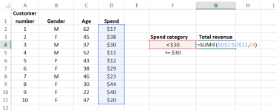
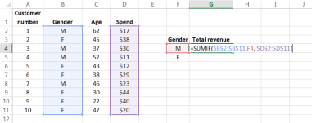
SUMIF
SUMIF(range, criteria, [sum_range]) sums cells that meet one condition.
  With two arguments, it sums the matching cells in range itself.
  With sum_range, it tests one column and sums a different one.

Slide 29
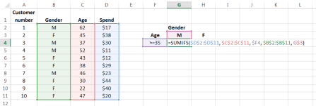
SUMIFS
SUMIFS(sum_range, criteria_range1, criteria1, …) sum_range comes first!
  Example: total revenue from male customers aged 35 or older.

Slide 30
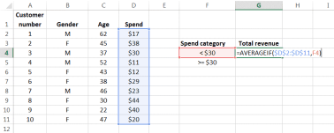
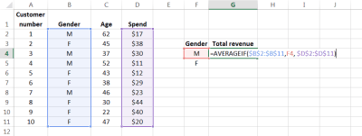
AVERAGEIF
AVERAGEIF(range, criteria, [average_range])
  Averages cells that meet one condition. Like SUMIF, average_range lets you test one column and average another.

Slide 31
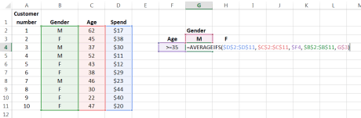
AVERAGEIFS
AVERAGEIFS(average_range, criteria_range1, criteria1, …)
  Averages values that meet all conditions. Criteria ranges must be the same length.

Slide 32
Watch the Argument Order
Single condition | Multiple conditions
COUNTIF(range, criteria) | COUNTIFS(range1, crit1, range2, crit2, …)
SUMIF(range, criteria, [sum_range]) | SUMIFS(sum_range, range1, crit1, …)
AVERAGEIF(range, criteria, [avg_range]) | AVERAGEIFS(avg_range, range1, crit1, …)
Common mistake
In the -IFS versions the range you add up or average moves to the front.

Slide 33
Preparing & Cleaning Data
Power Query, layout tools, and cleanup functions

Slide 34
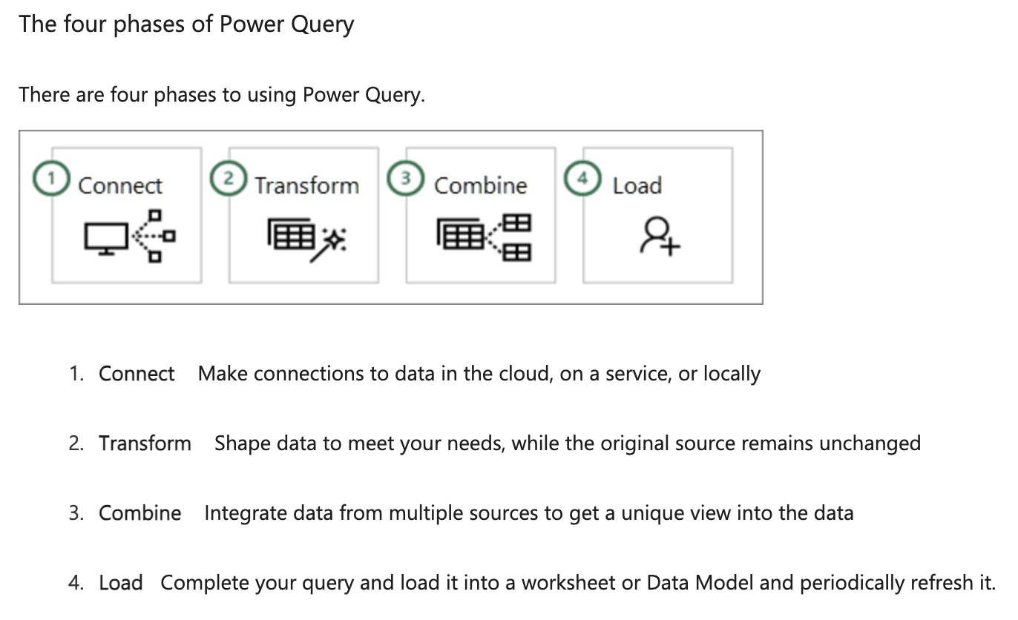
Power Query (Get & Transform)
Import or connect to external data
Shape the data: remove columns, change data types, merge tables
Load the query into Excel for charts and reports
Refresh periodically to keep data up to date
ETL = Extract, Transform, Load

Slide 35
Freeze Panes
Keep headers visible while you scroll through long or wide data.
Goal | How
Freeze top row | View → Freeze Panes → Freeze Top Row
Freeze first two columns | Select column C → View → Freeze Panes → Freeze Panes
Freeze rows and columns | Select the cell below the rows and right of the columns to keep → View → Freeze Panes → Freeze Panes
Unfreeze | View → Freeze Panes → Unfreeze Panes

Slide 36
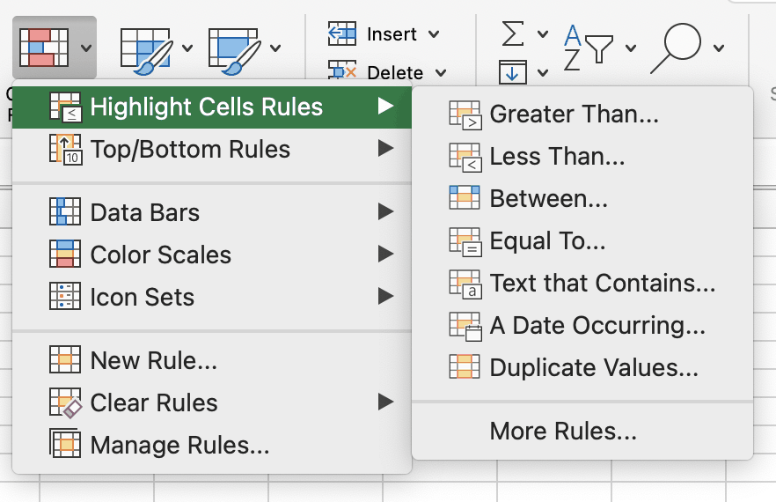
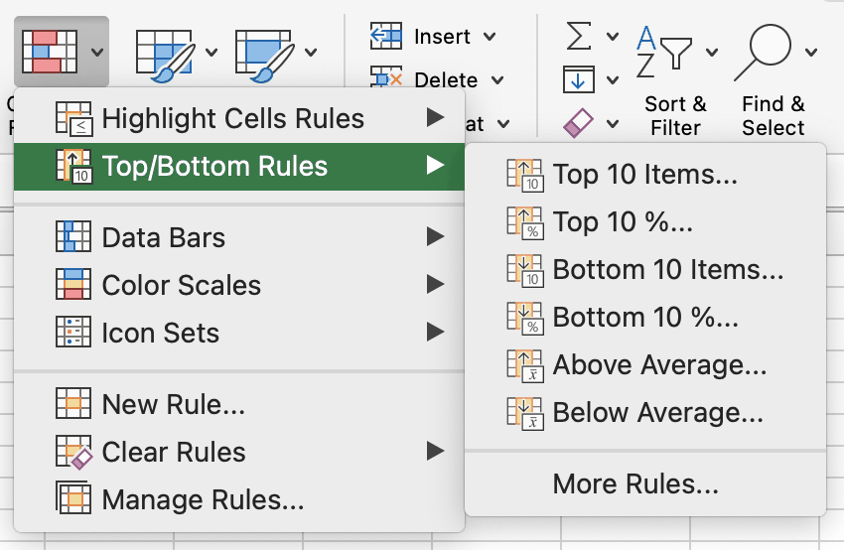
Conditional Formatting
Makes patterns and trends in your data easier to see.
  Home → Conditional Formatting
  Highlight Cells Rules: greater than, between, duplicates…
  Top/Bottom Rules: top 10, above average…
  Data Bars, Color Scales, Icon Sets

Slide 37
Auto Fill and Flash Fill
Auto Fill
Fills cells that follow a pattern: type a few values, then drag the fill handle.
e.g., 1, 2 → 3, 4, 5; Jan → Feb → Mar
Flash Fill
Spots a pattern from an example you type, then fills the rest.
Shortcut: Ctrl + E

Slide 38
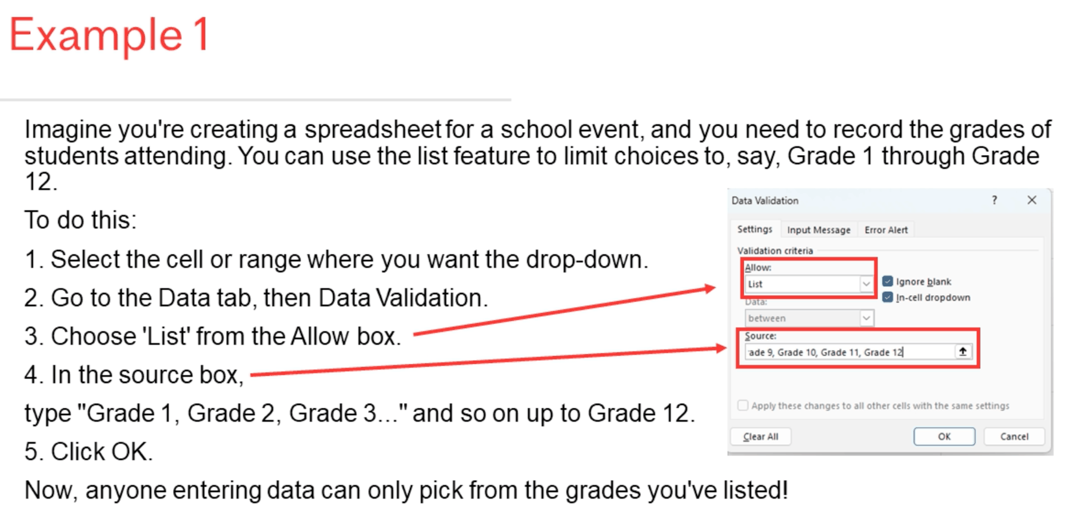
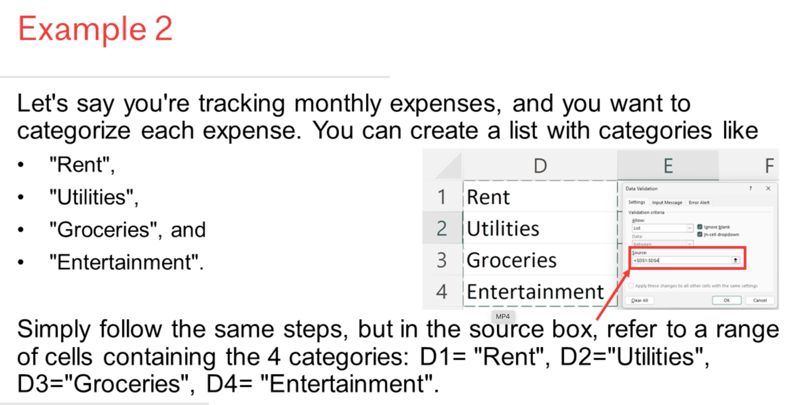
Data Validation
Restricts what users can enter in a cell, e.g. a dropdown list.
  Data → Data Validation → Allow: List → Source: type the options or point to a range

Slide 39
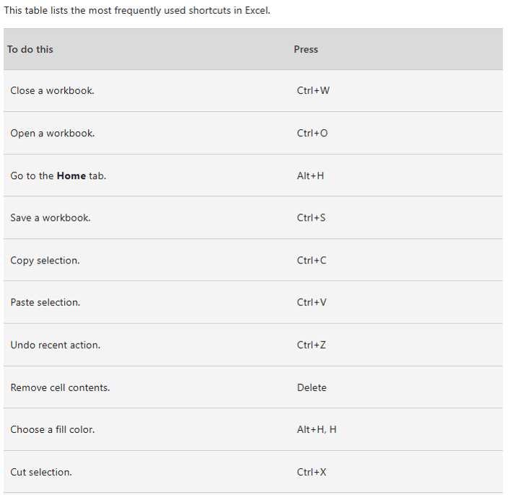
Handy Shortcuts
Learning a few keyboard shortcuts saves a lot of time in INSY 442 labs.
  Ctrl + C / X / V: copy, cut, paste
  Ctrl + Z: undo
  Ctrl + S: save
  Ctrl + Arrow: jump to the edge of the data
  Mac: use ⌘ in place of Ctrl

Slide 40
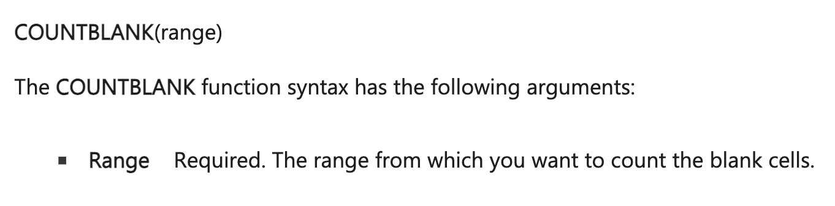
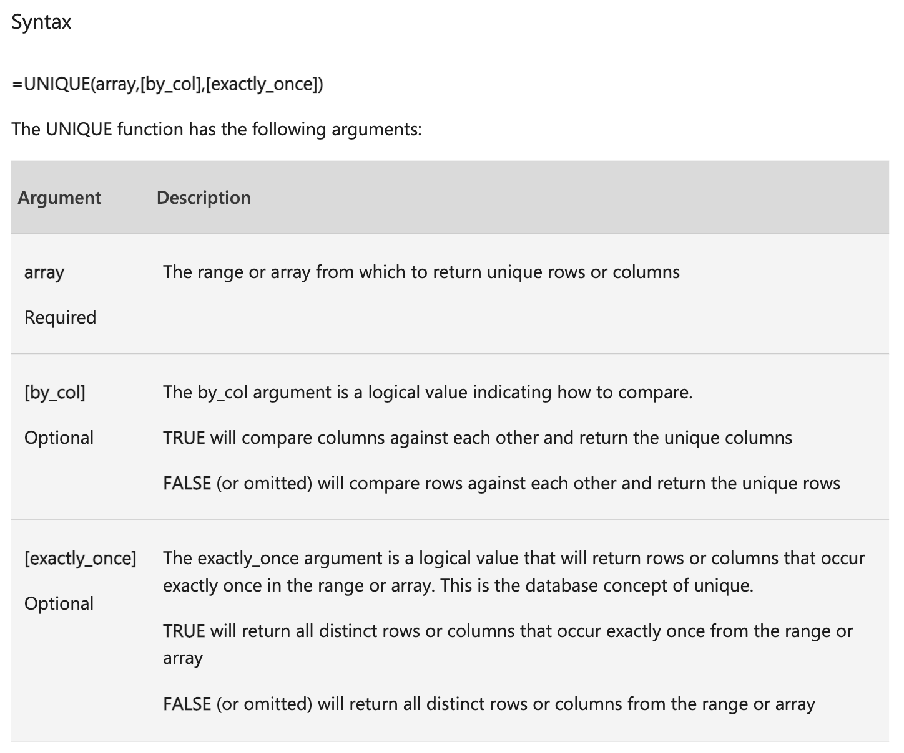
COUNTBLANK and UNIQUE
COUNTBLANK(range)
  Counts empty cells. Useful for spotting missing data.
UNIQUE(array, [by_col], [exactly_once])
  Returns the list of unique values in a range.
  exactly_once = TRUE returns values that appear only once.

Slide 41
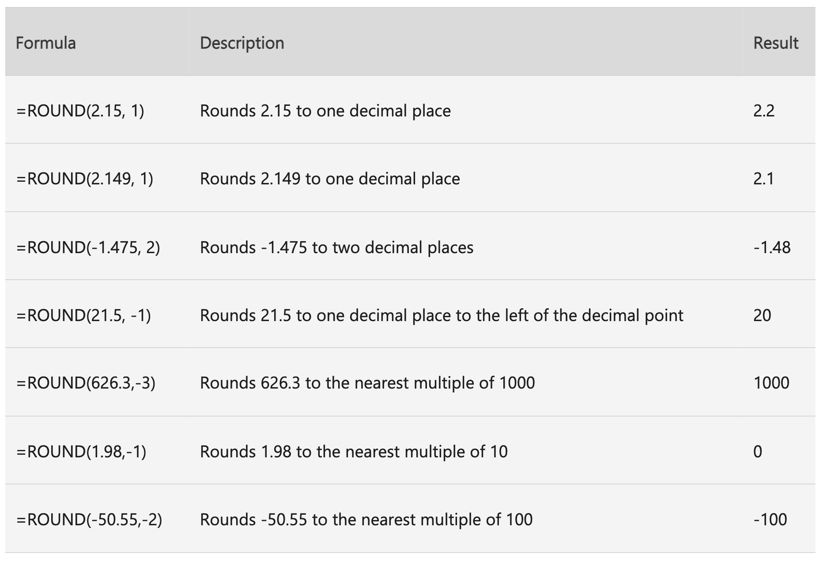
ROUND, ROUNDUP, ROUNDDOWN
ROUND(number, num_digits)
  num_digits > 0: round to that many decimal places
  num_digits = 0: round to the nearest integer
  num_digits < 0: round to the left of the decimal (tens, hundreds…)
ROUNDUP always rounds away from zero; ROUNDDOWN always toward zero.

Slide 42
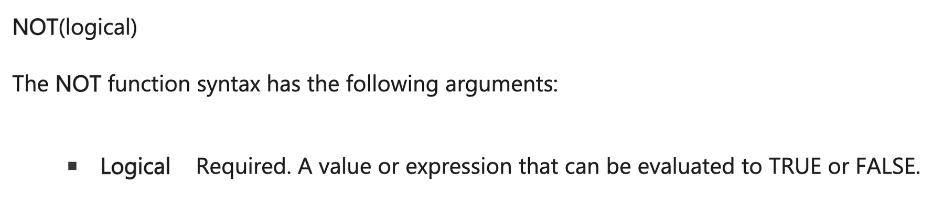
NOT
NOT(logical) reverses TRUE / FALSE. Use it to check that one value is not equal to another.

Slide 43
Building Clean Models
Structure, error messages, IFERROR, named ranges

Slide 44
4 Strategies to Organize Spreadsheets
1
2
3
4
State inputs & assumptions clearly
Separate model inputs from analysis
Analyze in easy-to-debug steps
Lay out the model so others can use it

Slide 45
Use a Conceptual Model
INPUTS
All numbers and assumptions go here
MODEL
Calculations that only reference input cells
OUTPUTS
The results you report
Golden rule
Never hard-code numbers inside calculation formulas. Point to an input cell instead.

Slide 46
Excel Error Messages
#VALUE!
Text or spaces where a number is expected
#NAME?
Excel does not recognise the function or name
#####
Column too narrow to show the value
#DIV/0!
Dividing by zero or an empty cell
#REF!
Formula refers to a cell that is not valid
#NULL!
Ranges that do not intersect or a wrong range operator
#N/A
The value you are looking for cannot be found
#NUM!
Numeric values that are not valid

Slide 47
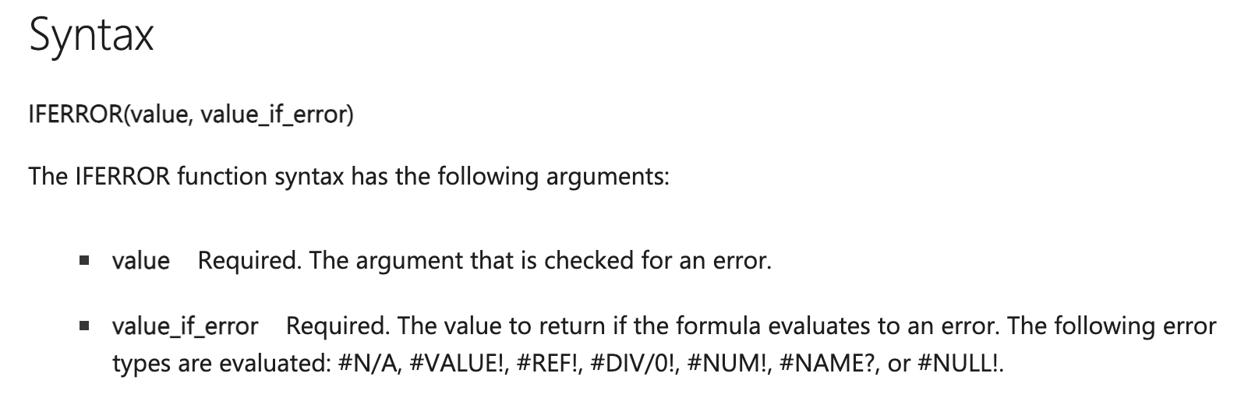
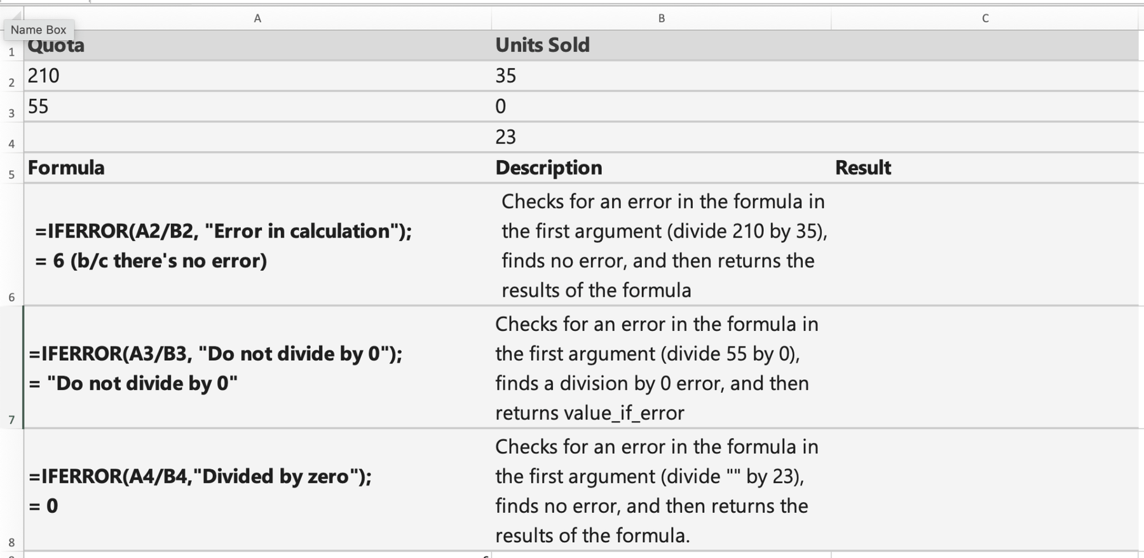
IFERROR
IFERROR(value, value_if_error)
Returns value_if_error if the formula errors; otherwise returns the normal result.
  Catches #N/A, #VALUE!, #REF!, #DIV/0!, #NUM!, #NAME?, #NULL!
=IFERROR(A2/B2, "Error in calculation")

Slide 48
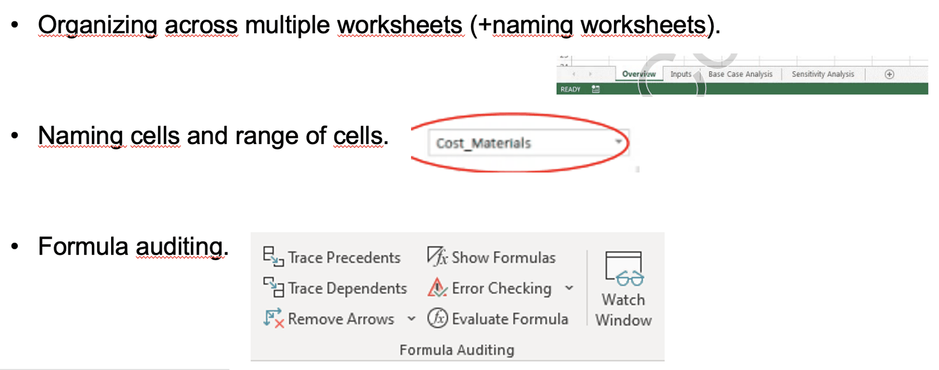
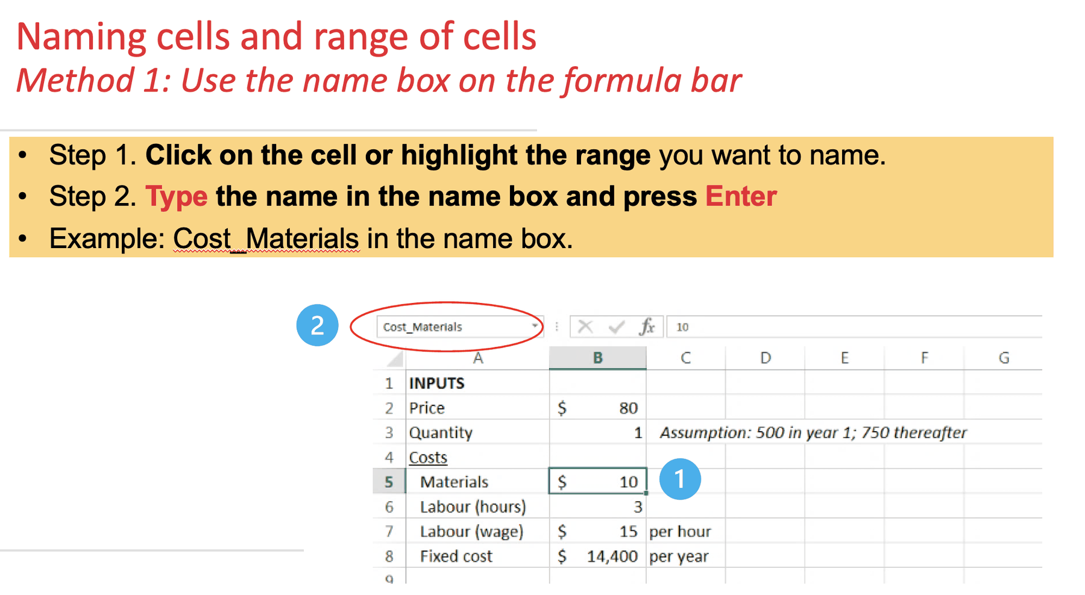
Naming Cells and Ranges
Names make formulas easier to read: =Price*Quantity instead of =B4*B5.
Also useful for organizing across worksheets and for formula auditing.
  Method 1: type the name in the Name Box (left of the formula bar), press Enter

Slide 49
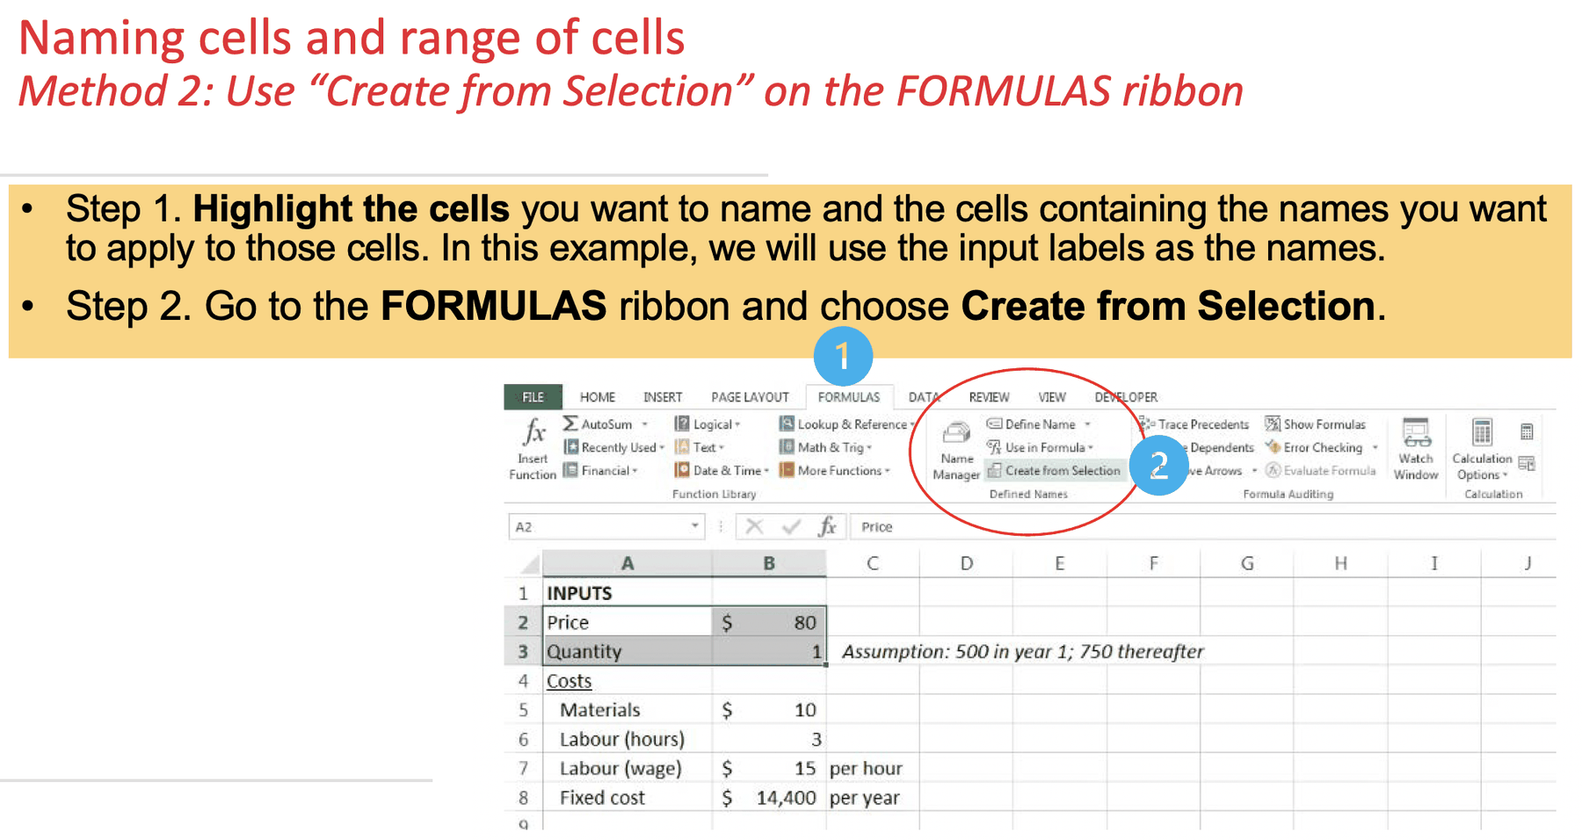
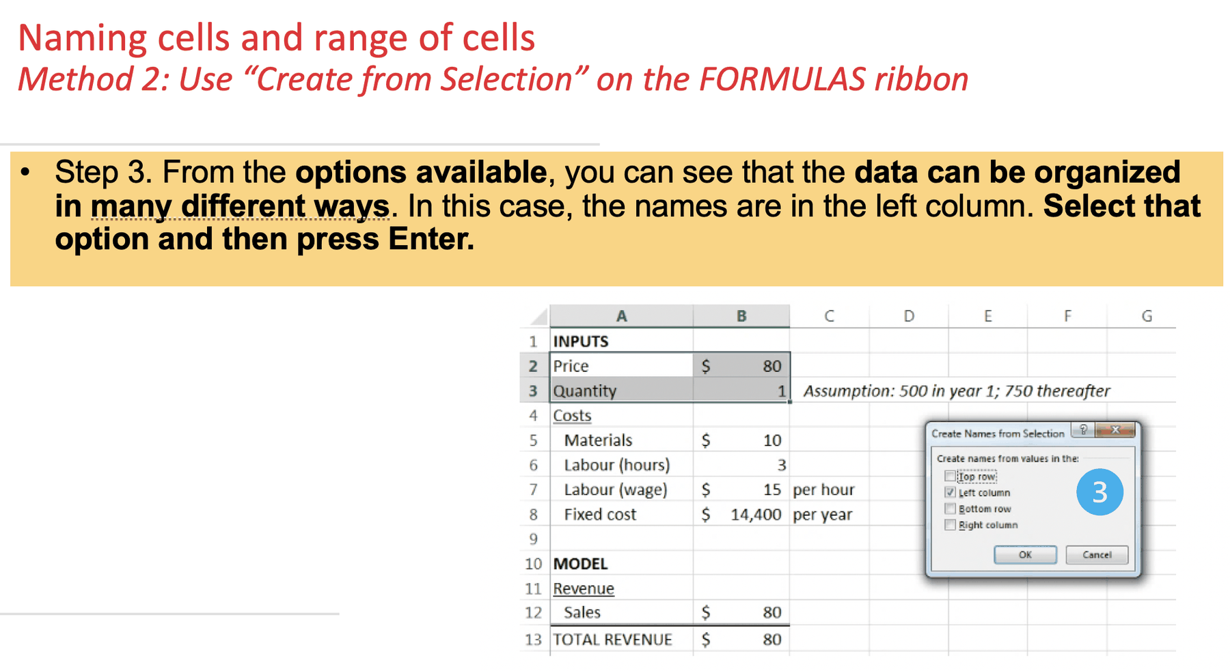
Naming Method 2: Create from Selection
Formulas → Define Names → Create from Selection: uses your row/column labels as names.

Slide 50
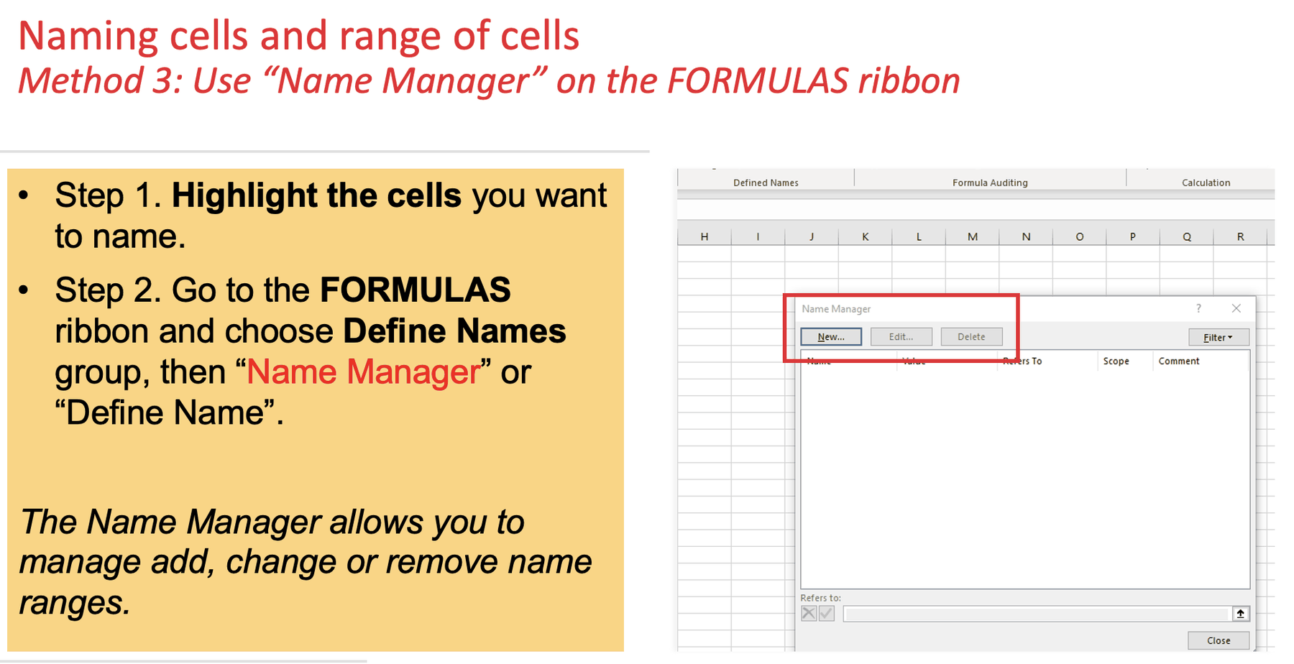
Naming Method 3: Name Manager
Formulas → Define Name or Name Manager: add, change or remove names.

Slide 51
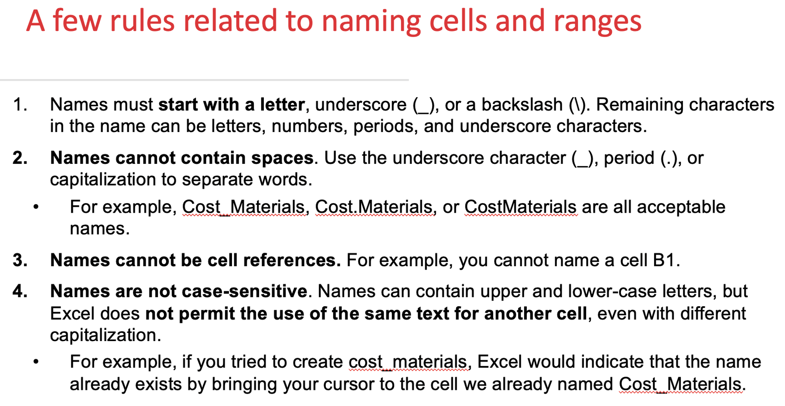
Naming Rules
Start with a letter, underscore or backslash
No spaces: use _ or . instead (Cost_Materials)
Cannot look like a cell reference (no "B1")
Not case-sensitive: cost_materials = Cost_Materials
Only the Name Manager lets you manage a name's scope

Slide 52
XLOOKUP & PivotTables
Find values and summarise data

Slide 53
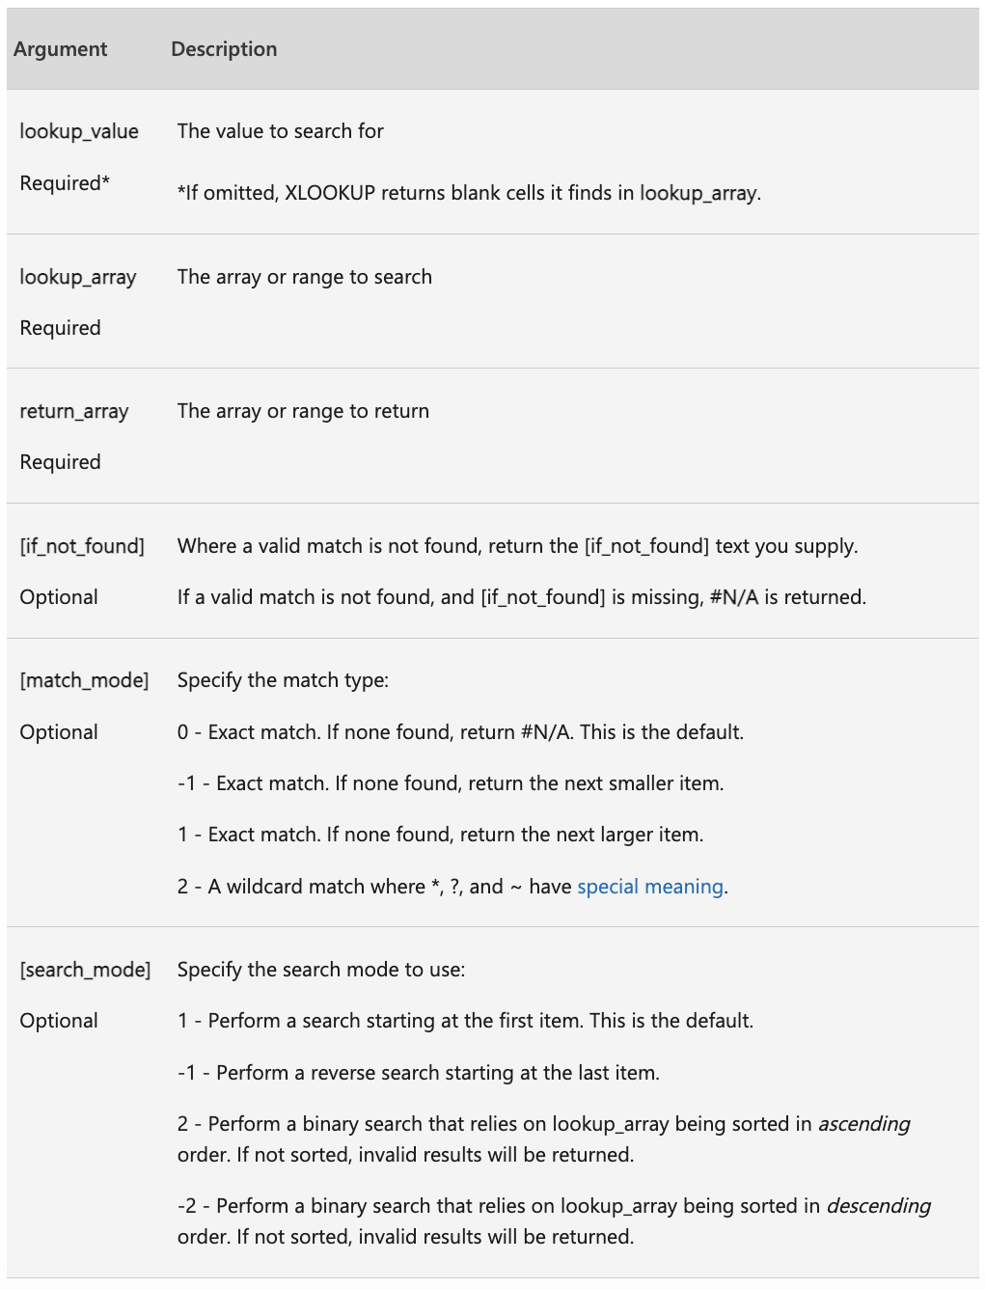
XLOOKUP
Searches a range for a match and returns the matching item from a second range.
  =XLOOKUP(lookup_value, lookup_array, return_array, [if_not_found], [match_mode], [search_mode])
  Only the first three arguments are required.

Slide 54
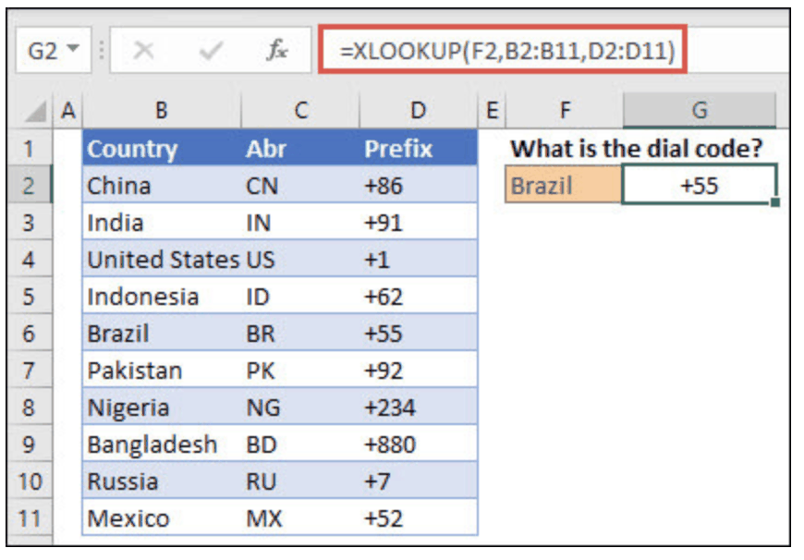
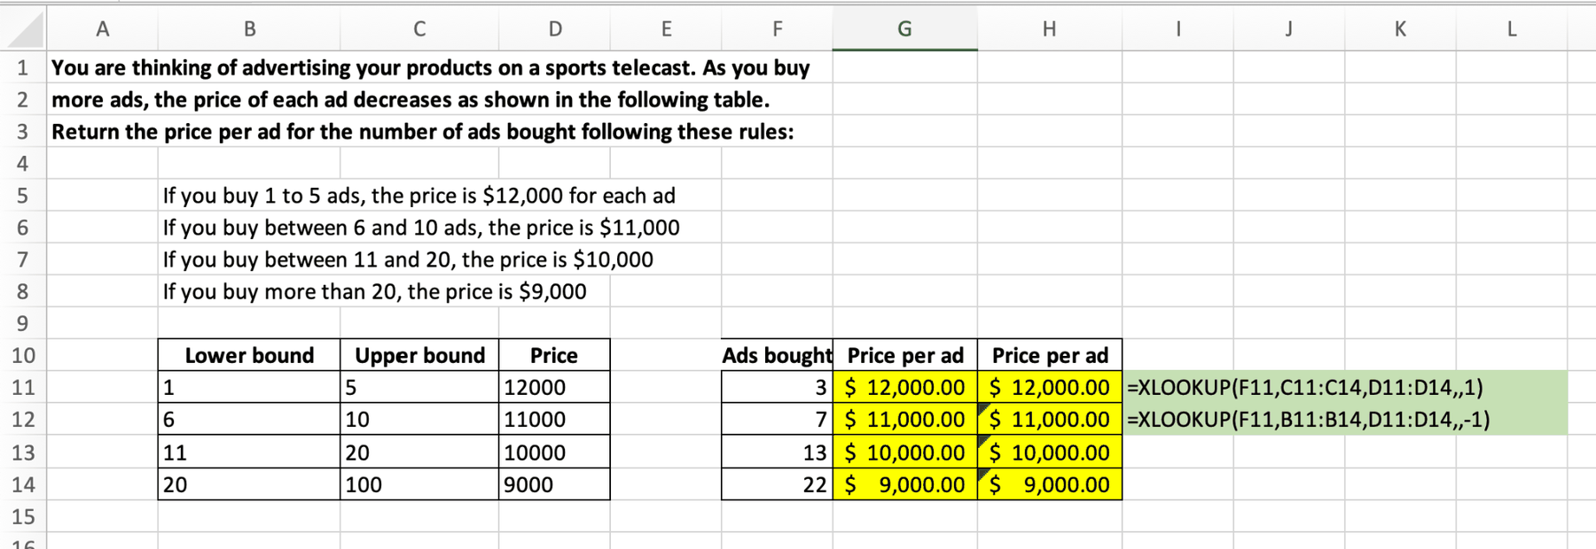
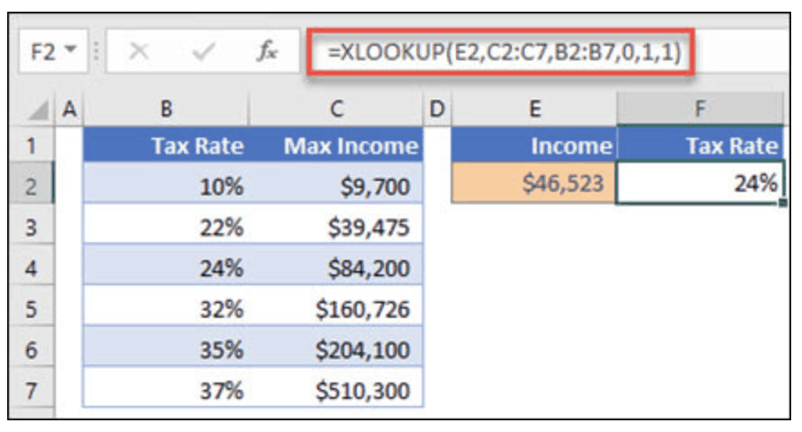
XLOOKUP: Exact and Approximate Match
Exact match (default)
  Find Brazil's dial code
  =XLOOKUP(F2, B2:B11, D2:D11)
Approximate match
  match_mode = 1 finds the next larger item, e.g. a tax bracket
  =XLOOKUP(E2, C2:C7, B2:B7, 0, 1, 1)

Slide 55
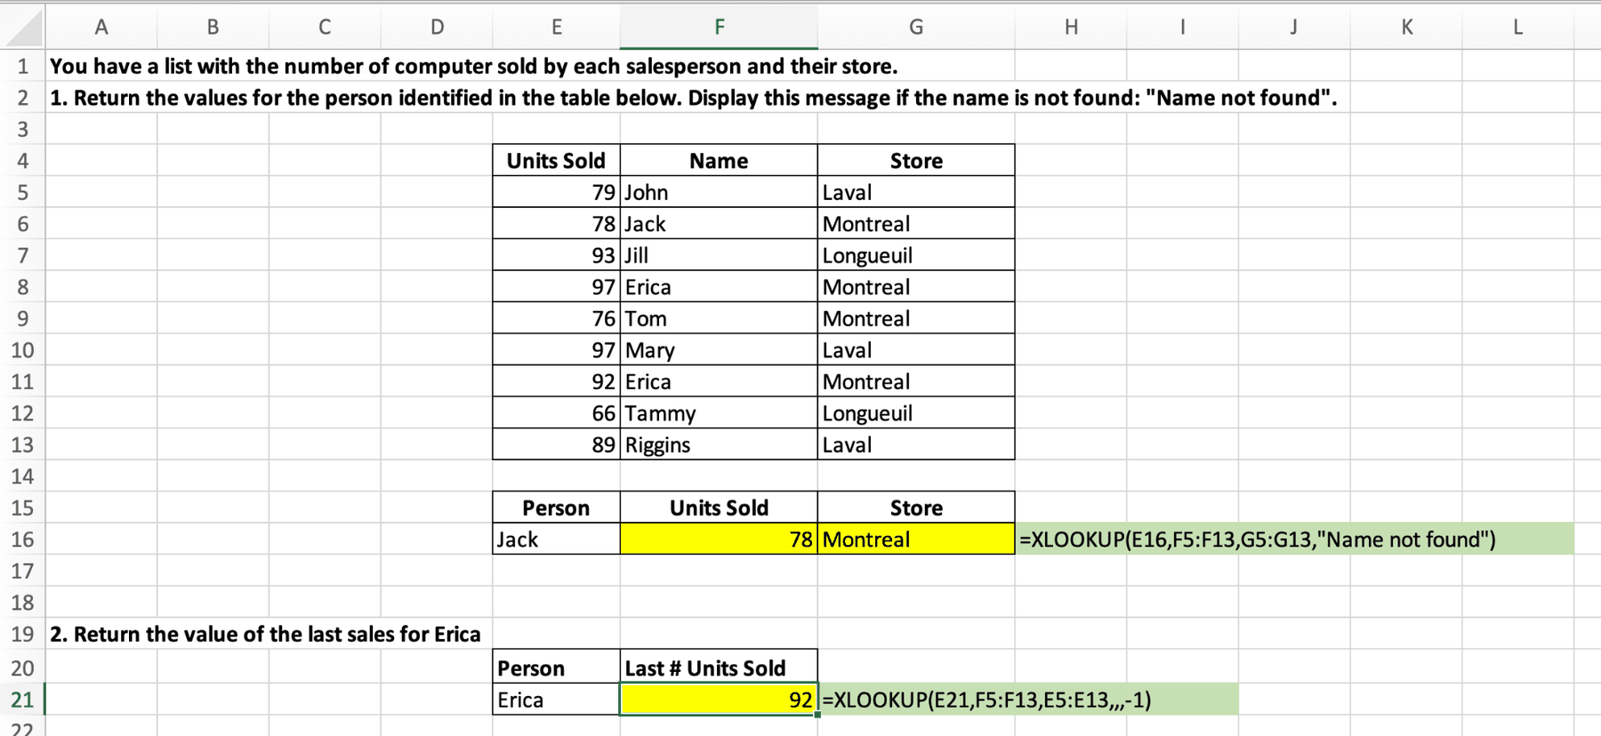
XLOOKUP: if_not_found, search_mode
if_not_found returns a message instead of #N/A; search_mode = -1 searches from the bottom (e.g., the most recent sale).

Slide 56
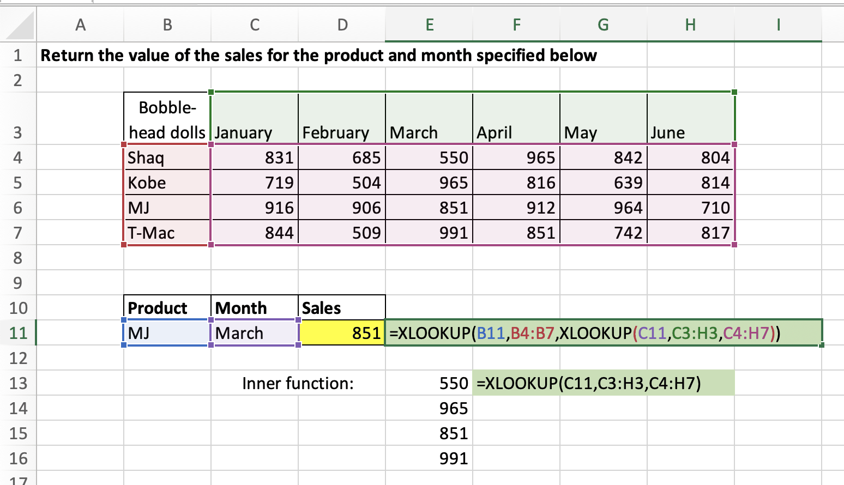
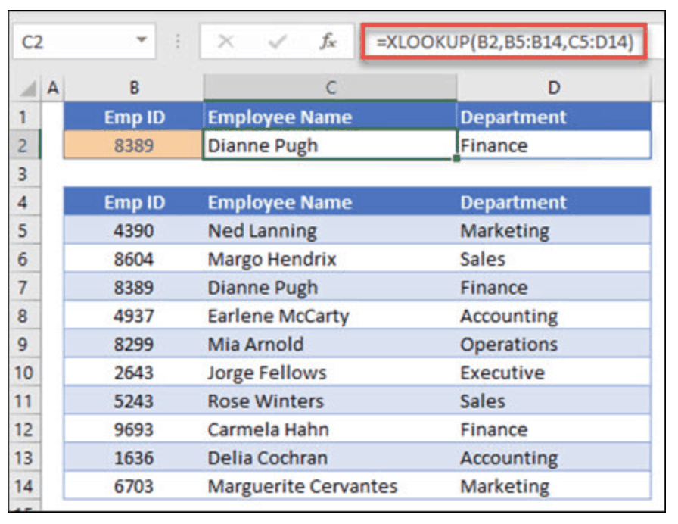
XLOOKUP: Row and Column
Nest one XLOOKUP inside another to match a row and a column at the same time.
  =XLOOKUP(B11, B4:B7, XLOOKUP(C11, C3:H3, C4:H7))
The inner XLOOKUP returns the whole month column; the outer one picks the product.

Slide 57

PivotTables
Create an interactive summary of the source data:
  Pivot: change the view of the data on the fly
  Sort and filter
  Group summary items
  Add subtotals, totals and calculated fields
  Slice and dice; build a PivotChart

Slide 58


PivotTables: Grouping & Calculated Fields

Slide 59


PivotTables: Charts and Label Filters

Slide 60




PivotTable Examples (1)

Slide 61
What-If Analysis
Goal Seek and Data Tables

Slide 62


Goal Seek
What-if / sensitivity analysis: how results change when assumptions change.
Goal Seek works backward: you know the output you want and solve for one input.
  Set cell: the formula cell with the result
  To value: the target result
  By changing cell: the input Excel may change
  Data → What-If Analysis → Goal Seek

Slide 63


Goal Seek: Examples (1)

Slide 64

Data Tables
Show results for many input values at once.
  One-variable: one input in a row or column
  Two-variable: change two inputs, see every combination
  Data → What-If Analysis → Data Table
Row/Column input cell = the input the table substitutes into the formula.

Slide 65


One-Way and Two-Way Data Tables

Slide 66
Financial Functions
PMT, PV, FV

Slide 67

PMT: Payment
PMT(rate, nper, pv, [fv], [type])
Payment for a loan with constant payments and a constant interest rate.
  Match units: monthly payments → annual rate / 12, years × 12
  type: 0 = end of period (default), 1 = beginning

Slide 68

PMT: Practice Questions

Slide 69


PV: Present Value
PV(rate, nper, pmt, [fv], [type])
Present value of a loan or investment at a constant interest rate.
  Money you pay out (a deposit) is negative; money you receive is positive.

Slide 70

PV: Practice Questions

Slide 71

FV: Future Value
FV(rate, nper, pmt, [pv], [type])
Future value of an investment with periodic, constant payments and a constant rate.

Slide 72

FV: Practice Questions

Slide 73
Date & Text Functions
Working with dates and cleaning text

Slide 74



DATE and Serial Numbers
=DATE(year, month, day)
Returns the serial number for a date.
Excel stores dates as numbers (days since 1 Jan 1900). 2023-08-10 = 45148.
Change the cell format to switch between date and serial number.

Slide 75



DAY
=DAY(serial_number)
Returns the day of the month (1–31).
Works whether the date is shown in date or general (serial number) format.

Slide 76


MONTH
=MONTH(serial_number)
Returns the month (1–12).
  =MONTH(A1) on 2023-10-15 returns 10 (October).

Slide 77



TODAY
=TODAY()
Returns the current date; updates each time the file opens.
Subtract one date from another to get the days between them, whatever the format (as long as both are valid dates).

Slide 78


YEAR
=YEAR(serial_number)
Returns the year as an integer from 1900 to 9999.

Slide 79

CONCAT
=CONCAT(text1, [text2], …)
Joins text from several cells and/or strings.
  Add separators as strings, e.g. " is a "

Slide 80



FIND
=FIND(find_text, within_text, [start_num])
Returns the position of one text string inside another.
  start_num: where to start searching (optional)
  Case-sensitive; returns an error if the text is not found

Slide 81




LEFT and RIGHT
=LEFT(text, [num_chars])
  First character(s). Omit num_chars → only the first character.
=RIGHT(text, [num_chars])
  Last character(s) of the text.

Slide 82


MID and LEN
=MID(text, start_num, num_chars)
  num_chars characters, starting at start_num.
=LEN(text)
  Number of characters. Spaces and every character count!

Slide 83

TEXT: Format Numbers and Dates
=TEXT(value, format_text)
Changes how a number appears by applying a format code.
Formula (A1 = 2023-08-10) | Output
=TEXT(A1,"DD") | 10
=TEXT(A1,"DdD") | Thu
=TEXT(A1,"DDDD") | Thursday
=TEXT(A1,"YYYY-MMMM_DDDD") | 2023-August_Thursday

Slide 84

TRIM
=TRIM(text)
Removes all spaces except single spaces between words.
Use it to clean imported or copy-pasted data before a lookup.

