Slide 1

NYC Layover
Itinerary Chatbot
Yuyao (Cindy) Liu

Slide 2







IMAGINE
You just arrived at the JFK airport for your layover, and you have…
$50 to spend
6 hours to kill
0 planned activities
An urge to tour the city
No clue what’s popular
No clue what the traffic situation is
So, how do you account for all these variables without wasting too much time?

Slide 3
THE PROBLEM
This isn’t some rare edge case.
145M+
6-12 hrs
100+
0
annual passengers flying into JFK, EWR and LGA
typical international layover window
airlines flying into JFK from 50+ different countries
time-aware travel itinerary tools that exist today
Millions of travelers land in NYC every year with time to explore and tour the city, but without a structured way to use it.
Google, Tripadvisor and others gives laundry lists, not an actionable plan.

Slide 4






THE SOLUTION – NYC Layover Itinerary Chatbot
We Built This For
Chatbot that helps travelers make use of their airport layover time by recommending attractions in NYC.
NYC Tourism + Conventions is NYC's official destination marketing organization, promoting the city as a premier global travel destination.
Takes available time, departure airport, time, budget and attraction preferences as input
Filters 81 curated NYC attractions by category, time slot and budget
Current Offerings:
General tourism resources designed for traditional visitors
Scores each attraction using a 6-factor algorithm for the best possible response
Provides tourists with a curated list of food and beverage, attractions, accommodations and various guides
Accounts for realistic airport transit and inter-attraction travel
No presence in airports or platforms serving transient travelers
Outputs a ready-to-use itinerary with cost and time summary

Slide 5


DIFFERENTIATION
Features
TripAdvisor / Google
NYC Tourism Site
Our Chatbot
Personalized to time available
Accounts for airport transit
Budget filtering
partial
Time-of-day awareness
partial
Prioritizes iconic landmarks
partial
Ready-to-use itinerary output

Slide 6


CHATBOT USE CASE
NYC AIRPORT LAYOVER ITINERARY CHATBOT
Welcome! I'll help you plan your NYC layover.
How many hours do you have available?
(From when you can leave the airport until you need to be back)
✓ Airport: LGA
When will you be visiting attractions?
1. Daytime (9am-6pm)
2. Evening (6pm-12am)
3. Flexible (any time)
1
9
✓ Time preference: Daytime
What is your budget?
1. Low (FREE - $30 per attraction)
2. Medium ($31 - $100 per attraction)
3. High ($100+ per attraction)
Which airport are you travelling from?
1. JFK (John F. Kennedy)
2. LGA (LaGuardia)
3. EWR (Newark)
2
2

Slide 7
CHATBOT USE CASE (CONT)
✓ Budget: Medium
Select categories you'd like to explore.
(You can choose the same category multiple times)
1. Food & Drink
2. Historical & Cultural Sites, Landmarks & Viewpoints
3. Museums & Galleries
4. Nature & Adventure
5. Shopping
6. Shows & Nightlife
How many attractions would you like recommendations for?
Please select first choice (enter a number 1-6):
1
Choice 1: Food & Drink
Please select second choice (enter a number 1-6):
3
3

Slide 8
CHATBOT USE CASE (CONT)
BUILDING YOUR PERSONALIZED ITINERARY
1. CHELSEA MARKET - Food & Drink
Cost: FREE | Duration: 1.5 hours | Neighborhood: Chelsea
2. MUSEUM OF MODERN ART (MOMA) - Museums & Galleries
Cost: $25 | Duration: 2.5 hours | Neighborhood: Midtown
3. EMPIRE STATE BUILDING - Historical & Cultural Sites, Landmarks & Viewpoints
Cost: $44 | Duration: 2.0 hours | Neighborhood: Midtown
ITINERARY SUMMARY
Total attractions: 3
Total time needed: 7.8 hours (visits + all transit)
Available time: 9.0 hours
Estimated total cost: $69.00
This itinerary fits comfortably in your 9.0 hour window!
Choice 2: Museums & Galleries
Please select third choice (enter a number 1-6):
2
Choice 3: Historical & Cultural Sites, Landmarks & Viewpoints
✓ Selected 3 categories

Slide 9
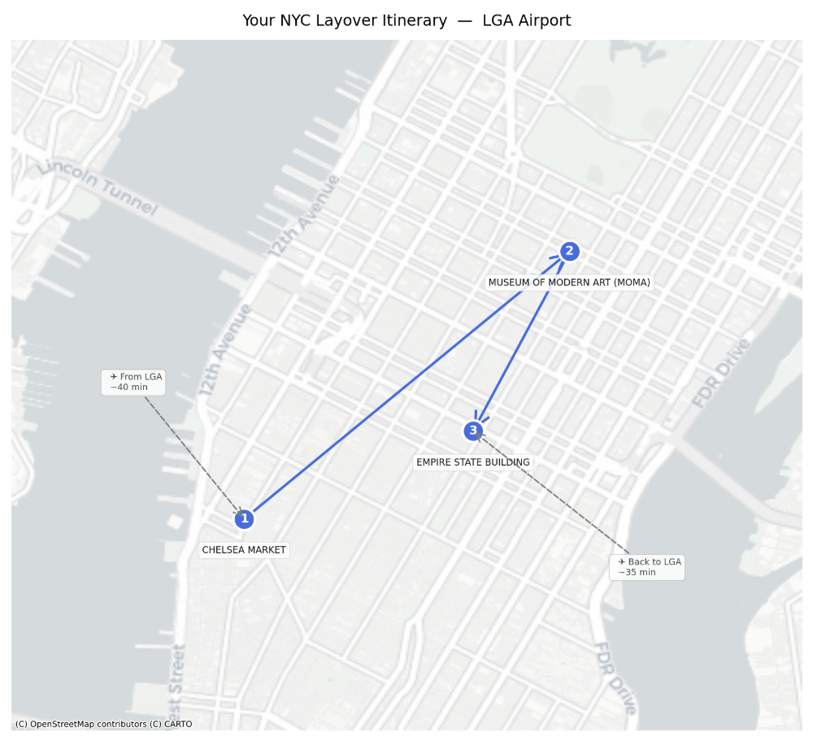
CHATBOT USE CASE (CONT)
IMPORTANT REMINDERS
Before you go:
• Verify opening hours - they may vary by day/season
• Some attractions require advance ticket reservations
• Allow extra time for security lines and unexpected delays
• Check weather conditions for outdoor attractions
Thank you for using NYC Airport Layover Chatbot!
Safe travels!

Slide 10
NYC Layover Itinerary Chatbot
Appendix

Slide 11
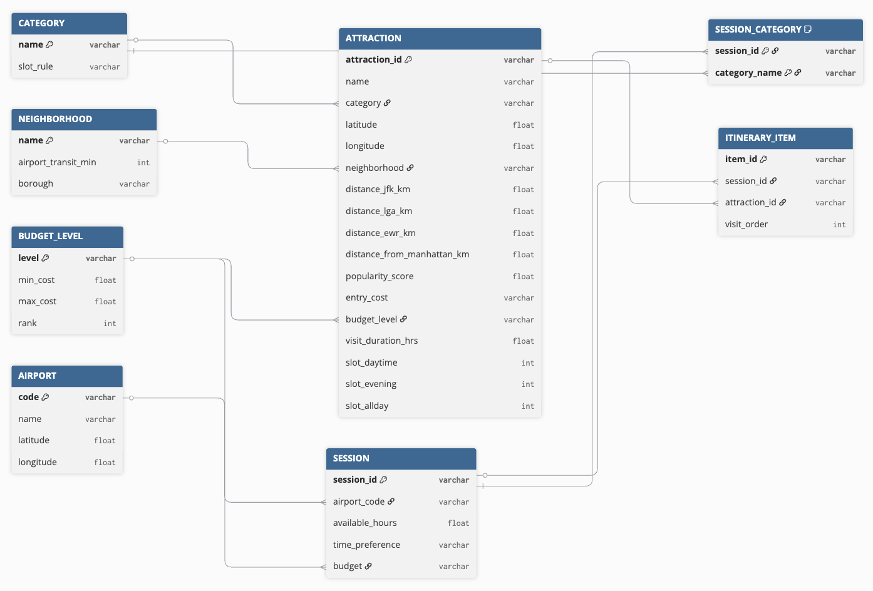
APPENDIX – ERD Diagram

Slide 12
SCORING LOGIC – 6 FACTOR ALGORITHM
Factor | Points range | Purpose
Category priority | 0–100 | High = matches 1st/2nd choice category; Low = matches lower-ranked category
Budget fit | 25–50 (or exclude) | High = exact budget match; Low = cheaper than budget
Proximity bonus | 0–20 | High = Midtown/Chelsea (close to airports); Low = Brooklyn/Bronx (far)
Fame bonus | 0 or +200 | High = world-famous landmark; Low = not famous
Duration bonus | 0–80 | High = 2.5+ hour visit; Low = under 1.5 hour visit
Diversity penalty | –20 or 0 | High (0) = different neighborhood than previous; Low (–20) = same neighborhood
Final Score = Sum of all applicable factors (higher = better)

Slide 13
SELECTION LOGIC
Step | Action | Rational
1. Filter | Remove attractions that don't match category, time preference, or budget | Eliminates obviously irrelevant options early, reducing computational waste. No point scoring an attraction that's closed, unaffordable, or in the wrong category.
2. Score 3. Sort | Score remaining candidates using the 6-factor table Rank from highest score to lowest | Quantifies subjective preferences (fame, budget, proximity, etc.) into an objective rank. Sorting ensures the best options are considered first.
4. Test | Check each in order: does it fit remaining time (including transit)? | Accounts for the user's most critical constraint: available hours. A perfect attraction is useless if you can't get there and back.
5. Pick | Select the highest-scoring attraction that fits | Guarantees the optimal feasible choice. If the highest-scoring attraction fits, take it. If not, fall back to the next best — no need to test lower scores first.
6. Repeat | Move to next category rank and repeat | Respects the user's priority order. Their 1st choice category gets first pick of the best available attraction, not a leftover.

Slide 14
Future Extensions with Gen AI
Natural-Language Planning
Conversational
Edits
Review
Summaries
Real-Time
Optimization
Partner Recommendations
Users describe their layover in their own words (e.g., "I have 6 hours, want something cheap and outdoors")
Chatbot automatically translates the description into a structured itinerary
Eliminates need for menu-based inputs
Users ask to swap, shorten, or cheapen parts of the itinerary
Chatbot updates the plan in real time without restarting
Supports follow-up requests like "replace this with something closer to the airport"
Chatbot summarizes customer reviews from multiple sources
Delivers quick, useful insights (e.g., "too crowded at noon" or "great for families")
Helps users make faster, more informed decisions
Chatbot adjusts recommendations using live data
Factors include weather, traffic, attraction wait times, and current opening hours
Ensures itineraries remain feasible and enjoyable despite changing conditions
Chatbot naturally surfaces partner restaurants, stores, or attractions
Integrates sponsored or affiliated options within the itinerary
Maintains relevance while enabling monetization or cross-promotion

