Slide 1
INSY 442 · DATA ANALYSIS & VISUALIZATION
Good vs. Bad Data
Visualizations in Tableau
Visualization design Comparisons and Rationale
Using 2026 FIFA World Cup Data

Slide 2
AGENDA
Topic inspiration & data sources
Q1 · Most valuable squads
Q2 · Experience vs. market value
Q3 · Squad value by position
Q4 · Player age profile
Q5 · Attacking output vs. playing time
Q6 · Market value across ages
Key takeaways

Slide 3




1. Topic Inspiration & Data Sources
Topic Inspiration
Dataset at a Glance
r/dataisbeautiful
[OC] Self-updating circular 2026 World Cup bracket
48
4
Dataset Source
National squads
Playing positions (GK, DEF, MID, FWD)
Kaggle · FIFA World Cup 2026 Dataset
player_stats.csv
squads_and_players.csv
2
6
Analysis Scope
Squad-level and player-level views
Market value, caps, age, minutes, goals & assists
Kaggle CSV files joined
Business questions tested
3
Data
Q1
Q2
Q3
Q4
Q5
Q6
Takeaways

Slide 4

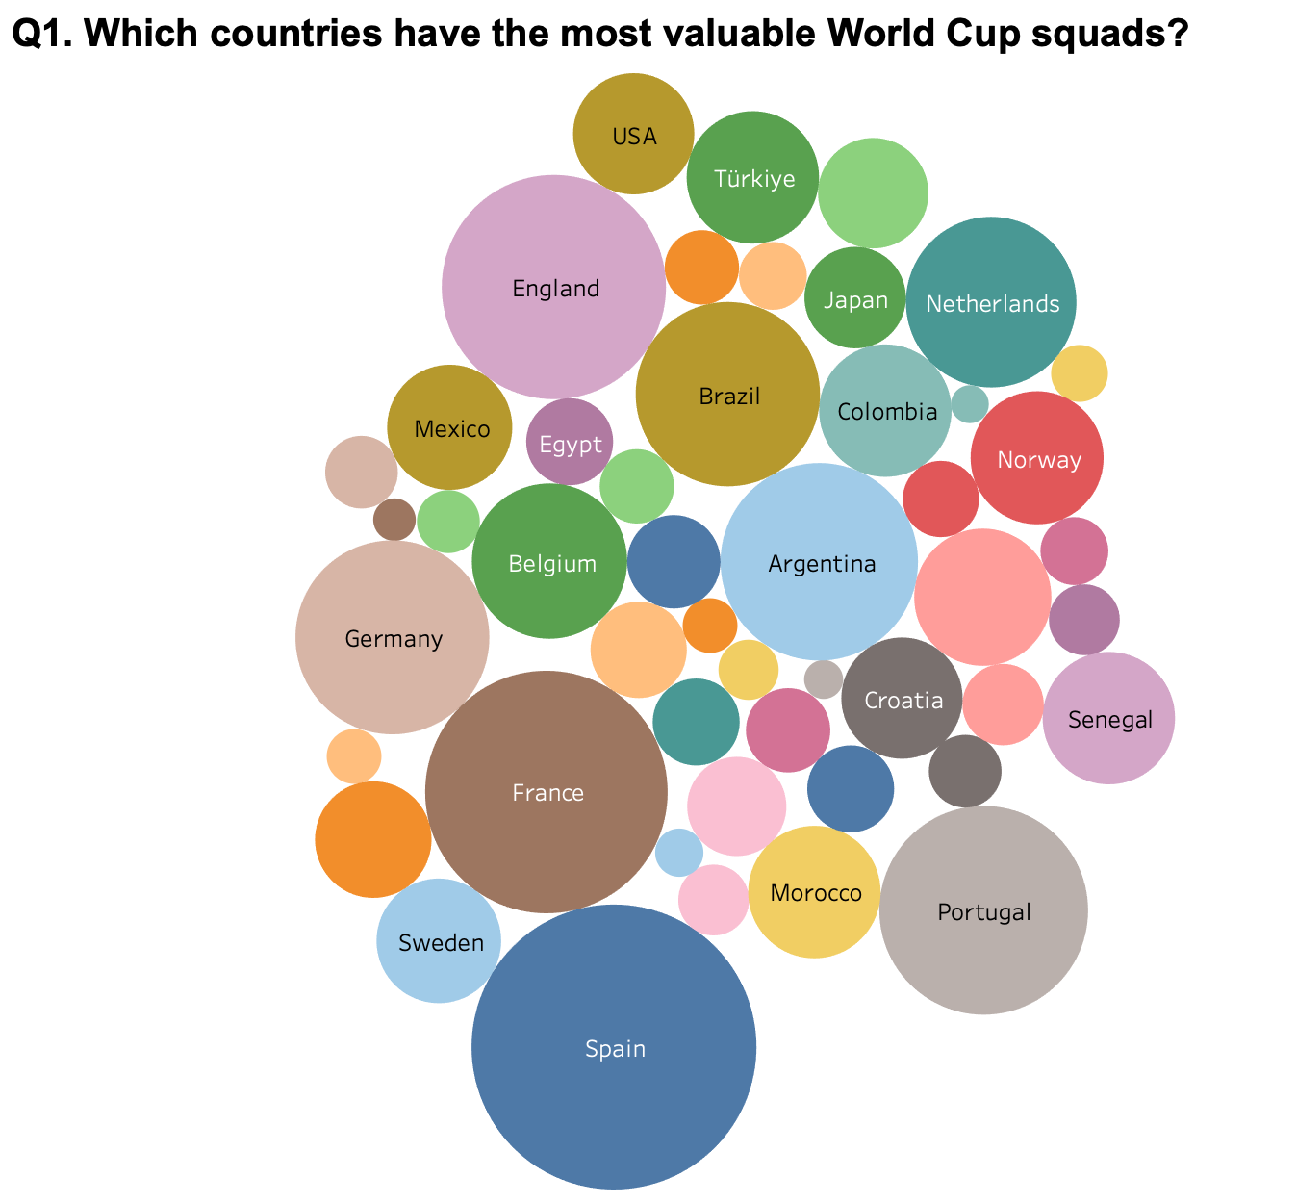

2.1 Packed bubbles make squad values hard to rank
Question 1
Visualization — Packed bubble chart
Which countries have the most valuable World Cup squads?
Why this visualization doesn't work
Packed bubble chart
Bubble sizes are difficult to compare precisely, especially when squad values are similar.
Too many colors add unnecessary visual clutter.
Countries are not clearly ranked, making it difficult to identify the most valuable squads.
Exact market values are not immediately visible.
4
Data
Q1
Q2
Q3
Q4
Q5
Q6
Takeaways

Slide 5
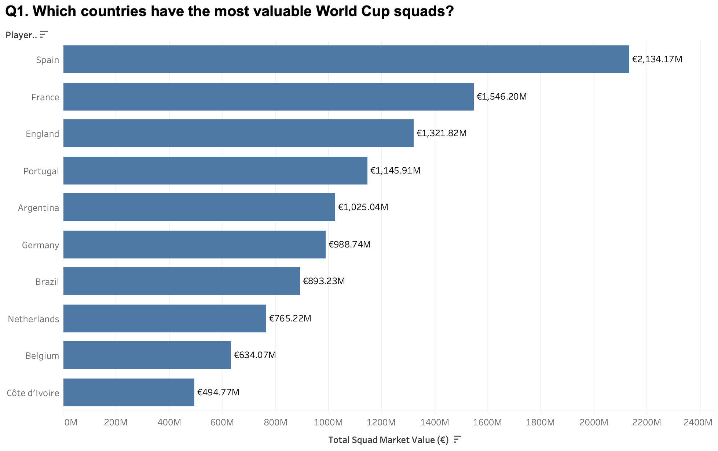

2.2 A sorted bar chart ranks squad values precisely
Question 1
Visualization — Horizontal bar chart
Which countries have the most valuable World Cup squads?
Why this visualization works
Horizontal bar chart
Horizontal bars allow easy and accurate comparison of squad values.
Countries are clearly ranked from highest to lowest.
Data labels show exact market values.
Consistent colors reduce clutter and keep attention on the data.
The chart directly answers which countries have the most valuable squads.
5
Data
Q1
Q2
Q3
Q4
Q5
Q6
Takeaways

Slide 6
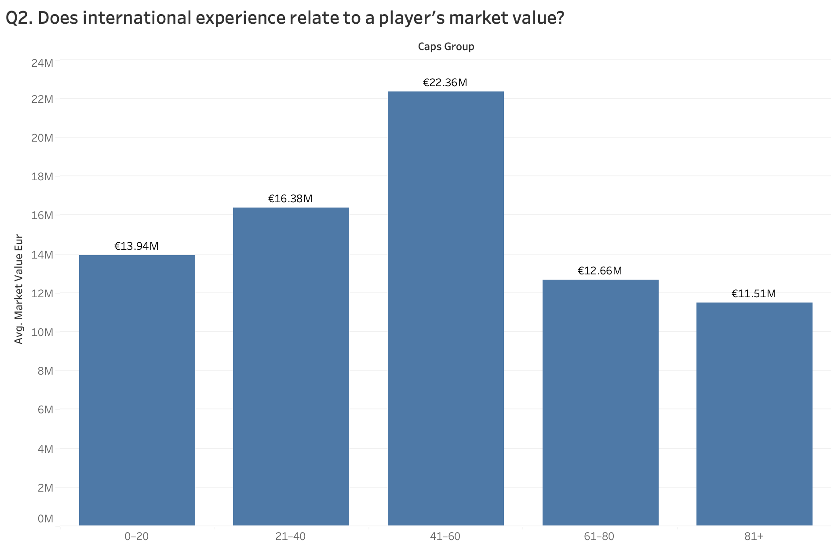
3.1 Averaged cap ranges hide the real relationship
Question 2
Visualization — Vertical bar chart
Does international experience relate to a player’s market value?
Why this visualization doesn't work
Vertical bar chart
Grouping caps into ranges hides differences between individual players.
Using averages hides the distribution and outliers within each group.
The caps ranges are arbitrary and can affect the apparent pattern.
It doesn't show the relationship between caps and market value as directly as a scatterplot.
Example: 41–60 caps appears to have the highest value (€22.36M), but we can't see whether that's a general pattern or driven by a few very valuable players.
6
Data
Q1
Q2
Q3
Q4
Q5
Q6
Takeaways

Slide 7
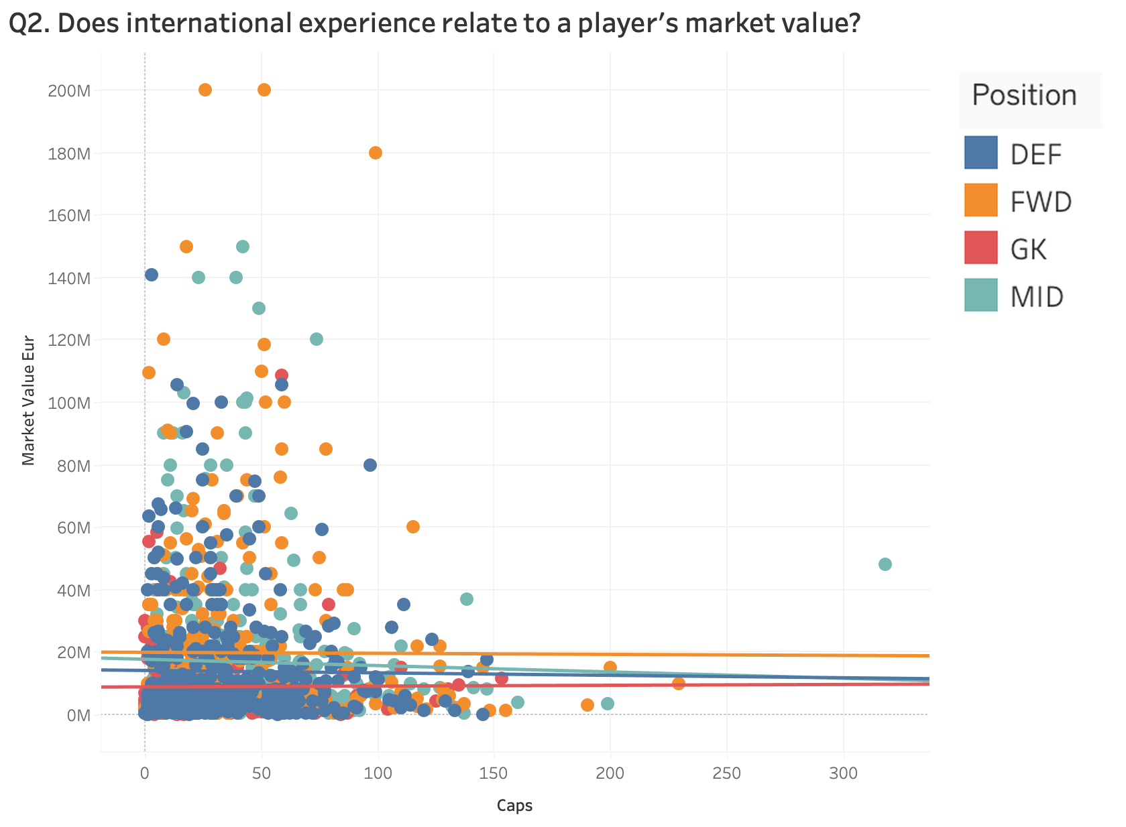
3.2 A scatter plot with trend lines shows the relationship by position
Question 2
Visualization — Scatter plot with trend lines
Does international experience relate to a player’s market value?
Why this visualization works
Scatter plot with trend lines
Appropriate for showing the relationship between two quantitative variables: caps and market value.
Each dot represents an individual player, preserving variation and making outliers visible.
Position is distinguished by color, allowing comparisons across player roles.
Trend lines make the overall relationship easier to identify for each position.
Avoids arbitrary grouping, so no information is lost by putting players into caps ranges.
Shows that the relationship may differ by position, adding another layer of insight.
7
Data
Q1
Q2
Q3
Q4
Q5
Q6
Takeaways

Slide 8
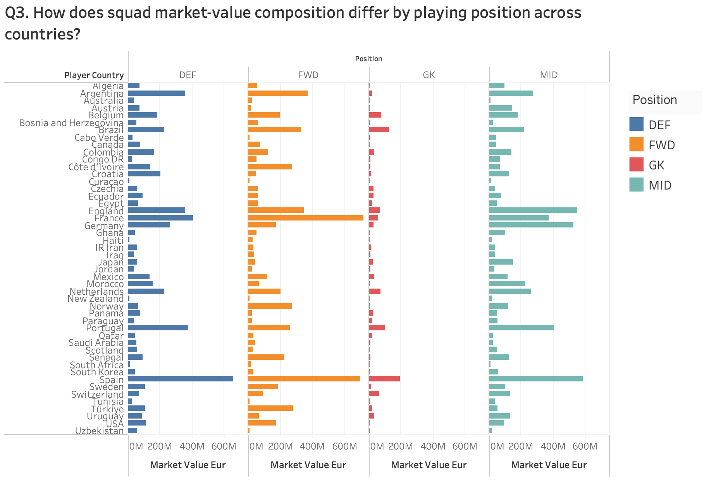
4.1 Absolute values across four panels obscure squad composition
Question 3
Visualization — Small multiples bar chart
How does squad market-value composition differ by playing position across countries?
Why this visualization doesn't work
Small multiples bar chart
Uses absolute market value rather than each position's share of total squad value, making composition difficult to compare.
Countries with very high total market values visually dominate the chart.
Positions are split into four panels, so viewers must look back and forth to understand one country's composition.
With 48 countries, there is still a lot of information to scan.
Hard to answer questions like “Which country has the greatest share of its squad value in forwards?”
8
Data
Q1
Q2
Q3
Q4
Q5
Q6
Takeaways

Slide 9
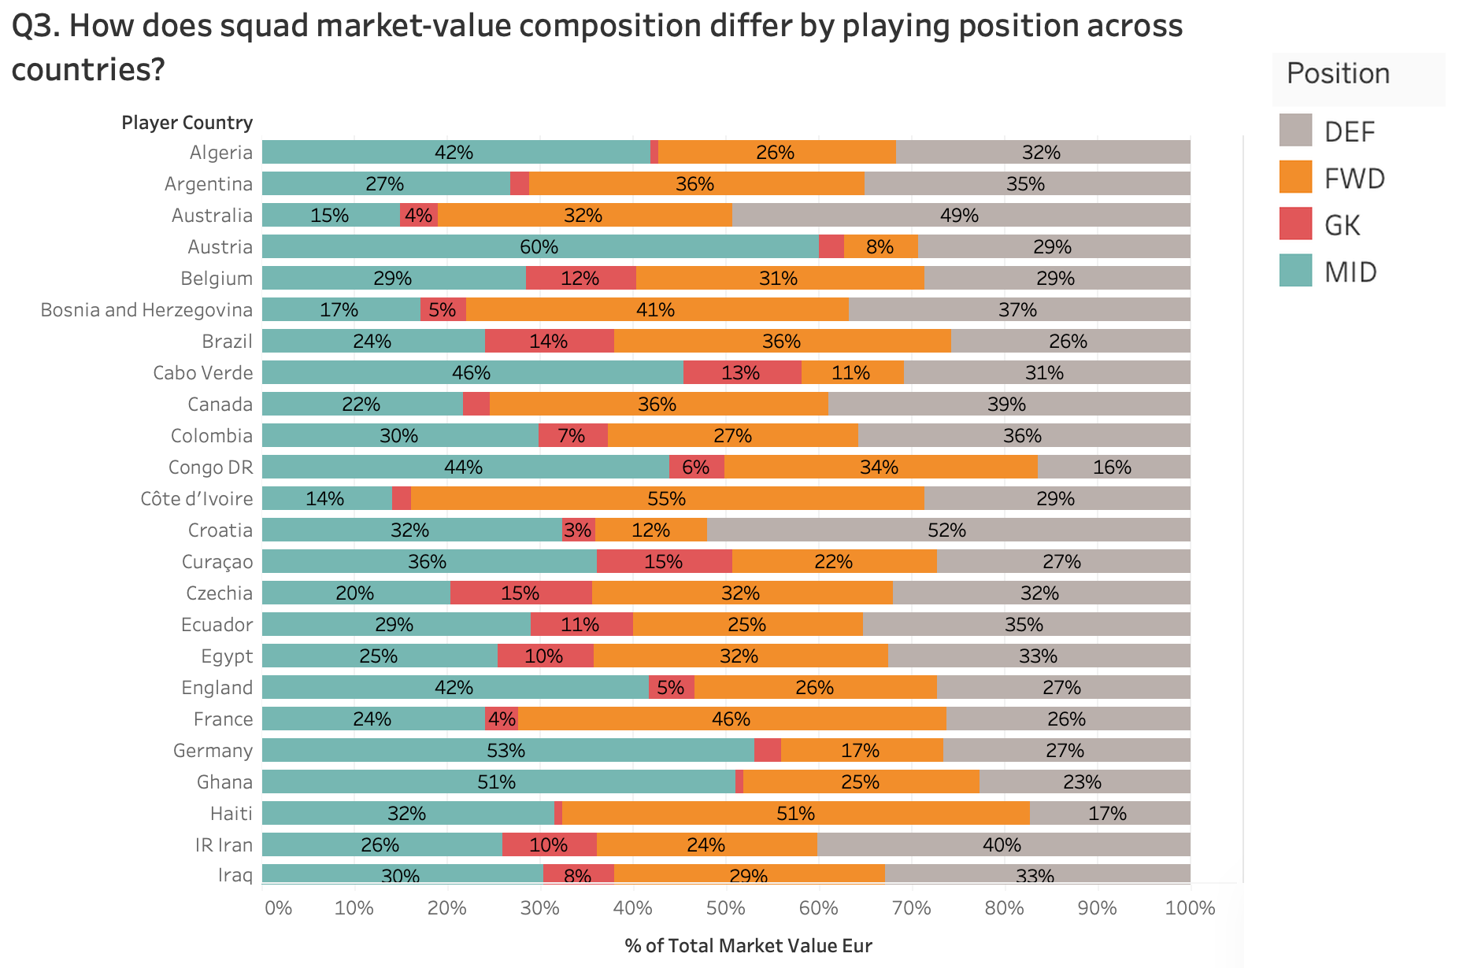
4.2 100% stacked bars make positional composition comparable
Question 3
Visualization — 100% stacked horizontal bar chart
How does squad market-value composition differ by playing position across countries?
Why this visualization works
100% stacked horizontal bar chart
Shows how each country's total squad value is distributed across positions.
Standardizing each country to 100% allows fair comparison regardless of total squad value.
One bar per country makes positional composition easy to compare.
Consistent colors make it easy to track the same position across countries.
Percentage labels provide exact values without estimation.
Countries with unusually high or low concentration in certain positions stand out.
9
Data
Q1
Q2
Q3
Q4
Q5
Q6
Takeaways

Slide 10
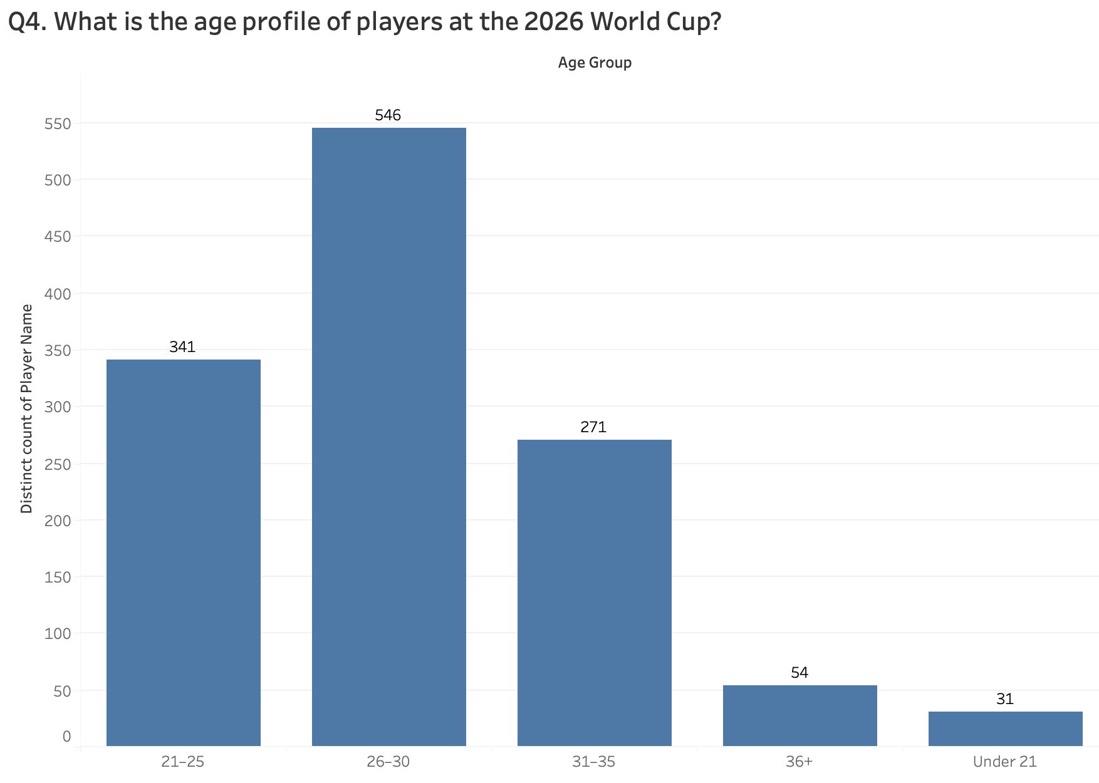
5.1 Broad age groups flatten the age distribution
Question 4
Visualization — Vertical bar chart
What is the age profile of players at the 2026 World Cup?
Why this visualization doesn't work
Vertical bar chart
Broad age groups hide differences between individual ages.
Group boundaries are arbitrary and can influence how the distribution appears.
Makes it difficult to identify the exact peak age.
Hides the detailed shape and spread of the age distribution.
10
Data
Q1
Q2
Q3
Q4
Q5
Q6
Takeaways

Slide 11
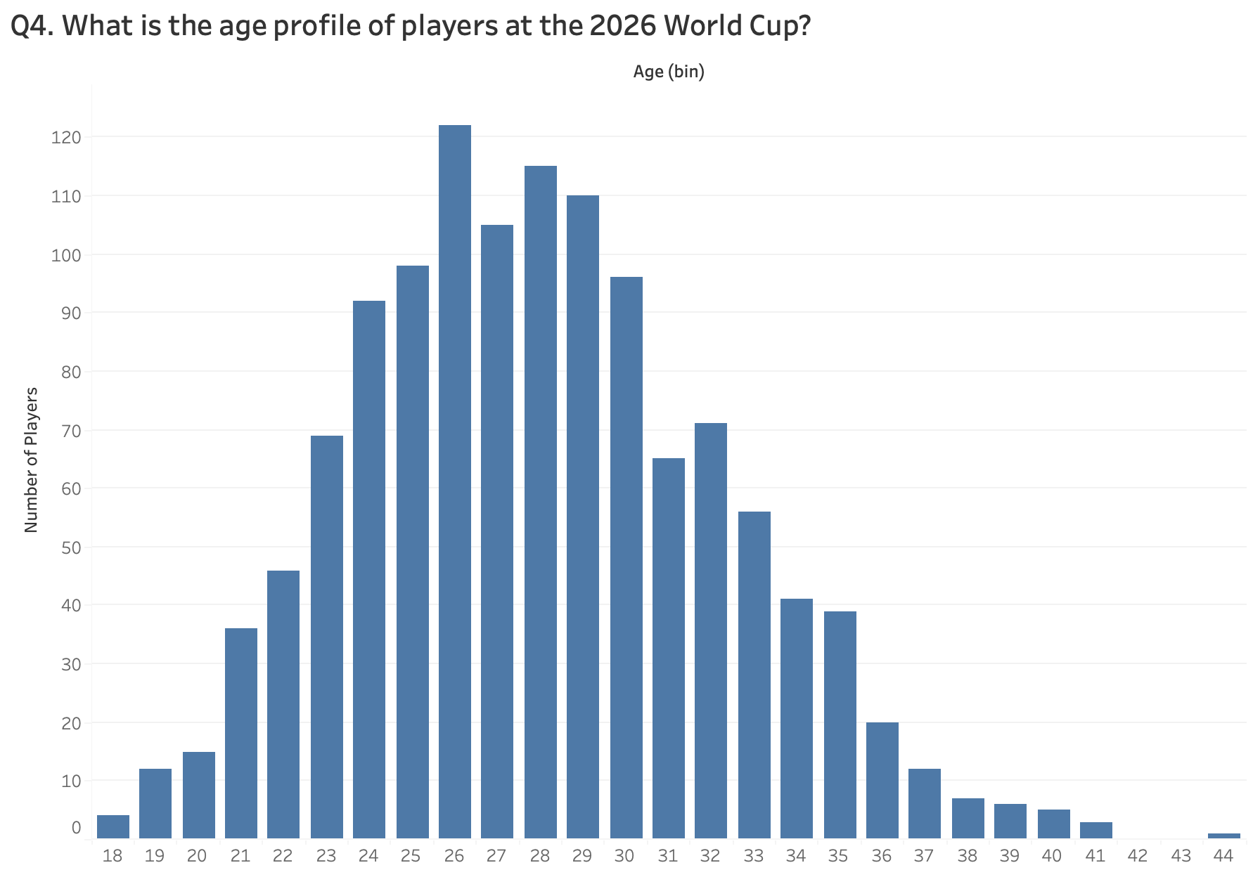
5.2 A one-year histogram reveals the true age profile
Question 4
Visualization — Histogram
What is the age profile of players at the 2026 World Cup?
Why this visualization works
Histogram
Histogram is appropriate for showing the distribution of numerical data like age.
One-year bins preserve the detail of individual ages.
Clearly shows the most common ages and where players are concentrated.
Makes the overall shape, spread, and any unusual ages easy to identify.
11
Data
Q1
Q2
Q3
Q4
Q5
Q6
Takeaways

Slide 12
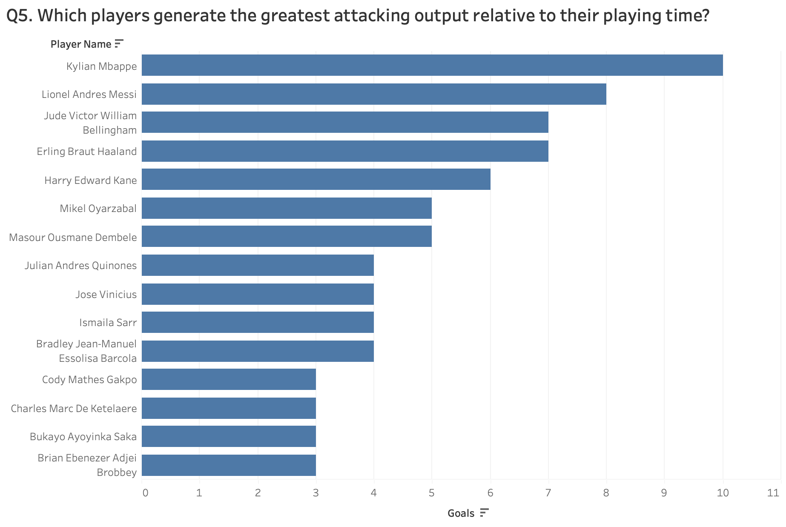
6.1 Total goals reward playing time, not efficiency
Question 5
Visualization — Horizontal bar chart
Which players generate the greatest attacking output relative to their playing time?
Why this visualization doesn't work
Horizontal bar chart
Shows total goals but ignores the playing time required to score them.
Favors players with more minutes, so efficiency comparisons can be misleading.
Only considers goals and ignores assists, even though both contribute to attacking output.
Sorted bars make top scorers easy to find, but not who produces the most output relative to playing time.
12
Data
Q1
Q2
Q3
Q4
Q5
Q6
Takeaways

Slide 13
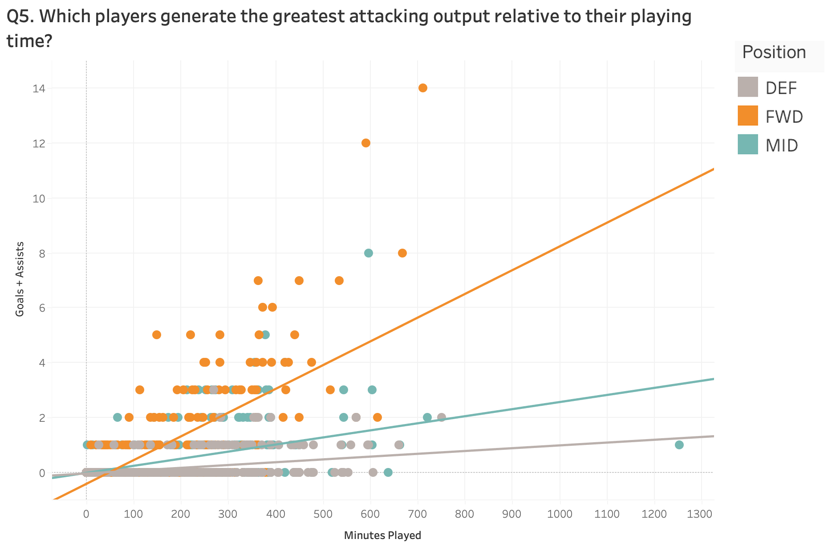
6.2 Plotting output against minutes reveals efficient attackers
Question 5
Visualization — Scatter plot with trend lines
Which players generate the greatest attacking output relative to their playing time?
Why this visualization works
Scatter plot with trend lines
Directly compares playing time with attacking output, answering the question better than ranking total goals.
Appropriate for showing the relationship between two continuous variables.
Each dot is an individual player, making high-performing outliers visible.
Trend lines make the relationship between minutes and output easier to see.
Color separates DEF, MID, and FWD, so productivity can be compared across positions.
Goals + assists gives a broader measure of attacking contribution than goals alone.
13
Data
Q1
Q2
Q3
Q4
Q5
Q6
Takeaways

Slide 14
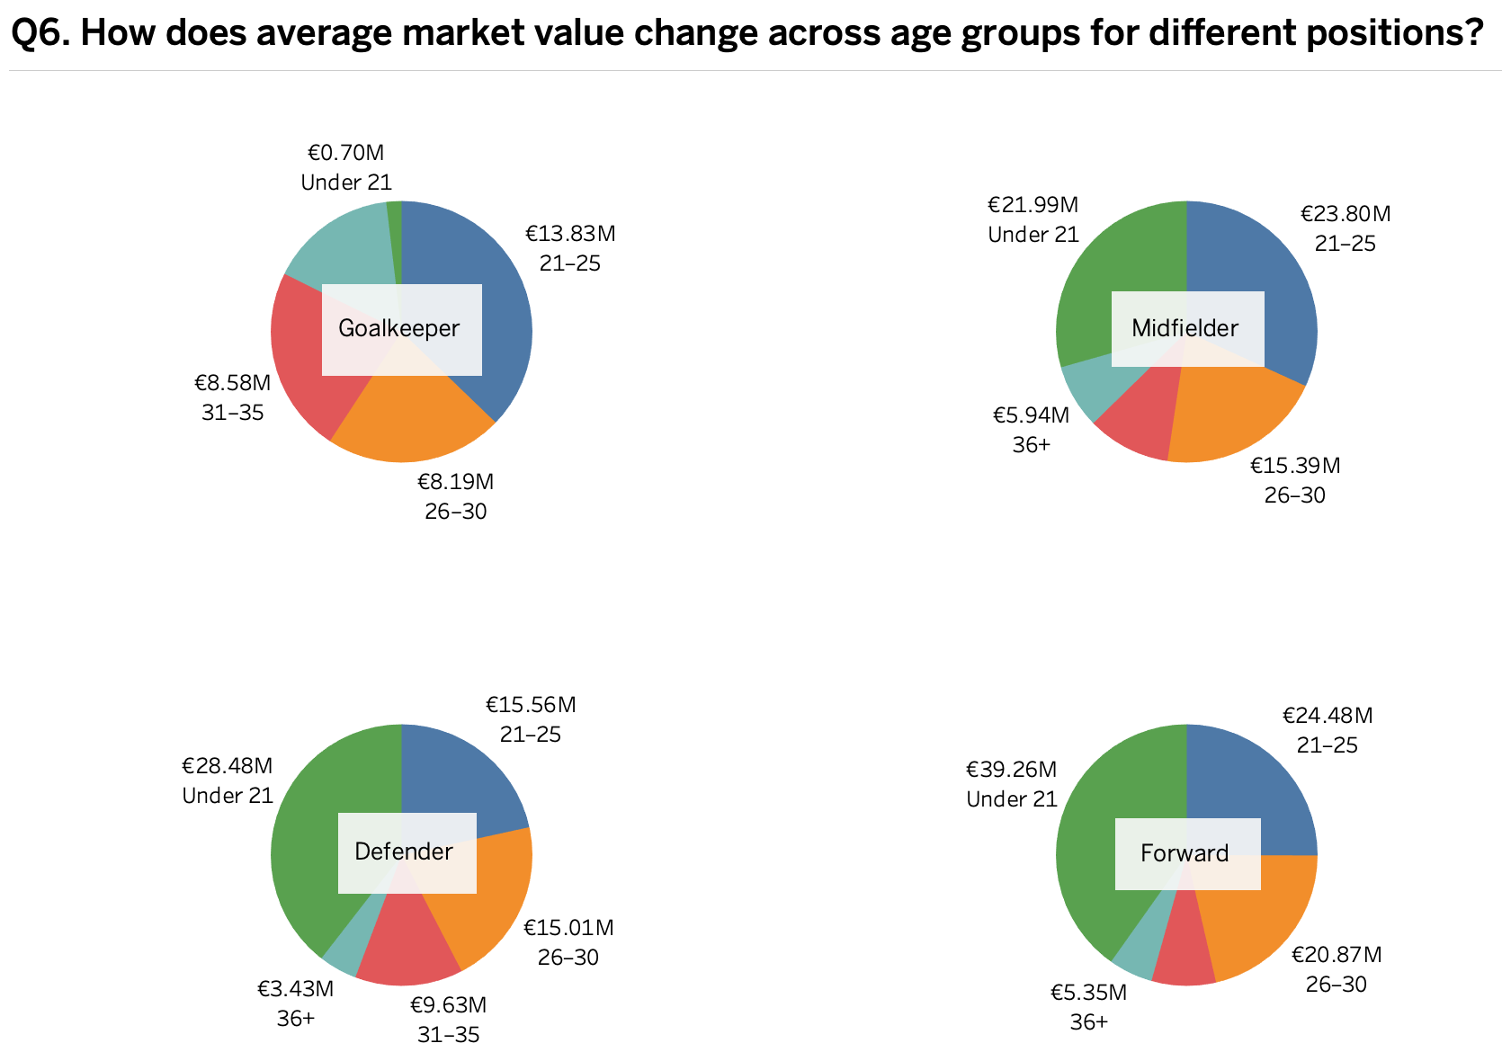
7.1 Four pie charts obscure how value changes with age
Question 6
Visualization — Pie charts
How does average market value change with age across different playing positions?
Why this visualization doesn't work
Pie charts
People judge angles and areas less accurately than position or length, so values are hard to compare.
Four separate pies force viewers to look back and forth between positions.
Age groups have a natural order, but pies do not emphasize the progression.
Hard to see whether value increases, decreases, or peaks at a certain age.
Similar-sized slices are difficult to distinguish without reading labels.
14
Data
Q1
Q2
Q3
Q4
Q5
Q6
Takeaways

Slide 15
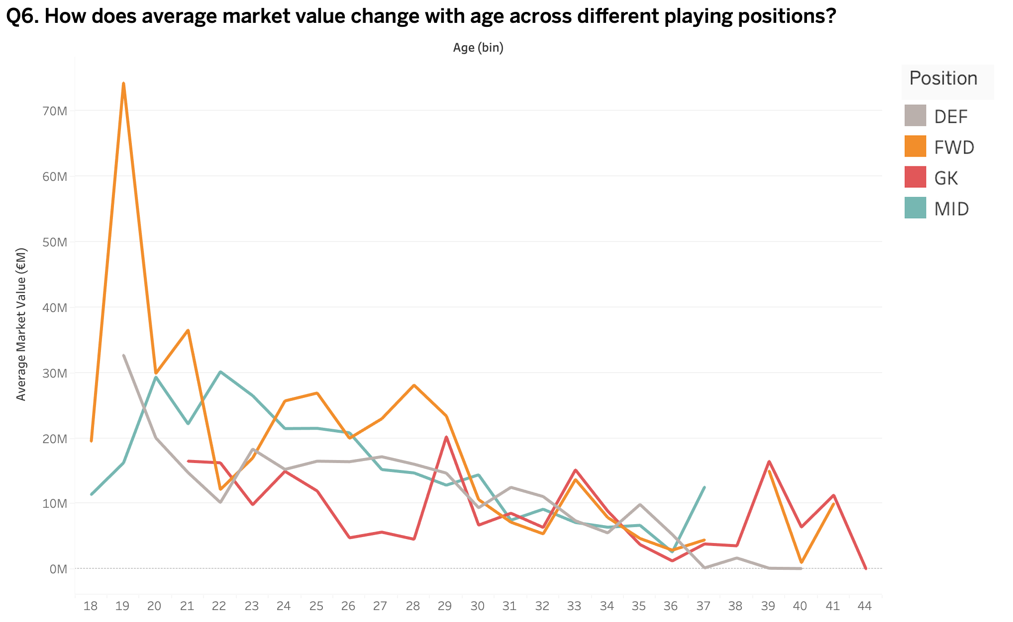
7.2 A multi-series line chart traces value across ages
Question 6
Visualization — Multi-series line chart
How does average market value change with age across different playing positions?
Why this visualization works
Multi-series line chart
Clearly shows how average market value changes as age increases.
Age is naturally ordered, making a line chart appropriate for the progression.
Separate lines make differences between positions easy to compare.
Peaks and declines in market value are immediately visible.
Consistent colors make each position easy to follow across ages.
15
Data
Q1
Q2
Q3
Q4
Q5
Q6
Takeaways

Slide 16
8. Key Takeaways: match the chart to the question
# | Question focus | ✕ Weak choice | ✓ Better choice | Design principle
Q1 | Most valuable World Cup squads | Packed bubble chart | Horizontal bar chart | Sort bars — length beats area
Q2 | International caps vs. market value | Vertical bar chart | Scatter plot with trend lines | Plot individuals to show relationships
Q3 | Squad value composition by position | Small multiples bar chart | 100% stacked horizontal bar chart | Normalize to 100% for composition
Q4 | Age profile of players | Vertical bar chart | Histogram | Use fine bins for distributions
Q5 | Attacking output relative to playing time | Horizontal bar chart | Scatter plot with trend lines | Normalize output by opportunity
Q6 | Market value by age and position | Pie charts | Multi-series line chart | Use lines for ordered progressions
16
Data
Q1
Q2
Q3
Q4
Q5
Q6
Takeaways

