Slide 1
CONTROL CONDITION

Slide 2
1
question

Slide 3
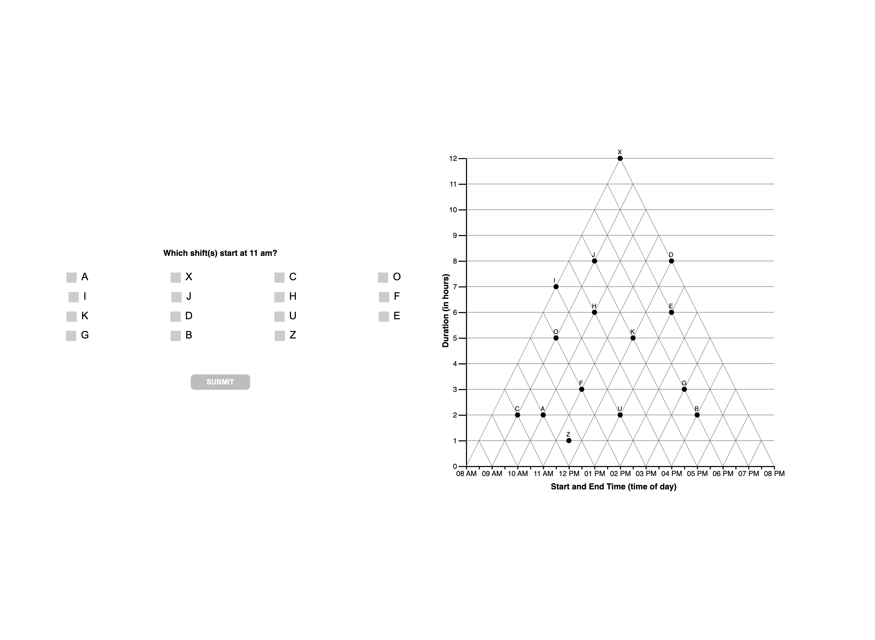

Slide 4
1 TRI

Slide 7
1 ORTH

Slide 9
1 ANG

Slide 11
1 ??

Slide 12
FIXED
Should be both… classified as unknown
DIJ
AF
Z
X

Slide 13
2
question

Slide 14
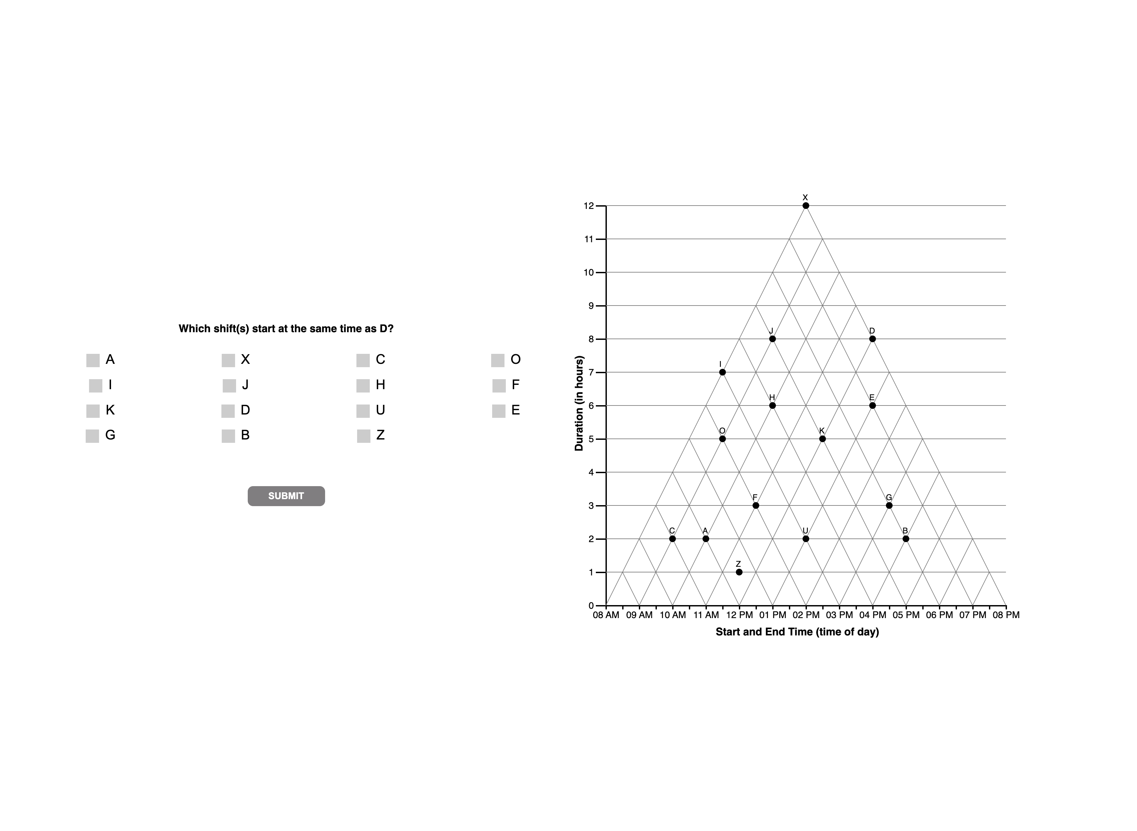

Slide 15
2 TRI

Slide 17
2 ORTH

Slide 19
2 ANG

Slide 20
REMOVE A FROM ANGULAR DEFN??

Slide 22
2 ??

Slide 24
3
question

Slide 25


Slide 26
3 TRI

Slide 28
EFK …
N=1
CODED as ‘tri’ (CORRECT)
BUT should be ‘other’/unknown?
DECISION
HARDCODE AS unknown

Slide 29
3 ORTH

Slide 31
3 ANG

Slide 33
These two should be
Unknown?? Instead of Tverky
HARDCODE AS TVERSKY
Should be Tversky??
DISTRACTOR?
N = 18
Classified as ?? Rather than
TVERSKY bc it doesn’t include U and B

Slide 34
3 ??

Slide 40
4
question

Slide 41


Slide 42
4 TRI

Slide 45
4 ORTH

Slide 46
U
FU

Slide 47
4 ??

Slide 48
DE, E
Classifies as OTHER
DEU
Classifies as ORTH
Recode as OTHER
KU
Classifies as ORTH
RECODE as OTHER
DEOU
Classifies as ORTH
RECODE as OTHER

Slide 49
4
unknown

Slide 51
D, DE, E | N = 14 + 6 + 1
Reclassify as satisficing!
0 | N = 2
Reclassify as satisficing!

Slide 52
5
question

Slide 53
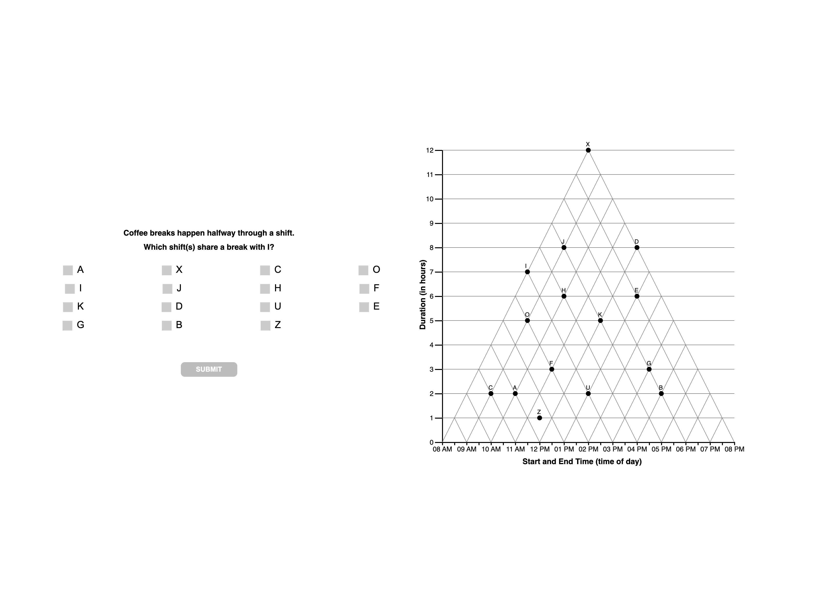

Slide 54
5 TRI

Slide 57
5 ORTH

Slide 59
5 ang

Slide 61
5 ??

Slide 62
F
Classifies as OTHER likely attempt at orthog
LEAVE AS OTHER

Slide 63
5
interpretations

Slide 66
5
unknown

Slide 68
F | N = 10… classify as VE?/satisfice?
H = 3 … classify as VE?
JH good example of wm overload?

