Slide 1
CONTROL CONDITION

Slide 2
1
question

Slide 3
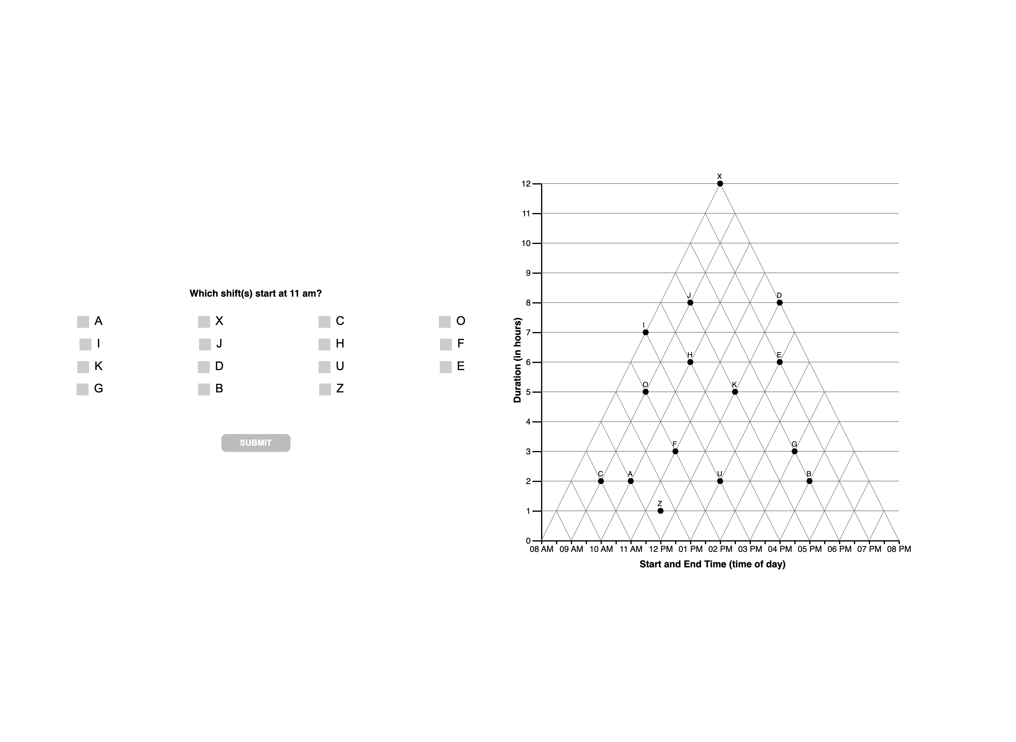

Slide 4
1 TRI

Slide 6
1 ORTH

Slide 8
1 ANG

Slide 10
1 ??

Slide 11
Should be both… classified as unknown
DIJ
AF
Z
X

Slide 12
2
question

Slide 13
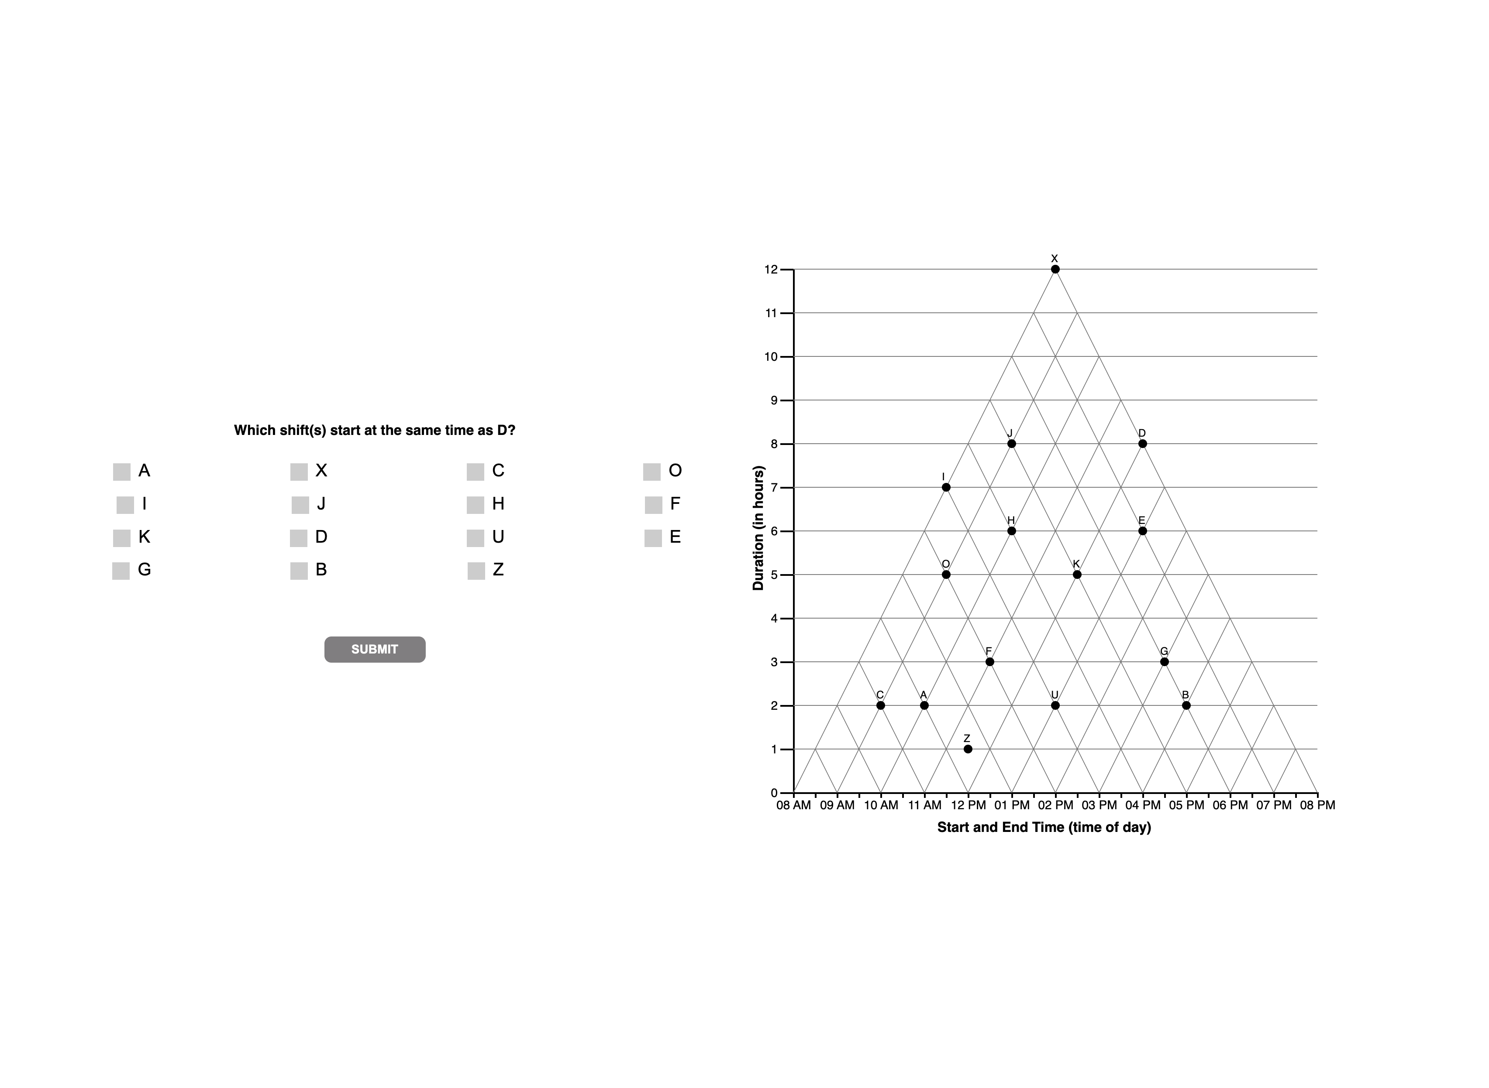

Slide 14
2 TRI

Slide 16
2 ORTH

Slide 18
2 ANG

Slide 19
REMOVE A FROM ANGULAR DEFN??

Slide 21
2 ??

Slide 23
3
question

Slide 24


Slide 25
3 TRI

Slide 27
3 ORTH

Slide 29
3 ANG

Slide 31
3 ??

Slide 32
These two should be
Unknown?? Instead of Tverky
DISTRACTOR?
N = 18
Why is classified as ?

Slide 40
4
question

Slide 41


Slide 42
4
interpretations

Slide 44
4
unknown

Slide 46
D, DE, E | N = 14 + 6 + 1
Reclassify as satisficing!
0 | N = 2
Reclassify as satisficing!

Slide 47
5
question

Slide 48
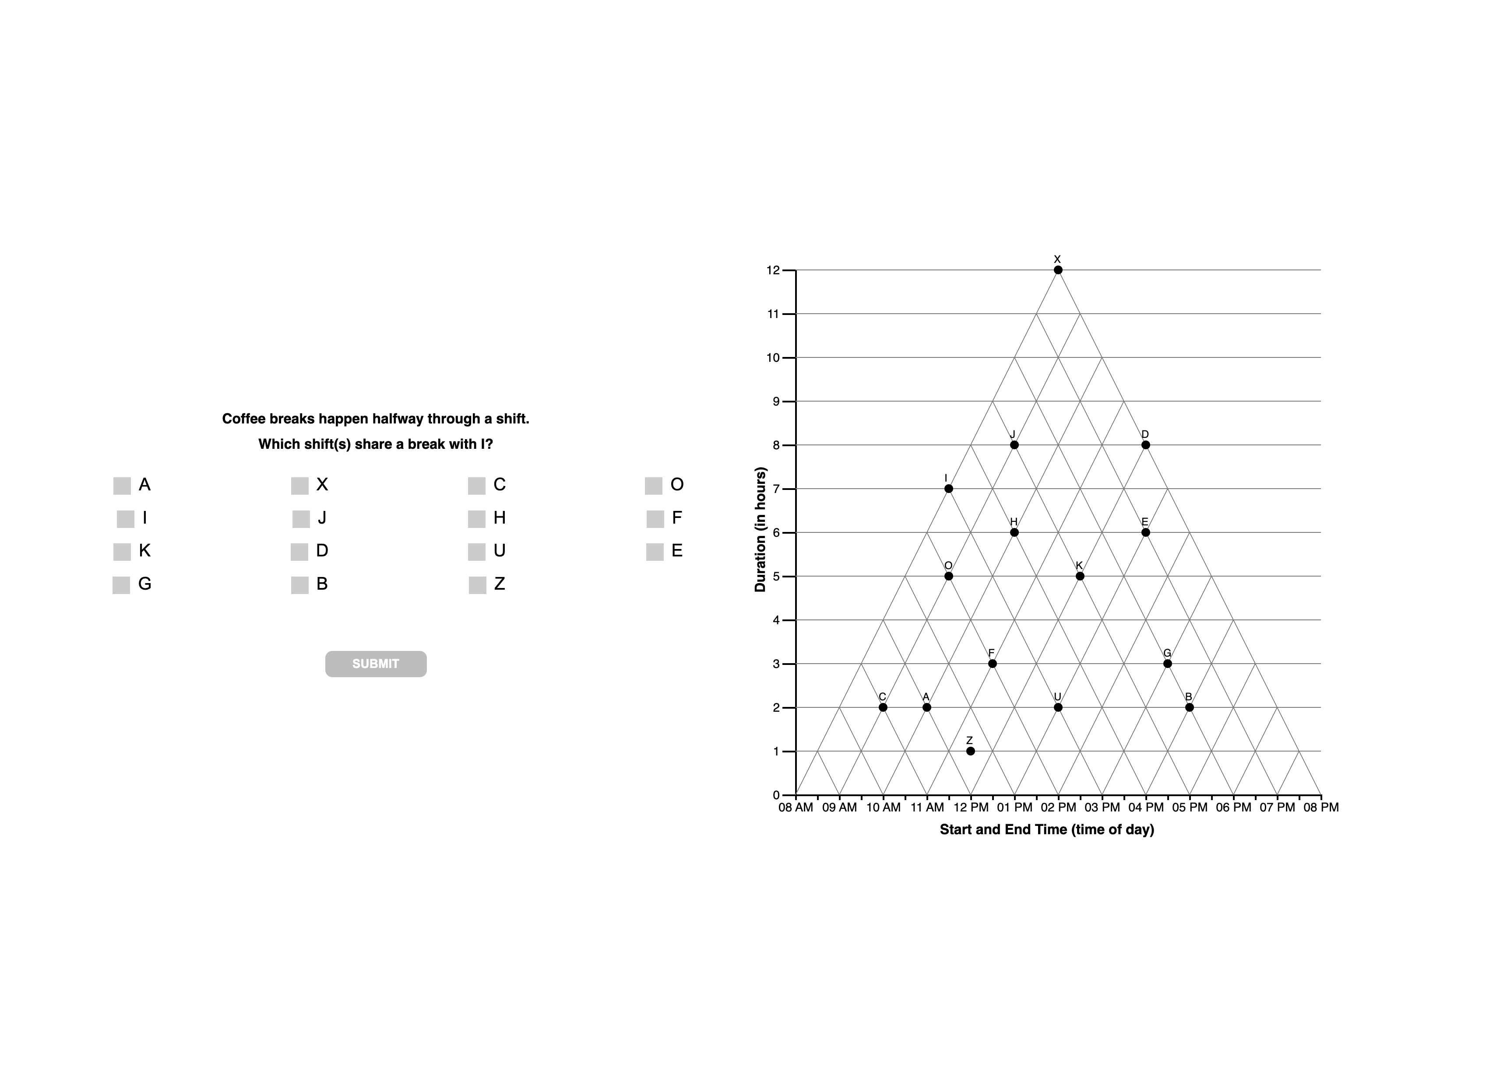

Slide 49
5
interpretations

Slide 51
5
unknown

Slide 53
F | N = 10… classify as VE?/satisfice?
H = 3 … classify as VE?
JH good example of wm overload?

