Slide 1
Crafting an impasse
[control ] vs [impasse] in Q1

Slide 2
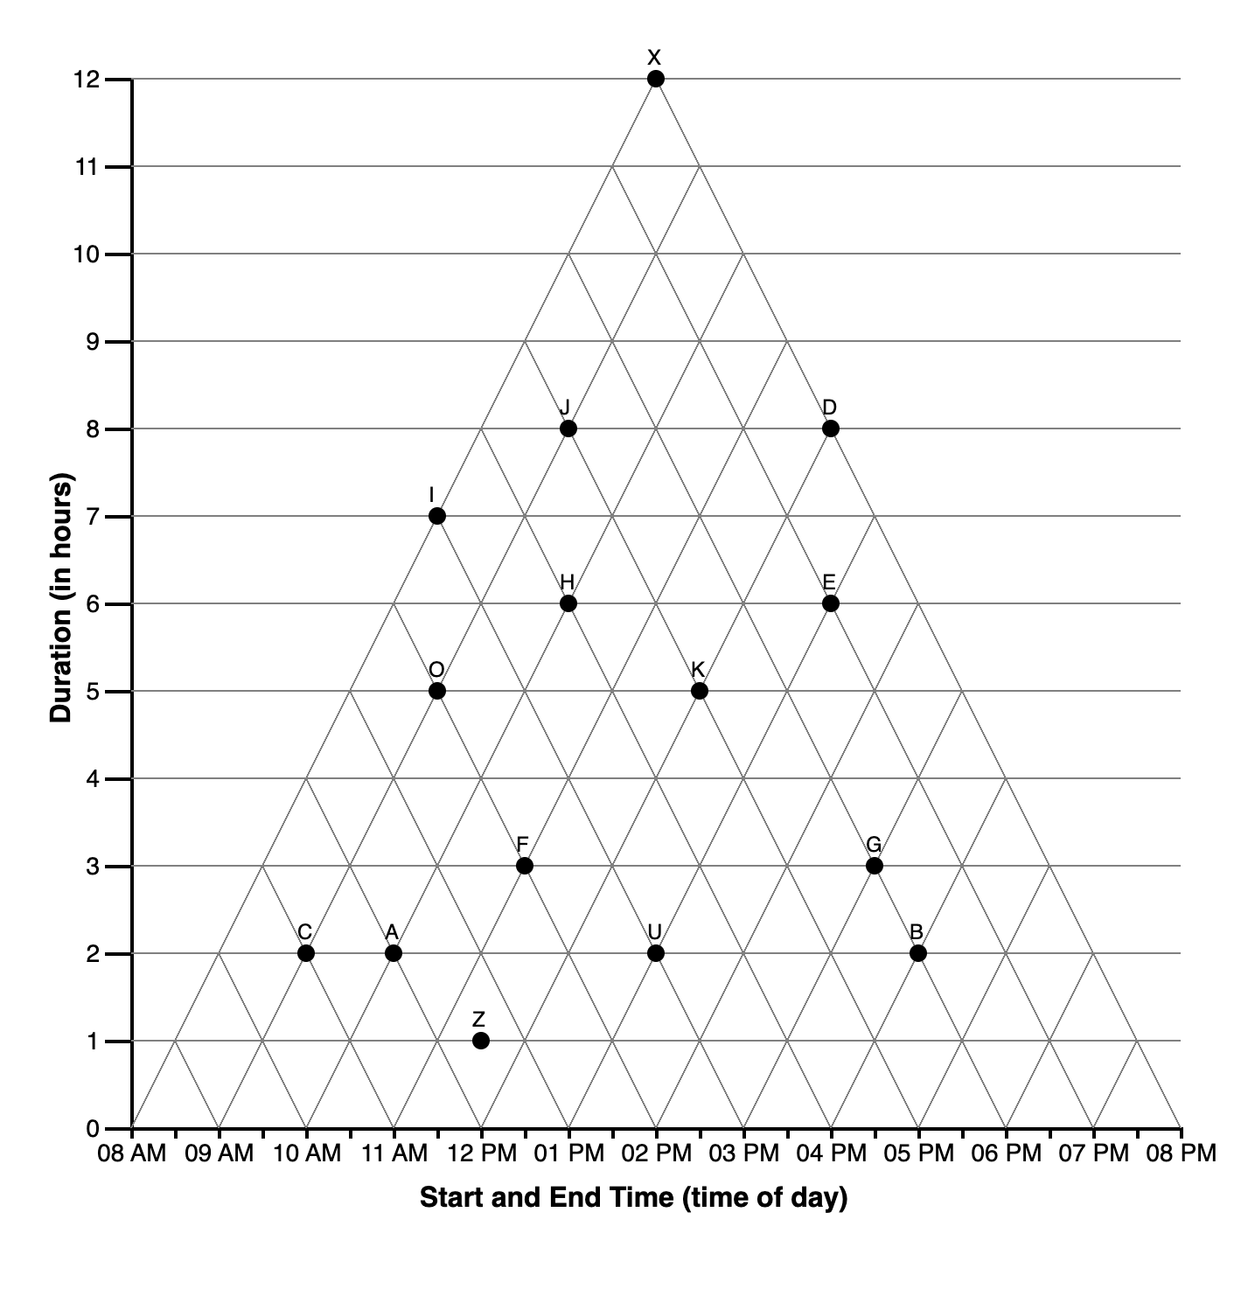
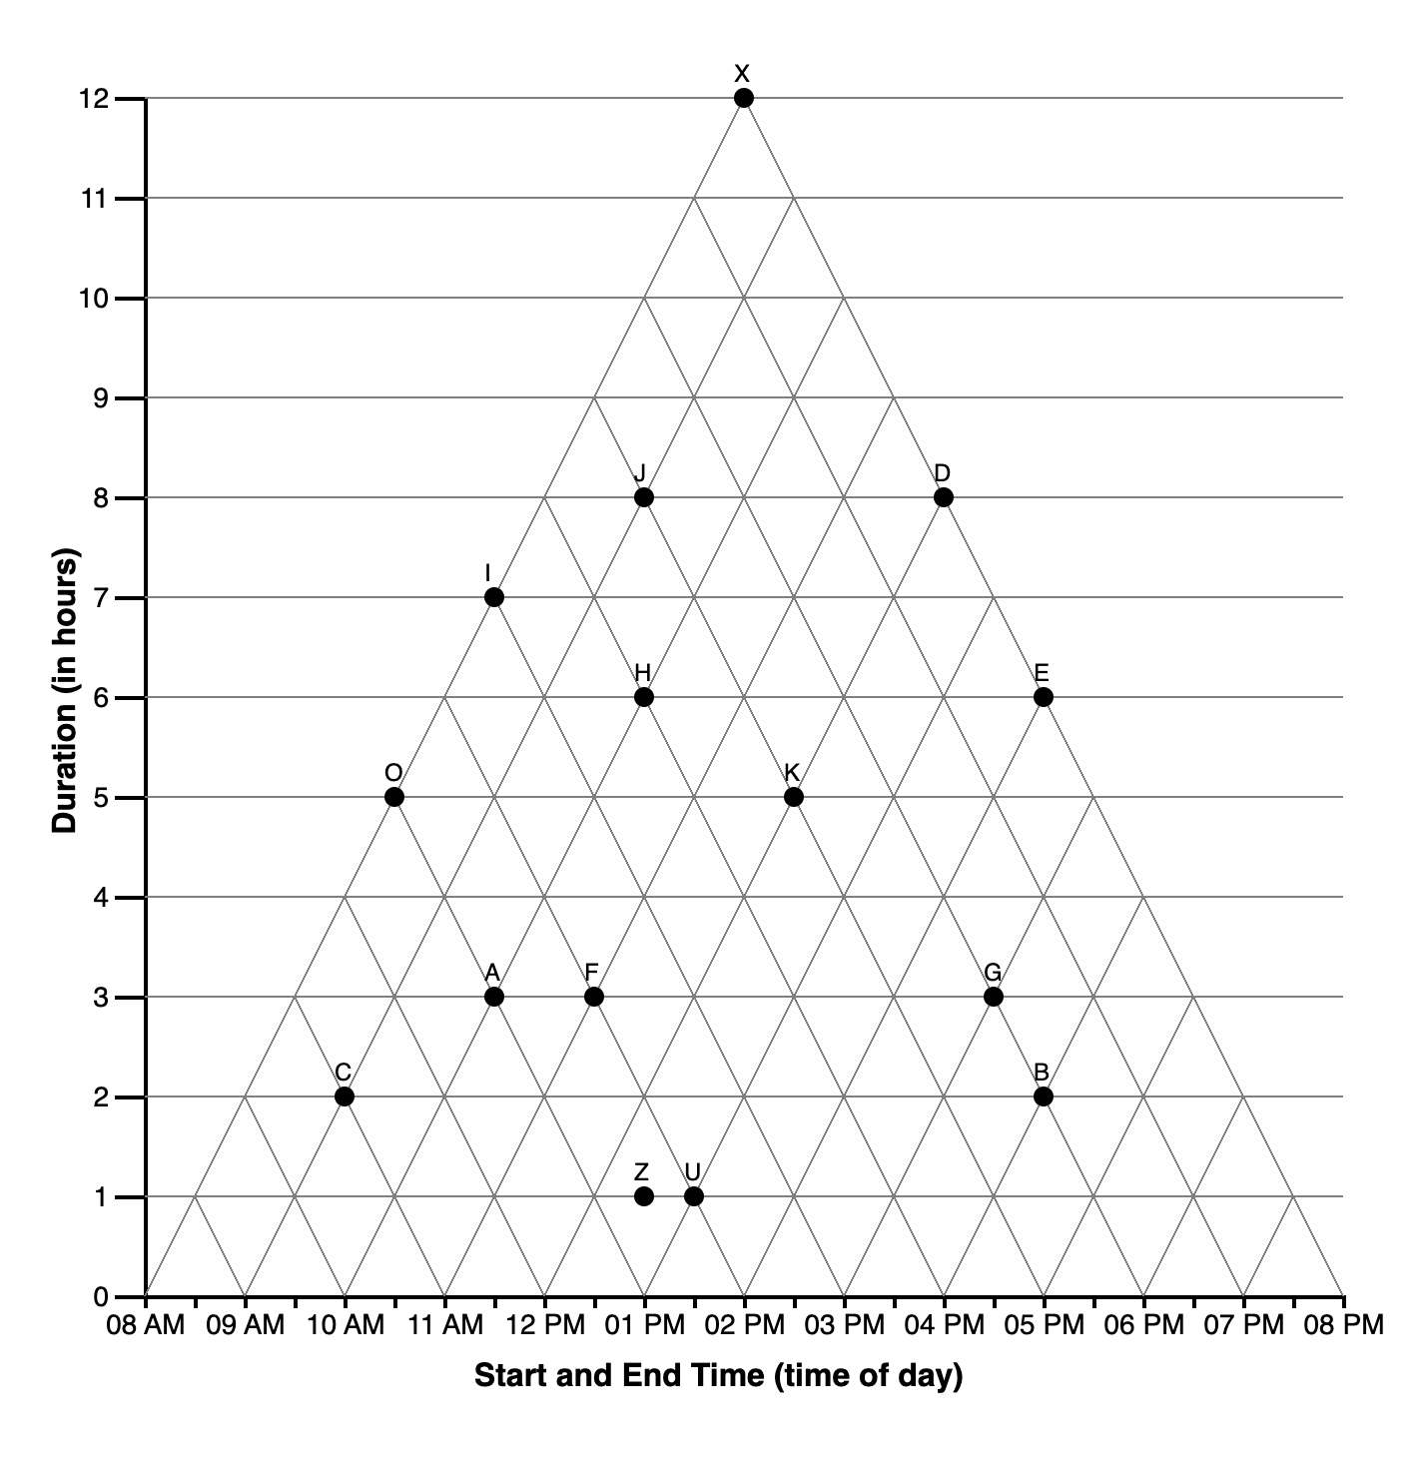

Slide 3
ALTERNATIVE INTERPRETATIONS
2nd question

Slide 4
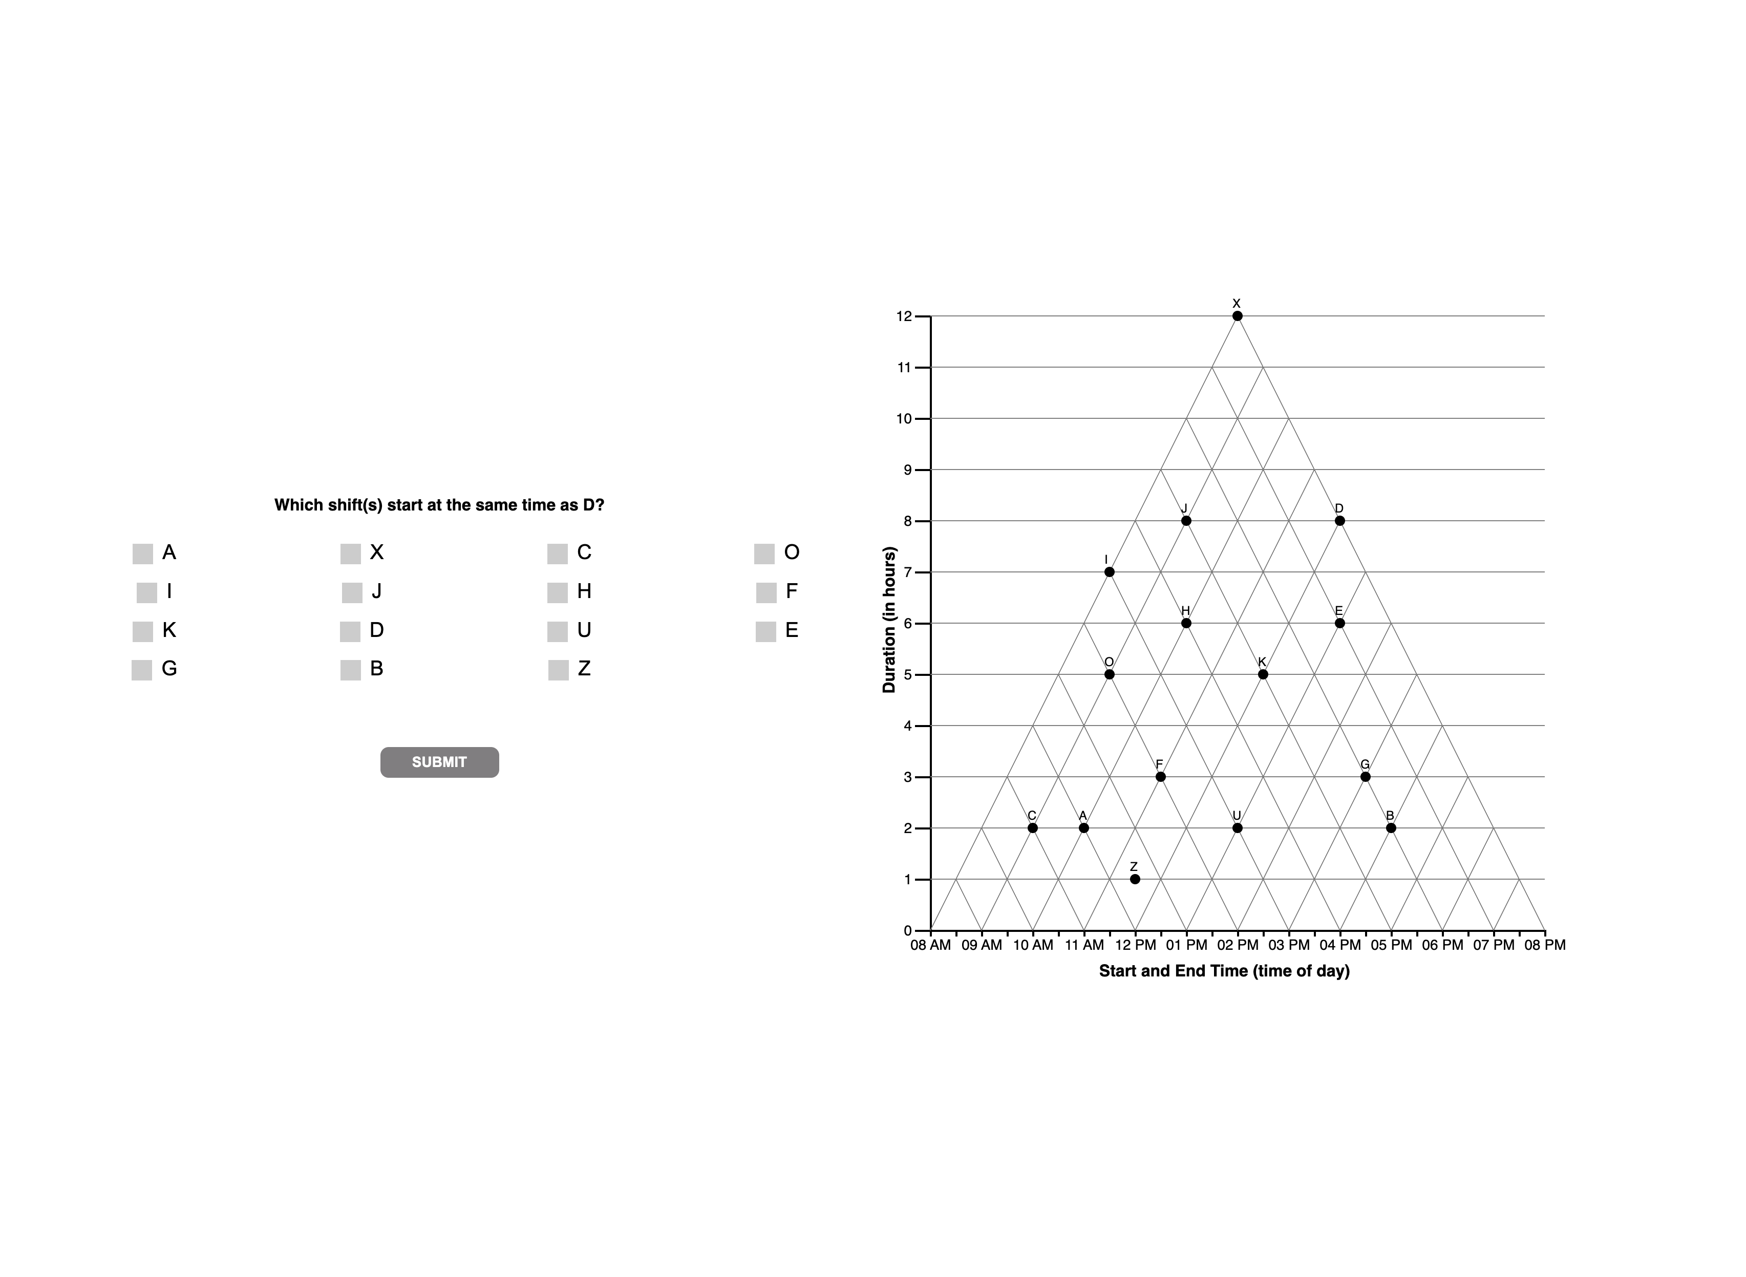
TRIANGULAR

Slide 5
ORTHOGONAL

Slide 6
BOTH

Slide 7
ANGULAR

Slide 8
REFERENCE POINT

Slide 9
UNKNOWN

Slide 10
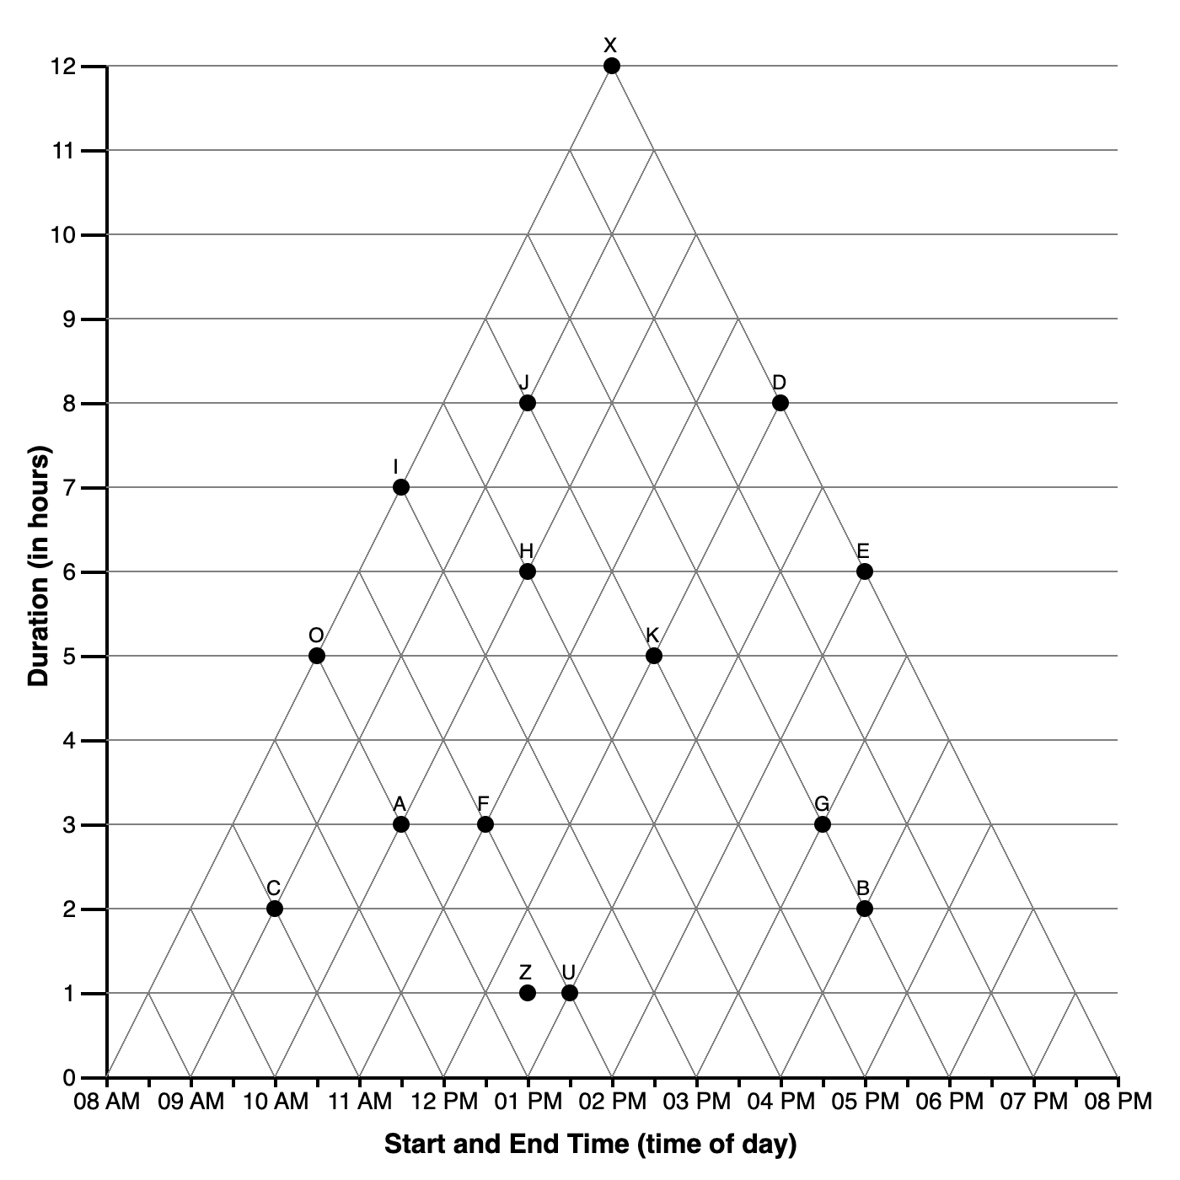
SATISFICING

