Slide 1
CONTROL CONDITION

Slide 2
1
question

Slide 3
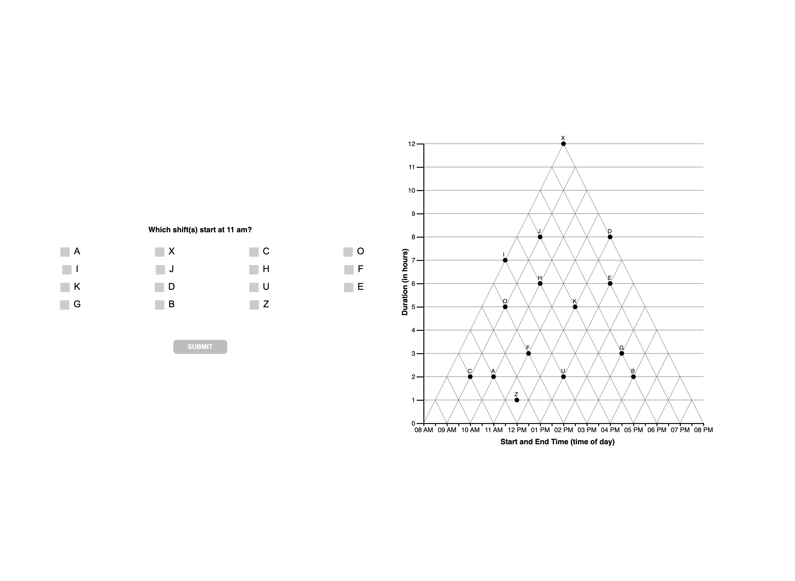

Slide 4
1
interpretations

Slide 6
1
unknown

Slide 8
2
question

Slide 9
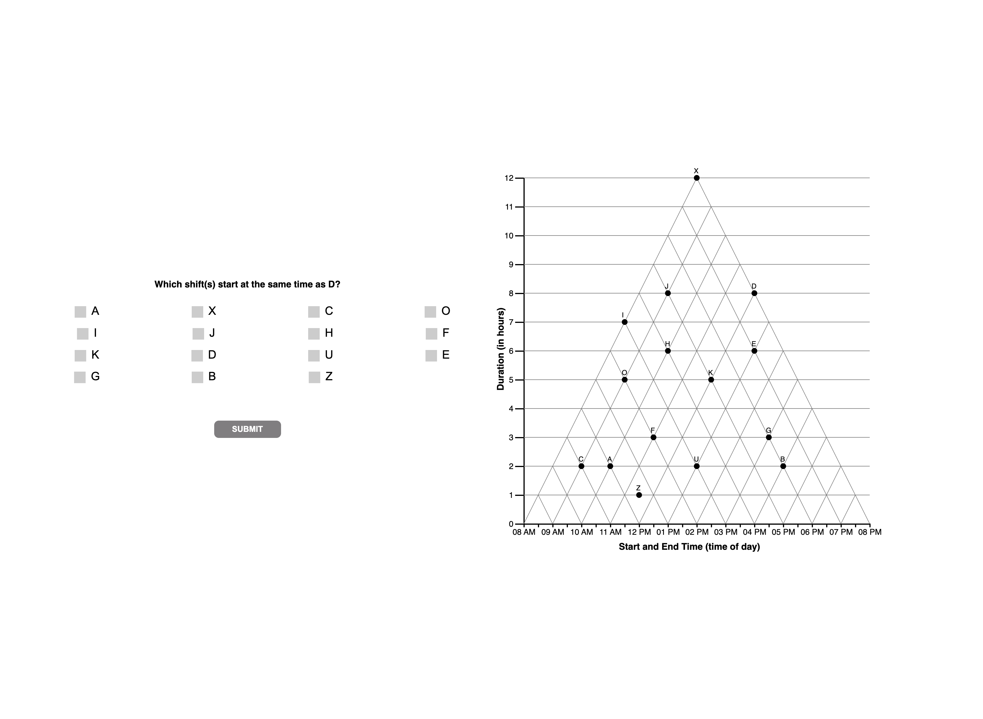

Slide 10
interpretations

Slide 11
2
interpretations

Slide 13
2
unknown

Slide 16
3
question

Slide 17


Slide 18
interpretations

Slide 19
3
interpretations

Slide 21
3
unknown

Slide 29
4
question

Slide 30
4

Slide 31


Slide 32
4
interpretations

Slide 34
4
unknown

Slide 36
5
question

Slide 37
5

Slide 38
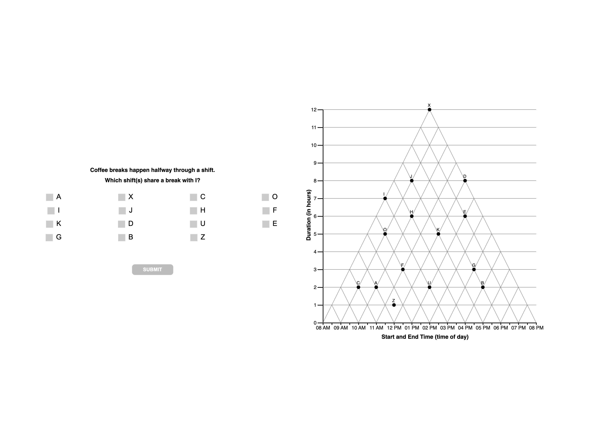

Slide 39
5
interpretations

Slide 41
5
unknown

