Slide 1
TEST PHASE Q6 – Q15

Slide 2
6
question

Slide 3
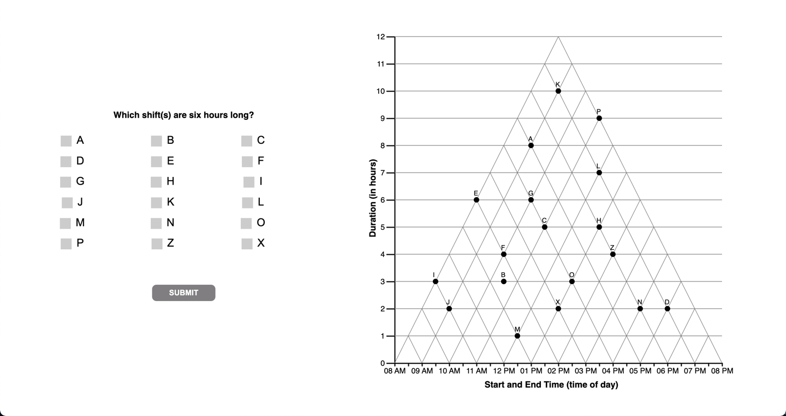

Slide 4
6
interpretations

Slide 5
[Question 6 is non discriminant]
The question does not yield different response patterns
Under different interpretations of the graph.

Slide 6
6
unknown

Slide 7
7
question

Slide 8
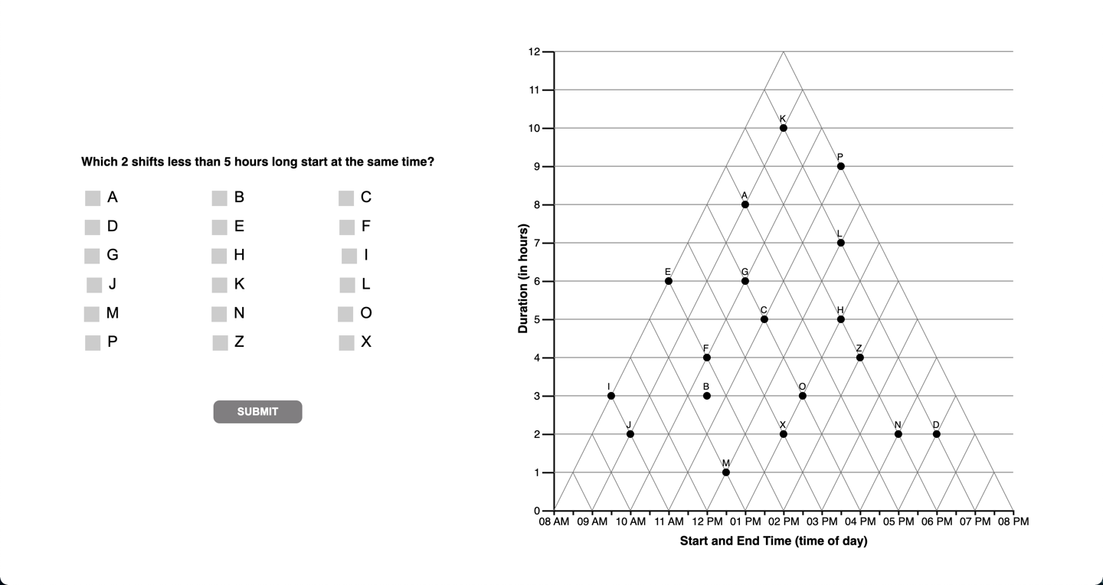

Slide 9
7
interpretations

Slide 11
8
question

Slide 12
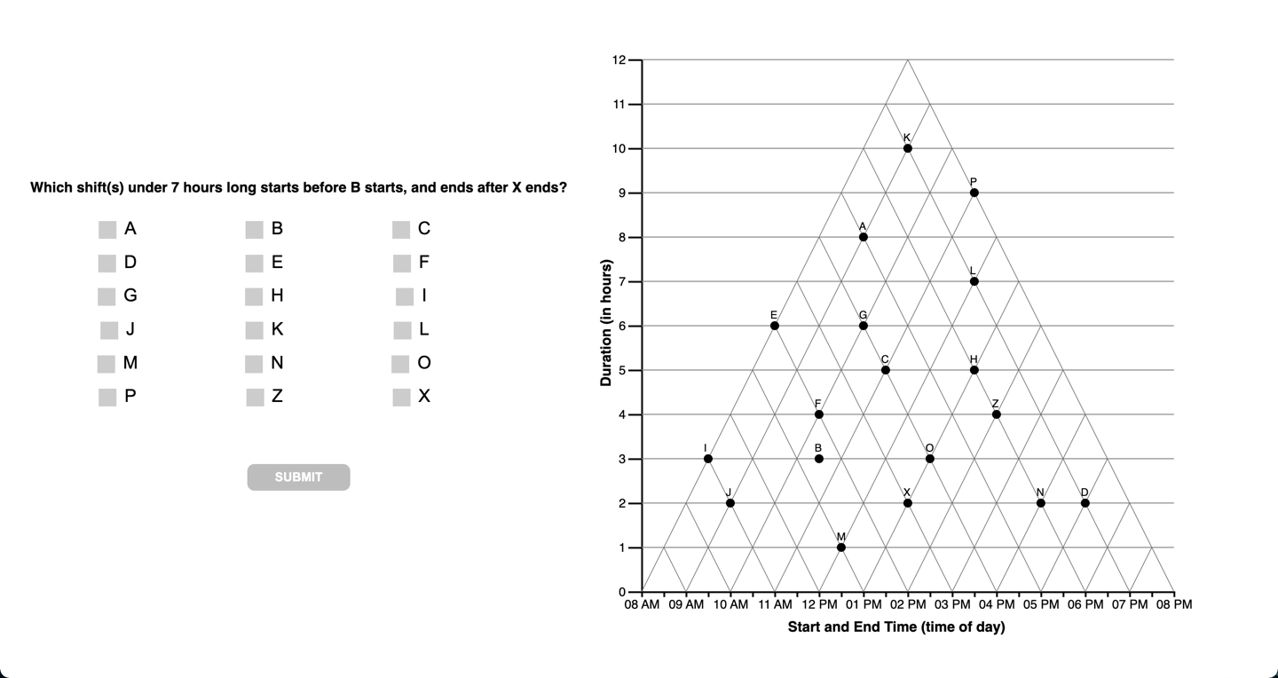

Slide 13
8
interpretations

Slide 15
9
question

Slide 16
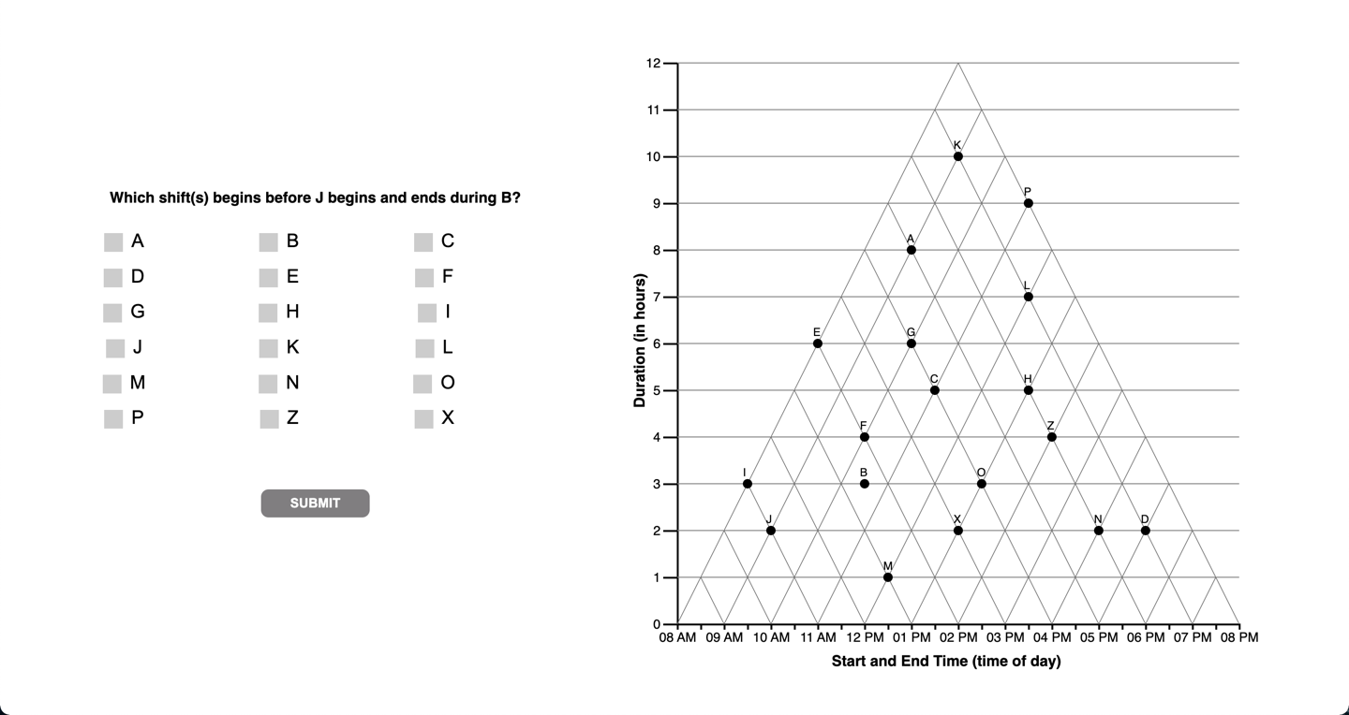

Slide 17
9
interpretations

Slide 18
[Question 9 is non discriminant]
The question does not yield different response patterns
Under different interpretations of the graph.

Slide 19
10
question

Slide 20


Slide 21
10
interpretations

Slide 23
11
question

Slide 24
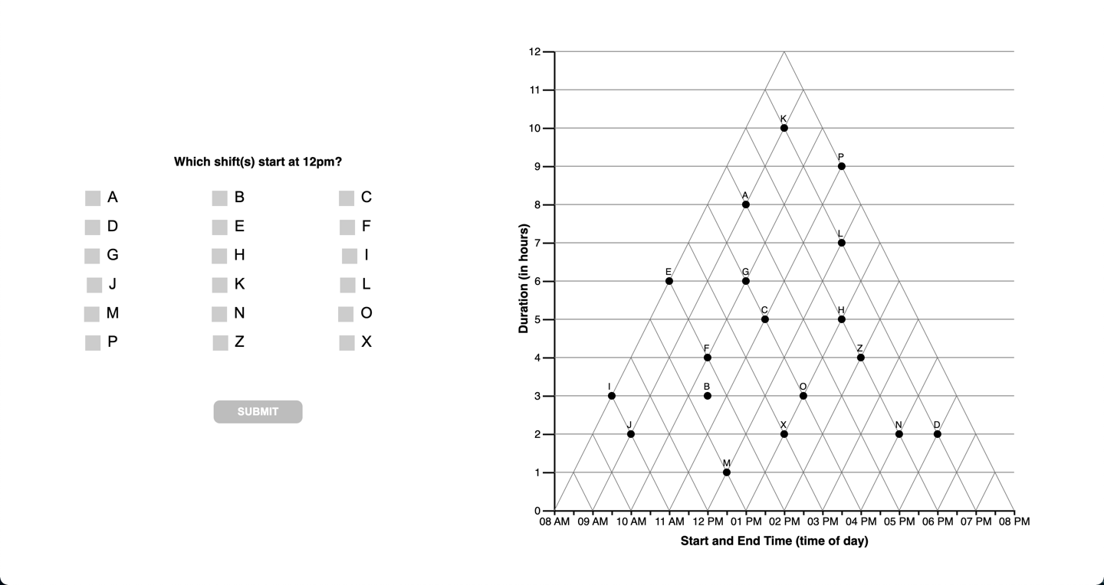

Slide 25
11
interpretations

Slide 27
12
question

Slide 28


Slide 29
12
question

Slide 31
13
question

Slide 32
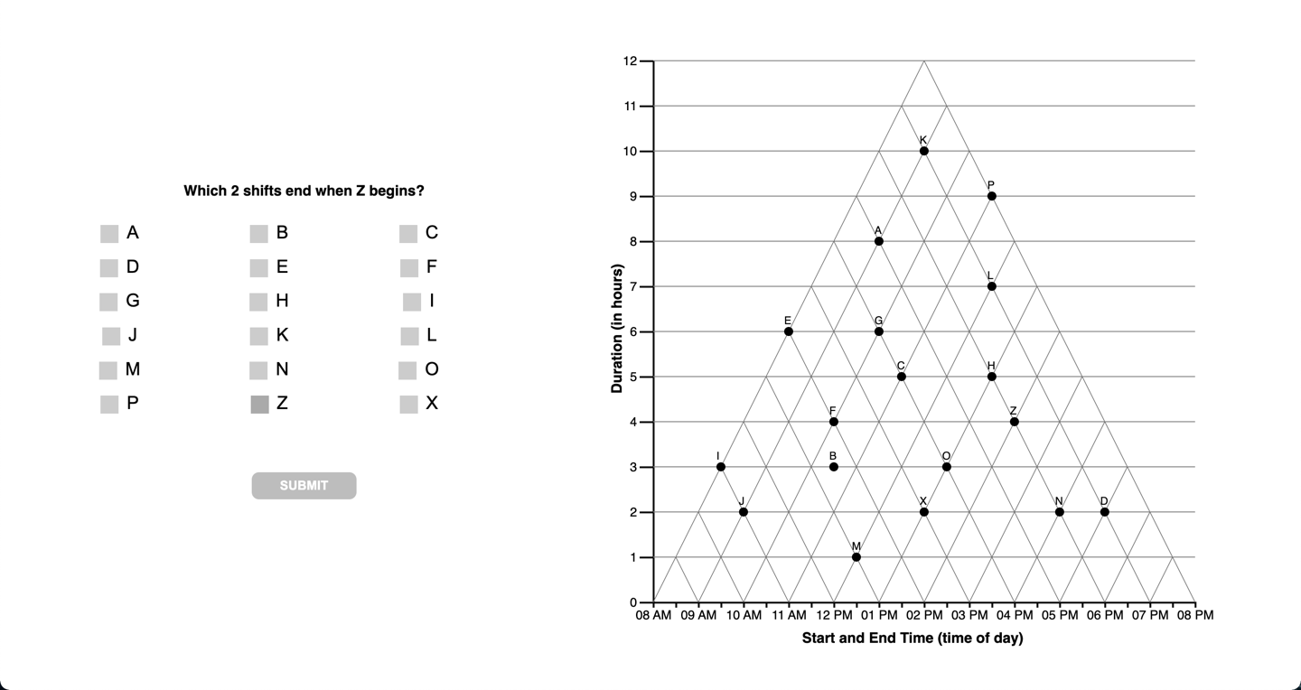

Slide 33
13
question

Slide 35
14
question

Slide 36
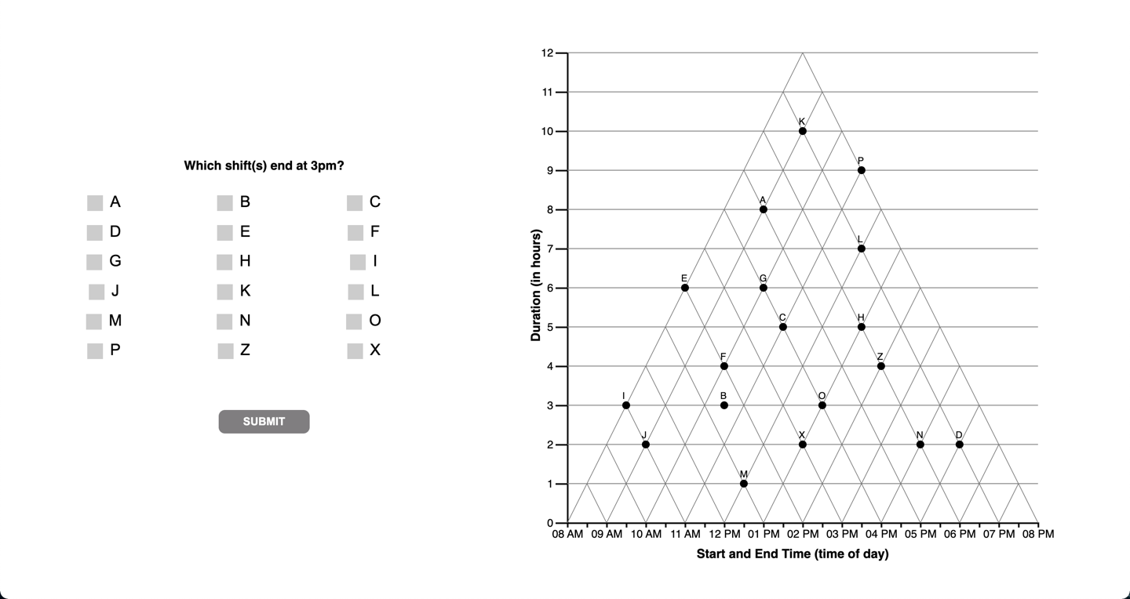

Slide 37
14
interpretations

Slide 39
15
question

Slide 40
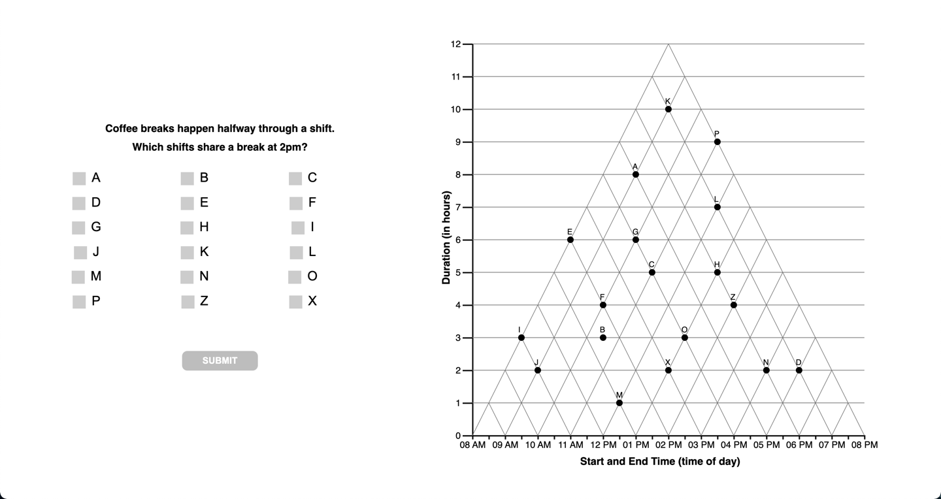

Slide 41
15
question

Slide 43
F
question

Slide 44
