Slide 1
Question 1

Slide 2
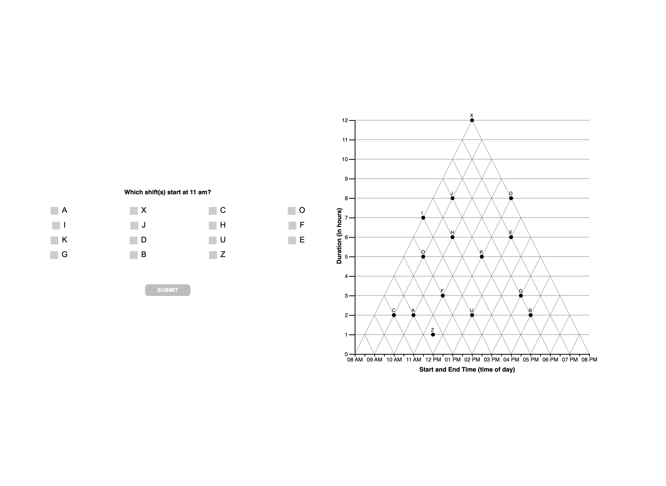

Slide 4
Question 2

Slide 5
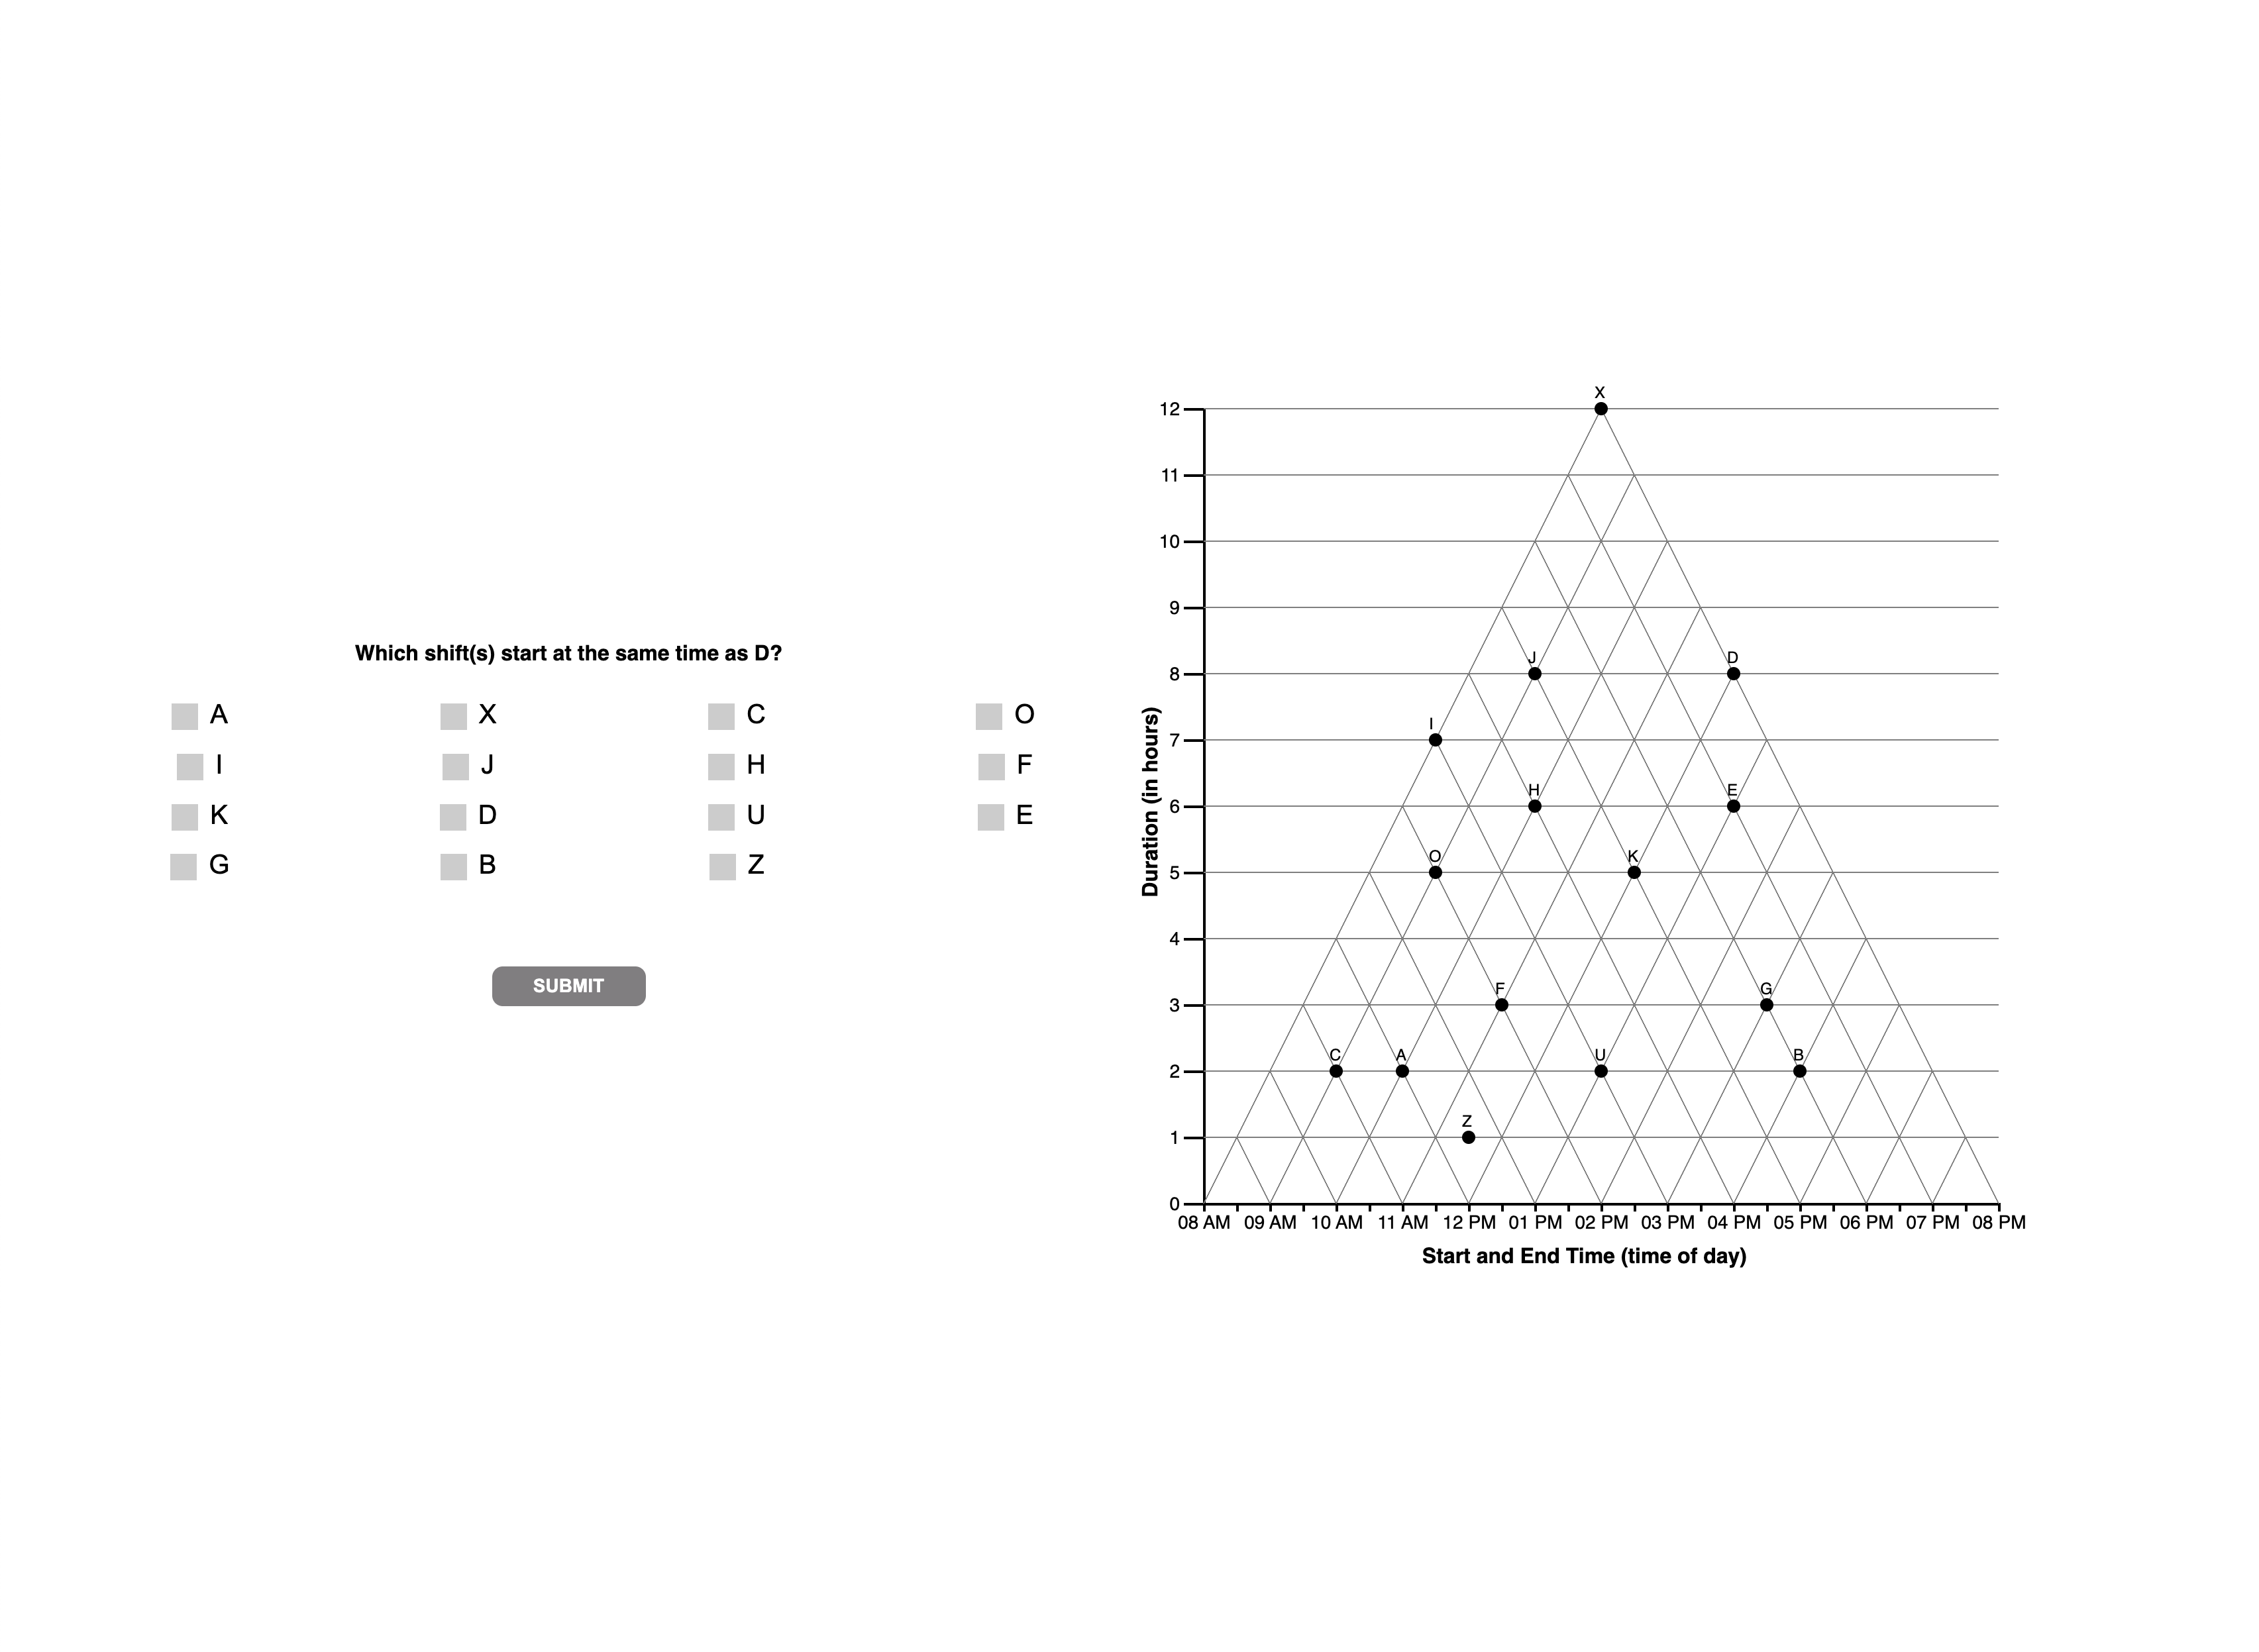

Slide 7
Question 3

Slide 8


Slide 10
Question 4

Slide 11


Slide 13
Question 5

Slide 14
