Slide 1
TEST PHASE Q6 – Q15

Slide 2
6
question

Slide 3
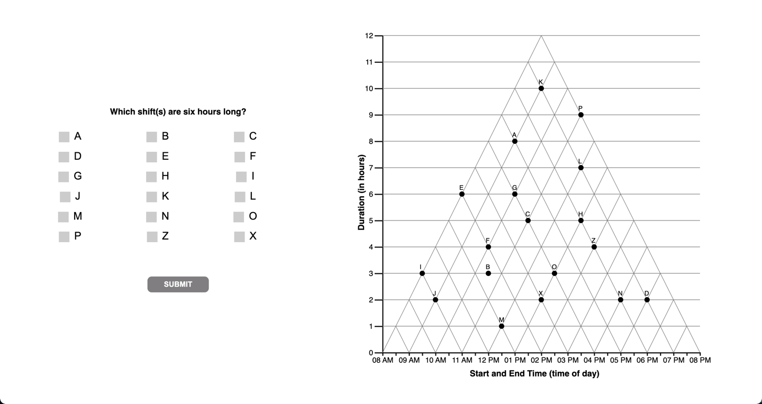

Slide 4
6
interpretations

Slide 5
[Question 6 is non discriminant]
The question does not yield different response patterns
Under different interpretations of the graph.

Slide 6
6
unknown

Slide 7
7
question

Slide 8
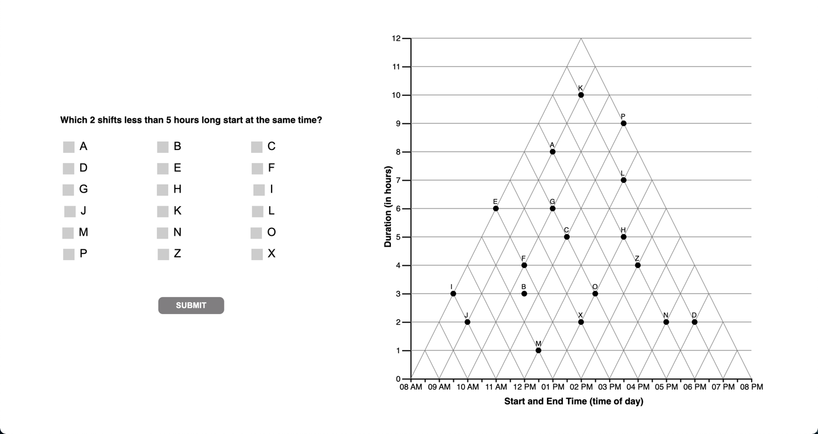

Slide 9
7
interpretations

Slide 11
8
question

Slide 12
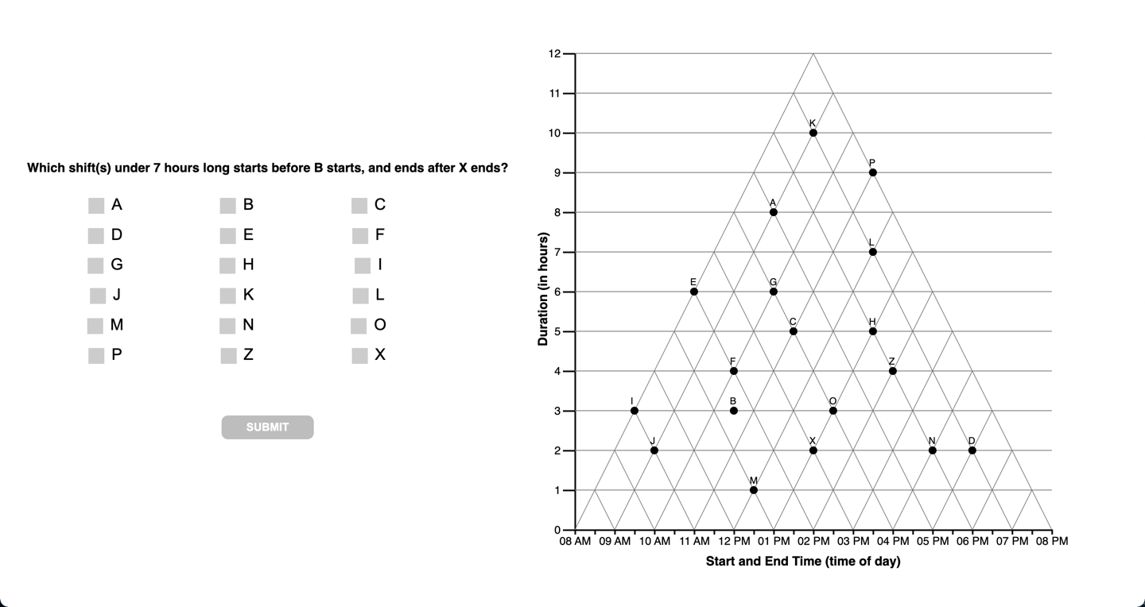

Slide 13
8
interpretations

Slide 15
IJ = 17. lazy? Distractor?
I = 7
…??

Slide 16
9
question

Slide 17
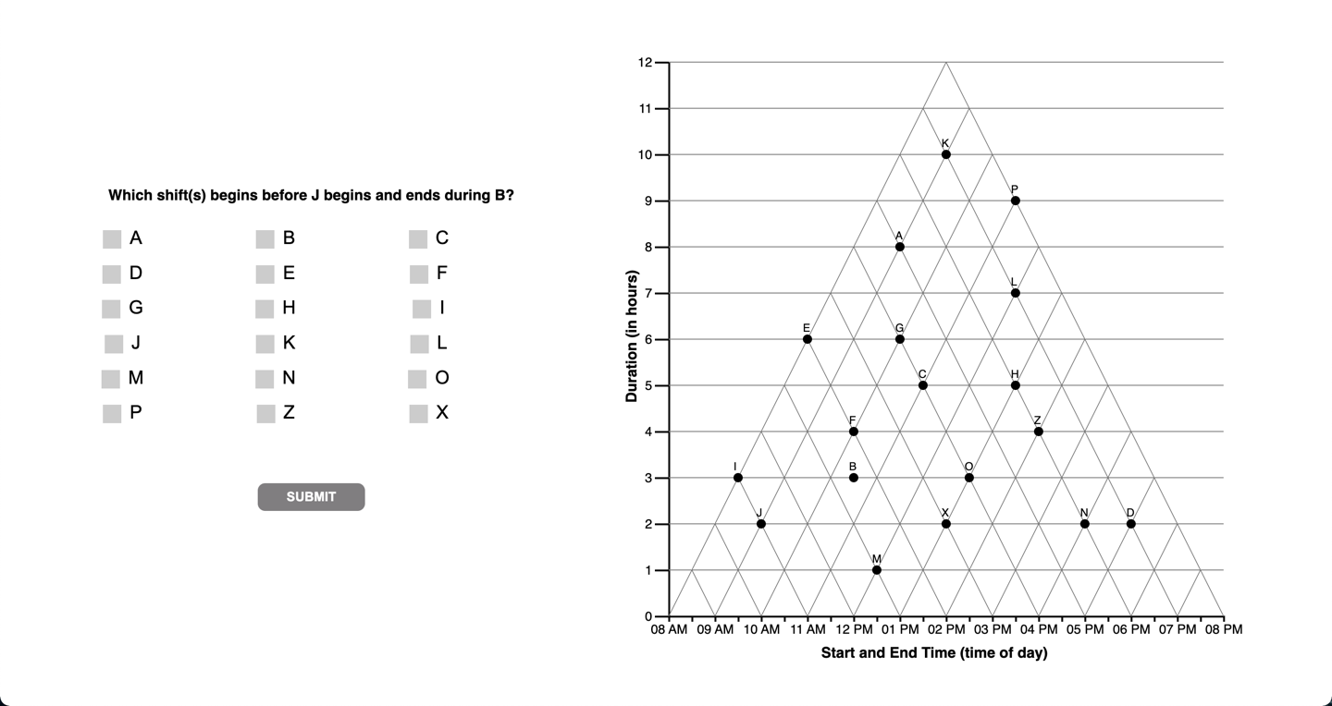

Slide 18
9
interpretations

Slide 19
[Question 9 is non discriminant]
The question does not yield different response patterns
Under different interpretations of the graph.

Slide 20
10
question

Slide 21


Slide 22
10
interpretations

Slide 24
B = 27
Open up satisficing to 1pt instead of 0.5 pts?

Slide 25
11
question

Slide 26
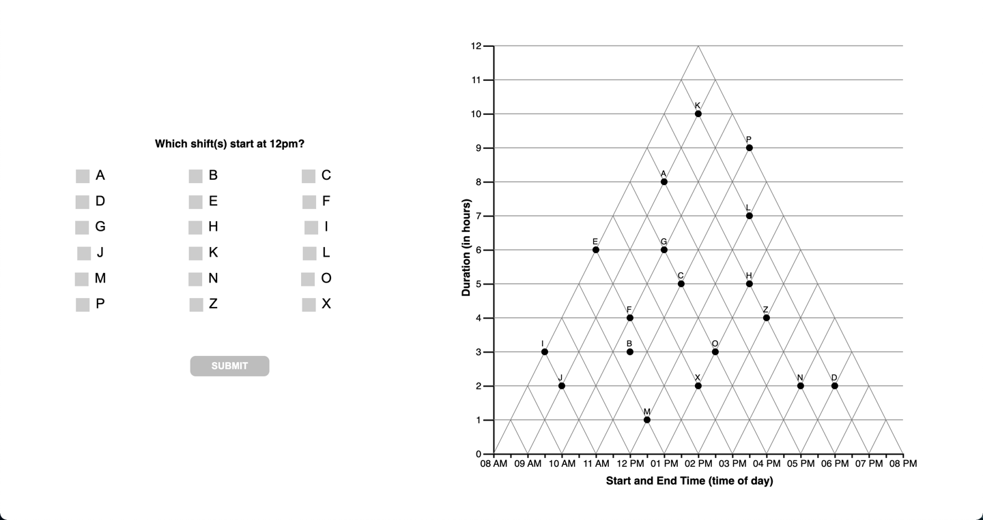

Slide 27
11
interpretations

Slide 29
12
question

Slide 30


Slide 31
12
question

Slide 33
13
question

Slide 34
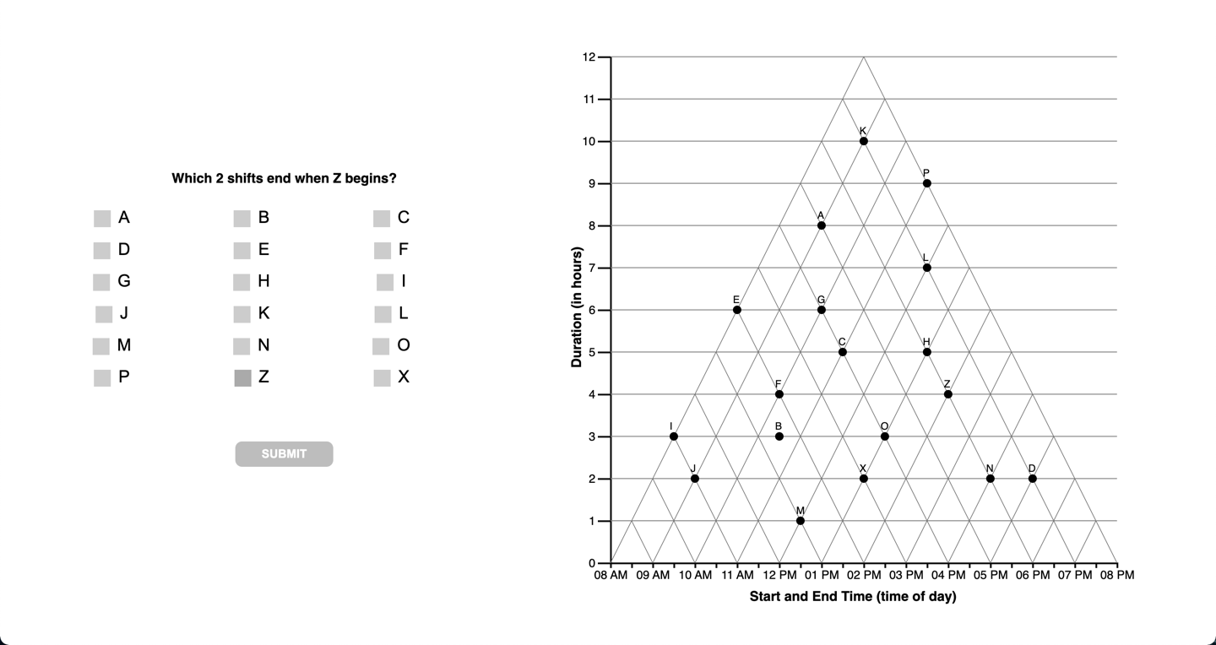

Slide 35
13
question

Slide 37
HN = 13, visual attractor
BF = 11,
F = 10… code as orthog
EX … visual attractor/wm error
FLAVORS OF ‘OTHER’ mistakes:
Within 1 hour offset from orthog
Conflating encoding near orthog (ie. PLH, above. ‘visual distractors’??
Visual “attractors” (vs) visual distractors [ie. Crossing something wrong on the way]

Slide 38
14
question

Slide 39
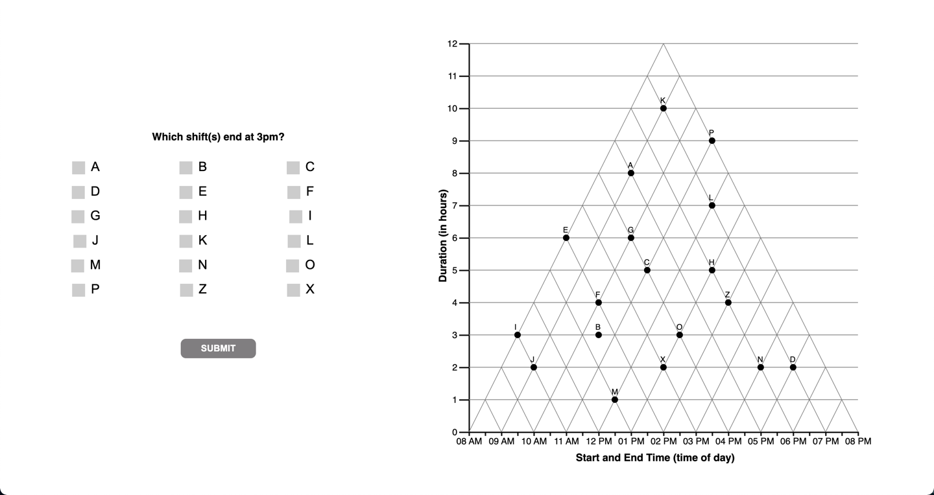

Slide 40
14
interpretations

Slide 42
15
question

Slide 43
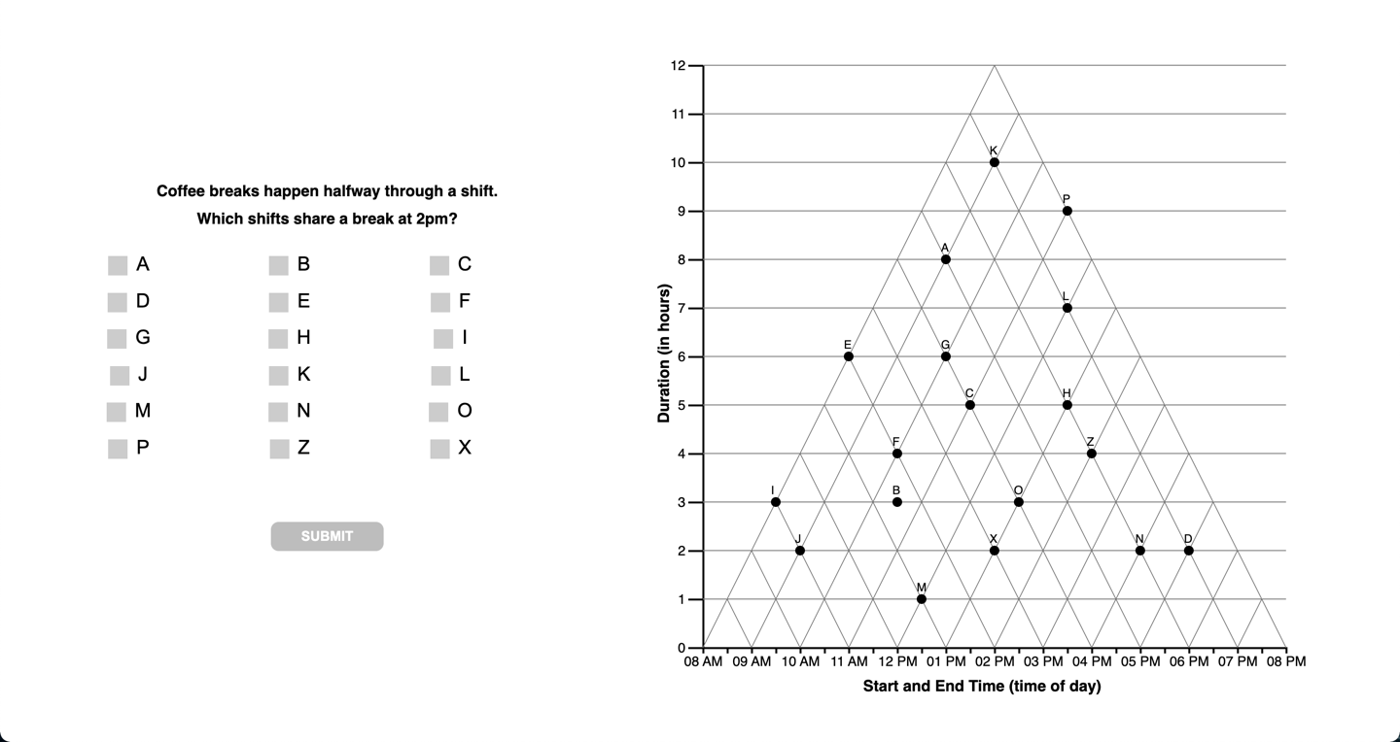

Slide 44
15
question

Slide 47
F
question

Slide 48
