Slide 1
CONTROL CONDITION

Slide 2
1
question

Slide 3
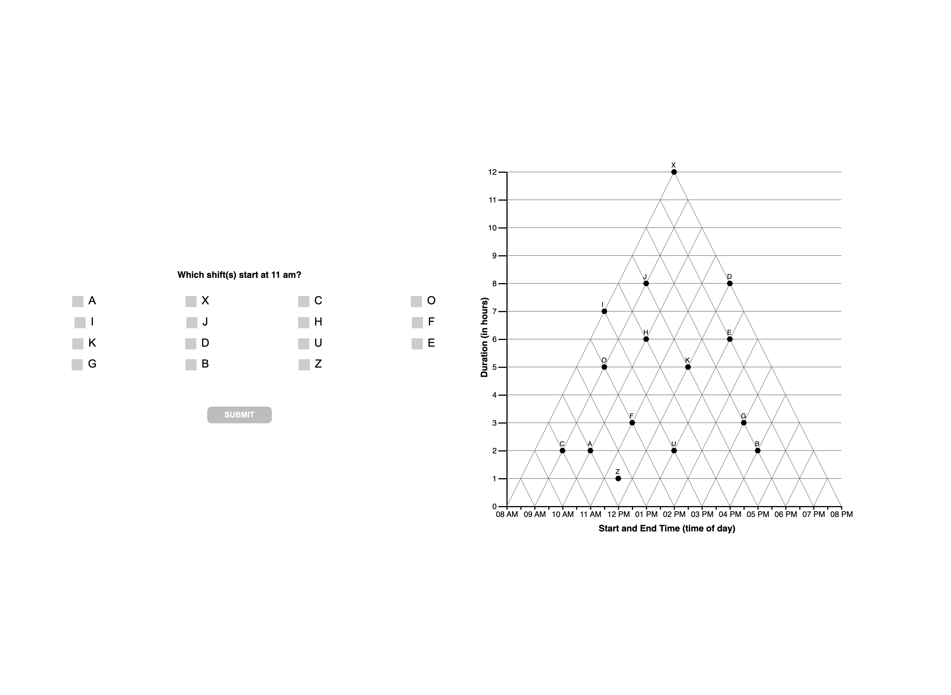

Slide 4
1 TRI

Slide 6
1 ORTH

Slide 8
1 ANG

Slide 10
1 ??

Slide 11
FIXED
Should be both… classified as unknown
DIJ
AF
Z
X

Slide 12
2
question

Slide 13
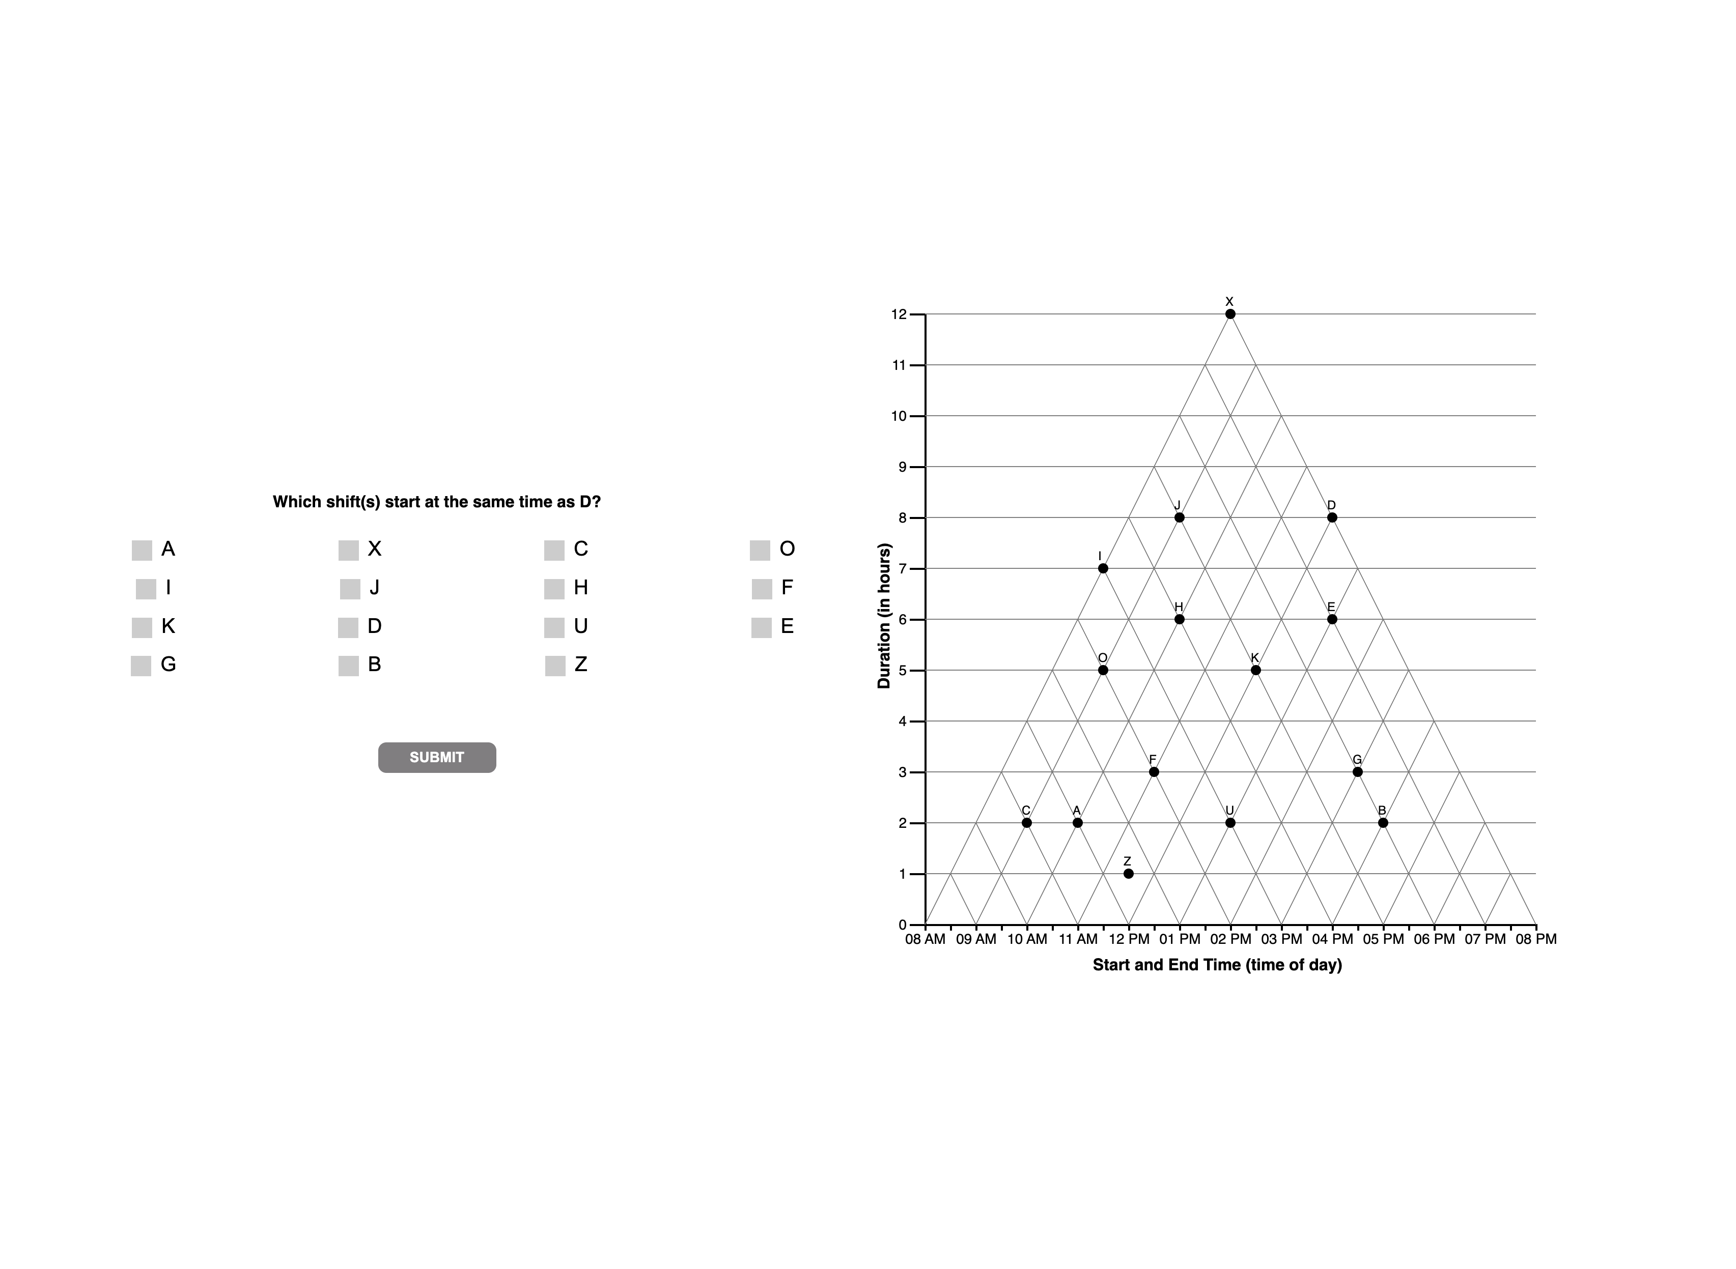

Slide 14
2 TRI

Slide 16
2 ORTH

Slide 18
2 ANG

Slide 19
REMOVE A FROM ANGULAR DEFN??

Slide 21
2 ??

Slide 23
3
question

Slide 24


Slide 25
3 TRI

Slide 27
EFK …
N=1
CODED as ‘tri’ (CORRECT)
BUT should be ‘other’/unknown?
DECISION
HARDCODE AS unknown

Slide 28
3 ORTH

Slide 30
3 ANG

Slide 32
These two should be
Unknown?? Instead of Tverky
HARDCODE AS TVERSKY
Should be Tversky??
DISTRACTOR?
N = 18
Classified as ?? Rather than
TVERSKY bc it doesn’t include U and B

Slide 33
3 ??

Slide 39
4
question

Slide 40


Slide 41
4 TRI

Slide 44
4 ORTH

Slide 45
U
FU

Slide 46
4 ??

Slide 47
DE, E
Classifies as OTHER
DEU
Classifies as ORTH
Recode as OTHER
KU
Classifies as ORTH
RECODE as OTHER
DEOU
Classifies as ORTH
RECODE as OTHER

Slide 48
4
unknown

Slide 50
D, DE, E | N = 14 + 6 + 1
Reclassify as satisficing!
0 | N = 2
Reclassify as satisficing!

Slide 51
5
question

Slide 52
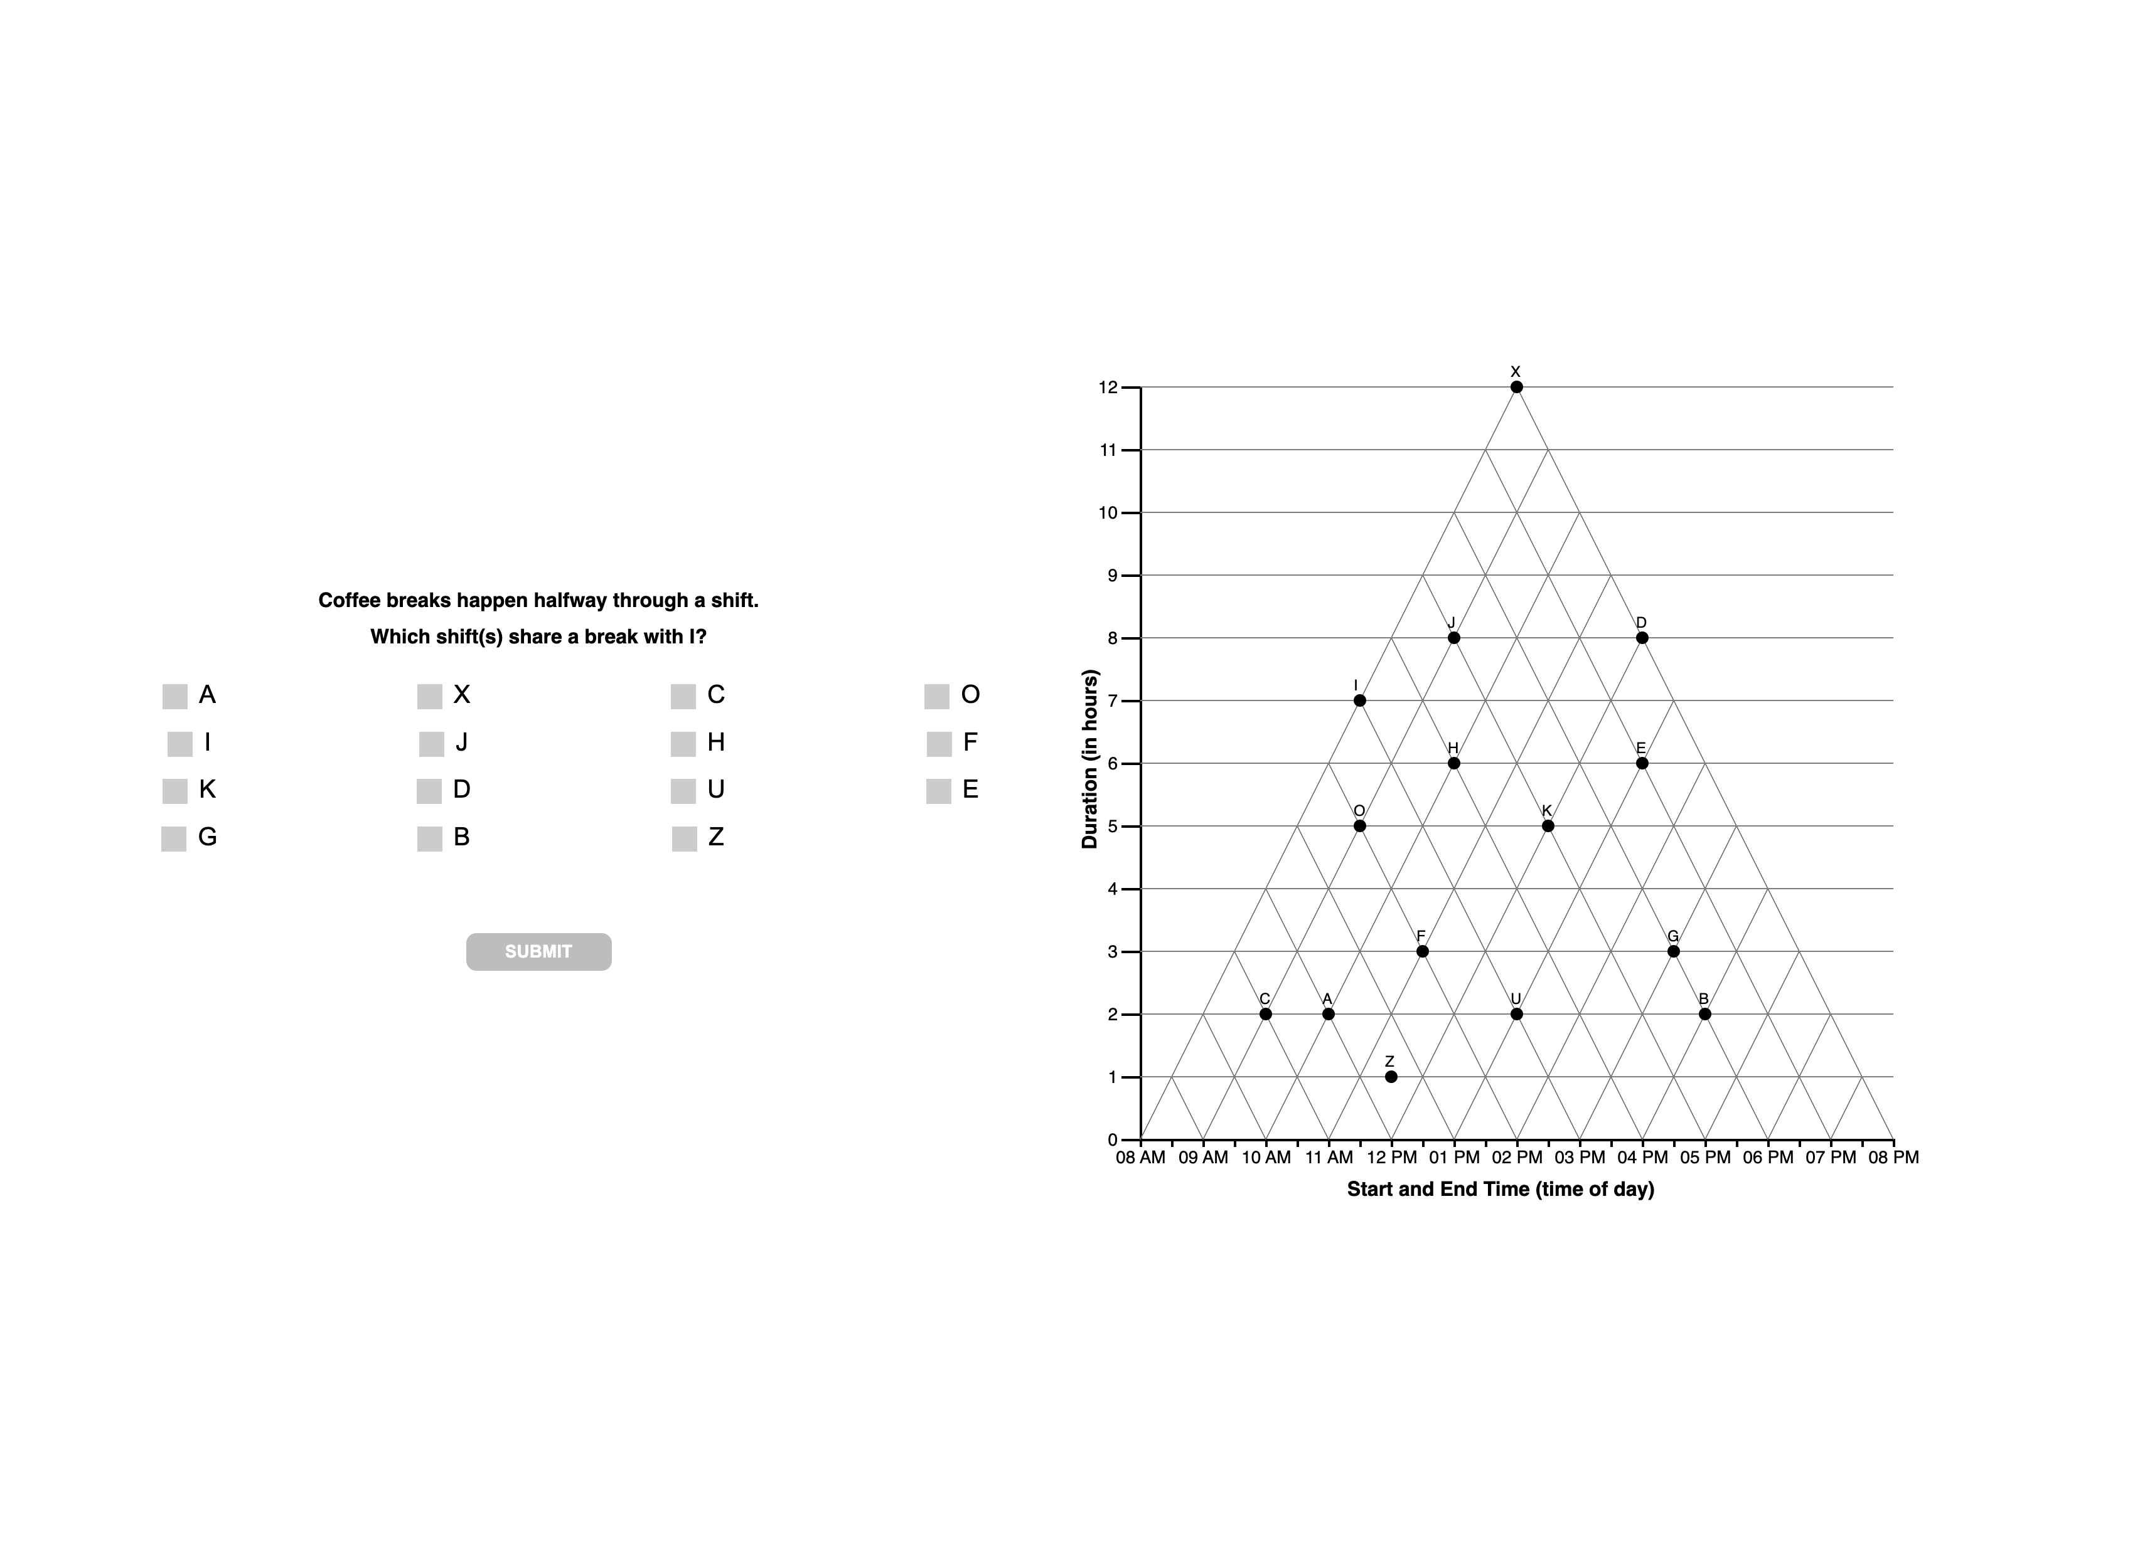

Slide 53
5 TRI

Slide 56
5 ORTH

Slide 58
5 ang

Slide 60
5 ??

Slide 61
F
Classifies as OTHER likely attempt at orthog
LEAVE AS OTHER

Slide 62
5
interpretations

Slide 65
5
unknown

Slide 67
F | N = 10… classify as VE?/satisfice?
H = 3 … classify as VE?
JH good example of wm overload?

