Slide 1
TEST PHASE Q6 – Q15

Slide 2
6
question

Slide 3
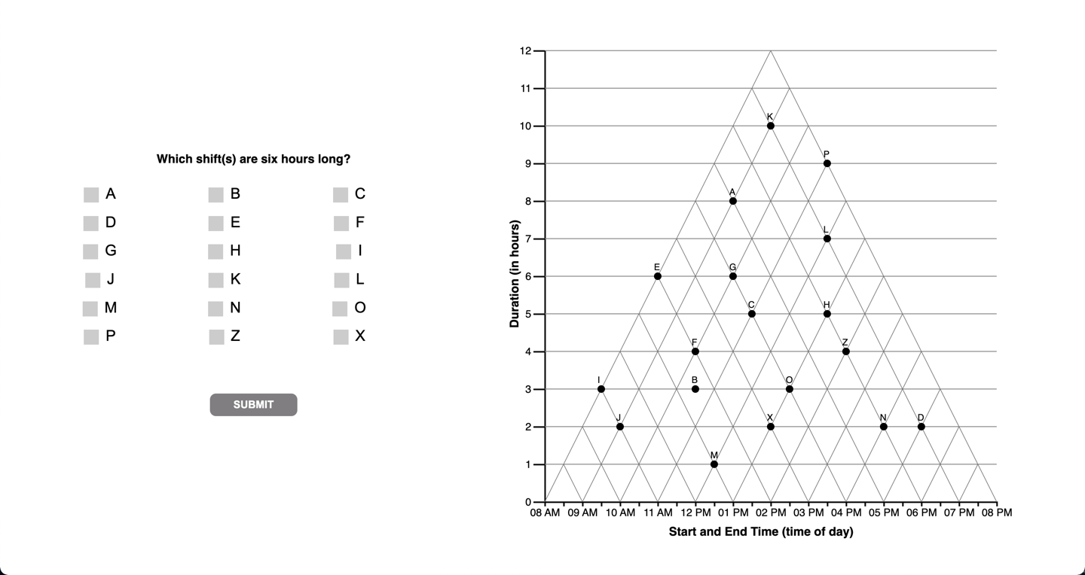

Slide 4
6
interpretations

Slide 5
[Question 6 is non discriminant]
The question does not yield different response patterns
Under different interpretations of the graph.

Slide 6
6
unknown

Slide 7
7
question

Slide 8
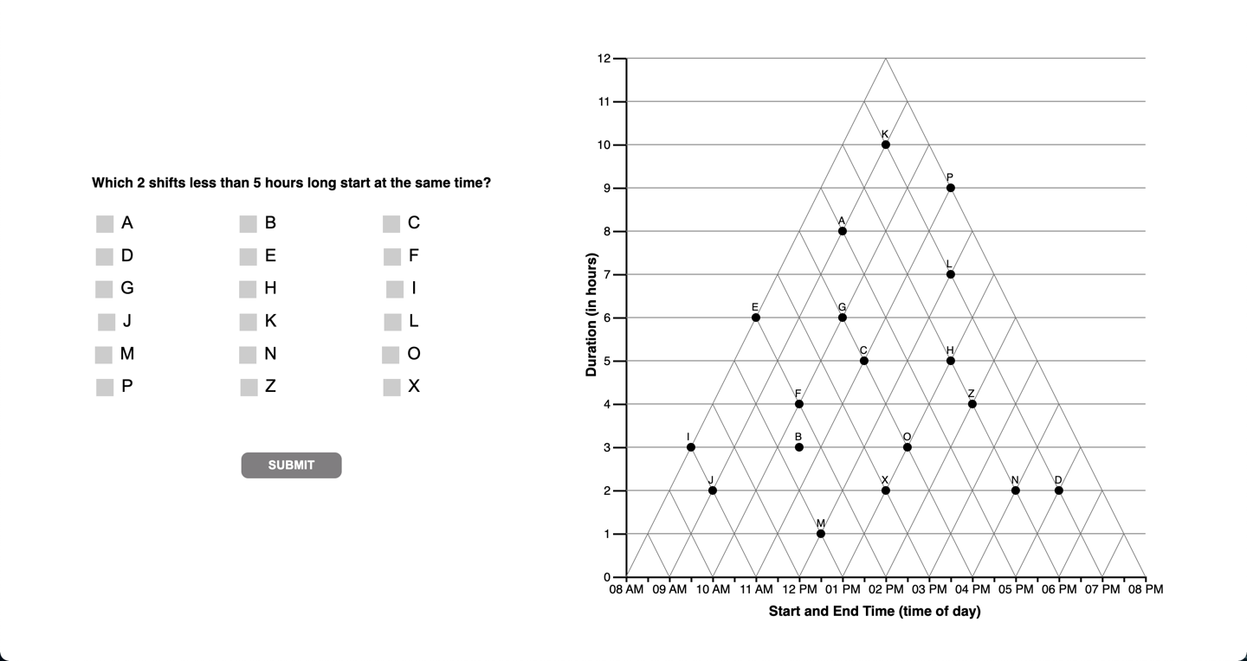

Slide 9
7
interpretations

Slide 10
TRI

Slide 13
ORTH

Slide 15
FZ
Coded as ORTH
Consistent with ‘angular’

Slide 16
ANGULAR

Slide 19
???

Slide 21
8
question

Slide 22
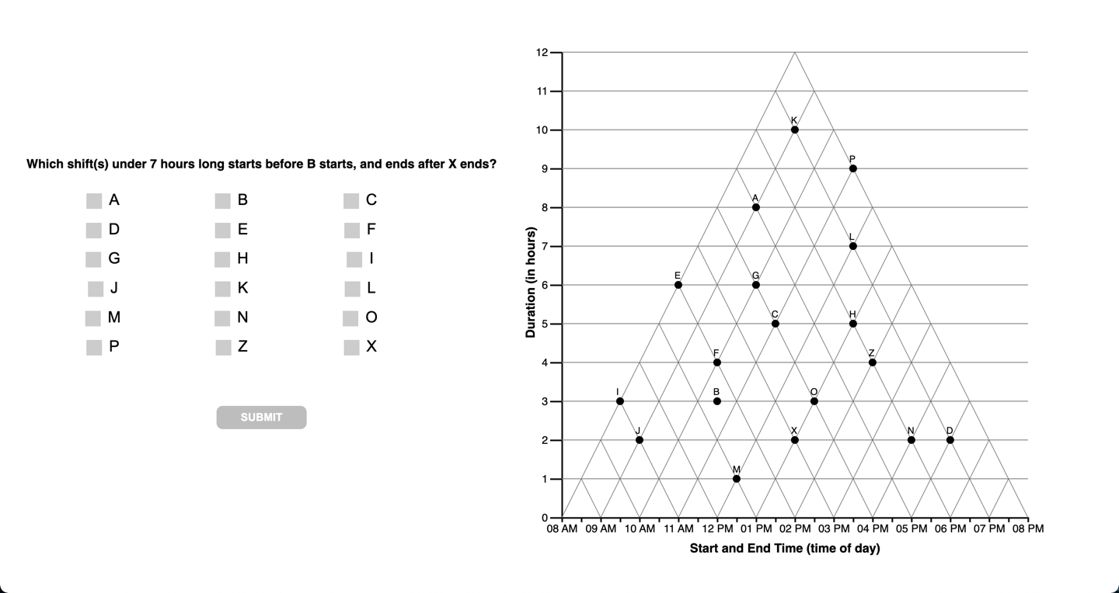

Slide 23
TRI

Slide 25
AGK
Coded as ORTH
Consistent with ‘angular’??

Slide 27
ORTH

Slide 30
ANGULAR

Slide 31
???

Slide 33
9
question

Slide 34
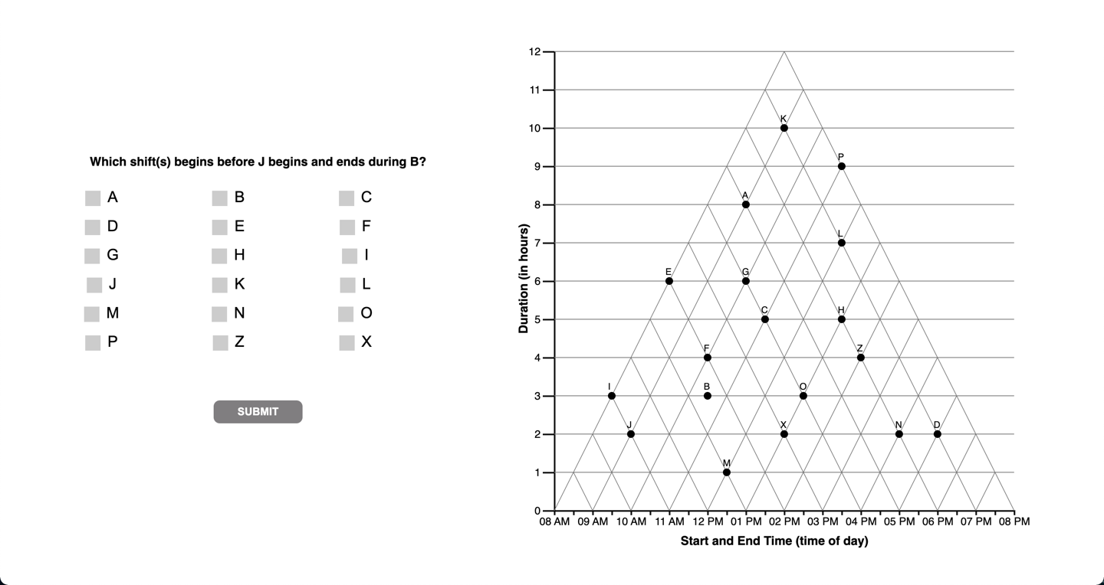

Slide 35
9
interpretations

Slide 36
[Question 9 is non discriminant]
The question does not yield different response patterns
Under different interpretations of the graph.

Slide 37
10
question

Slide 38


Slide 39
10
interpretations

Slide 41
B = 27
Open up satisficing to 1pt instead of 0.5 pts?

Slide 42
11
question

Slide 43
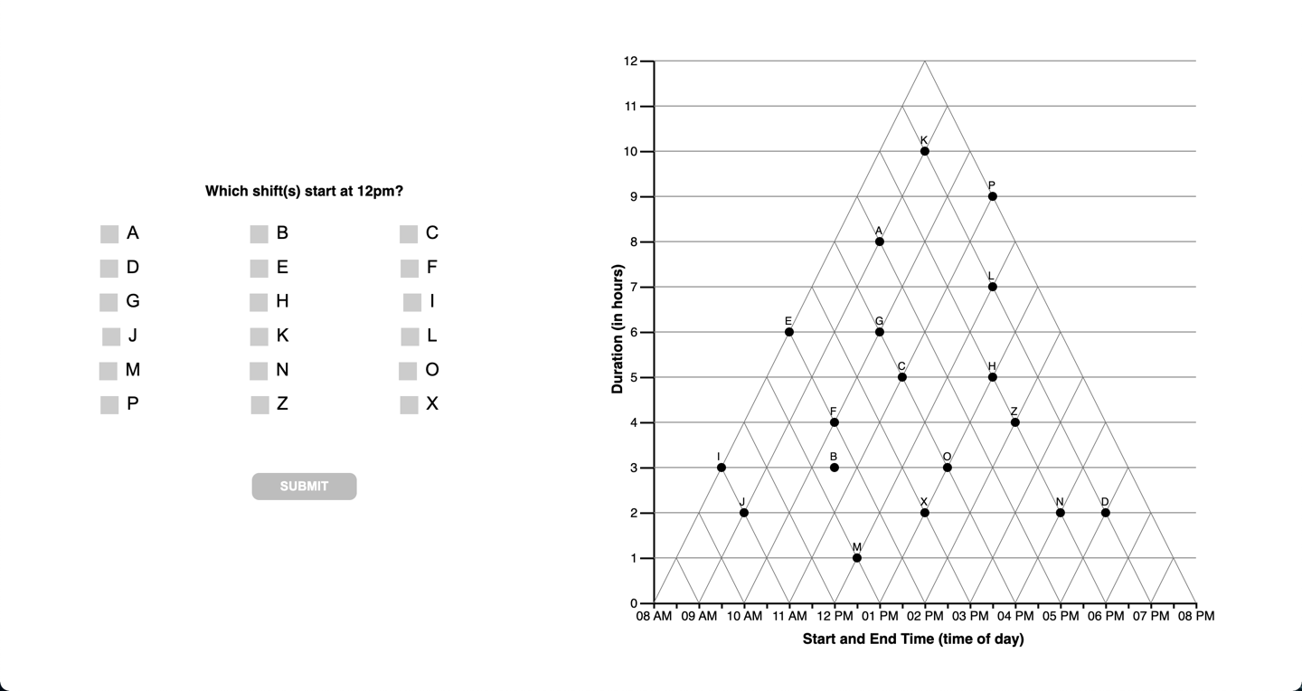

Slide 44
11
interpretations

Slide 46
12
question

Slide 47


Slide 48
12
question

Slide 50
13
question

Slide 51
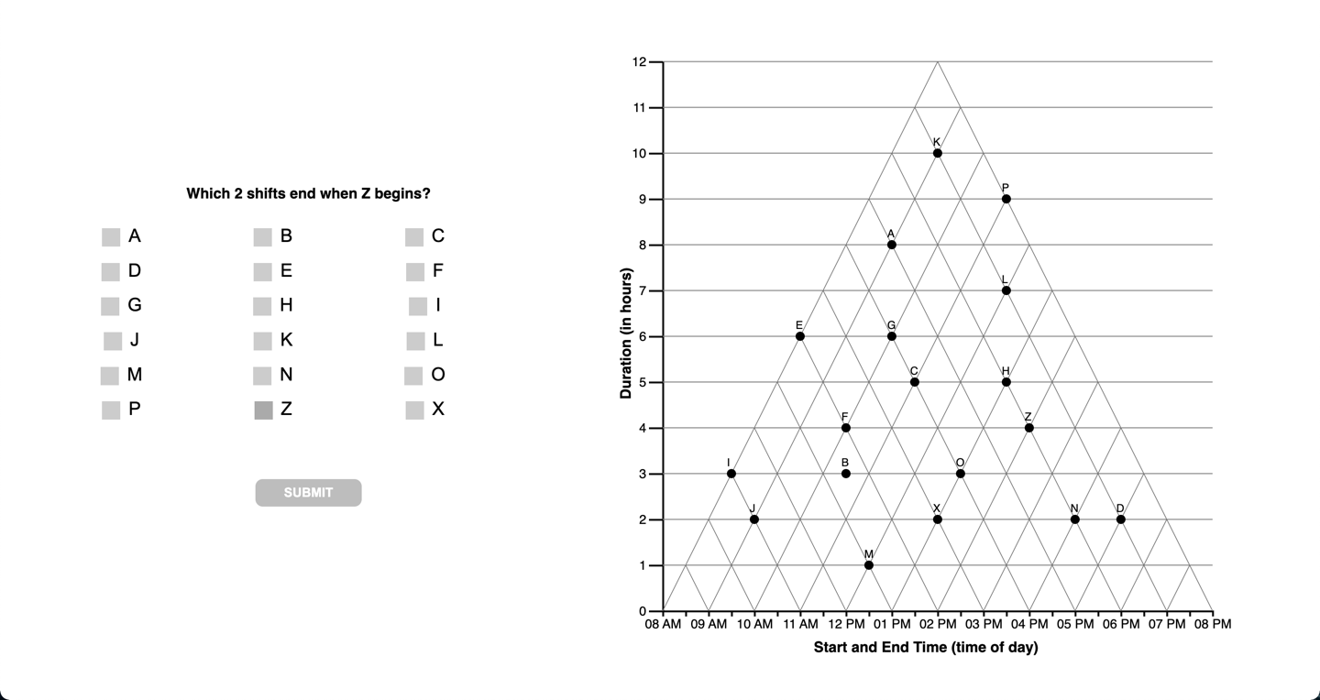

Slide 52
13
question

Slide 54
HN = 13, visual attractor
BF = 11,
F = 10… code as orthog
EX … visual attractor/wm error
FLAVORS OF ‘OTHER’ mistakes:
Within 1 hour offset from orthog
Conflating encoding near orthog (ie. PLH, above. ‘visual distractors’??
Visual “attractors” (vs) visual distractors [ie. Crossing something wrong on the way]

Slide 55
14
question

Slide 56
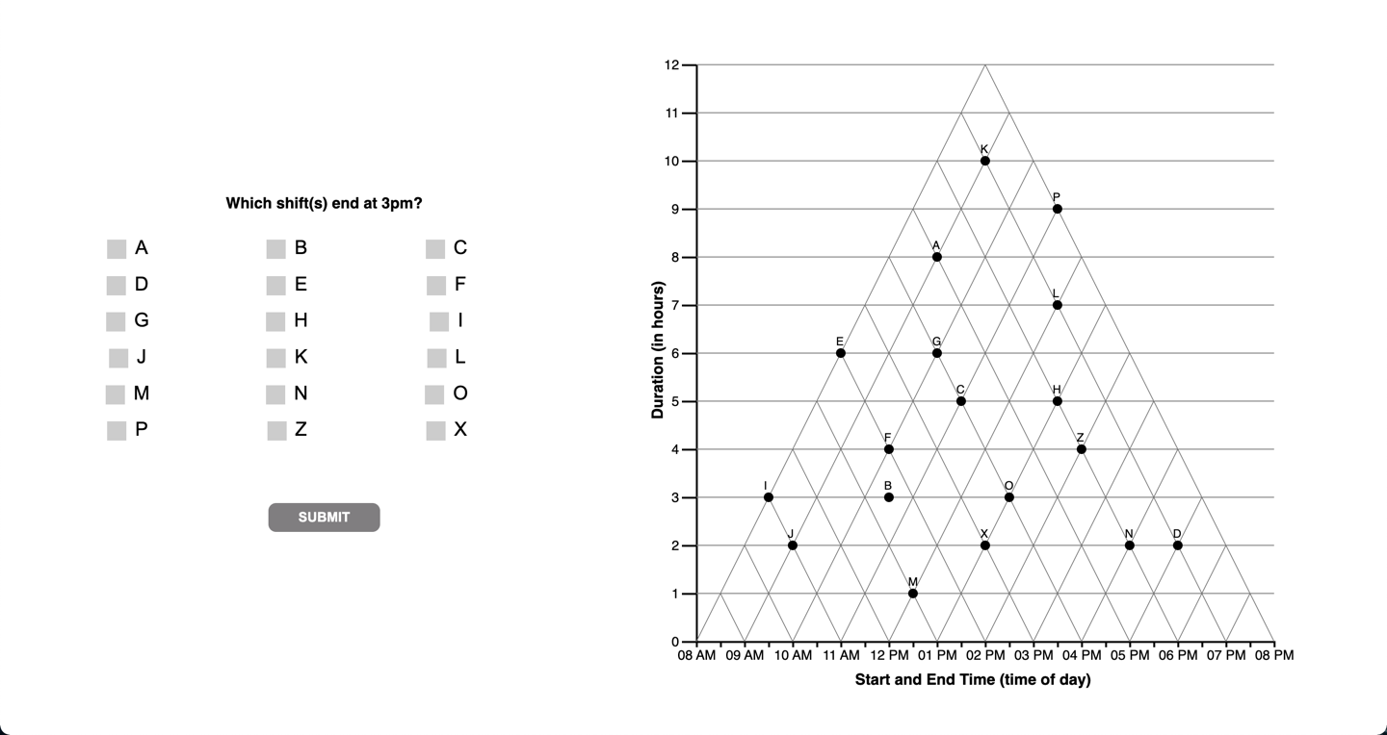

Slide 57
14
interpretations

Slide 59
15
question

Slide 60
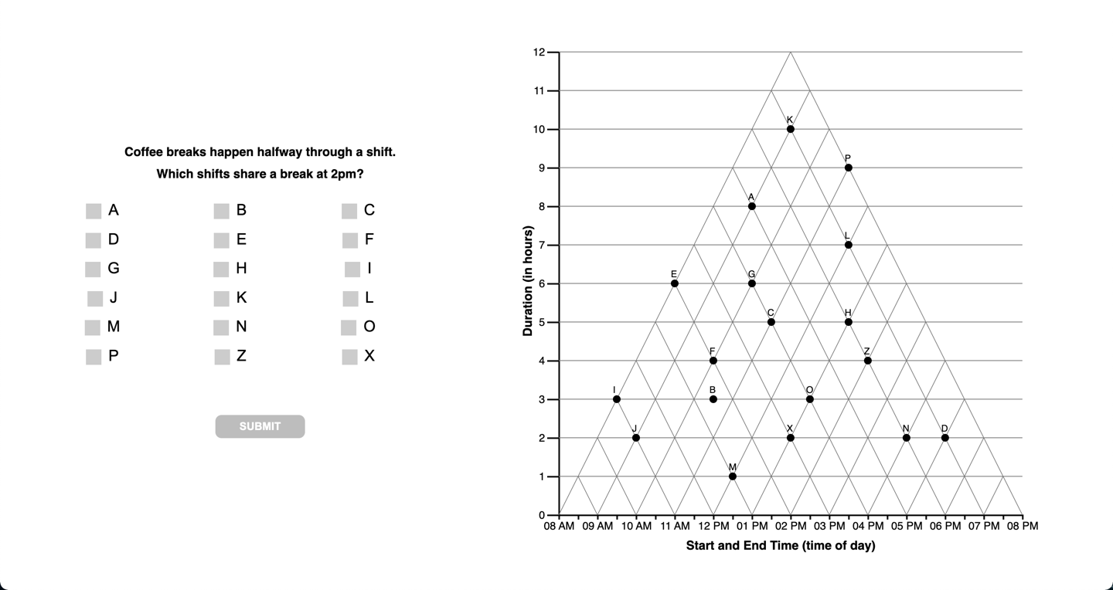

Slide 61
15
question

Slide 64
F
question

Slide 65
