Slide 1
IMPASSE CONDITION

Slide 2
1
question

Slide 3
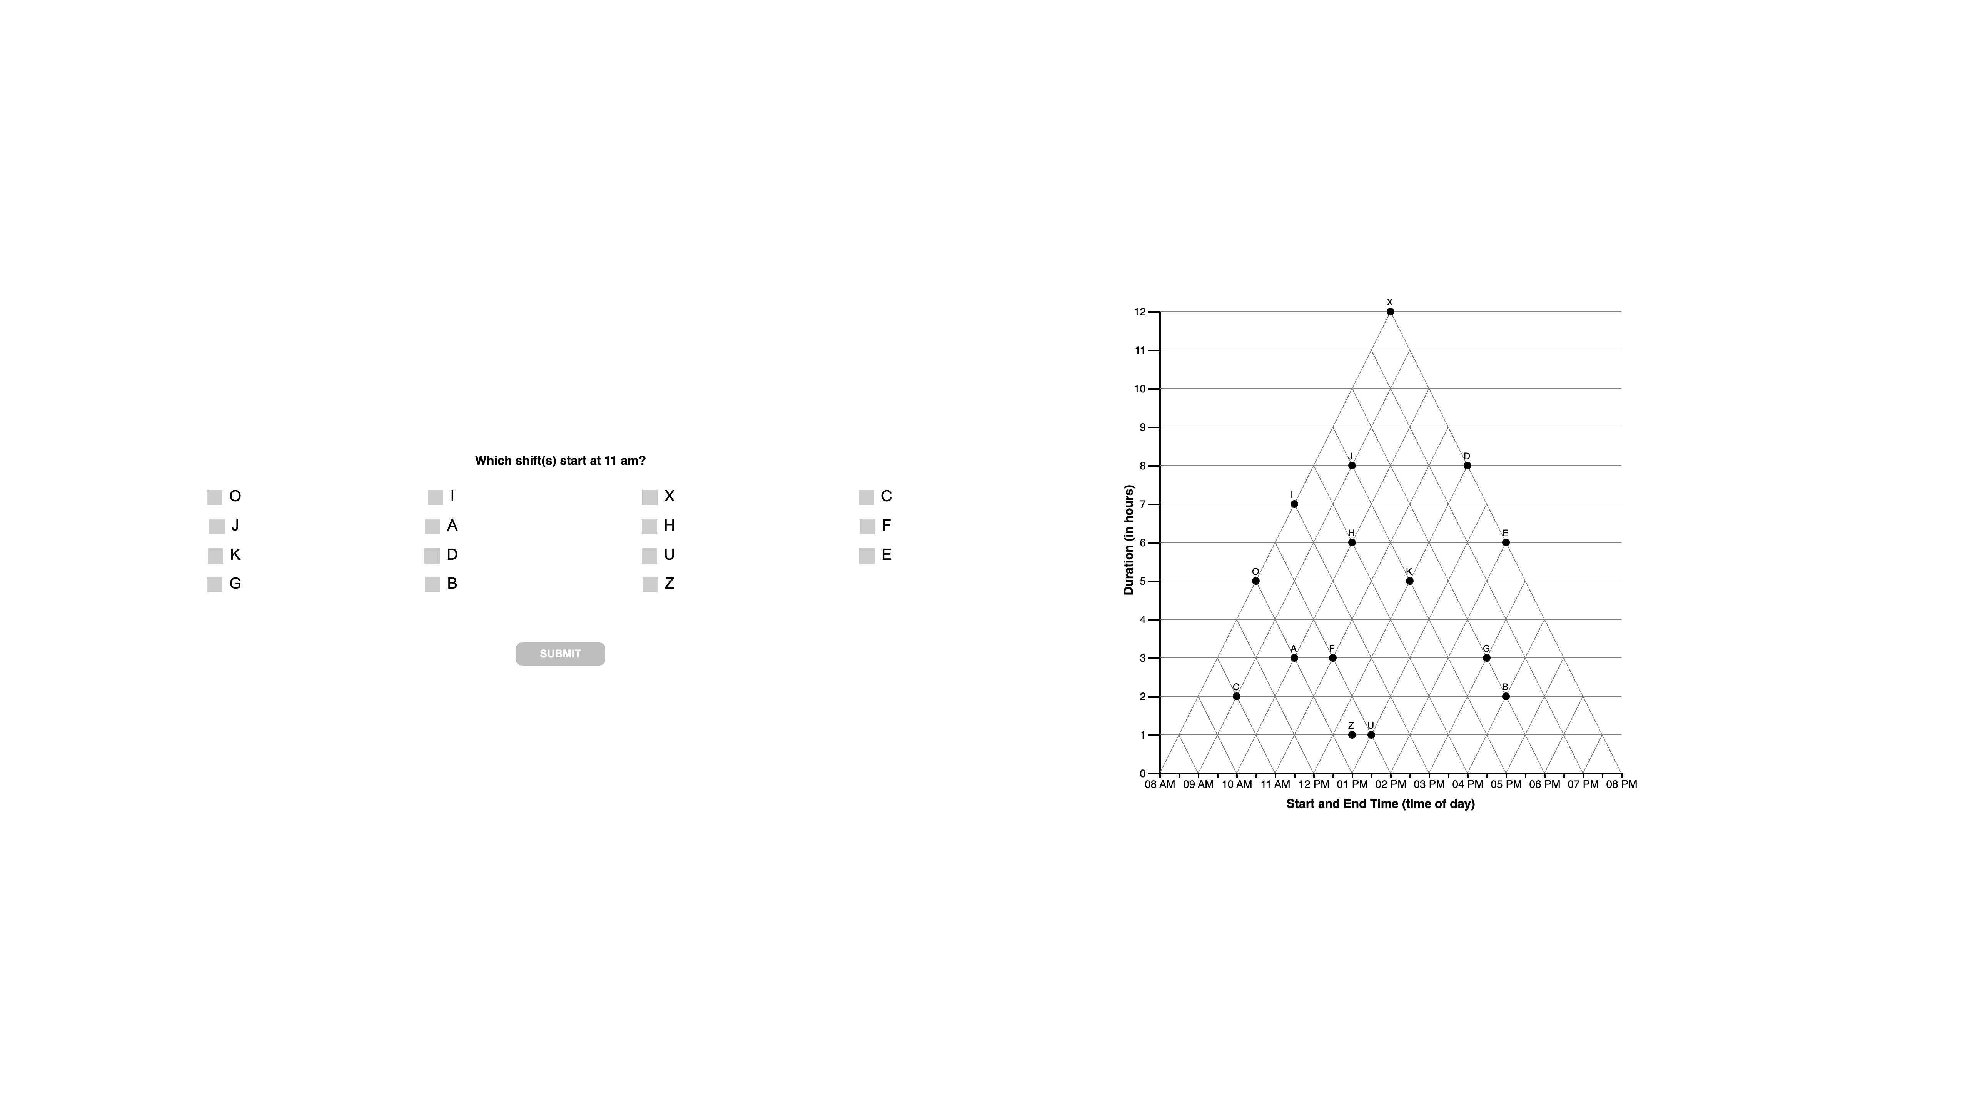

Slide 4
1 TRI

Slide 6
1 ORTH

Slide 8
1 SATIS

Slide 10
1 ANG

Slide 12
1 ??

Slide 14
2
question

Slide 15
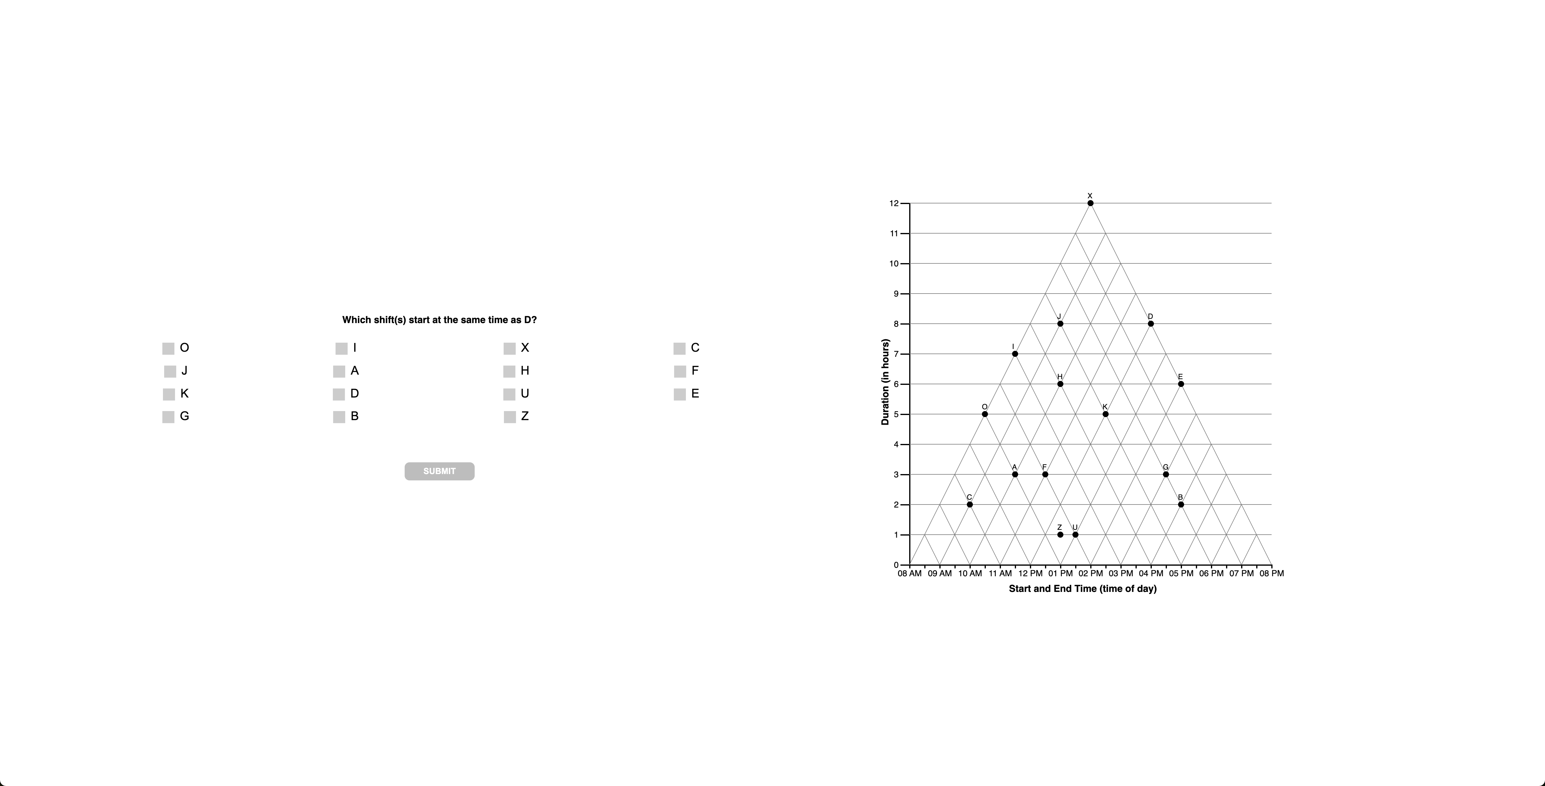

Slide 16
2 TRI

Slide 18
2 ORTH

Slide 20
2 SATIS

Slide 22
1 ANG

Slide 24
2 ??

Slide 25
???? C , n = 6????
BEG … should be ‘other,’
Coded as angular
But n=1, so probably OK

Slide 26
3
question

Slide 27


Slide 28
3 TRI

Slide 30
3 ORTH

Slide 32
3 ang

Slide 34
3 ??

Slide 35
DERVIES as ‘triangular’
HARDCODE AS UNKNOWN

Slide 36
“AH”
Derives as SATISFICE
Hardcode as angular
“AO” “AOU”
Derives as SATISFICE
Hardcode as angular

Slide 37
“O”
Derives as unknown
“AFI” Derives as SATISFICE
“DK”
Derives as unknown
“AIO”, AI
Derives as SATISFICE

Slide 39
4
question

Slide 40
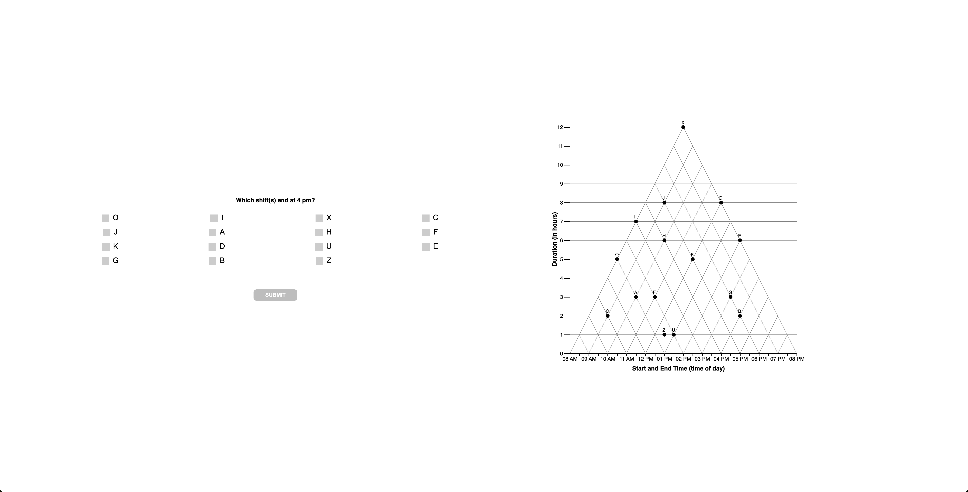

Slide 41
4 TRI

Slide 43
4 ANG

Slide 44
“BD”
Derives as TVERSKY
RECODE as OTHER
“BDEG”
Derives as TVERSKY
RECODE as OTHER

Slide 45
4 satis

Slide 46
“AFG” derives as SATISFICE RECODE as OTHER
“OF”, F, O
Derives as SATISFICE

Slide 47
4 ??

Slide 48
“D” Derives as OTHER
“A” Derives as OTHER
“K” Derives as OTHER

Slide 49
4
interpretations

Slide 51
4
unknown

Slide 52
5
question

Slide 53
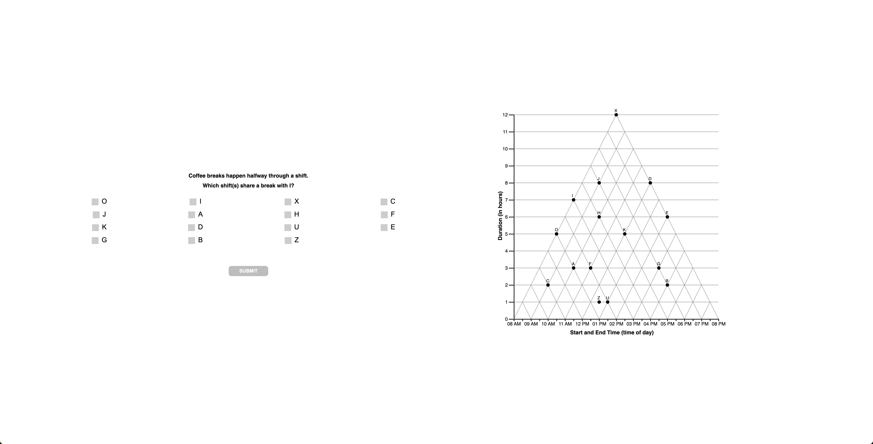

Slide 54
5 TRI

Slide 56
“AFG”, AF
derives as TRI RECODE as angular

Slide 57
5 SATIS

Slide 59
5 ??

Slide 61
5
unknown

