Slide 1
CONTROL CONDITION

Slide 2
Question 1

Slide 3
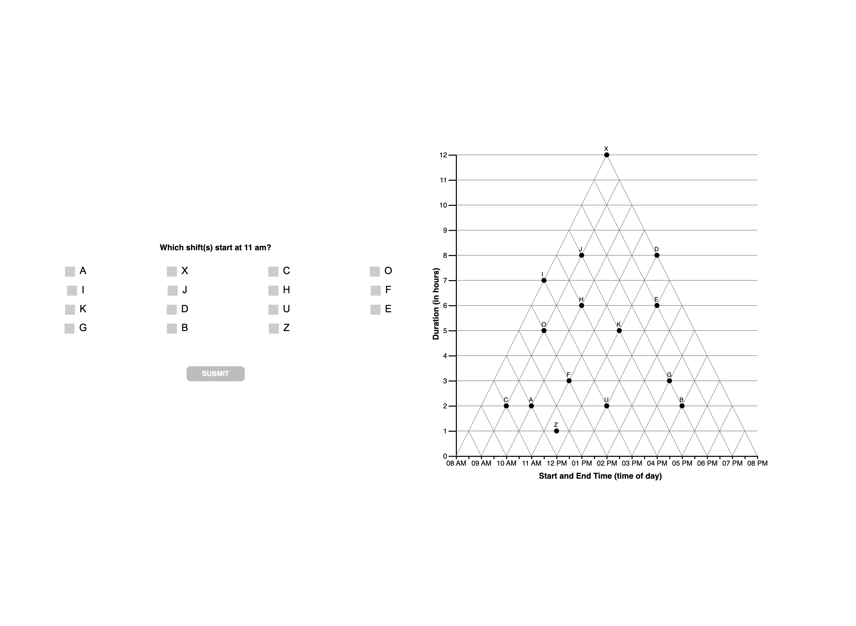

Slide 5
Question 2

Slide 6
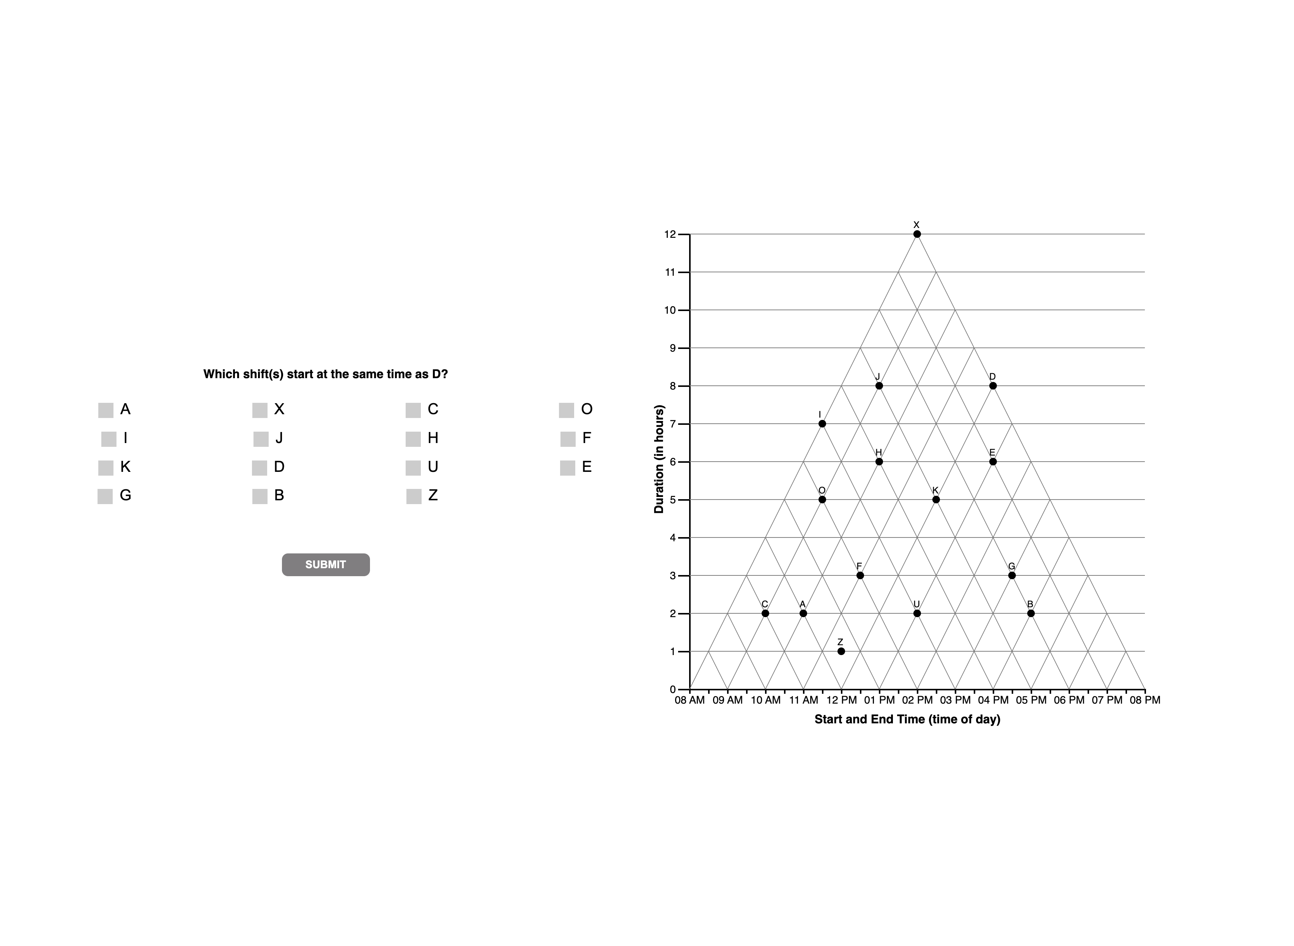

Slide 8
Question 3

Slide 9


Slide 11
Question 4

Slide 12


Slide 14
Question 5

Slide 15
