Slide 1
CONTROL CONDITION

Slide 2
1

Slide 3
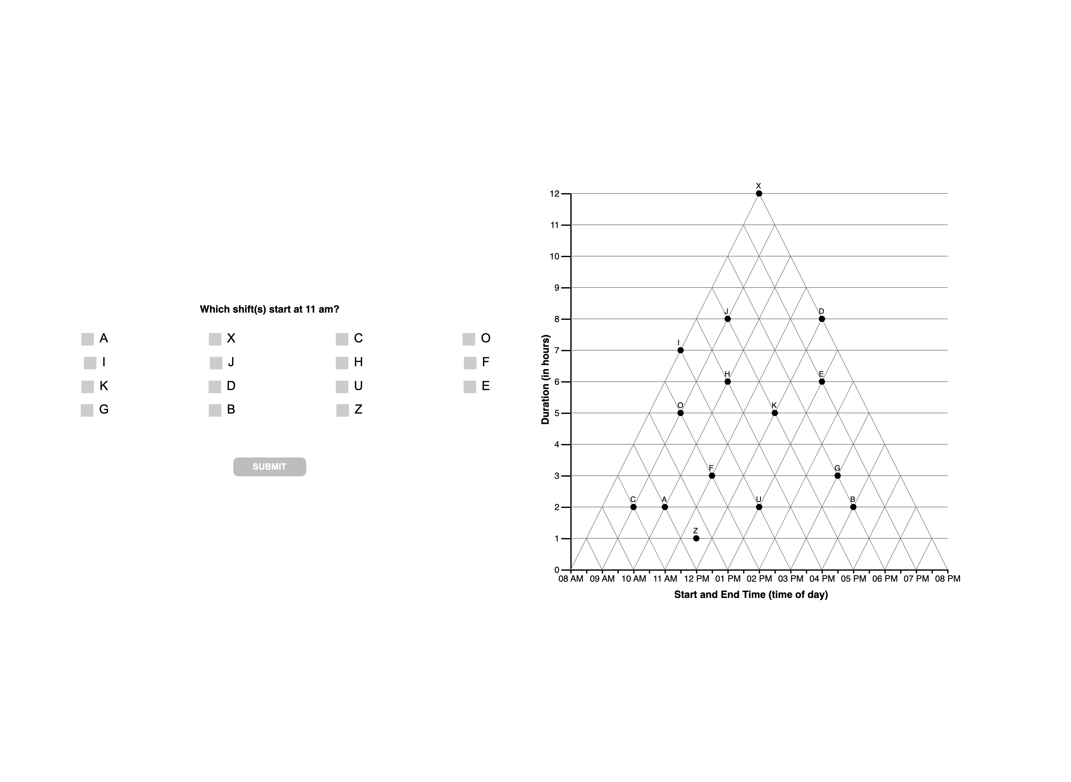

Slide 6
2

Slide 7
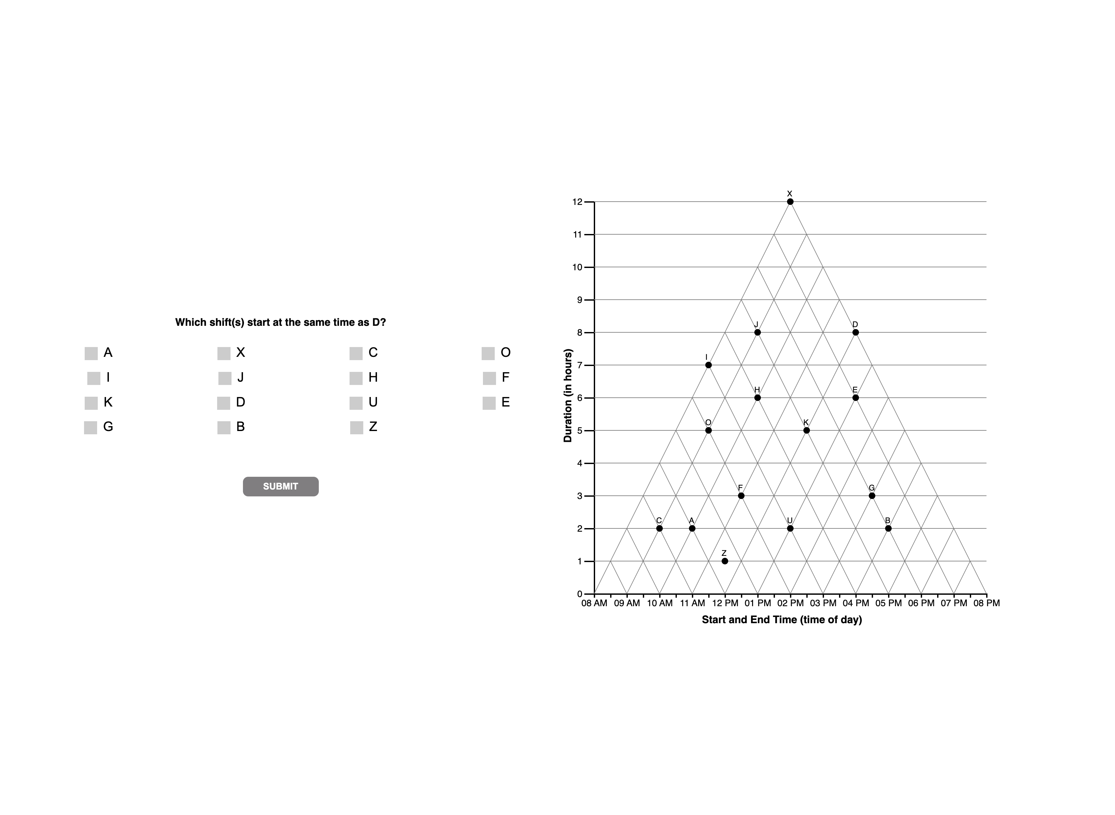

Slide 11
3

Slide 12


Slide 21
4

Slide 22


Slide 24
5

Slide 25
