Slide 1




International Cognitive Visualization
Thesis Defense for Amy Rae Fox
Notes:
Good morning, and welcome to my thesis defense!

Slide 2

Visualizing Time
The Influence of Timeline Axis and Direction on Causal Reasoning in Litigation Law
© Amy Rae Fox
Notes:
The title of my thesis is..
Visualizing Time
The influence of timeline axis and direction on causal reasoning in litigation law.

Slide 3
Introduction & Literature Review
Methodology
Results & Discussion
Notes:
I will start this morning/afternoon by introducing the motivation and conceptual framework for my work this year.
Then, I will discuss the design, materials and procedure used in my study.
Finally, I will share my results, before discussing implications for future work and then open the floor for questions.

Slide 4

Introduction

Slide 5
Introduction
Human Cognitive Architecture
Text-Picture Integration
Conceptual Metaphor
Conceptual Flexibility
Multimedia Learning
Temporal & Spatial Cognition
Litigation Law
Notes:
My work this year was informed by the desire to apply theories relevant to multimedia learning which I learned in the first 1.5 years of the ICV program, to a particular domain that interests me.
For the domain, I chose temporal & abstract cognition, which touch on perception/cognition, abstract thinking, mental representations and embodied cognition.
I decided to apply these concepts to the domain of litigation law, in which the ICV LCI lab has expertise.

Slide 6
Introduction > Conceptual Metaphor
think
reason
learn
How do we { } about abstract concepts?

Slide 7
Introduction > Conceptual Metaphor
LOVE is a JOURNEY
Look how far we’ve come.
It’s been a long, bumpy road.
We can’t turn back now. We’re at a crossroads.
We may have to go our separate ways.
The relationship isn’t going anywhere.
We’re spinning our wheels.
Our relationship is off the track.
The marriage is on the rocks.
We may have to bail out of this relationship.
JOURNEY
LOVE
Travellers are the lovers
A vehicle is the relationship
Destinations are the lovers’ common goals
Obstacles are relationship difficulties
Lakoff, G., & Johnson, M. (1980). Metaphors We Live By. Chicago: University of Chicago Press. doi:978-0226468013
Lakoff, G. (1992). The Contemporary Theory of Metaphor. In A. Ortony (Ed.), Metahpor and Thought (Vol. 2, pp. 1–47). Cambridge University Press.
Notes:
A concetpual metaphor involves understanding one domain of experience, love, in terms of a very different domain of experience, journeys.
The metaphor can be understood as a mapping from a source domain (in this case, journeys) to a target domain (in this case, love).
There are ontological correspondences, according to which entities in the domain of love (e.g., the lovers, their common goals, their difficulties, the love relationship, etc.) correspond systematically to entities in the domain of a journey (the travelers, the vehicle, des tinations, etc.).

Slide 8
Introduction > Conceptual Metaphor
TIME is SPACE
SPACE
TIME
In language
In gesture
In drawing
Psycholinguistic experiments
Inter-cultural variation
Inter-individual variation
Intra-individual variation
Notes:
Time is understood in terms of things (i.e., entities) and motion.
The present time is at the same location as a canonical observer.
The passing of time is motion.
One thing is moving, the other is stationary; the stationary entity is the deictic center.
Since motion is continuous and one-dimensional, the passage of time is continuous and one-dimensional.

Slide 9
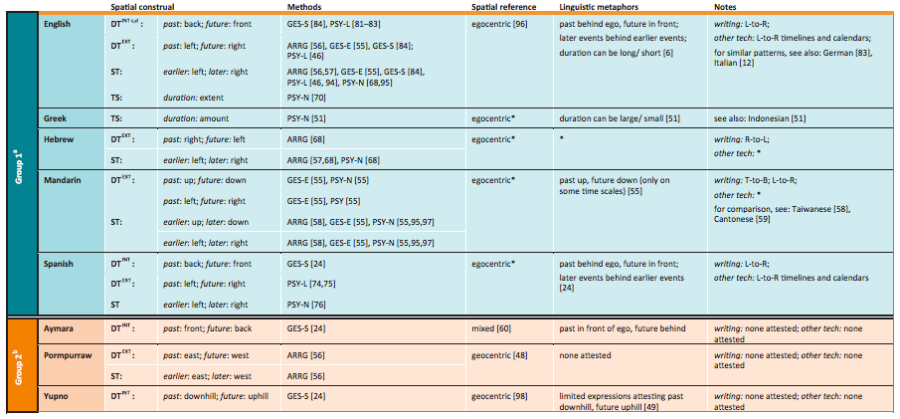
Introduction > Conceptual Metaphor
Núñez, & Cooperrider. (2013). The tangle of space and time in human cognition. Trends in Cognitive Sciences, 17(5), 220–9.
doi:10.1016/j.tics.2013.03.008

Slide 10
Introduction > Coherent Working Models Theory
How do individuals choose which metaphor to activate in a given context ?
Notes:
Conceptual Metaphor Theory suggests that abstract concepts are grounded through experiential correlations in primary metaphors, which in tum are grounded in perceptuo-motor correlations, such as watching an object to move from one location to another. Such experiences are supposed to be determined by the characteristics of human bodies and their perceptual and motor systems, as well as by the character- istics of the environment with which humans interact. Therefore, image schemas should be basically universal.
By including the possibility of language influences on conceptual mappings, the two current versions of Metaphoric Structuring (Weak and Integrated) are, in principle, better equipped to deal with cross- linguistic variability, but not with within-subject moment-to-moment variability.
As the upcoming review will reveal, there is an impressive degree offlexibility in conceptual mappings, both within and across languages and cultures. Alternative conceptual metaphors can be selected with high ease and speed, as well as old mappings replaced by new ones.
To summarize, the present review of research on conceptual metaphorsof time has revealed a massive degree of cognitive flexibility. First, several alternative mappings are available to each individual within a single lan- guage and culture, as well as across different languages and cultures. The alternatives can vary in about every possible parameter: they can res01t to different source domains to generate wholy inconsistent mappings; when they rely on the domain of space, they can map to all three spatial axes, to both poles within each axis, and taking each possible perspective. Second, there are clear effects of space on time, as well as effects of time on space, although the studies which have assessed both directionalities only report the former. Third, new conceptual metaphors can be acquired at an impres- sive speed, even in the face of highly practiced, life-long conceptual map- pings for the same abstract domain
Overall, studies on Iinem·Iy ordered sequences support the followingconclusions. There are cross-linguistic and cross-cultural vm·iations, cou- pled with wide within-individual variation. Clem· bidirectional effects be- tween the concrete and abstract domains are observed, against the Strict Directionality Hypothesis. Several factors mediating the manifestation of cross-domain influences have been isolated, namely, associative strength from number fmmat, temporal overlap between the processing of both domains, volunta1y choice of spatial shape and number-to-shape mapping, coherence interactions with other spatial mappings concurrently in use in the task at hand, and intrinsic differences in the automaticity of a given conceptual mapping.

Slide 11


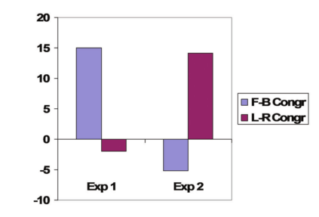




Introduction > Coherent Working Models Theory
Is the person thinking about the future or the past?
F/B L/R
F/B L/R
F/B L/R
F/B L/R
Comparison of congruency effects on response latency
Experiment 1: Respond vocally (past, future)
Experiment 2: Respond with left/right key press (past, future)
Torralbo, A., Santiago, J., & Lupiáñez, J. (2006). Flexible conceptual projection of time onto spatial frames of reference. Cognitive Science, 30(4), 745–57.

Slide 12
Introduction > Coherent Working Models Theory
Sensory memory
Working memory
Long term memory
Task demands
domain
space
domain
domain
domain
domain
domain
domain
time
domain
Coherence mechanism
Maximally coherent
Minimally complex
attention
Torralbo, A., Santiago, J., & Lupiáñez, J. (2006). Flexible conceptual projection of time onto spatial frames of reference. Cognitive Science, 30(4), 745–57.
Santiago, J., Román, A., & Ouellet, M. (2011). Flexible foundations of abstract thought: A review and a theory. In T. W. Schubert & A. Maass (Eds.), Applications of Cognitive Linguistics: Spatial dimensions of social thought. Berlin, Germany. Walter de Gruyter.
Notes:
The present theoretical fran1ework readily accounts for the availability ofseveral altemative, and often inconsistent, mappings for a given conceptual domain in the long tenn memory of a single individual, as well as across indi- viduals, languages and cultures: people can conceptualize an abstract domain in wholly different ways in different occasions and leam them all. They are only constrained not to use them at the same time within a single mental model. The

Slide 13
Introduction > Goals
Preferences for SCTs Replicate previous research on the relationship between SCTs and reading/writing direction (RWD), with computer-based stimuli.
Flexibility in SCTs Test hypotheses derived from the Coherent Working Models Theory about the construction of mental models from inconsistent SCTs, and subsequent reasoning and decision-making.
Stability in SCTs Explore the stability of SCT preferences and potential impacts on mental model construction.

Slide 14
Introduction > Experimental Model
stimulus SCT
reconstruction SCT
preferred SCT
mental model
information processing
recall
Preferences: Is there an observed preferred in SCT?
reasoning
decision-making
Flexibility: Does the combination affect comprehension/reasoning/decision-making?
Stability: Is the choice of SCT stable, or variant?

Slide 15
Introduction > Research Question
Can the visual-spatial representation of a temporal sequence influence comprehension, causal reasoning and decision-making in litigation law?

Slide 16
Introduction > Hypotheses
Sensory memory
Working memory
Long term memory
Task demands
2D
sequence
events
LEFT is PAST
time
space
LEFT is PAST
time
space
RIGHT is PAST
A B C
TOP is PAST
DOWN is PAST
A B C
BACK is PAST
C B A
FORWARD is PAST
money
attention
Coherence mechanism
Santiago, J., Román, A., & Ouellet, M. (2011). Flexible foundations of abstract thought: A review and a theory. In T. W. Schubert & A. Maass (Eds.), Applications of Cognitive Linguistics: Spatial dimensions of social thought. Berlin, Germany. Walter de Gruyter.
Notes:
The present theoretical fran1ework readily accounts for the availability ofseveral altemative, and often inconsistent, mappings for a given conceptual domain in the long tenn memory of a single individual, as well as across indi- viduals, languages and cultures: people can conceptualize an abstract domain in wholly different ways in different occasions and leam them all. They are only constrained not to use them at the same time within a single mental model. The

Slide 17
Introduction > Hypotheses
In an English speaking population :
(H1) Participants will select a SCT consistent with RWD (Left-to-Right) when asked to construct a timeline on a two dimensional plane.
(H2) After a stimulus presentation and brief delay, participants will again select a SCT consistent with RWD when asked to construct a timeline.
When compared to a control group (Stimulus SCT = Left-to-Right), participants presented with alternatively oriented timelines (Right-to-Left, Top-to-Bottom, Bottom-to-Top) will:
(H3) … make more errors in recalling details of the case.
(H4) … make more errors in reasoning about details of the case.
(H5) … have less confidence in their verdict.
(H6) … be less likely to find a defendant culpable.

Slide 18

Methodology

Slide 19
Methodology > Design
2 X 2 factorial
Timeline Axis (horizontal, vertical ) x Consistency with RWD (consistent, inconsistent)
 |  | Axis
 |  | Horizontal | Vertical
Direction | RWD Consistent | Left-to-Right | Top-to-Bottom
 | RWD Inconsistent | Right-to-Left | Bottom-to-Top

Slide 20


Methodology > Sample
n= 116 (64% female, median = 21)
Notes:
Data were collected for 173 undergraduates at Chico State.
20 participants were excluded on the basis of language fluency.
Of these, 116 indicated an initial preference for a left-to-right spatial construal of time, and constituted the sample for statistical analysis.
64% were female, 36% male, the median age was 21.

Slide 21
Methodology > Procedure
Jury members are chosen
Select Sample & Assign Groups
Demographic questions
Prosecution presents case
Present Case
Experimental Stimulus
Defense presents case
Comprehension Measure
Reasoning Measure
Jury receives instructions
Subject receives instructions
Jury deliberates
Subject makes decision
Decision-Making Measure
Jury renders verdict

Slide 22

Results

Slide 23
Results > Overview
Hypothesis
Result
✔
✔
7
7
7
7

Slide 24
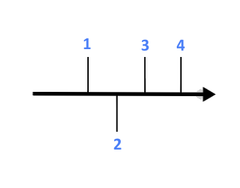
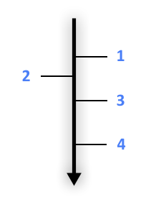
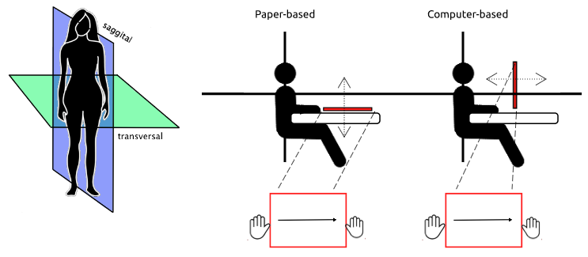
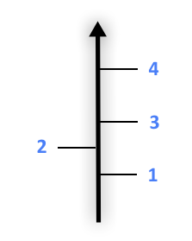
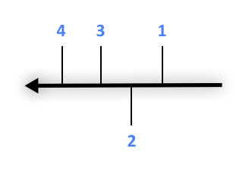
Results > Preferences for SCTs
H1
Participants will select a SCT consistent with RWD (Left-to-Right) when asked to construct a timeline on a two dimensional plane
✔
76% of participants selected SCT₁ of Left-to-Right.
76%
12%
10%
2%
Replicates (Tversky et al., 1991) showing preference for RWD consistent SCTs with computer-based stimuli in an adult population
Tversky, B., Kugelmass, S., & Winter, A. (1991). Cross-cultural and developmental trends in graphic productions. Cognitive Psychology, 23, 515–557.

Slide 25
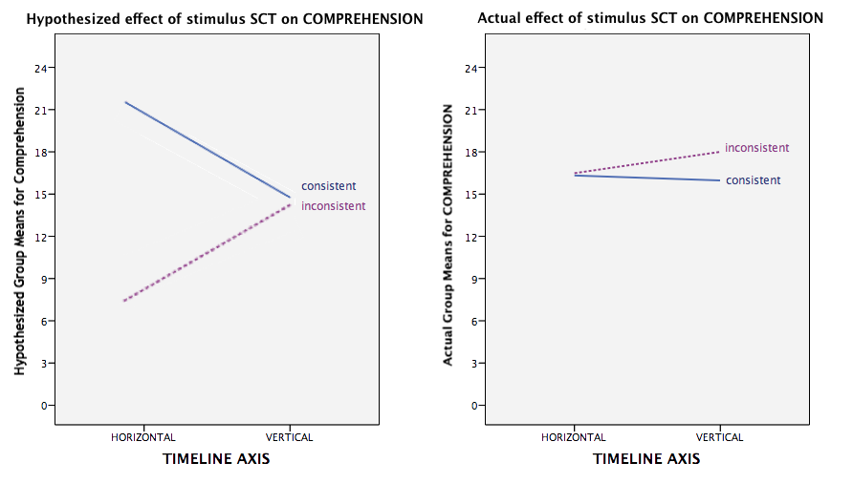
Results > Flexibility in SCTs
H3
Participants presented with alternative SCTs will make more errors in recalling details of the case
✗
… made fewer errors in comprehension.
Effect in opposite direction of hypothesis
Reconsider role of attention as coherence seeking mechanism
Notes:
significant effect of direction only on comprehension, F (1,112) = 3.92, p = 0.05, η_{p}² = .03

Slide 26
Results > Flexibility in SCTs
H4
Participants presented with alternative SCTs will …
make more errors in reasoning about details of the case
✗
… no significant differences between groups.
Actual correlations between comprehension & reasoning scores were low (r = .273, p < .001)
The complexity of the task may have resulted in modification of the individual’s mental model

Slide 27
Introduction > Coherent Working Models Theory
Sensory memory
Working memory
Long term memory
Task demands
2D
sequence
events
LEFT is PAST
time
space
LEFT is PAST
time
space
RIGHT is PAST
A B C
TOP is PAST
DOWN is PAST
A B C
BACK is PAST
C B A
FORWARD is PAST
money
attention
Coherence mechanism
Santiago, J., Román, A., & Ouellet, M. (2011). Flexible foundations of abstract thought: A review and a theory. In T. W. Schubert & A. Maass (Eds.), Applications of Cognitive Linguistics: Spatial dimensions of social thought. Berlin, Germany. Walter de Gruyter.
Notes:
The present theoretical fran1ework readily accounts for the availability ofseveral altemative, and often inconsistent, mappings for a given conceptual domain in the long tenn memory of a single individual, as well as across indi- viduals, languages and cultures: people can conceptualize an abstract domain in wholly different ways in different occasions and leam them all. They are only constrained not to use them at the same time within a single mental model. The

Slide 28
Introduction > Coherent Working Models Theory
Sensory memory
Working memory
Long term memory
LEFT is PAST
space
LEFT is PAST
time
space
time
RIGHT is PAST
A B C
TOP is PAST
DOWN is PAST
C B A
BACK is PAST
C B A
FORWARD is PAST
money
attention
Coherence mechanism
Santiago, J., Román, A., & Ouellet, M. (2011). Flexible foundations of abstract thought: A review and a theory. In T. W. Schubert & A. Maass (Eds.), Applications of Cognitive Linguistics: Spatial dimensions of social thought. Berlin, Germany. Walter de Gruyter.
Notes:
The present theoretical fran1ework readily accounts for the availability ofseveral altemative, and often inconsistent, mappings for a given conceptual domain in the long tenn memory of a single individual, as well as across indi- viduals, languages and cultures: people can conceptualize an abstract domain in wholly different ways in different occasions and leam them all. They are only constrained not to use them at the same time within a single mental model. The

Slide 29
Results > Flexibility in SCTs
H5
Participants presented with alternative SCTs will …
have less confidence in their verdict.
✗
… no significant differences between groups.
No significant correlations between comprehension/reasoning and confidence, for any experimental group
What other factors may strongly influence meta-cognition?

Slide 30
Results > Flexibility in SCTs
H6
Participants presented with alternative SCTs will …
be less likely to find the defendant culpable
✗
… no significant differences between groups.
No significant differences in culpability findings between groups.
Follows from confidence findings
Recommend modification of the measure to capture threshold of certainty

Slide 31
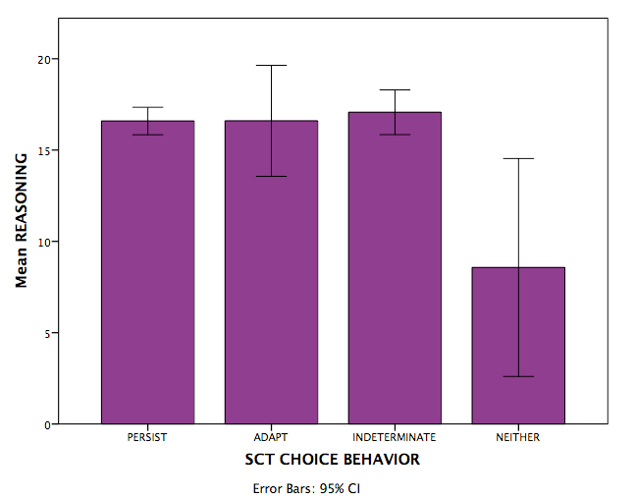
Results > Stability in SCTs
H2
After a stimulus presentation and brief delay, participants will again select a SCT consistent with RWD when asked to construct a timeline.
✔
84% of participants selected SCT₂ of Left-to-Right, despite receiving a different stimulus SCT.
 |  | SCT₂
 |  | LR | TB | RL | BT
Stimulus SCT | LR | 28 |  | 2 | 1
 | TB | 25 | 5
 | RL | 26 | 1 | 3 | 1
 | BT | 20 | 2 |  | 2
61 % persist
24 % indeterminate
9 % adapt
6 % neither
Seems to be preferable to transform incoming information into a familiar format for representation
Is performance better?
Notes:
A multivariate Kruskal-Wallis test examining the influence of SCT choice behavior on comprehension and reasoning revealed a significant effect on reasoning, X² (3, n = 116) = 10.7, p = .013.

Slide 32
Results > Limitations
External validity
Point of view & one-sided argument
Sample did not reflect target population
Length of exposure
Jury deliberation & external aids
Complexity of case
> Exceeds expectations of participant motivation?
Stimulus exposure time
Measures
> Reasoning measure too long/complex to capture mental model without encouraging manipulation
> Verdict measure failed to capture threshold of certainty

Slide 33
Results > Future Direction
Control allocation of attention by reducing case complexity (5, 10, 15, 20 events)
Compare causal and non-causal sequences
Introduce second stimulus (prosecution vs. defense)
Do the same patterns in flexibility exist for axes on which RWD does not operate?

Slide 34
Results > Summary
Individuals prefer RWD consistent SCTs for computer-based 2-D representations of temporal sequence
Performance on a complex comprehension task was better when information was presented in a RWD inconsistent direction
Preference for SCTs was consistent through sequential representational tasks
Performance on reasoning task was impaired when individuals chose to introduce a third SCT

Slide 35
{ }
THANK YOU
VIELEN DANK
MERCI BEAUCOUP

Slide 36
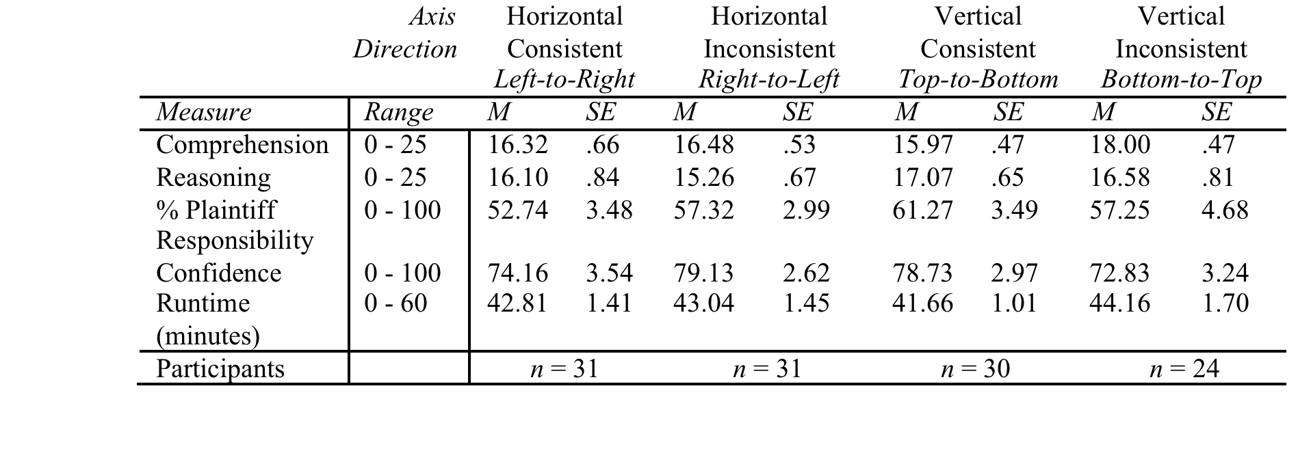
Results > Overview

