Slide 1
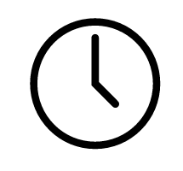
TIME USE RESEARCH
Amy Rae Fox

Slide 2
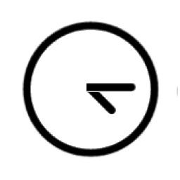
Le temps peut être considéré comme la contrainte ultime de l'activité humaine. Contrairement à d'autres ressources, il est partagé également par tous. Chacun de nous a 24 heures par jour.
TIME CAN BE VIEWED AS THE ULTIMATE CONSTRAINT ON HUMAN ACTIVITY. UNLIKE OTHER RESOURCES, IT IS SHARED EQUALLY BY EVERYONE. EACH OF US HAS 24 HOURS PER DAY.

Slide 3
Why research time-use?
Time-use data includes information on most common human activities
Reveals behavior of individuals and behavior of groups
Can be used to make comparisons between groups and over time
Can inform policy decisions
Notes:
How we spend our time can tell researchers a great deal about human behavior.
Much behavioral research is conducted via surveys, which are prone to reporting biases and experimental effects.
Time-use research seeks to collect detailed information about how people use their time in order to understand relationship between activities and factors.
When demonstrated via a large enough sample (ie. for a country), the results can be useful for policy-makers.

Slide 4
Why research time-use?
How much time is spent on (x) activity by men vs. women?
Exploring differences between societal groups
How much time is spent on productive work?
How much time is spent on non-market work?
Informing economic models and social accounting systems
Sociology
Economics
Psychology
Time poverty Transportation policy Environmental impact
Gender equality
Determinants of health Work-life balance
…
What patterns exist in the sequencing of activities?
How does our use of time relate to mood?
Exploring behavioral correlates and determinants.
Notes:
Time-use research began in earnest in the early 1960s.
Since that time, most research has been conducted in the realm of sociology and economics.
In Europe and developing countries, sociologists have used time-use data to help answer questions like:
How much time is spent doing household chores by men vs. women?
The resulting data can be compared to results from other countries (where similar data collection methods are used) and compared to past data sets, to detect differences based on policy changes.
A main finding is that there are very substantial differences among industrialized countries in time use patterns-differences that are often larger than those between particular industrialized and preindustrial economies
In North America, most time-use research has been conducted by economists, interested in informing economic models and social accounting systems.
They seek to answer questions such as: how much time is spent on work output to the market economy? These results can be compared to other measurements of economic output in order to analyze efficiency and produce models of economic activity.
In general, time-use research involves collection of huge data samples, so that conclusions can be drawn about large populations of individuals.
A smaller body of work is underway in psychology which seeks to evaluate time use at an individual level, investigating how the use of time relates to our subjective wellbeing.
SOME KEY FINDINGS
Even these basic descriptive data show a number and interesting of important differences among countries.
Total work time tends to be higher for men than for women only in countries with relatively high income levels.
Time spent in social interaction higher in the U. S. is substantially than in any other country.
Active leisure is higher by far in Sweden than for any other country for which such disaggregation available,
Men in low income societies do not work long hours, but instead to have large amounts of free appear time, and in the same societies total work time of women far exceeds that of men.
U.S. children, even at very young ages, spend substantially more time at market work than do Japanese children,
Japanese children spend almost 50 percent more time in school than do American children,
Japanese children spend substantially more time studying in junior high school and in senior high school than they do while -attending colleges or universities
This brief description of across-country and across-time differences in time allocation has at least three important implications:
1. There is a great deal of variation in time allocation to be explained;
2. Economic forces appear to have an important role to play even in explaining differences among countries with very different institutional structures
3. Cultural and social forces are likely to matter quite a lot in explaining some of the observed differences

Slide 5
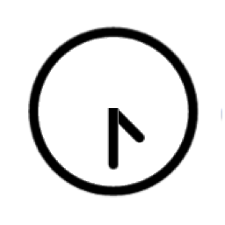
How do we collect data?
Direct observation
Survey
Experience sampling
Databases of time-stamped information
Time-use diaries
Notes:
There are five prevalent methods of data collection for time-use data.
Direct observation produces the a very detailed data record over a wide range of activities.
Though useful in qualitative contexts where a researcher can build a relationship of trust with participants, this method requires considerable labour resources.
Costs, post-coding and concerns such methods may raise with some participants make this approach unsuitable for national sample surveys.
Surveys involve questions that ask people to estimate the total time people spend undertaking various activities
Ie. (how long did you watch television/clean the house/take to drive to work yesterday?).
This method entails significant inaccuracy (that varies by activity type), and cannot capture other dimensions of time use necessary to measure some of the policy dimensions outlined in this chapter.25
The experience sampling method collects detailed information regarding the participants’ activities in response to a prompt from a beeper, instant message, text or phone app prompt (mentioned further in section 8.1.5). While this method works well in contained populations, such as school students, implementation difficulties mean this method is not readily useful across a national sample. Also, the absence of total time spent over a day and the lack of activity sequences make this method unsuitable for some of the policy areas outlined in this chapter.
Databases of time-stamped information, for example official records of periods of stay in institutions such as hospitals or prisons, use of facilities, such as public sports facilities or libraries, and time-stamped social media entries, from Twitter feeds or Facebook timelines, offer a range of time-use information. Nevertheless, these resources reflect the activities of highly selective samples and do not cover the comprehensive activity ranges needed to address the range of policy applications outlined in this chapter.
The preferred method for studying an individual’s time allocation is through a time- use diary. The time diary method records the detailed account of the activities undertaken by an individual, usually over a period of 24 hours. The respondent reports successively all activities either in predetermined fixed time intervals or by indicating the beginning and ending time of each activity. An advantage of the time diary method is to allow respondents to report activities that they have performed simultaneously, along with the context of these activities. This offers a wealth of analytical opportunities and policy- relevant information that would not be available otherwise. The policy issues described further in this chapter require collection of data on the total time spent in activities over whole days as opposed to participation at any moment in time. They also require data on the context surrounding the activities undertaken, for example, whom people are with, where they are and how they fit into chains of events over the day.

Slide 6
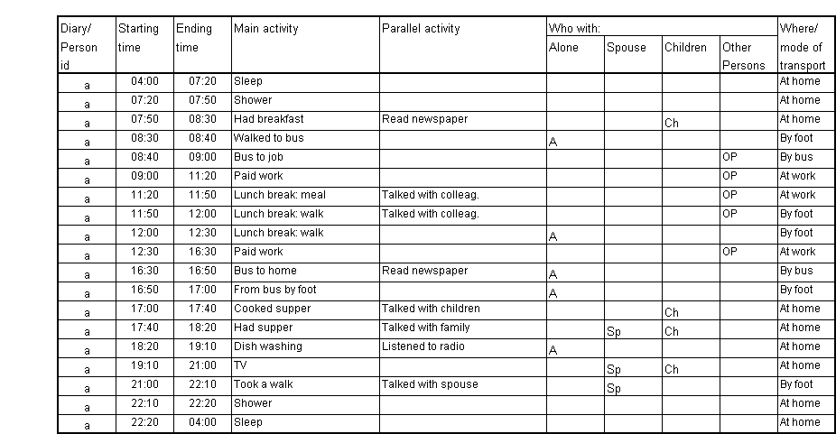
Sample Diary

Slide 7
How do we compare data?
Harmonization
Consistent activity list
Consistent operational definition of factors such as:
Multi-tasking
Transportation
Granularity of tracking

Slide 8
Methodological considerations
Length of observation window
Continuous recording or fixed intervals
Self-coding or post-coding
Size of sample
Population choice
Contextual questions

Slide 9

Dimensions of time-use
duration
timing
sequence
frequency
Quantity of time
How much time do I spend brushing my teeth?
Time of day
What time of day do I brush my teeth?
Order of activities What activities do I do before and after brushing my teeth?
Number of occurrences How many times do I brush my teeth?

Slide 10
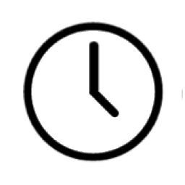




UN. (2013). Guidelines for Harmonizing Time-Use Surveys. United Nations Economic Commission for Europe.
Juster, F., & Stafford, F. (1991). The allocation of time: Empirical findings, behavioral models, and problems of measurement. Journal of Economic Literature, 29(2), 471–522.
Eurostat. (2008). Harmonised European time use surveys: 2008 Guidelines. European Commision.

