Slide 1

VISUALIZING TIME
Amy Rae Fox
Spring 2014
Université Pierre Mendes France

Slide 2
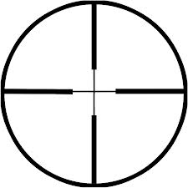
SCOPE
VISUALIZING TIME
Exploring perception, visualization, and behavioral correlates of human time allocation

Slide 3

CONTEXT
VISUALIZING TIME
Psychology
How do we experience time ?
How do we remember time ?
With what granularity do we perceive time ?
What is our (internal) representation of time ?
What is our (external) representation of time ?
What is time ?
What are the rules of time ?
Philosophy
Time Use Methods
Information Science (Visualization)
How can we accurately gather time use data?
The Quantified Self
What artifacts can be developed from personal time use data ?
How might these be used by an individual ?
Sociology &
Economics
Student Time Use
How do university students use their time, and what correlates exist ?
Are there patterns that exist in the sequencing of time use ?
What models have been developed
to explain how people allocate their time?
How can we represent time in relation to its correlates ?
How can we visualize data in order to find temporal correlates ?

Slide 4
CONTEXT
VISUALIZING TIME
How do we experience time ?
How do we remember time ?
With what granularity do we perceive time ?
What is our (internal) representation of time ?
What is time ?
What are the rules of time ?
What is our (external) representation of time ?
What artifacts can be developed from personal time use data ?
How can we accurately gather time use data?
What artifacts can be developed from personal time use data ?
How might these be used by an individual ?
How do university students use their time, and what correlates exist ?
Are there patterns that exist in the sequencing of time use ?
What models have been developed
to explain how people allocate their time?
How can we represent time in relation to its correlates ?
How can we visualize data in order to find temporal correlates ?

Slide 5
DIMENSIONS OF TIME-USE
duration
timing
sequence
frequency
Quantity of time
How much time do I spend brushing my teeth?
Time of day
What time of day do I brush my teeth?
Order of activities What activities do I do before and after brushing my teeth?
Number of occurrences How many times do I brush my teeth?

Slide 6

LEARNING GOALS
VISUALIZING TIME
Develop knowledge
(psychology) internal representations of time
(information science) methods for representing time
Develop skills
(data analysis) analyzing data sets with R
(information science) creating visualization of time use data
Gain experience
collaborating with research team
designing experimental studies

Slide 7

ACTIVITIES
VISUALIZING TIME
Evaluate MOTUS system as data collection tool
Contribute to enhancement of MOTUS system (mobile app + UX)
Develop activity list for student time use studies
Develop (my) research questions
Understand (team) research questions
Design student time allocation study
Conduct pilot study in France
Presentation of time-use research to L3 Master Preparation Students
Time Visualization exercise
(Manual) diary collection
Exploratory coding activity
Analyze data
Synthesize and communicate results

Slide 8
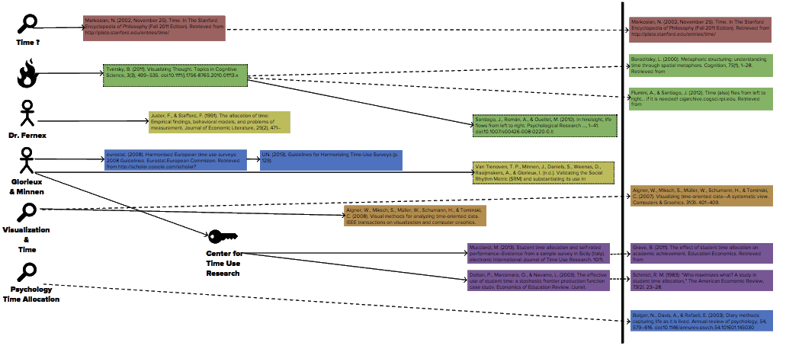

LITERATURE
VISUALIZING TIME

Slide 9
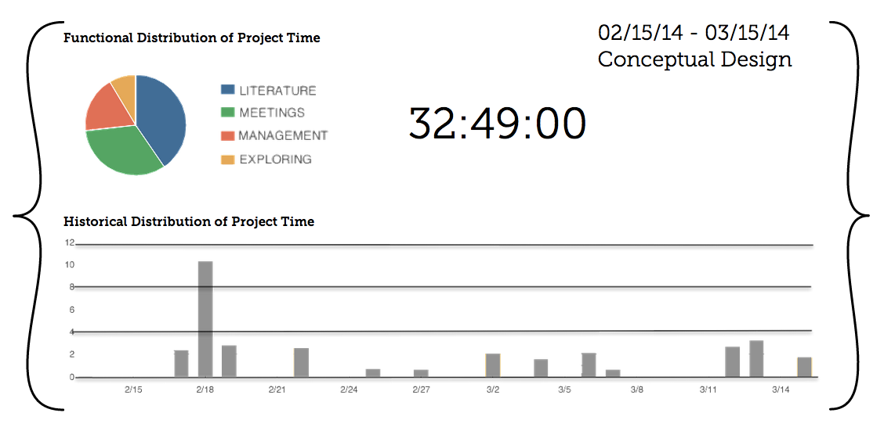

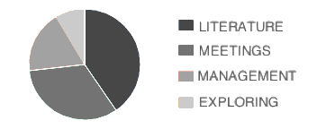
STATUS
VISUALIZING TIME

Slide 10
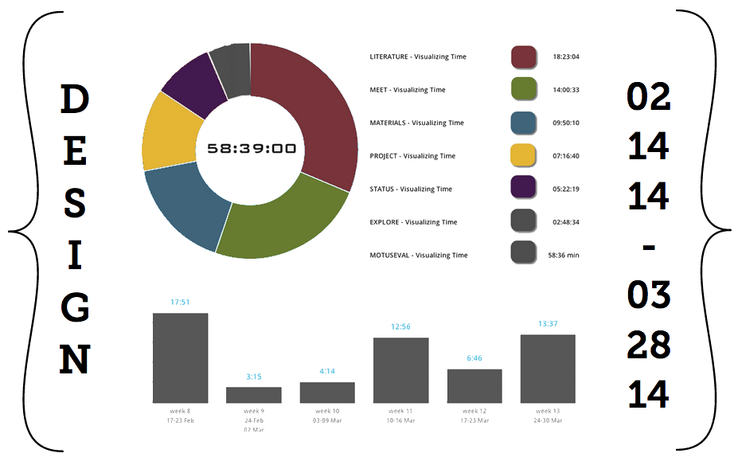
STATUS
VISUALIZING TIME

Slide 11








TOOLS
VISUALIZING TIME

