Slide 1
Cohort Analysis For Accessing Customer Retention and Segmentation in the E-commerce Industry
Prepared by: Oluwamuyiwa Jaiyeola

Slide 2
Project Objectives
Customer Retention Measurement
Segmentation of Customers
02.
Entity-Relationship Diagram (ER Diagram) for the Accident Database.
Identify Drop-Off Points
Support Customer Lifetime Value Estimation
Recommended Strategy from Insight
03.

Slide 3
Introduction
Cohort analysis groups customers based on when they first make a purchase (first purchase month) and tracks how long they stay active afterward. This answers how well a customer is being managed after acquisition over a given period.
In this project, we’ll use the shopshere dataset, and group customers based on their CohortMonth (first month of purchase) and track how many come back to make a purchase again after their first engagement. We'll visualize this with a retention heatmap to show drop-offs across months.
We’ll measure this using the RFM (Recency, Frequency, Monetary) Analysis metrics. Customers will be segmented using the Segmentation Analysis into distinct clusters based on the patterns in their RFM metrics. This will allow the knowledge about the categories of customers and what strategy will be put in place to address them to maximum satisfaction.

Slide 4
Tools Used
Jupyter Notebook: for Python coding
Numpy, Pandas: for Data Processing
Matplotlib, Seaborn: for Data Visualization
Scikit-Learn: for Statistical Analysis
Git, Github: Version Control

Slide 5
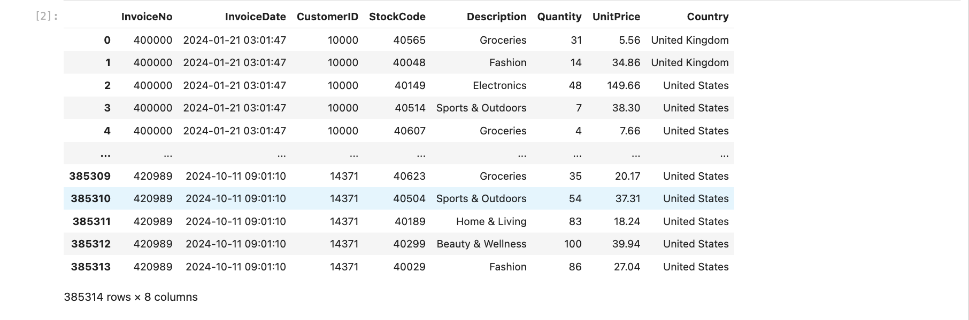
Dataset Visualization
Notes:
Our dataset has a row of 385314 and 8 columns
The features in our dataset include: InvoiceNo, InvoiceDate, CustomerID, StockCode, Description, Quantity, UnitPrice, and Country.
Necessary features for the analysis will be engineered during the exploratory data analysis.

Slide 6
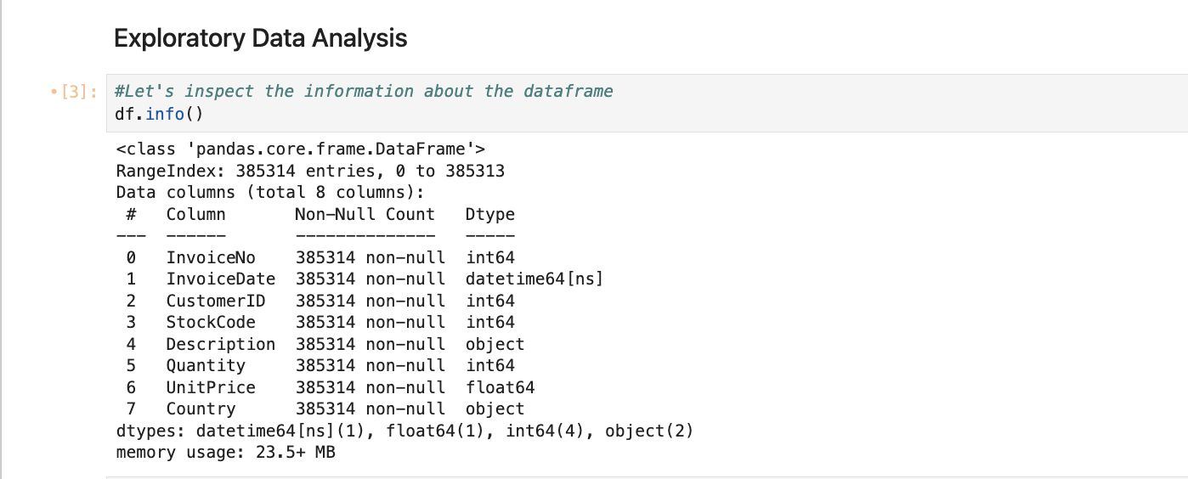
Exploratory Data Analysis
Notes:
During EDA, we discovered the dataset is a clean dataset with no missing or NaN values.
Nevertheless, minor adjustment was made to the necessary and important features, like the InvoiceDate was converted to a datetime datatype,
and the CustomerID was converted to an object as it was found to be an integer, which is not good for our analysis. This process helps
To remove inconsistency in the dataframe and prepare it for analysis

Slide 7
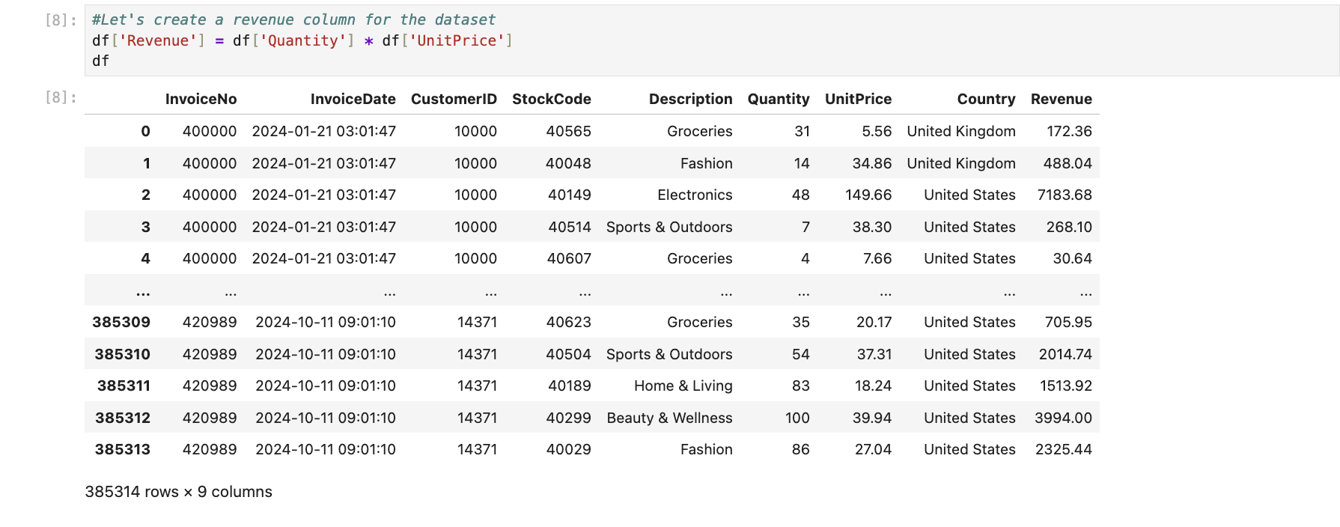
Feature Engineering
Notes:
We engineered the Revenue feature into the dataframe because this is an important feature that will be needed during the Cohort Analysis.
This will also give us insight into the sales and revenue of this business.
It is important to know that several other features will also be engineered into the dataframe as the analysis progresses

Slide 8
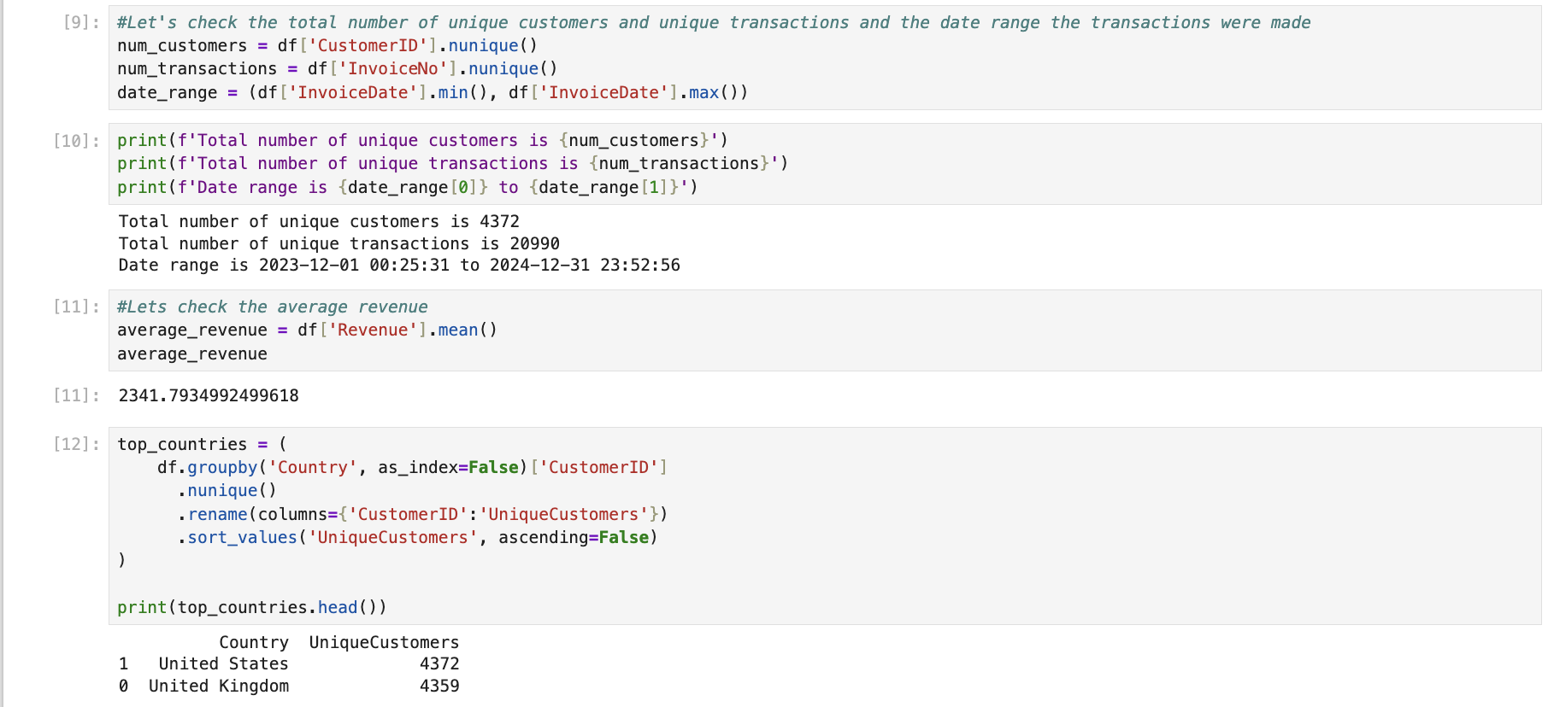
Exploratory Data Analysis
Notes:
Here we take a deep look into the number of unique customers we have and the number of unique transactions performed within the one-year period
We also looked at the top countries where most sales are coming from.
This gives us demographic information about our customers' origin

Slide 9
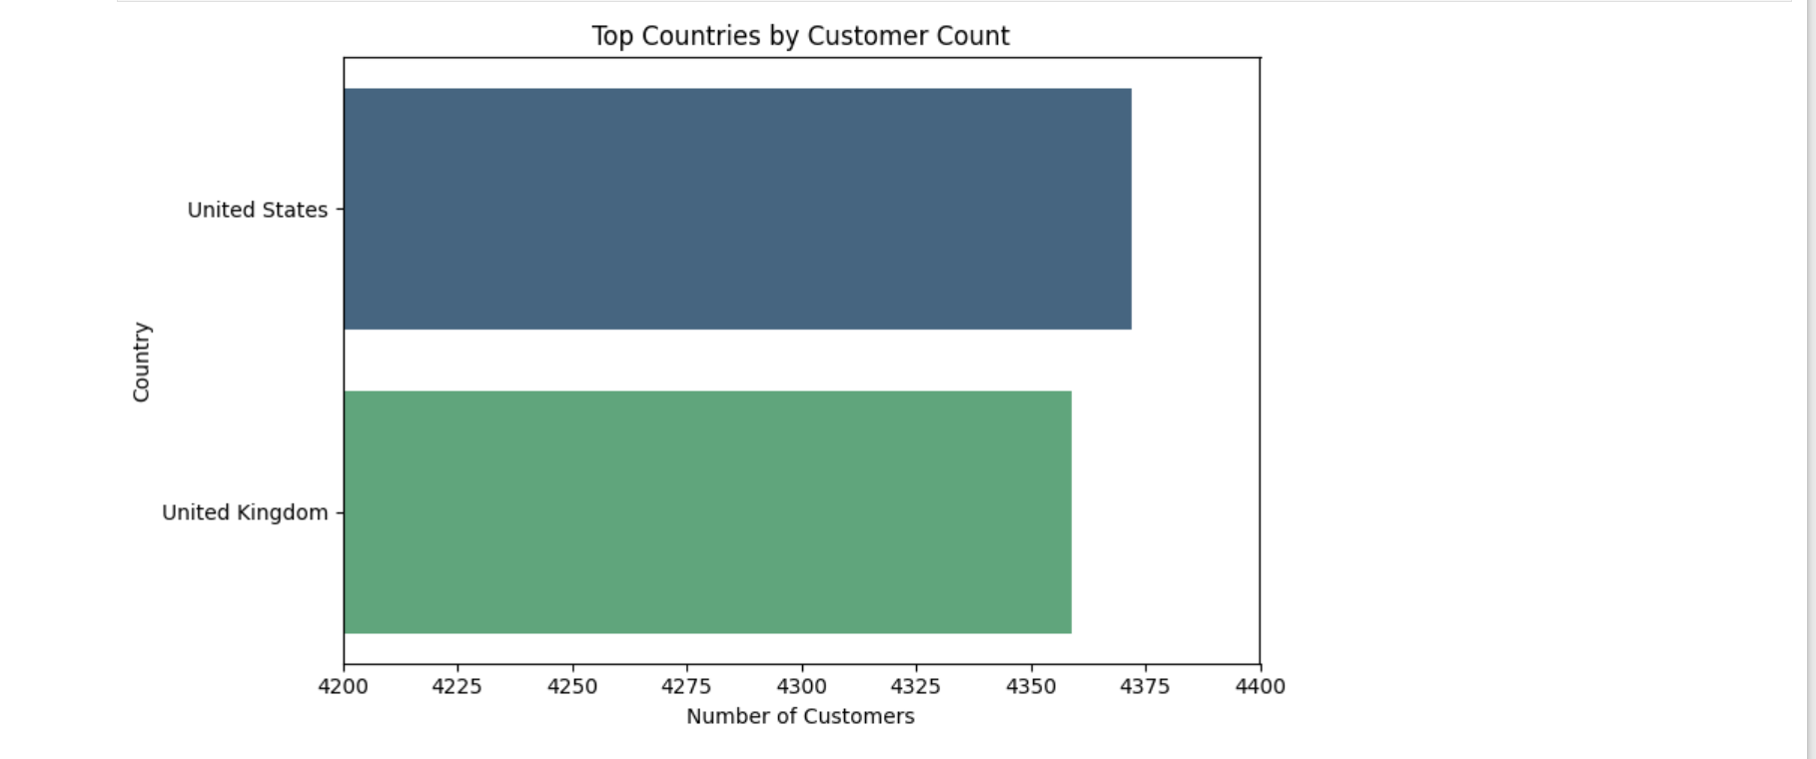
Data Visualization
Notes:
This visualization gives us a visual sense of what our demography looks like.

Slide 10
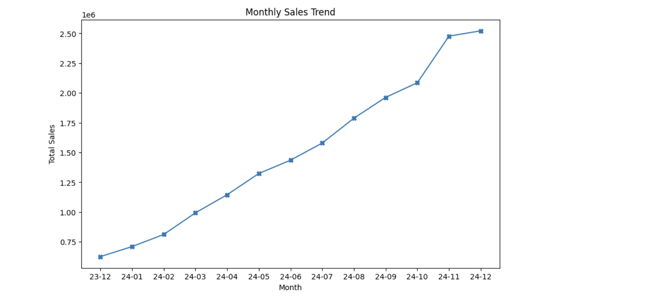
Data Visualization
Notes:
We also took a look at the monthly sales trend of the business, and it is visually clear that the sales have an upward movement for the one-year period
So it is clear to say, the business does not have a sales problem, rather a retention problem, which is the essence of this analysis

Slide 11
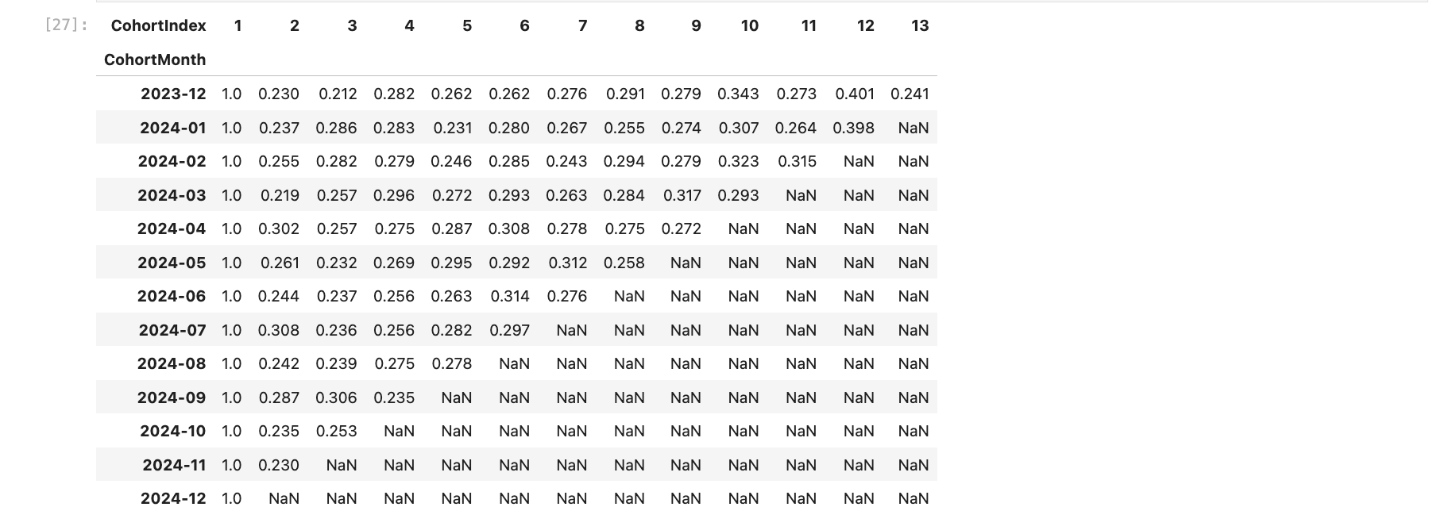
Cohort Analysis: Cohort_Pivot
Notes:
The pivot tables show the retention rate i.e the percentage of customers that returned after their first month of purchase
But it isn't easy to understand it this way at it just show numbers and figures, so to make this clearer and visually understandable,
We will build a retention heatmap.

Slide 12
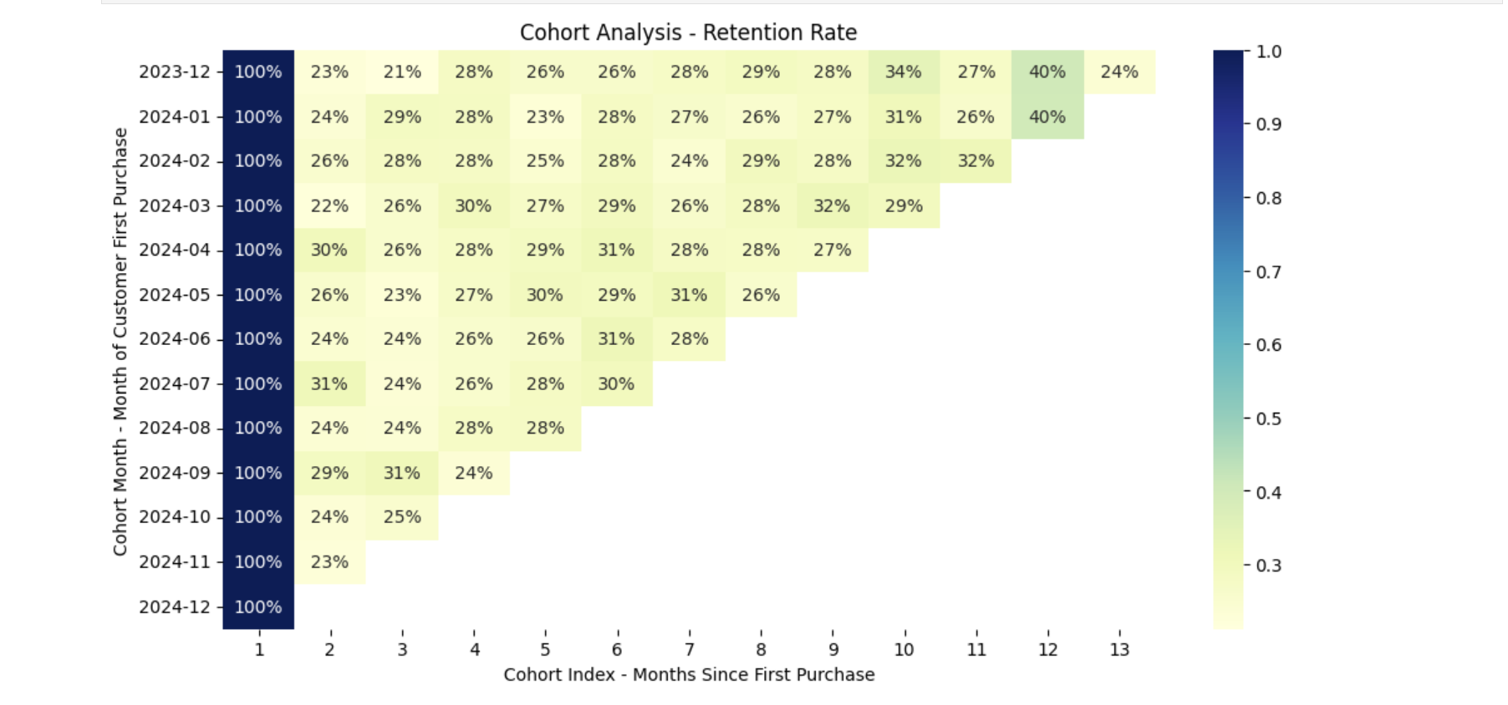
Cohort Analysis: Retention Heatmap
Notes:
Now the retention heatmap has given us a much visual explanation of what is happening in our pivot table earlier.
It also uses color grading to explain the degree of retention. Lighter color is bad, and the darker shade is better performance.
The percentage now tell us the percentage of customers that returned after their first month of purchase based on their cohort
And how they drop off over time.

Slide 13
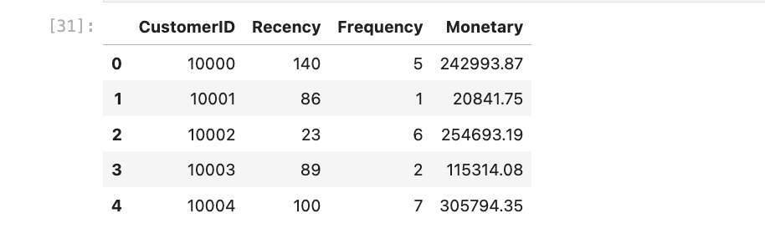
RFM Analysis
Notes:
The retention rate leads us to the RFM Analysis which will help us look into the Recency, Frequency and Monetary values of each cohort.
Now this cohort needs to be grouped into clusters, we need to know the segment of customers we have and how to treat them based on their segmentation.
To do this, will firstly derive the number of clusters need for our segmentation and this will be done using the elbow plot (Inertia)

Slide 14
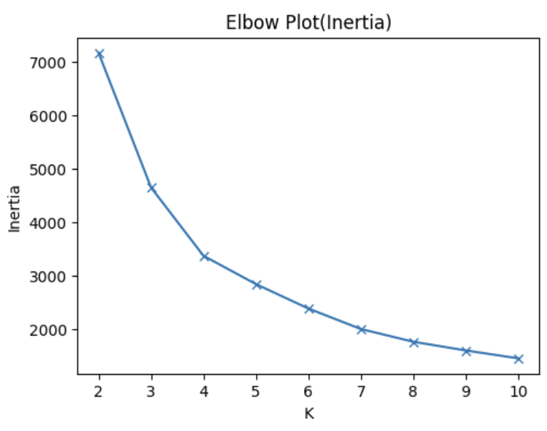
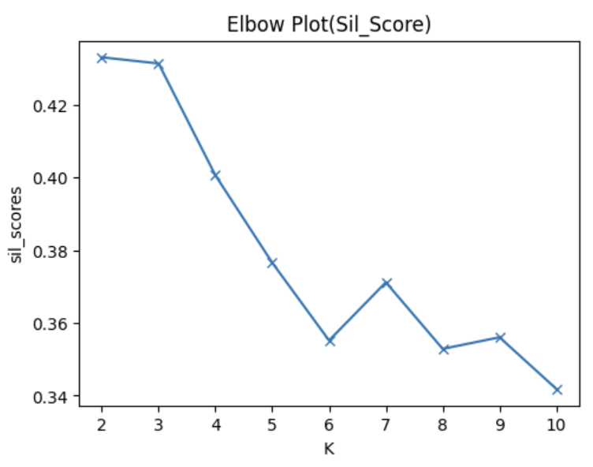
Application of K-Means, Elbow Plot and Yellowbrick to Derive n_clusters
Notes:
The result from the elbow plot using inertia and silhouette score varies, and a conclusion cannot to drawn on the number of clusters to choose
We then apply another method using the KElbowVisualizer, which will help visualize and point to the cluster number of choice to be employed.

Slide 15
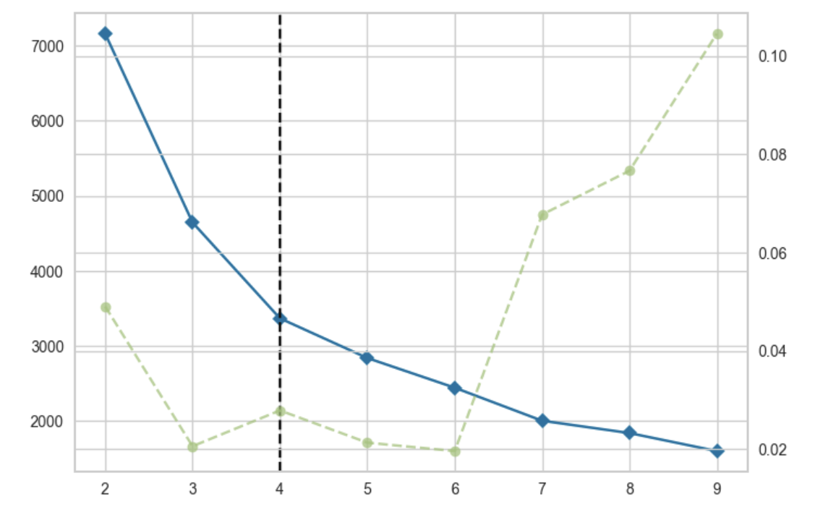
Application of K-Means, Elbow Plot and Yellowbrick to Derive n_clusters
Notes:
The KElbowVisualizer has now helped ascertain the right number of clusters to choose, which reduces and removes absolute reliance on guesswork or assumptions.

Slide 16
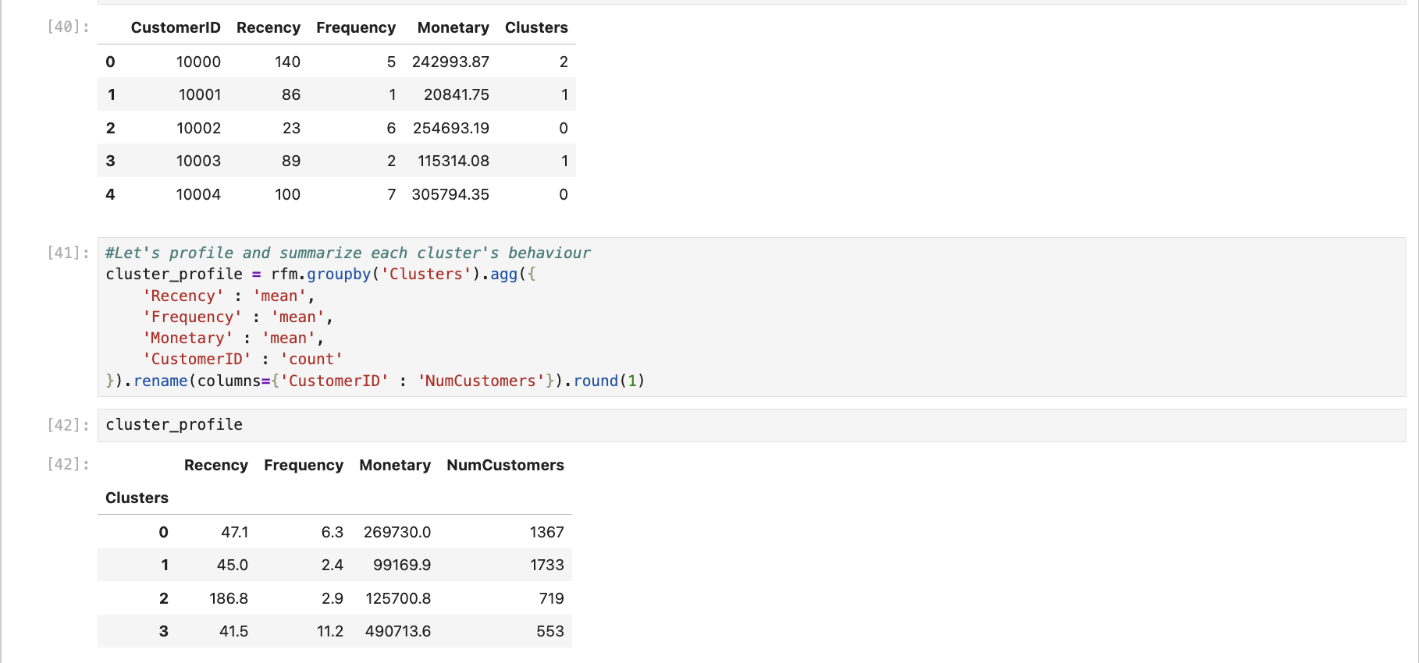
K-Means Model : Profile Clustering
Notes:
The K-Means Algorithm has help categorize our customers into 4 different clusters: 0, 1, 2, and 3
Doing this makes the segmentation of the customers into their appropriate segments easy.

Slide 17
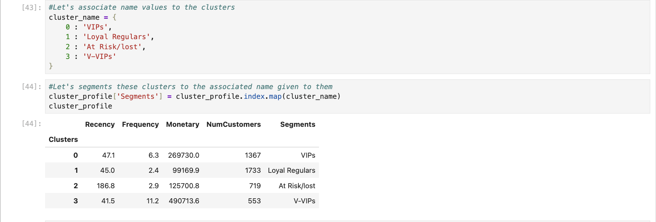
Segmentation Analysis
Notes:
Now our customers have been segmented into four different segments
This now allows us to analyze and profile how each group will be treated and retained

Slide 18
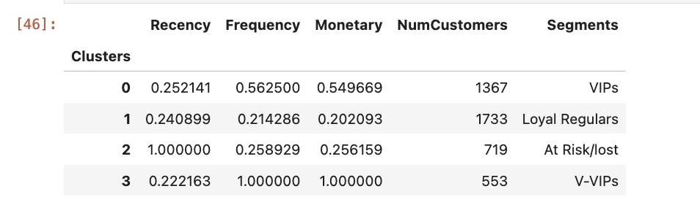
Segmentation Analysis
THANK YOU
Notes:
The values of the features have been normalize here to a range of 0-1.
This allow us to compare patterns rather than the magnitude of each features as they are on different numeric scales

Slide 19
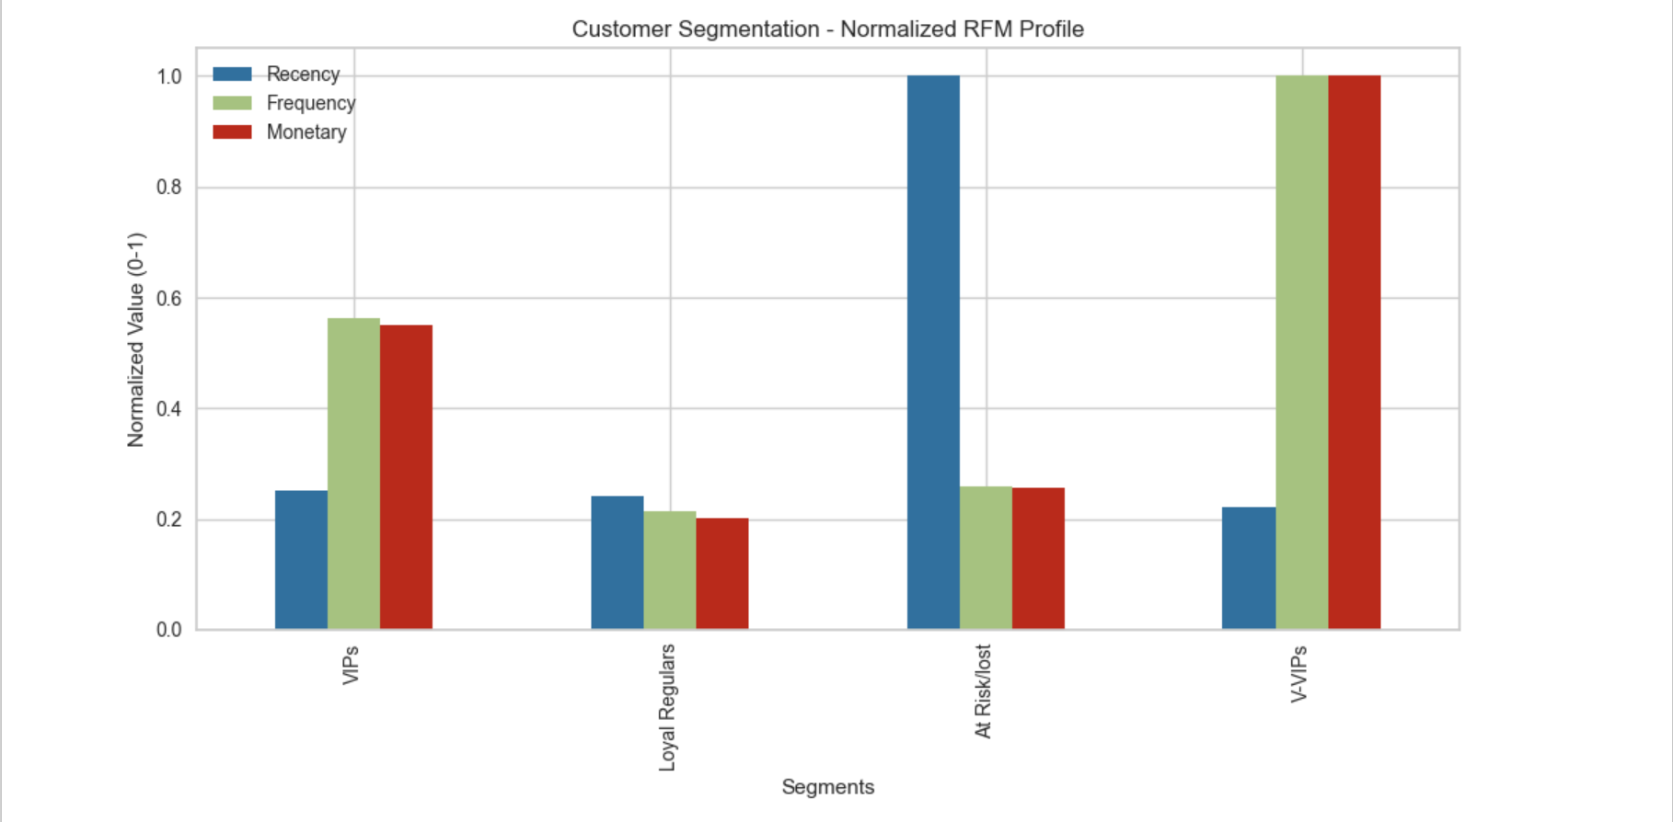
Customer Segmentation - Normalized RFM Profile

Slide 20
Recommended Strategy to Retain Customers
Segment 3 Customers : V-VIPs (Our Top Spenders)
Profile: Our Best Customers as they already trust the brand. Low Recency (0.22), highest Frequency (1.0), and highest Monetary value (1.0). These drive a disproportionate amount of revenue.
Retention Goal: Maintain Status Quo, turn them into brand advocates, and Maximize Lifetime Value (LTV).
Recommended Strategy:
Create an exclusive, top-tier loyalty group with premium benefits (dedicated support line, priority delivery, and invitation to private events/previews).
Focus on premium experience, convenience, and early access to new products and limited editions. They respond to value, not price (Do not discount).
Key Action: White-glove service and exclusive privilege to maintain happiness.

Slide 21
Recommended Strategy to Retain Customers
Segment 0 Customers: VIPs (Our Consistent Buyers)
Profile: High Recency (just purchased, 0.25), medium Frequency (0.56), and medium Monetary value (0.55). These customers like us but aren't fully engaged or maxing out their spend.
Retention Goal: Drive Frequency and Monetary Value. Convert recent buyers into habitual buyers.
Recommended Strategy:
Implement next-purchase incentives immediately after their current transaction (e.g., "Get 15% off your next order if you buy within 30 days").
Personalized cross-sell recommendations (suggesting higher-value or complementary products) to boost the Monetary score.
Introduce a loyalty tier system (points, milestones).
Key Action: Increase cadence of value-driven communication.

Slide 22
Recommended Strategy to Retain Customers
Segment 1 Customers : Loyal Regulars (Mid-Level Customers)
Profile: Good standing on all three metrics, but not market-leading. Low Recency (0.41), Low Frequency (0.21), Low Monetary (0.20). They are steady and predictable, but risk becoming stagnant.
Retention Goal: Build stronger habit, reward loyalty and prevent drop-off in Recency.
Recommended Strategy:
Introduce a mid-tier loyalty program with small, exclusive perks (e.g., early access to sales, small birthday reward) to make them feel valued.
Focus on surprise-and-delight moments (e.g., random free shipping codes) to maintain emotional connection and encourage the next purchase.
Highlight popular or trending products to re-ignite interest.
Key Action: Reward engagement to solidify their habit and increase frequency.

Slide 23
Recommended Strategy to Retain Customers
Segment 2 Customers: At Risk / Lost Customers (Highest Priority for Reactivation)
Profile: Critically High Recency (1.0 - haven't bought recently). Their Frequency (0.58) and Monetary (0.25) were good previously. These are former high-value customers who have churned.
Retention Goal: Immediate Reactivation and learn why they left. Get them to purchase anything to lower the Recency score.
Recommended Strategy:
Launch a deep-discount win-back campaign (e.g., "50% off , free delivery or a free gift with purchase") with a clear expiration date to create urgency.
Use direct, high-touch communication (phone or personalized email) to solicit feedback on why they left, gathering crucial insight for product improvement.
Limit marketing spend on non-responsive customers, reallocate to loyal groups.
Key Action: Aggressive, data-driven win-back campaigns and lower churn rate.

Slide 24
Actionable Recommendation
We recommend allocating the majority of our reactivation budget to the At Risk/Lost segment due to their high historical value, and our engagement budget to the VIP segment to convert them into Loyal Regulars.

Slide 25
THANK YOU
Prepared by: Oluwamuyiwa Jaiyeola

