Slide 1

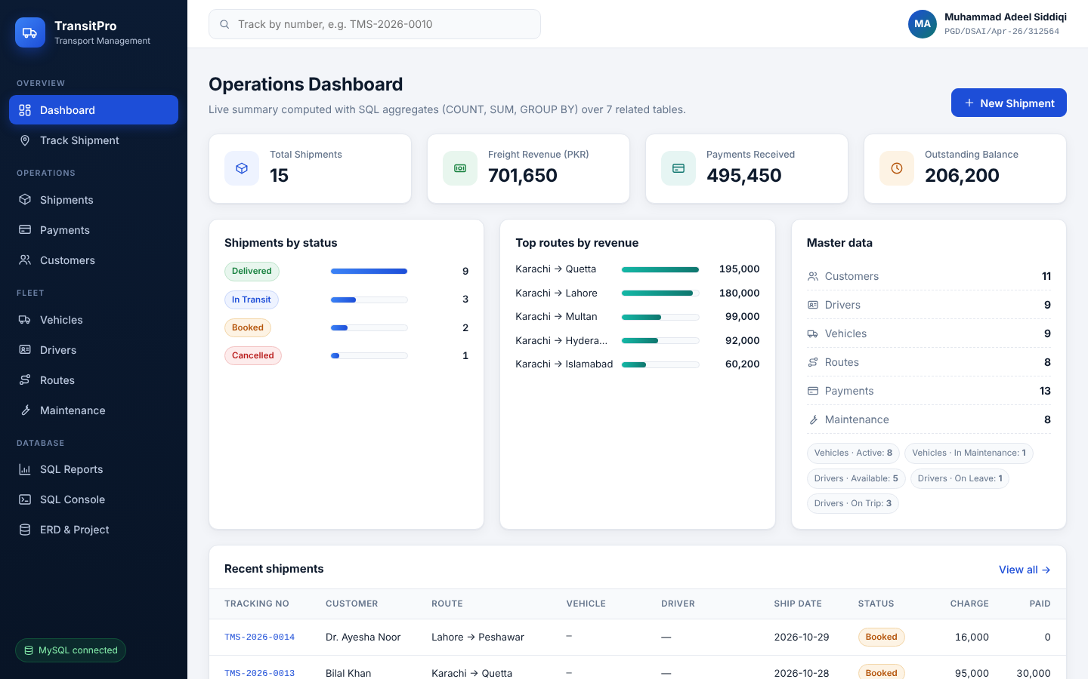
RDBMS PROJECT · PGD DSAI, BATCH XIV
TransitPro
Transport Management System
From ERD to a MySQL database to a working web application
Student
Muhammad Adeel Siddiqi
Registration
PGD/DSAI/Apr-26/312564
Course
RDBMS – Database Management Systems
Live dashboard, running on MySQL
Instructor
Sajid Majeed
University
NED University of Engineering & Technology
Notes:
Introduce the project: TransitPro is a transport management system built for the RDBMS course. It shows the full path from an ERD, to a normalised MySQL database, to a working web application with forms.

Slide 2






What's in this presentation
Click any card to jump straight to that part
01
02
03
ZIP navigator
Project & architecture
Database design
What's inside the ZIP and where to start
Problem, key numbers, architecture
ERD, tables, keys, SQL concepts
Slide 3 →
Slides 4–5 →
Slides 6–8 →
04
05
06
Run it in 3 steps
App tour
Evaluate & highlights
Requirements and one-click start
Dashboard, forms, JOINs, reports
5-minute checklist and what stands out
Slide 9 →
Slides 10–14 →
Slides 15–16 →
Notes:
This slide is the table of contents. Each card is a hyperlink: in slideshow mode, click a card title to jump to that section.

Slide 3








Inside the ZIP: where to start
Open the files on the left in order. The folders on the right hold the project itself.
OPEN IN THIS ORDER
TransitPro_Presentation.pptx
This deck: the whole project in pictures
database/
docs/
TransitPro_Overview.pdf
01_schema_mysql.sql: tables, keys, constraints
02_seed_data.sql: sample data
03_queries_demo.sql: JOINs, procedures, triggers
ERD.png / ERD.svg: the diagram
screenshots/: 12 page screenshots
One-page summary of the app
TransitPro_App_Guide.pdf
How to run and evaluate (4 pages)
TransitPro_User_Manual.docx
How to use every screen (Word)
START_HERE.bat
app.py · db.py · config.py
templates/ · static/
Double-click to run the app
Flask web app and MySQL connection
requirements.txt: Flask, PyMySQL
HTML pages (forms, lists, reports)
CSS design and ERD image
README.md
Full project report and data dictionary
Notes:
This slide explains how to use the ZIP. Start with this presentation, then the one-page overview, then the App Guide. START_HERE runs the app. The database folder has the SQL scripts for MySQL Workbench, and docs has the ERD and screenshots.

Slide 4


Project at a glance
One system for shipments, fleet, drivers, routes, payments and maintenance
The problem
7
6
19
A transport company tracks bookings, trucks, drivers and payments in separate sheets. Data gets duplicated, payments are missed and nobody knows where a shipment is.
Tables (3NF)
Foreign keys
CHECK rules
The solution: TransitPro
73
9
1
One normalised MySQL database designed from an ERD, with a web interface to book, assign, track and bill every shipment. The database itself protects data quality.
Sample records
Live SQL reports
Click to run
Notes:
The problem is scattered, duplicated data. The solution is one relational database. Key numbers: 7 tables, 6 foreign keys, 19 CHECK constraints, 73 sample records and 9 SQL reports, all started with one click.

Slide 5

How the parts work together
Every click in the browser becomes an SQL statement on MySQL
Browser
Flask (Python)
MySQL 8
Web interface
Application layer
transport_db
Dashboard and forms
Search, filters, tracking
Responsive HTML + CSS
Routes and validation
Business rules
SQL via PyMySQL
7 tables, 1 view, 2 indexes
Keys and constraints
Transactions (COMMIT)
EXAMPLE: SAVING A NEW SHIPMENT
1
Fill the form
2
Flask validates and calculates freight
3
INSERT INTO shipments … COMMIT
4
Page shows the result + SQL
Notes:
Three layers. The browser shows forms and pages. Flask, written in Python, validates input, applies business rules and sends parameterised SQL to MySQL through the PyMySQL connector. MySQL stores the data and enforces keys and constraints. Every save runs inside a transaction.

Slide 6
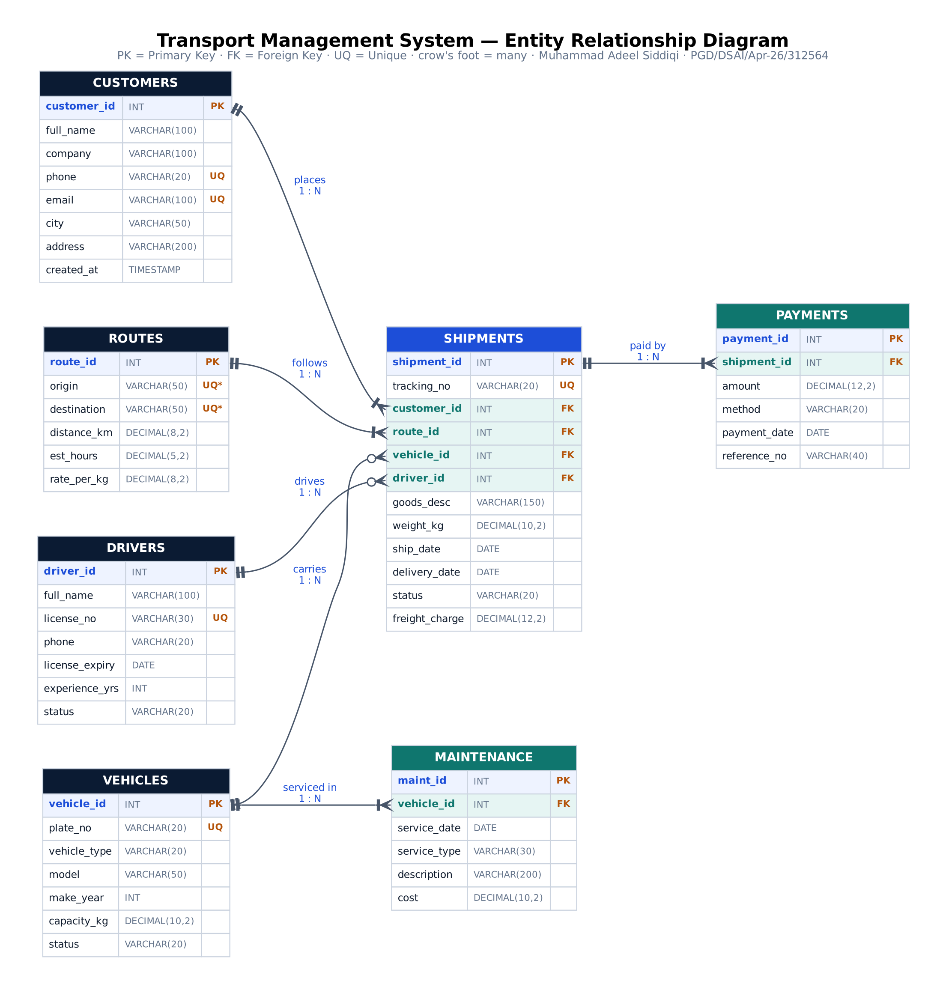
Entity Relationship Diagram
7 entities, 6 one-to-many relationships; SHIPMENTS is the central entity
RELATIONSHIPS (ALL 1 : N)
ON DELETE
CUSTOMERS places SHIPMENTS
RESTRICT
ROUTES is followed by SHIPMENTS
RESTRICT
VEHICLES carries SHIPMENTS
SET NULL
DRIVERS drives SHIPMENTS
SET NULL
SHIPMENTS is paid by PAYMENTS
CASCADE
VEHICLES is serviced in MAINTENANCE
CASCADE
Many-to-many resolved: customers ↔ routes ↔ vehicles ↔ drivers meet in SHIPMENTS, which holds 4 foreign keys.
Notes:
SHIPMENTS is the central, transaction entity. Customers, routes, vehicles and drivers each have a one-to-many relationship with it. Payments belong to a shipment, and maintenance belongs to a vehicle. The ON DELETE rules show what happens to child rows: RESTRICT blocks the delete, SET NULL un-assigns, CASCADE removes children.

Slide 7
Tables, keys and constraints
Normalised to 3NF: every fact is stored once, in the table it belongs to
Table | Primary key | Foreign keys | Main constraints | Rows
customers | customer_id | — | UNIQUE phone, email · CHECK email format | 11
drivers | driver_id | — | UNIQUE license_no · CHECK status, experience | 9
vehicles | vehicle_id | — | UNIQUE plate_no · CHECK type, year, capacity | 9
routes | route_id | — | UNIQUE (origin, destination) · CHECK origin ≠ destination | 8
shipments | shipment_id | customer_id, route_id, vehicle_id, driver_id | UNIQUE tracking_no · CHECK weight, dates, status | 15
payments | payment_id | shipment_id | CHECK amount > 0, method | 13
maintenance | maint_id | vehicle_id | CHECK cost ≥ 0, service type | 8
3NF
NOT NULL
DEFAULT values
AUTO_INCREMENT keys
View: v_shipment_details
2 indexes
ON UPDATE CASCADE
Notes:
Each table has an AUTO_INCREMENT primary key. Shipments carries four foreign keys, payments and maintenance one each. UNIQUE stops duplicate phone numbers, licence numbers, plates and tracking numbers. 19 CHECK constraints enforce valid values, such as positive weight and a delivery date on or after the ship date.

Slide 8






SQL concepts covered
Everything from the course, used inside the app or in 03_queries_demo.sql
DDL & keys
Constraints
CRUD
CREATE / ALTER / DROP, primary keys, foreign keys, indexes
NOT NULL, UNIQUE, CHECK, DEFAULT, ON DELETE rules
INSERT, SELECT, UPDATE, DELETE with WHERE / LIKE / ORDER BY
Where: 01_schema_mysql.sql
Where: Enforced in every form
Where: Add, edit, delete forms
Joins
Aggregates & sub-queries
Advanced
INNER, LEFT, RIGHT and SELF JOIN across up to 5 tables
COUNT, SUM, AVG, GROUP BY, HAVING, IN / NOT IN, correlated
View, stored procedure, function, triggers, COMMIT / ROLLBACK, GRANT
Where: SQL Reports, detail page
Where: Dashboard, reports
Where: 03_queries_demo.sql
Notes:
Every concept from the course outline appears in the project, either live in the web app or as a runnable script in 03_queries_demo.sql, which can be executed statement by statement in MySQL Workbench.

Slide 9




Run it in 3 steps
No commands to type: the database builds itself on the first run
1
2
3
Unzip the folder
Double-click START_HERE.bat
Use the app
Right-click the ZIP → Extract All. Everything is inside, including the SQL scripts and ERD.
Installs Flask and PyMySQL automatically (first time 1–2 min), then asks for the MySQL root password.
The browser opens 127.0.0.1:5000. A green MySQL connected badge confirms the link. Keep the console window open.
WHAT YOU NEED
Python 3.10+
MySQL 8.0.16+ & Workbench
Any web browser
python.org, with "Add to PATH" ticked
Optional: without it, the app uses built-in SQLite
Edge, Chrome or Firefox
Notes:
Running the project takes three steps. START_HERE.bat checks for Python, installs the packages, asks for the MySQL root password and opens the browser. If transport_db does not exist yet, the app creates it from the same SQL scripts used in Workbench. On macOS or Linux, run: pip install -r requirements.txt, then python app.py.

Slide 10
Tour 1: the operations dashboard
Live numbers computed with SQL every time the page loads
1
KPI cards
SUM of freight and payments; outstanding balance
1
2
Shipments by status
COUNT(*) … GROUP BY status
3
Top routes by revenue
2
3
4
JOIN routes + SUM + ORDER BY … LIMIT 5
4
Master data
Record counts for all 7 tables
5
5
Recent shipments
Read from the view v_shipment_details
Notes:
The dashboard is the home page. Each block is a live SQL query: the KPI cards use SUM, the status bars use COUNT with GROUP BY, the top routes join shipments to routes, and the recent list reads from the view v_shipment_details. The badge at the bottom-left of the sidebar shows MySQL connected.

Slide 11
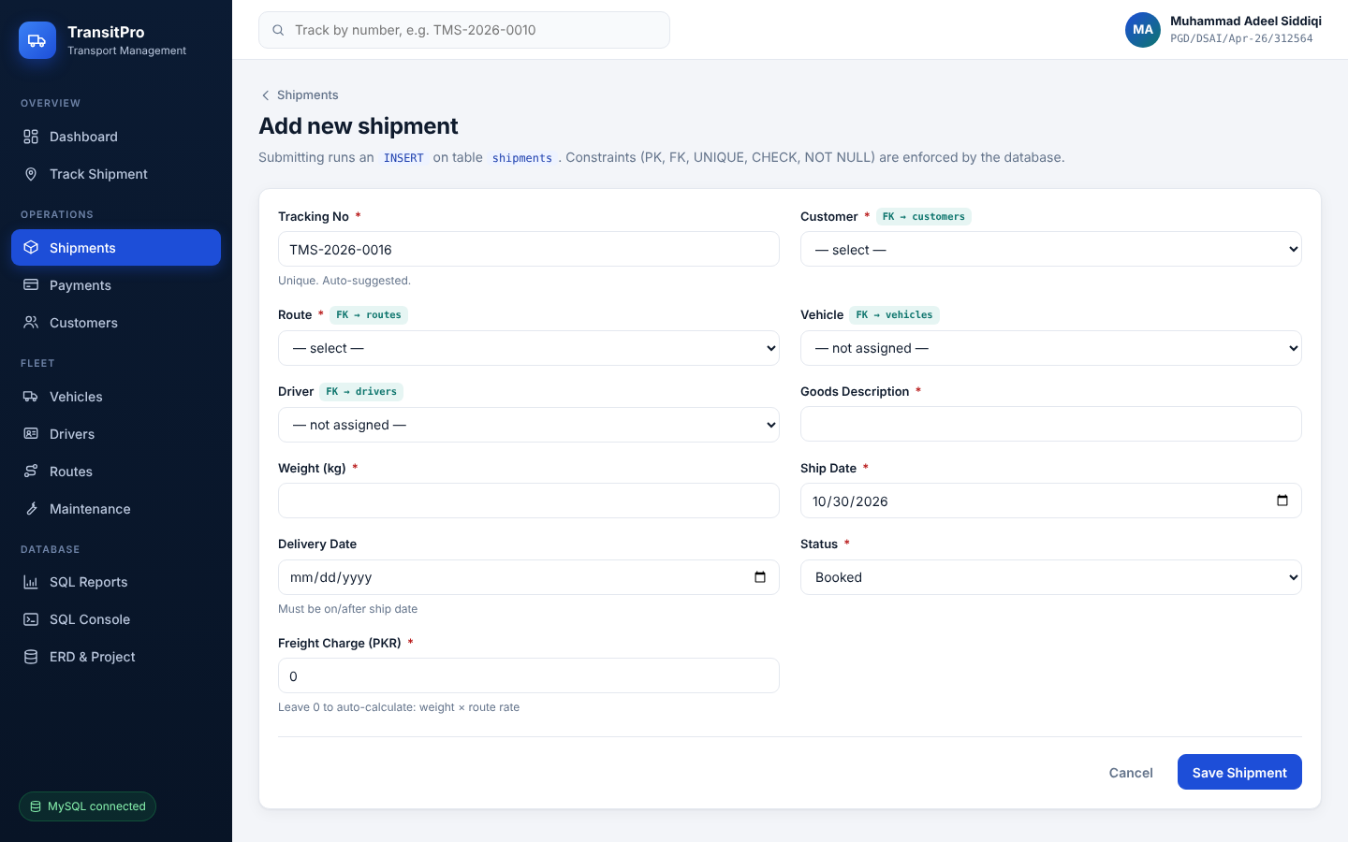
Tour 2: forms for every table (CRUD)
Add, view, search, edit and delete records in all 7 tables
CREATE
Add form → Save
INSERT INTO shipments (…) VALUES (…)
READ
List page + search box
SELECT … WHERE customer LIKE '%Ali%'
UPDATE
Edit icon → Update
UPDATE customers SET city = … WHERE id = 7
DELETE
Delete icon → confirm
DELETE FROM payments WHERE payment_id = 3
Foreign keys appear as dropdowns of real records, for example Customer → customers table
Notes:
Every table has the same pattern: a list page with search, an Add form, an Edit form and a Delete button. After each save the app shows the SQL statement it ran, which makes the link between the web form and the database visible. All queries are parameterised, which prevents SQL injection.

Slide 12
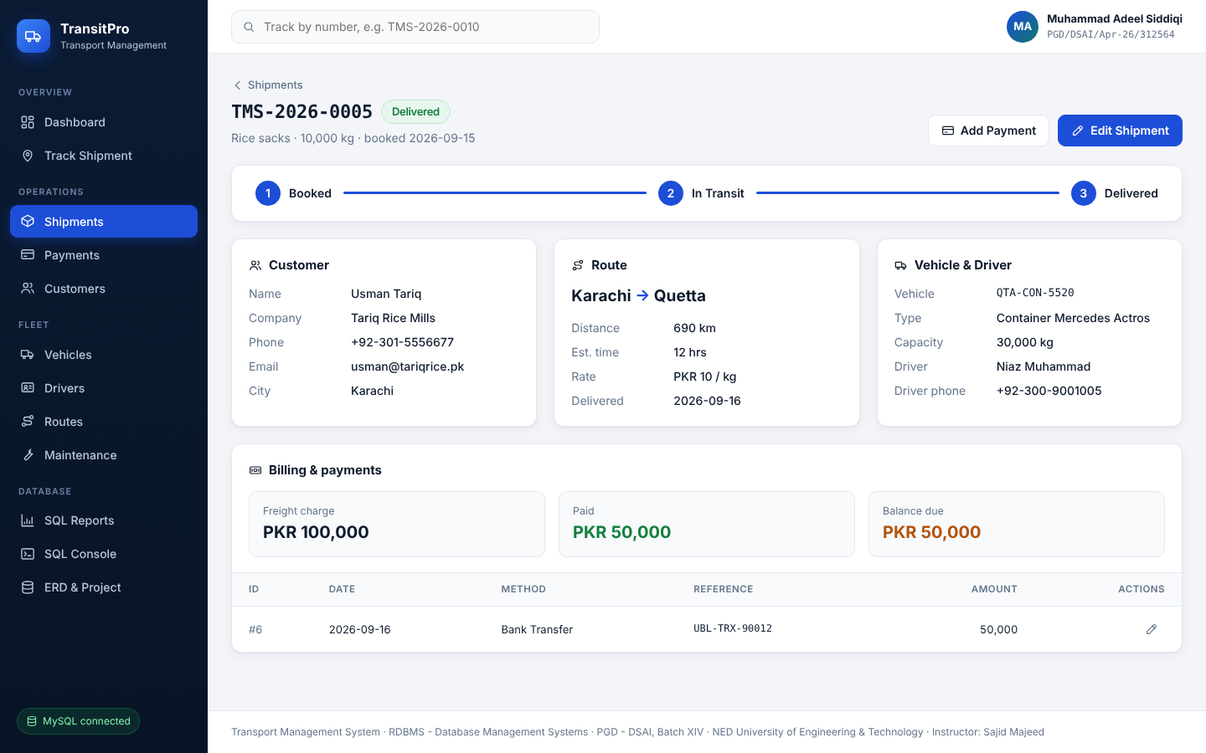



Tour 3: shipment detail and tracking
One page built from a 5-table JOIN
5-table JOIN
shipments + customers + routes, LEFT JOIN vehicles + drivers
Track by number
Type TMS-2026-0010 in the top bar
Progress tracker
Booked → In Transit → Delivered
Smart billing
Freight = weight × rate; balance = charge − payments
Notes:
Clicking a tracking number opens this page. It joins five tables: INNER JOIN for customer and route, which are mandatory, and LEFT JOIN for vehicle and driver, which can still be unassigned. Payments and the balance due come from a SUM over the payments table.

Slide 13
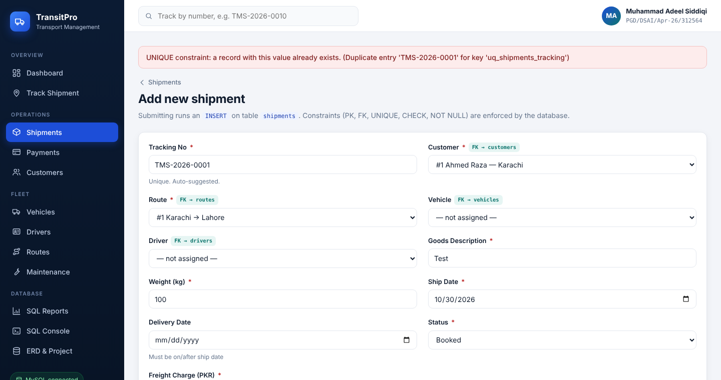
Tour 4: the database protects the data
Bad input is rejected by MySQL constraints, and the app explains why
Try this | Constraint | Result
Tracking no. TMS-2026-0001 again | UNIQUE | Refused
Weight −5 kg | CHECK | Refused
Delivery before ship date | CHECK | Refused
Route Karachi → Karachi | CHECK | Refused
Empty customer form | NOT NULL | Refused
Delete customer #1 | FK RESTRICT | Refused
Delete shipment with payments | FK CASCADE | Payments removed
Delete a vehicle in use | FK SET NULL | Un-assigned
Duplicate tracking number rejected by the UNIQUE constraint
Notes:
Data quality is enforced by the database, not only by the web page. Each of these actions is blocked or handled by a constraint, and the app turns the MySQL error into a clear message. These are good live tests to show in a viva.

Slide 14
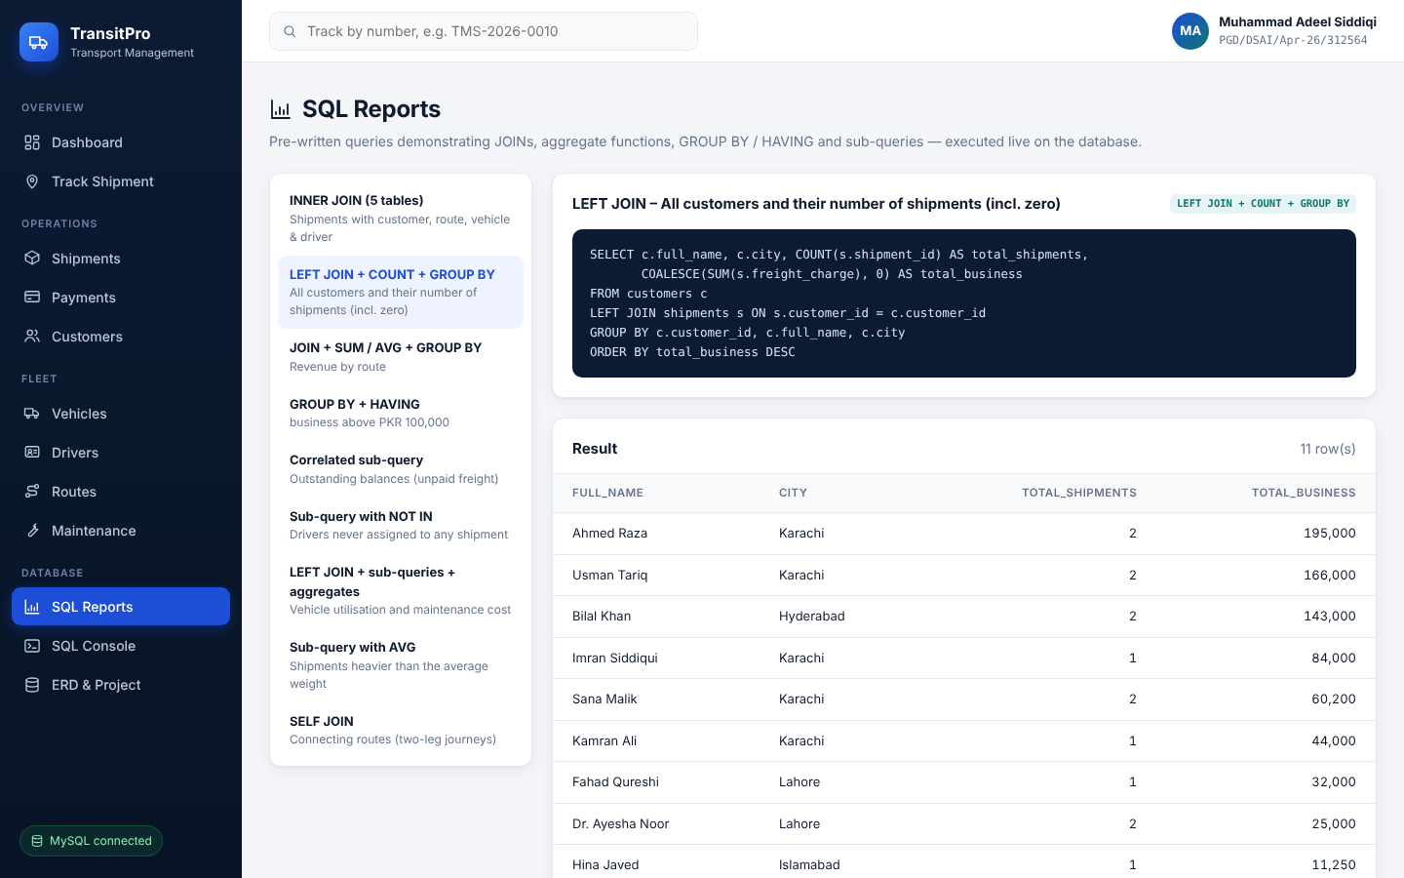
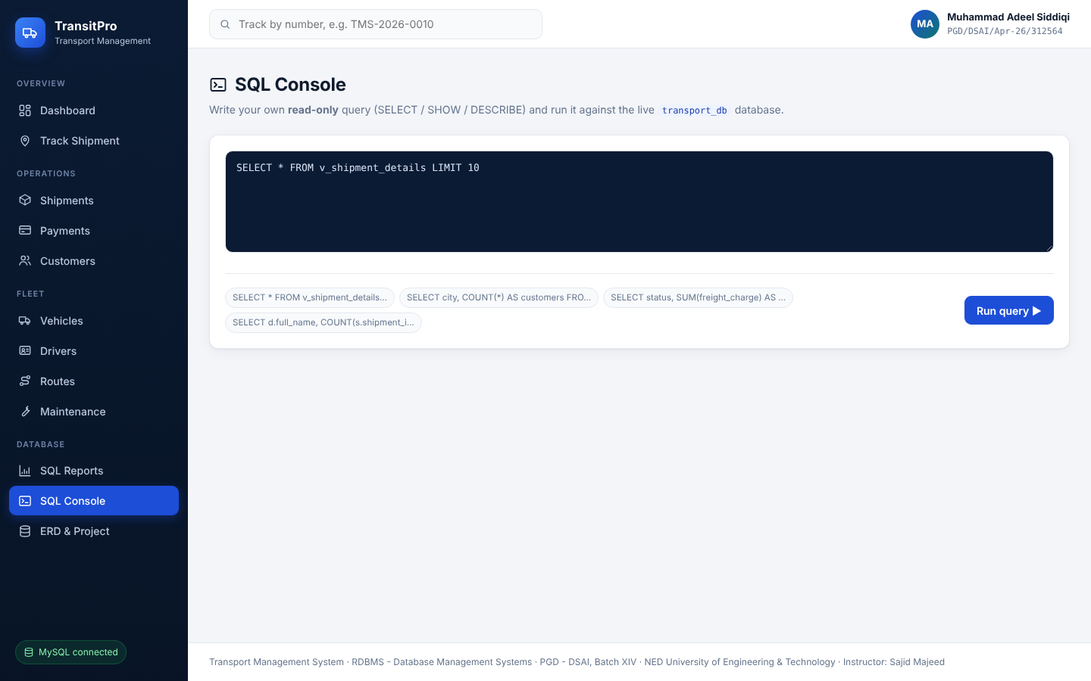
Tour 5: SQL Reports and SQL Console
See the query and its live result side by side
SQL Reports: 9 ready queries with their SQL text
SQL Console: run your own read-only SELECT
INNER JOIN
LEFT JOIN
SELF JOIN
GROUP BY
HAVING
Correlated sub-query
NOT IN
AVG sub-query
Revenue by route
Notes:
SQL Reports runs nine pre-written queries covering every type of join, grouping and sub-query, and shows each query next to its live result. The SQL Console lets the examiner type any SELECT, SHOW or DESCRIBE statement; write statements are blocked there on purpose.

Slide 15
Evaluate it in 5 minutes
Follow these steps in the running app; each one proves a requirement
1
Open the Dashboard
6
Add shipment TMS-2026-0001
Proves: Aggregates over joined tables
Proves: UNIQUE constraint
2
Customers → Add, then SELECT in Workbench
7
Add a shipment with weight −5
Proves: INSERT + MySQL connectivity
Proves: CHECK constraint
3
Edit any row → Update
8
Delete the customer from step 2
Proves: UPDATE
Proves: DELETE
4
Search "Karachi" on Shipments
9
Open any shipment
Proves: SELECT … WHERE … LIKE
Proves: 5-table JOIN
5
Delete customer #1 Ahmed Raza
10
Click through SQL Reports
Proves: FOREIGN KEY RESTRICT
Proves: JOINs, HAVING, sub-queries
Notes:
This is the same checklist as in TransitPro_App_Guide.pdf. To restore the original sample data afterwards, run DROP DATABASE transport_db in Workbench and start START_HERE again; it rebuilds the database.

Slide 16




What makes TransitPro stand out
One-click setup
SQL made visible
Data integrity
The database builds itself in MySQL
Every save shows the statement it ran
19 CHECK rules, 6 UNIQUE, 6 FOREIGN KEYS
Real business rules
Secure by design
Professional UI
Auto freight, balance due, capacity warning
Parameterised SQL and transactions
Responsive on laptop, tablet and phone
Thank you
Muhammad Adeel Siddiqi
PGD/DSAI/Apr-26/312564
NED University of Engineering & Technology
Questions are welcome. Live demo: double-click START_HERE.bat
Notes:
Summary of the strongest points, then thank the audience. Future enhancements could include user login with roles, PDF invoices and live GPS tracking.

