Slide 1
gamekeeper
Becca Blanton, Madeline Morris, Rachel Kroetch, Uyen Nguyen

Slide 2
Concept – USER story
• As an avid Board game player, I want to be able to search board games.
• Then I can filter games by amount of players, game time, and age level.
• As I search, I want to keep track of all the games I want to play.
• When I log in, I can save games to my Wishlist or games that I own.
• As I keep track of the games I want, I can organize my games into my Wishlist or add them to a list of games I already play and own.

Slide 3
Motivation

Slide 4
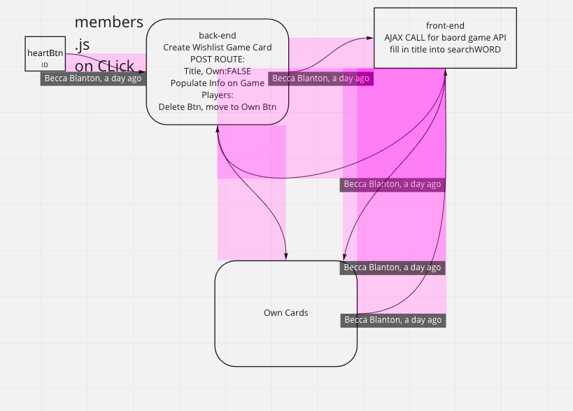
Design Process

Slide 5
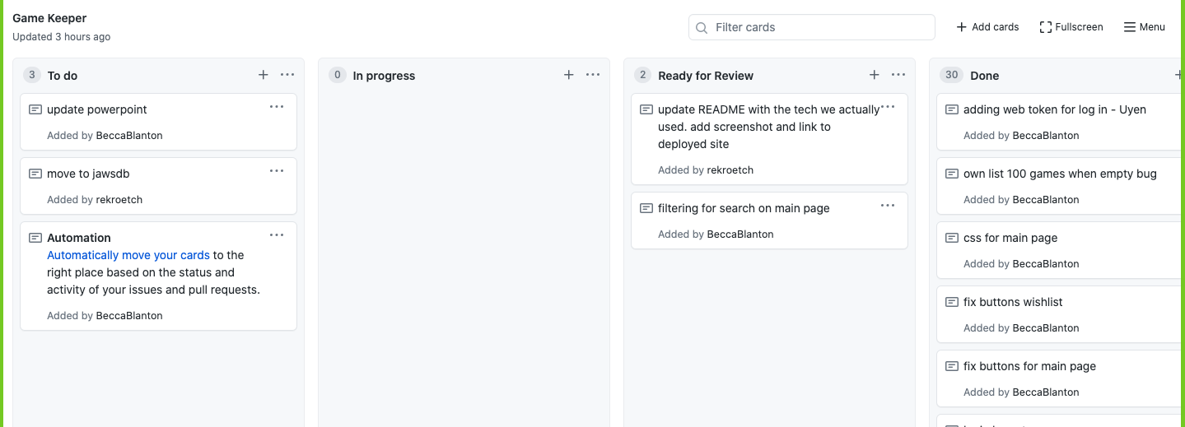
KanBan

Slide 6
Technologies Used
GSAP to add graphics
Node to download packages
Handlebars for templating
Passport to handle login
Express for server
FontAwesome for icons
• JavaScript
• A board game atlas API to pull all info for searching
• CSS for styling
• Bootstrap for UI
• JWT.IO web token
• Heroku for app deployment

Slide 7
Demo

Slide 8
Problems

Slide 9
Directions for future development
Filter through owned games & Wishlist
Add friends and compare Wishlists.
Review games through comments section.
Add a search bar with map that shows where user can buy game and will locate stores near the user where the game is available.

