Slide 1
Evaluating Automated Redistricting Algorithms Using Measures of Compactness and Partisan Fairness: A Case Study of 2021 Congressional Redistricting in Virginia
Madeleine Goertz

Slide 2
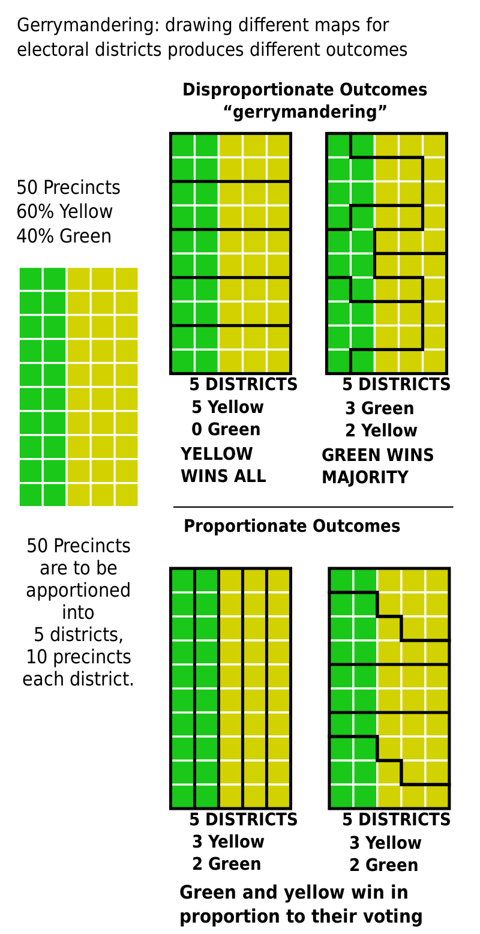
Adapted from M.boli, 2017
Notes:
Gerrymandering explained. (M.boli, 2017)

Slide 3
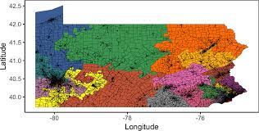
Automated Redistricting Algorithms
Population Data & Geographic Data
(many maps)
(Fifield et al., 2020)

Slide 4
How do the hypothetical district maps for the Virginia Congressional delegation for the 2020s generated by different automated redistricting algorithms compare based on compactness and partisan fairness measures?

Slide 5
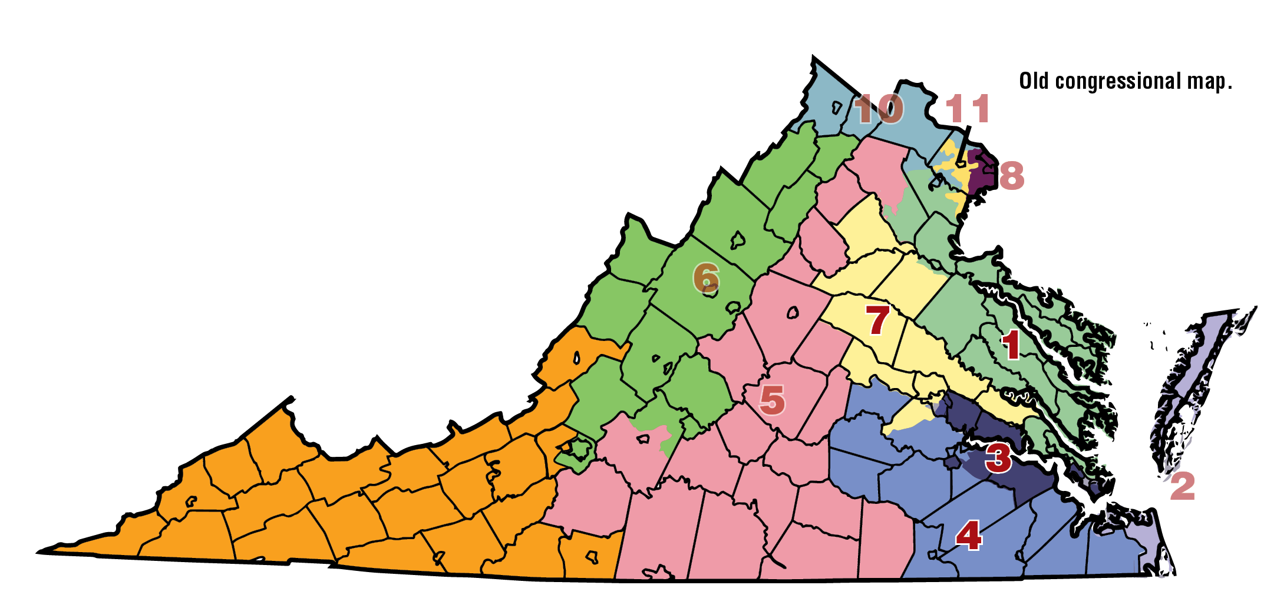
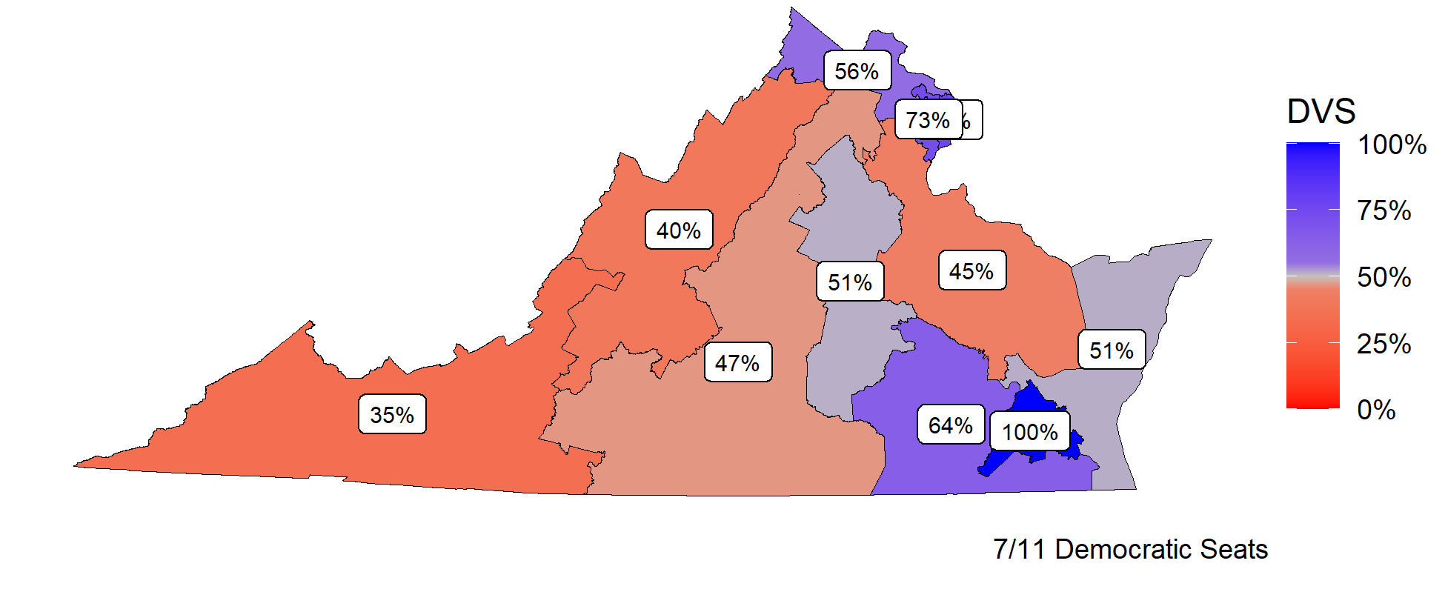

Why Virginia?
Gerrymandered Map
Competitive Elections
(Loughran, 2016;
Virginia Division of Legislative Services, 2021)
Notes:
(Loughran, 2016) (Virginia Division of Legislative Services, 2021)

Slide 6
Which Algorithms?
Compact Random Seed Growth (CRSG), 2013
Sequential Monte Carlo (SMC), 2020
(Chen & Rodden, 2013;
McCartan & Imai, 2020)
Notes:
(Chen & Rodden, 2013; McCartan & Imai, 2020)

Slide 7

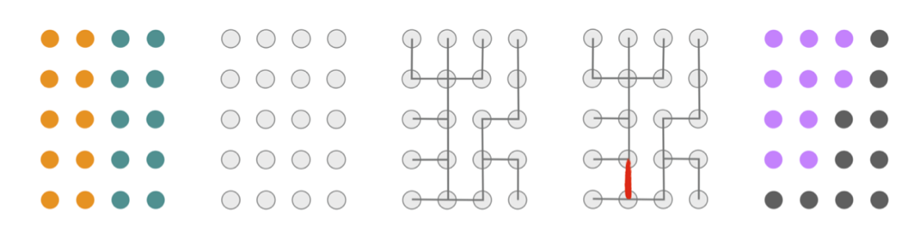
Which Compactness Measures?
Geometry Perspective
Graph Theory Perspective
(Fisher, 2017;
DeFord et al., 2021)
Notes:
(Chen & Rodden, 2013; McCartan & Imai, 2020)

Slide 8
Which Partisan Fairness Measures?
Seats-Votes Curve
Efficiency Gap
Partisan Symmetry
Declination
Partisan Bias
Mean-Median Difference
(Tufte, 1973;
Katz et al., 2020;
Stephanopoulos & McGhee, 2014;
Warrington, 2018;
McDonald & Best, 2015)
Notes:
(Tufte, 1973; Katz et al., 2020; Stephanopoulos & McGhee, 2014; Warrington, 2018; McDonald & Best, 2015)

Slide 9
Literature Review

Slide 10
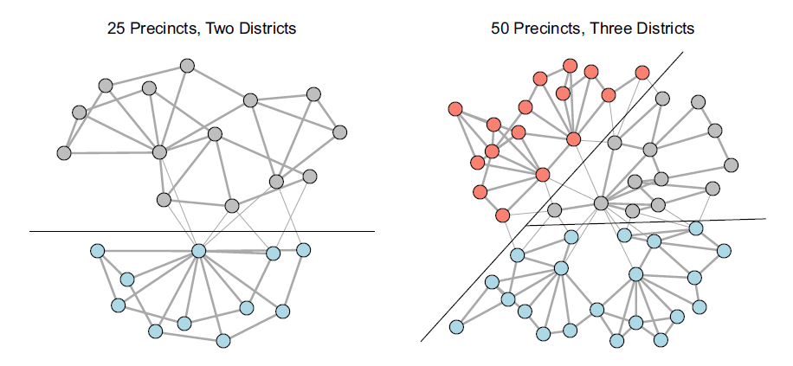
Redistricting as Graph Cutting
(Fifield et al., 2020)

Slide 11
Compact Random Seed Growth (CRSG)
Each precinct is one district.
Repeat until desired number of districts formed:
2. Random district: merge with closest neighbor.
Repeat until desired population parity reached:
3. Reassign one precinct from most-populous district to less populous district.
(Chen & Rodden, 2013)

Slide 12
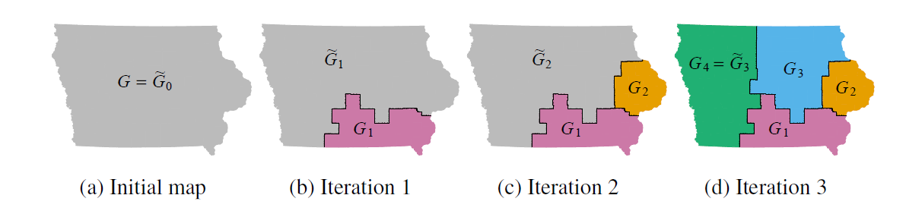
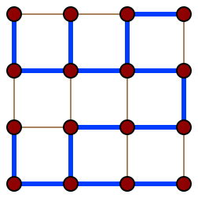
Sequential Monte Carlo (SMC)
A Spanning Tree
Sample Run of SMC
(Eppstein, 2007;
McCartan & Imai, 2020)

Slide 13

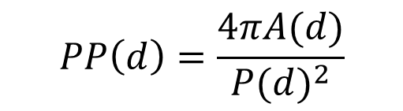
Polsby-Popper Score
$$PP\left(d\right)=\frac{4πA(d)}{{P(d)}^{2}}$$
$$PP\left(d\right)∝compactness$$
(Fischer, 2017;
Polsby & Popper, 1991)

Slide 14



Edge-Cut Compactness
$$ECC=1−\frac{n}{N}$$
$$ECC∝compactness$$
(DeFord et. al, 2021;
Dube & Clark, 2016)

Slide 15
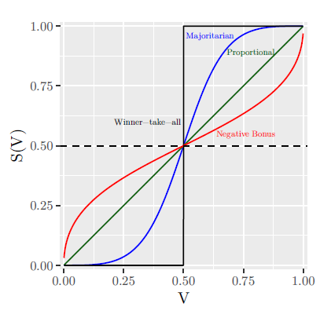
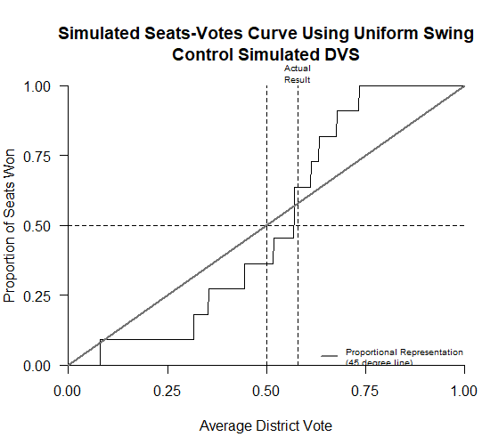
Seats-Votes Curves, Partisan Symmetry & Bias
Hypothetical Curve
Curve generated by UPS
(Katz et. al, 2020;
Tufte, 1973)

Slide 16
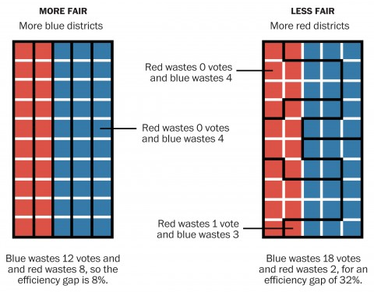
Efficiency Gap
(McGlone, 2017;
Stephanopoulos & McGhee, 2014)

Slide 17
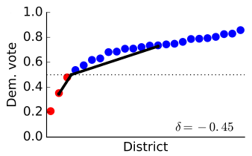
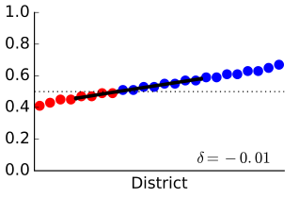
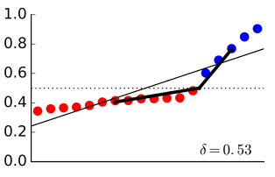
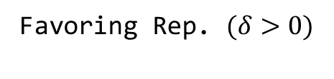

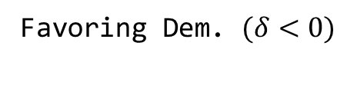
Declination
Favoring Dem. $(δ<0)$
Fair $(δ≈0)$
Favoring Rep. $(δ>0)$
(Warrington, 2018)

Slide 18
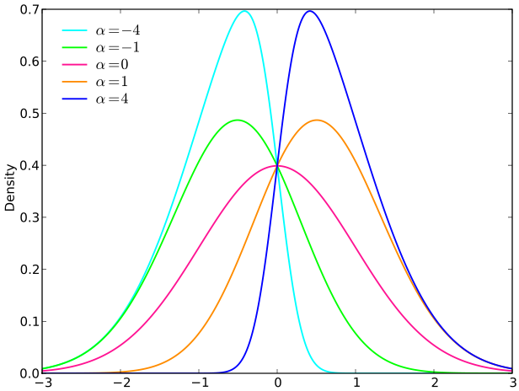


Mean-Median Difference
$$MMD=μ−m$$
$$\left|\frac{1}{MMD}\right|∝fairness$$
(Skbkekas, 2009;
McDonald & Best, 2015)
Notes:
(Skbkekas, 2009)

Slide 19
Method

Slide 20
Experimental Research
Isolate effect of algorithms on fairness.
Explanatory variable: algorithm choice.
Response variables: compactness, fairness measures.
Control: 2015-2020 district map.

Slide 21
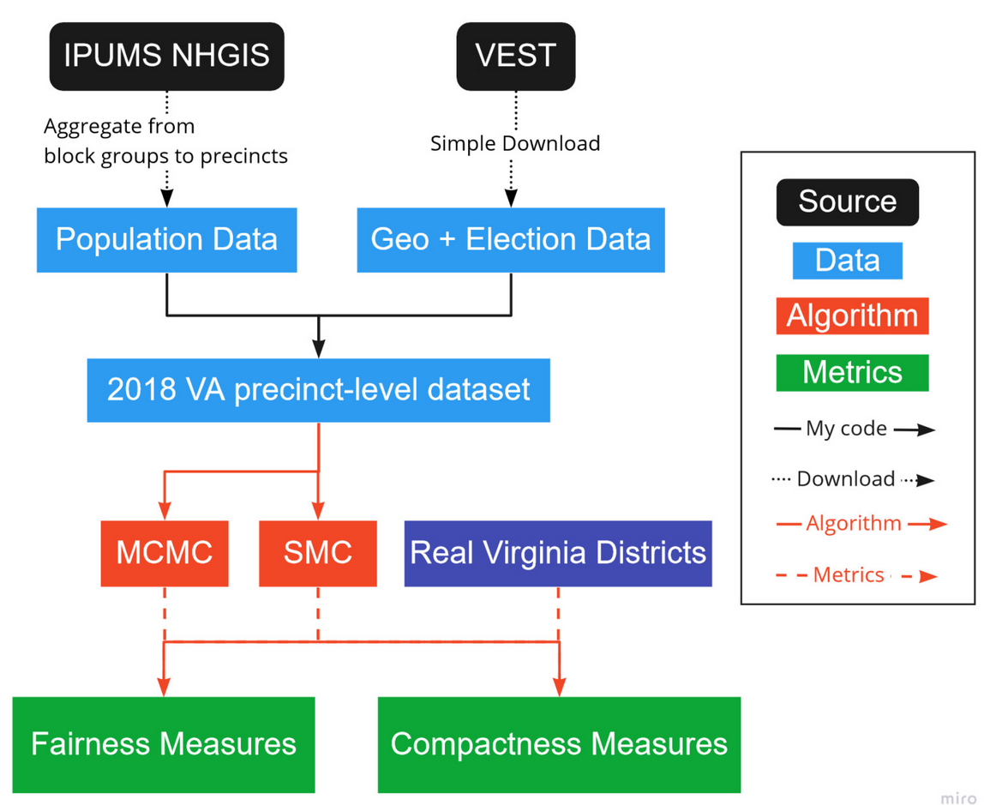

Notes:
(Skbkekas, 2009)

Slide 22
Results

Slide 23
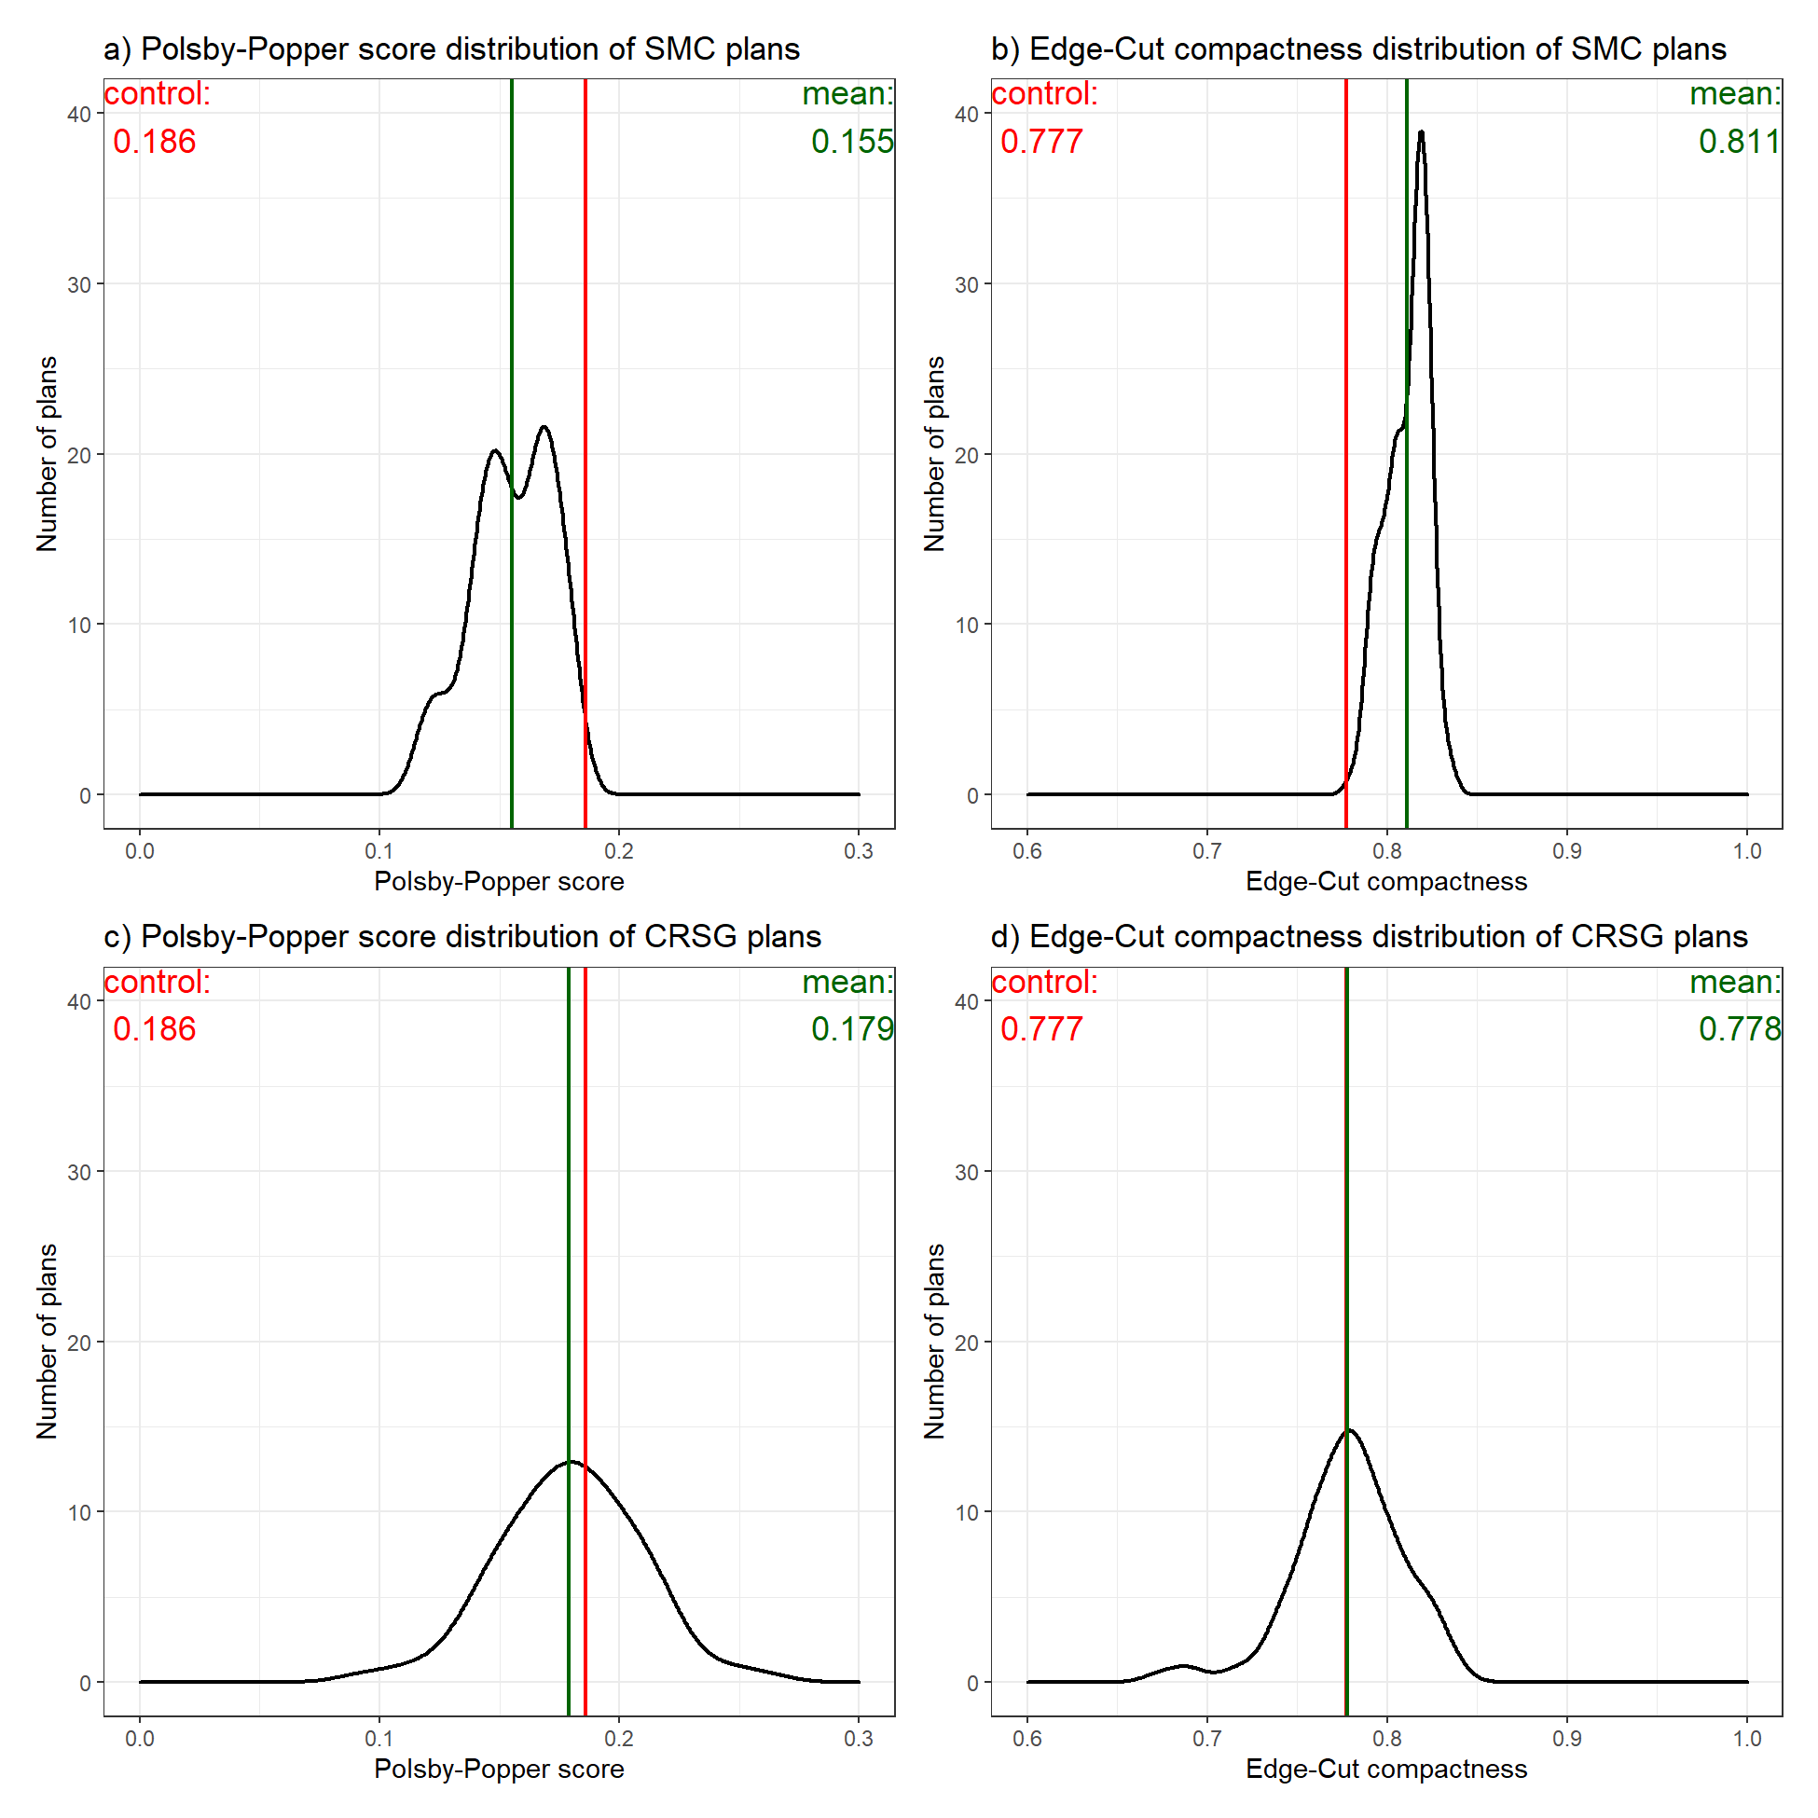

Slide 24
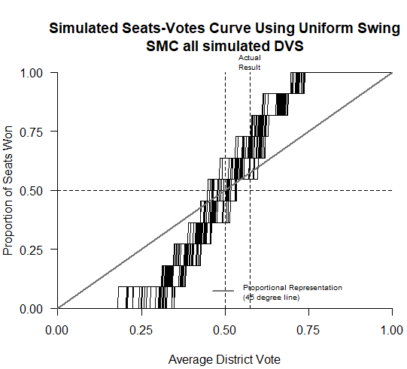
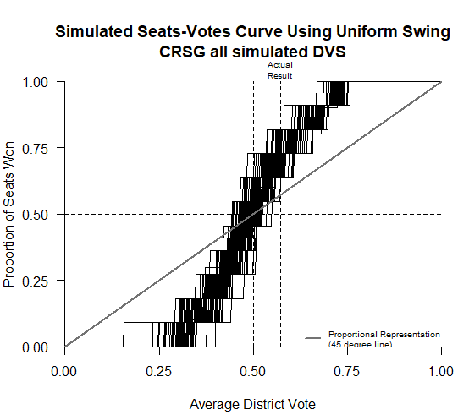

Slide 25
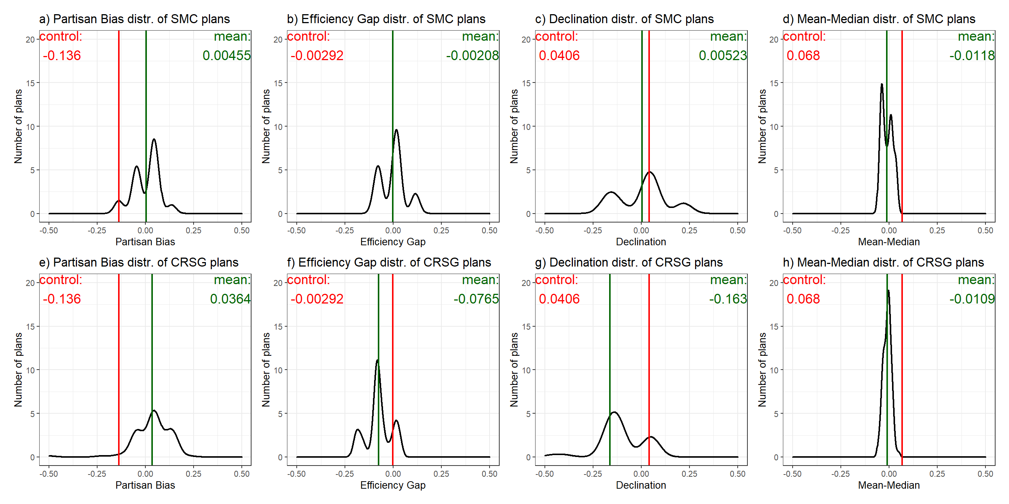

Slide 26
Conclusion

Slide 27
How do the hypothetical district maps for the Virginia Congressional delegation for the 2020s generated by different automated redistricting algorithms compare based on compactness and partisan fairness measures?

Slide 28
SMC >
CRSG >
Control

Slide 29
Limitations
Only one state, one election, two algorithms.
Only focused on major parties.
Should observe the Voting Rights Act.
State legislative districts.

Slide 30
Implications
Algorithms are viable tool for redist. commissions.
Necessary under The For The People Act.
Cost-savings for redist. commissions.
Trust in electoral system.

Slide 31

Bibliography
tinyurl.com/redist-sources

