Slide 1
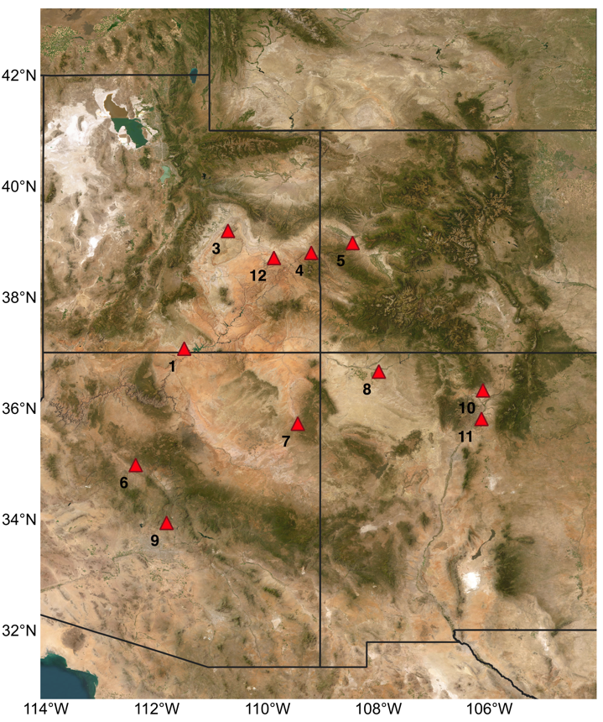
a)
b)
Pop | State | SAP (mm) | SAT (C) | SVPD (kPa) | SVPD CV (%)
1 | UT | 23.91 | 19.90 | 3.62 | 9.81
3 | UT | 72.00 | 12.49 | 2.02 | 13.29
4 | UT | 58.76 | 17.56 | 3.26 | 10.67
5 | CO | 59.02 | 16.46 | 2.75 | 12.04
6 | AZ | 29.00 | 17.81 | 3.39 | 10.86
7 | AZ | 29.78 | 13.18 | 2.46 | 11.19
8 | NM | 35.98 | 16.65 | 3.10 | 9.23
9 | AZ | 26.50 | 20.54 | 3.59 | 8.67
10 | NM | 58.09 | 13.99 | 2.40 | 12.84
11 | NM | 53.37 | 15.91 | 2.80 | 11.14
12 | UT | 48.86 | 16.56 | 2.76 | 11.10
Notes:
Figure 1. a) Collection locations and b) growing season climate characteristics for each population of Plantago patagonica. Spring climate characteristics were averaged across 30 years (1989 – 2019, April – June). SVPD = spring VPD

Slide 2
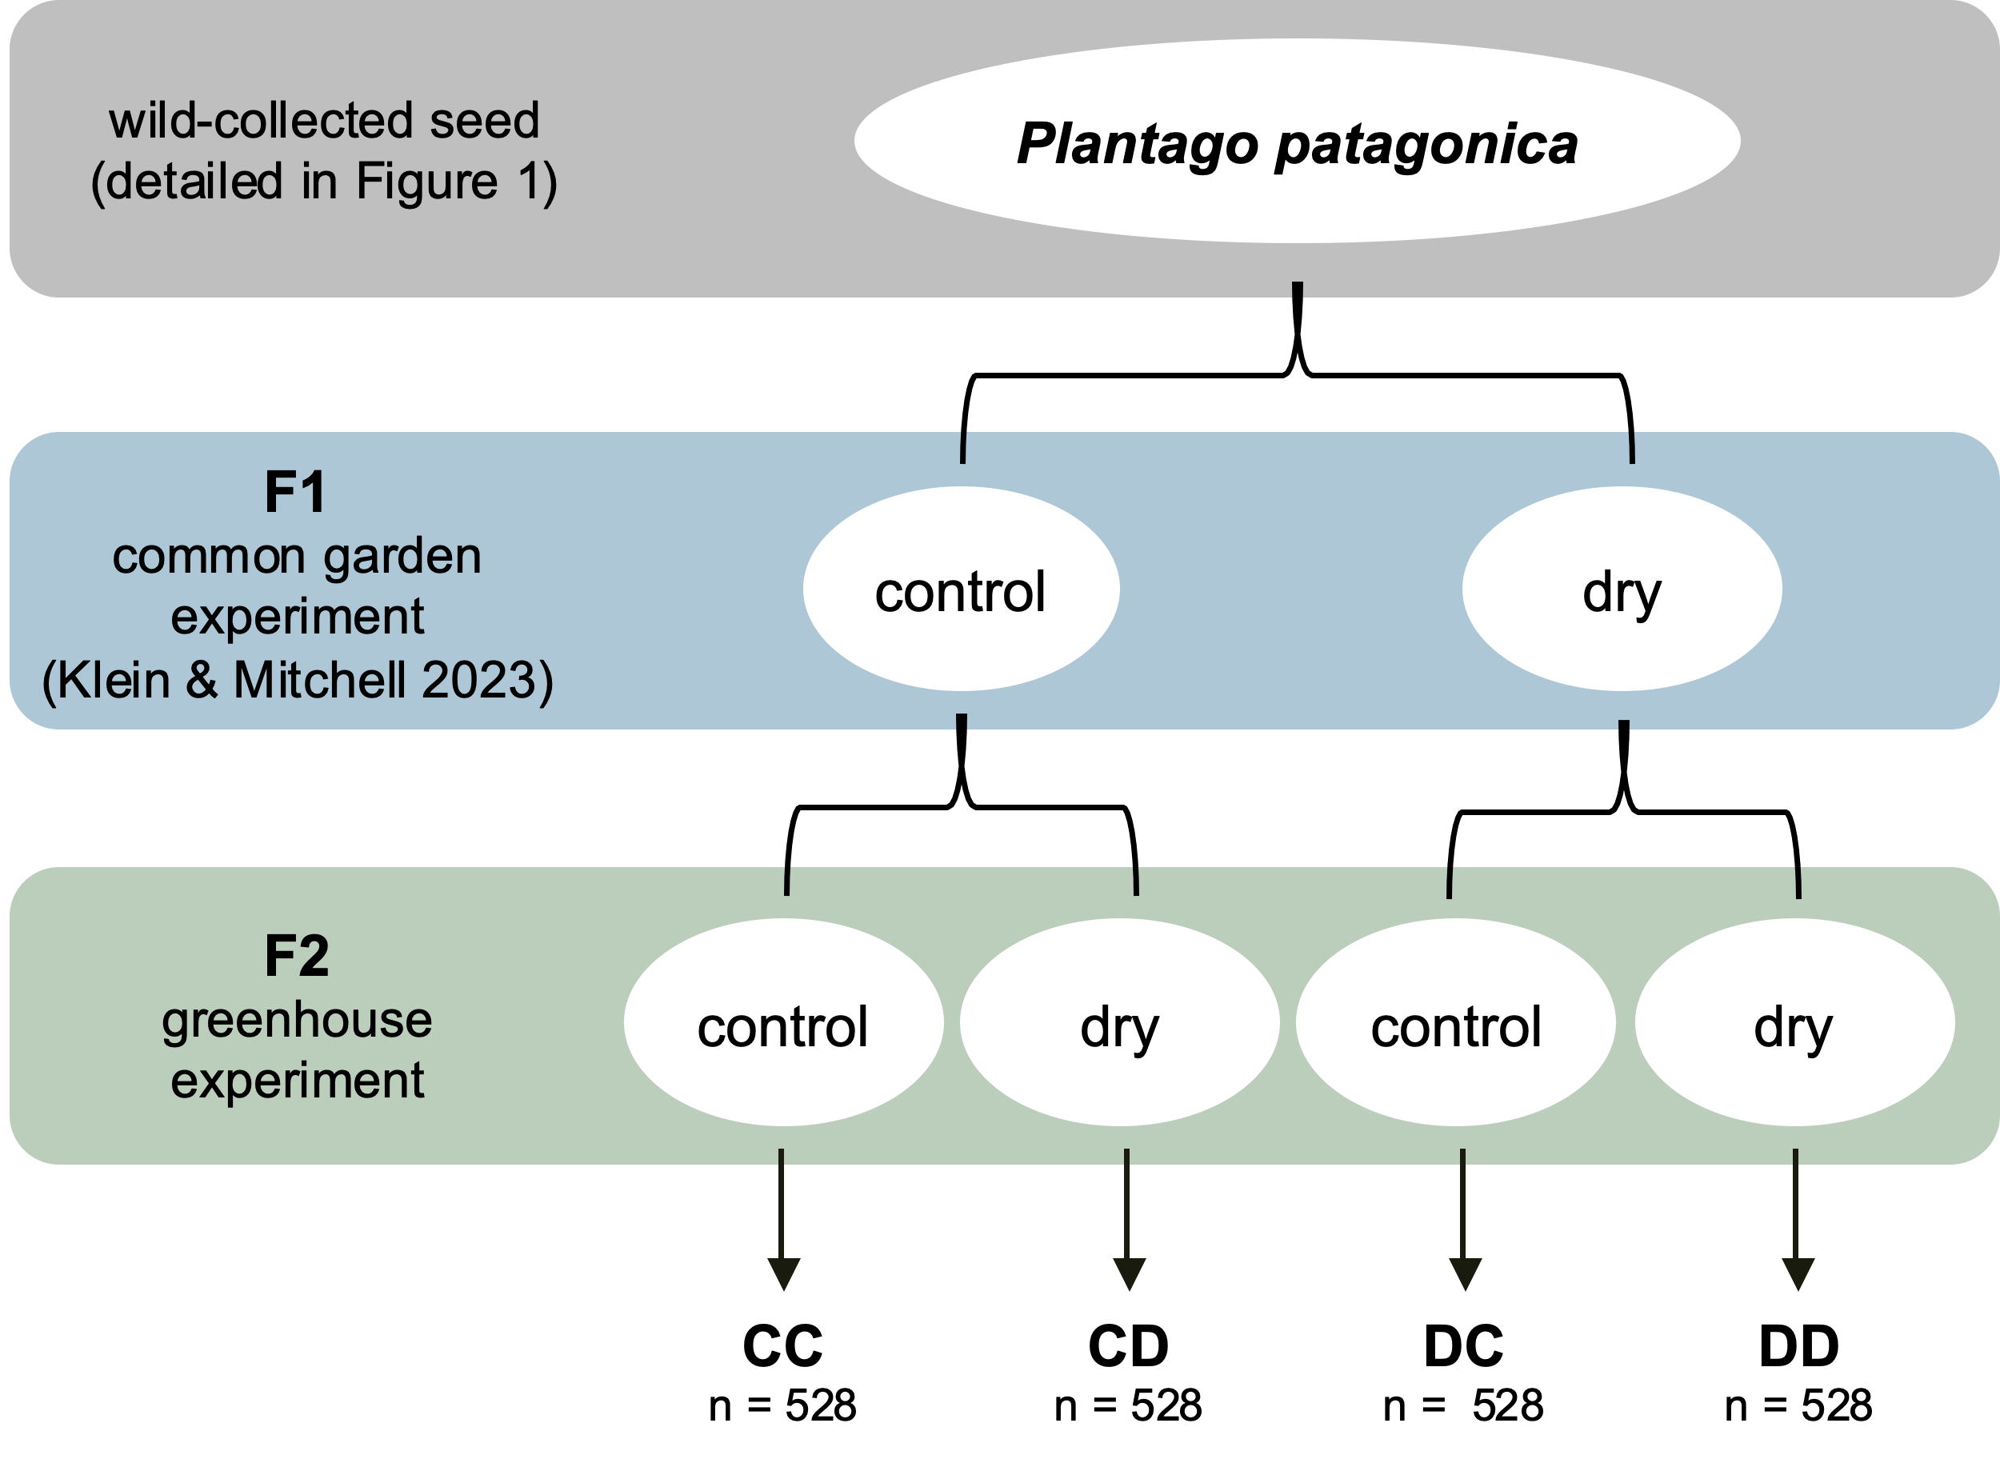
Notes:
Figure 2. Schematic of the fully factorial experimental design detailing F1 and F2 generations. We collected seeds from individuals in natural Plantago patagonica populations across a climatic gradient in AZ, UT, NM, and CO (Figure 1). In F1, these seeds were reared in a common-garden experiment and exposed to two experimental watering conditions. In F2, seeds from F1 were reared in a greenhouse experimental and again exposed to two experimental watering conditions, resulting four cohort groups: CC, CD, DC, and DD, as outlined in the text.

Slide 3
 | OT | PT | OT x PT | R²m | R²c
GROWTH
root biomass | F = 44.1209*** | F = 2.6995 | F = 0.9111 | 0.130 | 0.163
shoot biomass | F = 178.3746*** | F = 1.2064 | F = 0.5113 | 0.317 | 0.421
total biomass | F = 94.5629*** | F = 3.2213 # | F = 1.0857 | 0.225 | 0.287
max height | F = 2.1731 | F = 0.0069 | F = 1.1009 | 0.002 | 0.128
RESOURCE ALLOCATION
R:S ratio | F = 36.5018*** | F = 2.1155 | F = 0.6739 | 0.077 | 0.133
RGR | F = 12.1817*** | F = 0.0119 | F = 0.1523 | 0.017 | 0.055
SLA | F = 2.0644 | F = 0.5044 | F = 0.1812 | 0.008 | 0.067
LDMC | F = 8.3839** | F = 1.2024 | F = 0.5974 | 0.030 | 0.067
SURVIVAL
mortality | X2 = 1.5009 | X2 = 2.5306 | X2 = 0.3944 | 0.017 | 0.048
REPRODUCTION
days to flowering | X2 = 1.8167 | X2 = 0.8656 | X2 = 0.8667 | 0.047 | 0.112
number flowered
conditional model | X2 = 11.3193*** | X2 = 7.8754** | X2 = 0.0077 | 0.147 | 0.482
zero-inflation model | X2 = 0.204 | X2 = 0.8181
number of flowering structures
conditional model | X2 = 4.3122* | X2 = 0.6727 | X2 = 0.4926 | 0.482 | 0.482
zero-inflation model | X2 = 23.038*** | X2 = 10.265**
seed number | X2 = 5.0412* | X2 = 1.8286 | X2 = 7.1231** | 0.226 | 0.226
seed mass | X2 = 6.7250** | X2 = 1.7384 | X2 = 7.8555** | 0.277 | 0.295
df | 1 | 1 | 1
Notes:
Table 1. Results of mixed models testing the effects of offspring watering treatment (OT), parental watering treatment (PT), and their interactions on traits in Plantago patagonica. P values = p. < 0.1; *p < 0.05; **p < 0.01; ***p < 0.001. Signiﬁcant terms are shown in bold; terms in italics are marginally signiﬁcant. F-statistic (linear models) or Chi-squared statistic (generalized linear models), signiﬁcance levels and degrees of freedom (d.f.) are shown for each term. Zero inflated models were used for number flowered and number of flowering structures produced per plant. Population was included as a random factor. R2m = marginal R2; R2c = conditional R2.

Slide 4
trait | OT | PT | sVPD-CV | OT x PT | OT x sVPD-CV | PT x sVPD-CV | OT x PT x sVPD-CV | R²m | R²c
GROWTH
root biomass | F = 42.1948*** | F = 3.1251 # | F = 2.0861 | F = 1.0453 | F = 6.6818** | F = 6.4877* | F = 6.9657** | 0.141 | 0.175
shoot biomass | F = 184.3293*** | F = 0.8007 | F = 8.7548** | F = 0.3128 | F = 4.0071* | F = 3.8151 # | F = 0.909 | 0.345 | 0.433
total biomass | F = 92.9724*** | F = 3.3317 # | F = 0.0065 | F = 1.0925 | F = 2.3834 | F = 2.2751 | F = 3.6949 # | 0.234 | 0.293
max height | F = 1.9401 | F = 0.0358 | F = 0.5302 | F = 1.0994 | F = 0.0117 | F = 5.6204* | F = 0.3554 | 0.009 | 0.147
RESOURCE ALLOCATION
R:S ratio | F = 38.6267*** | F = 2.6923 | F = 8.6016** | F = 0.8986 | F = 6.3966* | F = 2.5964 | F = 3.4765 # | 0.101 | 0.147
RGR | F = 12.7805*** | F = 0.0007 | F = 0.0786 | F = 0.3424 | F = 0.7966 | F = 0.5182 | F = 5.8834* | 0.025 | 0.069
SLA | F = 1.8832 | F = 0.4492 | F = 0.111 | F = 0.1753 | F = 0.2841 | F = 2.0341 | F = 0.1777 | 0.016 | 0.084
LDMC | F = 8.1292** | F = 1.2131 | F = 0.0856 | F = 0.5561 | F = 0.0461 | F = 0.0098 | F = 0.2471 | 0.031 | 0.071
SURVIVAL
mortality | X2 = 1.5818 | X2 = 1.9809 | X2 = 0.5622 | X2 = 0.3407 | X2 = 0.1891 | X2 = 3.7915 # | X2 = 0.2526 | 0.026 | 0.053
REPRODUCTION
days to flowering | X2 = 2.4899 | X2 = 1.1826 | X2 = 0.4963 | X2 = 0.2623 | X2 = 0.8655 | X2 = 0.0651 | X2 = 0.864 | 0.058 | 0.120
number flowered
conditional model | X2 = 7.2036** | X2 = 10.0314** | X2 = 0.7833 | X2 = 0.3388 | X2 = 0.3699 | X2 = 9.7222** | X2 = 2.9813 # | 0.263 | 0.596
zero-inflation model | X2 = 0.0247 | X2 = 0.575 | X2 = 16.8902***
number of flowering structures
conditional model | X2 = 0.8824 | X2 = 3.3255 # | X2 = 6.1195* | X2 = 2.0336 | X2 = 1.1482 | X2 = 2.8731 # | X2 = 1.2142 | 0.305 | 0.000*
zero-inflation model | X2 = 23.078*** | X2 = 10.632** | X2 = 15.949***
seed number | X2 = 3.8636* | X2 = 1.879 | X2 = 0.0613 | X2 = 5.2154* | X2 = 0.0259 | X2 = 0.2191 | X2 = 0.6711 | 0.270 | 0.270
seed mass | X2 = 3.7370 # | X2 = 2.2043 | X2 = 0.0224 | X2 = 6.4568* | X2 = 0.0102 | X2 = 0.0282 | X2 = 0.3564 | 0.290 | 0.293
df | 1 | 1 | 1 | 1 | 1 | 1 | 1
Notes:
Table 2. Results of mixed models testing the effects of offspring watering treatment (OT), parental watering treatment (PT), and seed source climate at origin value: the 30-year mean annual spring VPDmax (kPa) coefficient of variation for each seed source location, and their interactions. P values = p. < 0.1; *p < 0.05; **p < 0.01; ***p < 0.001. F-statistic (linear models) or Chi-squared statistic (generalized linear models), signiﬁcance levels and degrees of freedom (d.f.) are shown for each term. Zero inflated models were used for number flowered and number of flowering structures produced per plant. Population was included as a random factor. R2m = marginal R2; R2c = conditional R2.

Slide 5
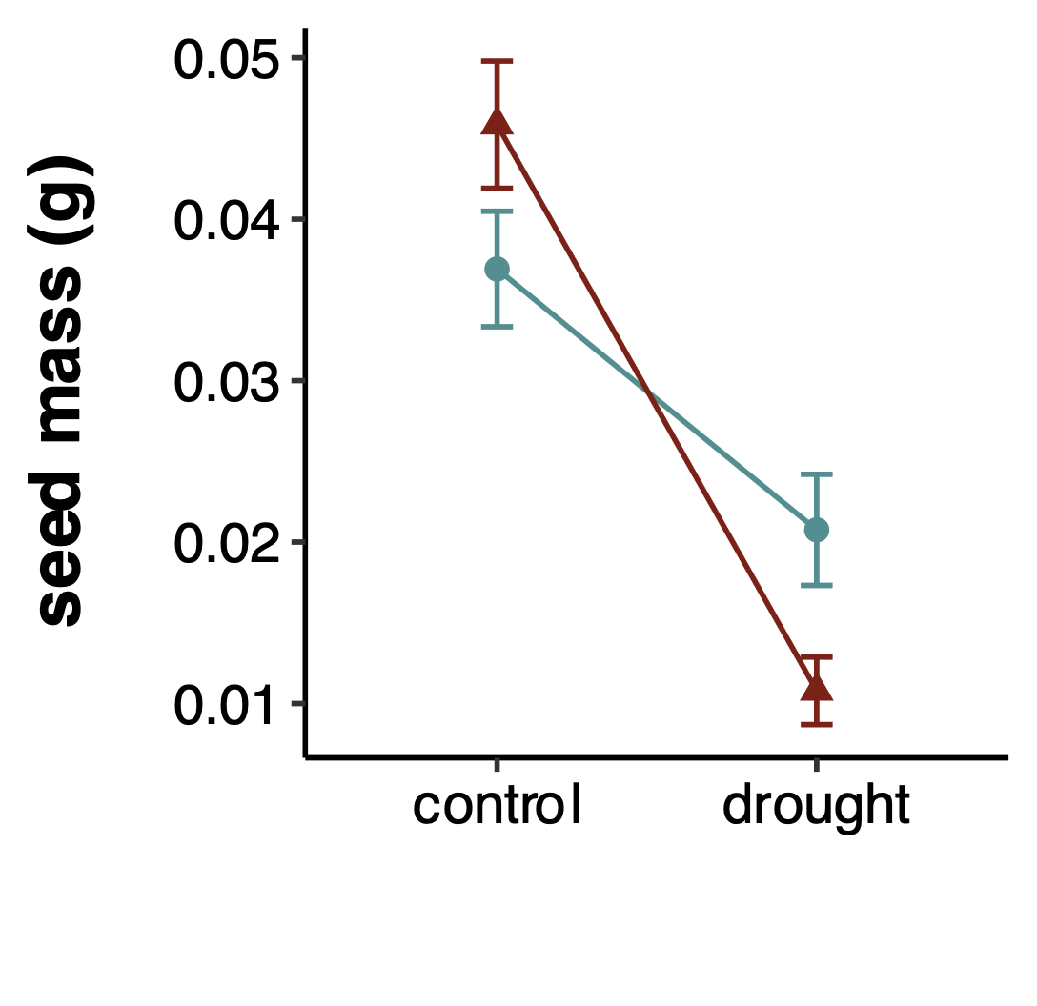
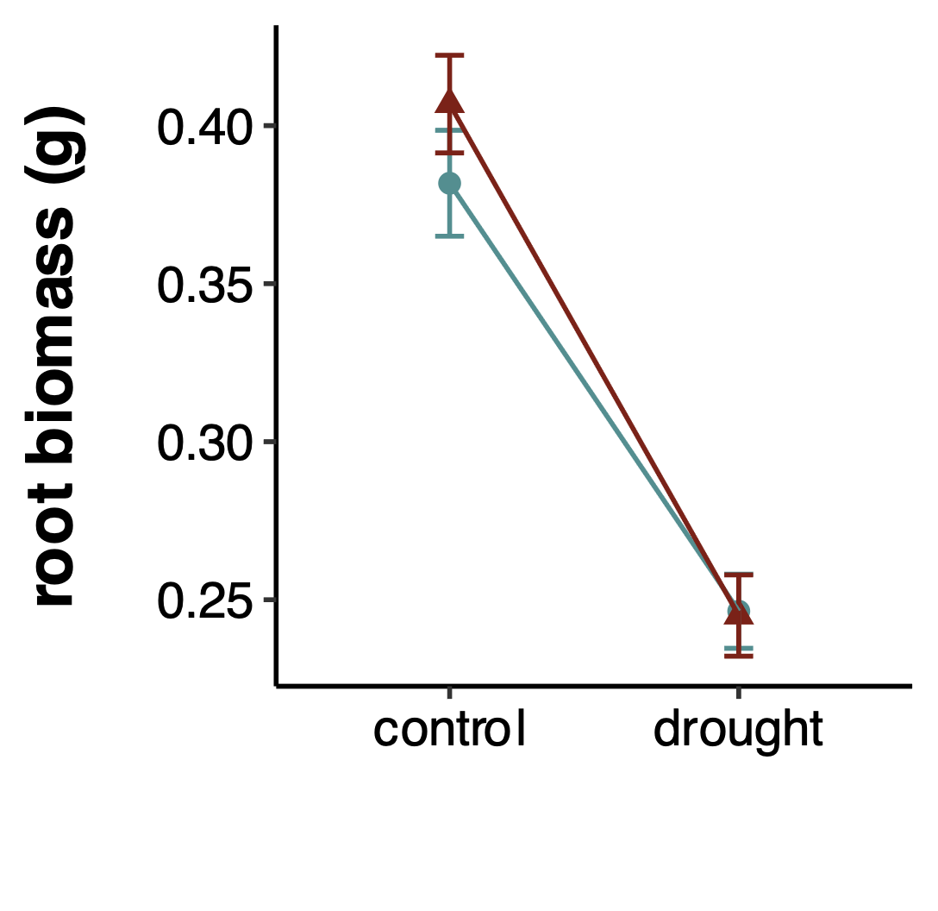
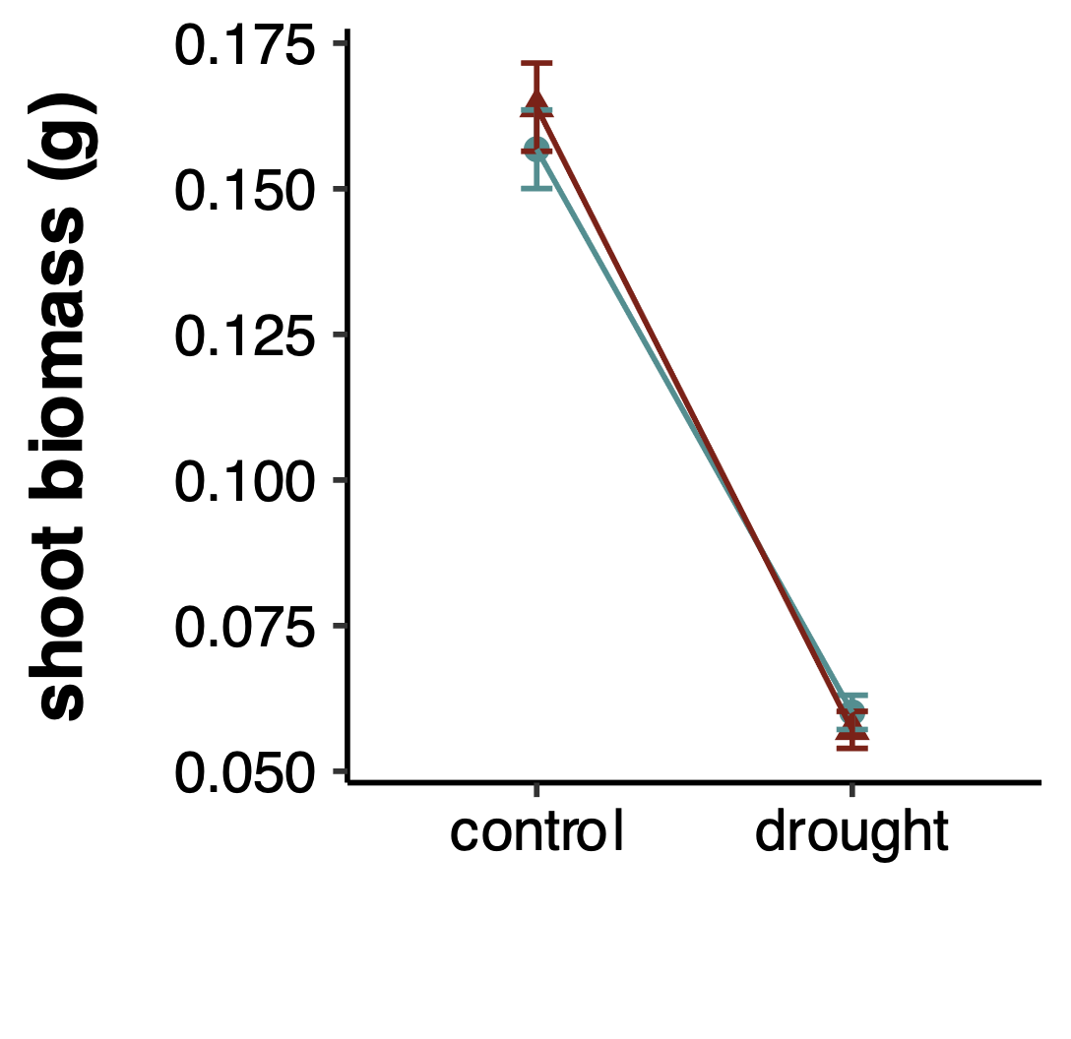
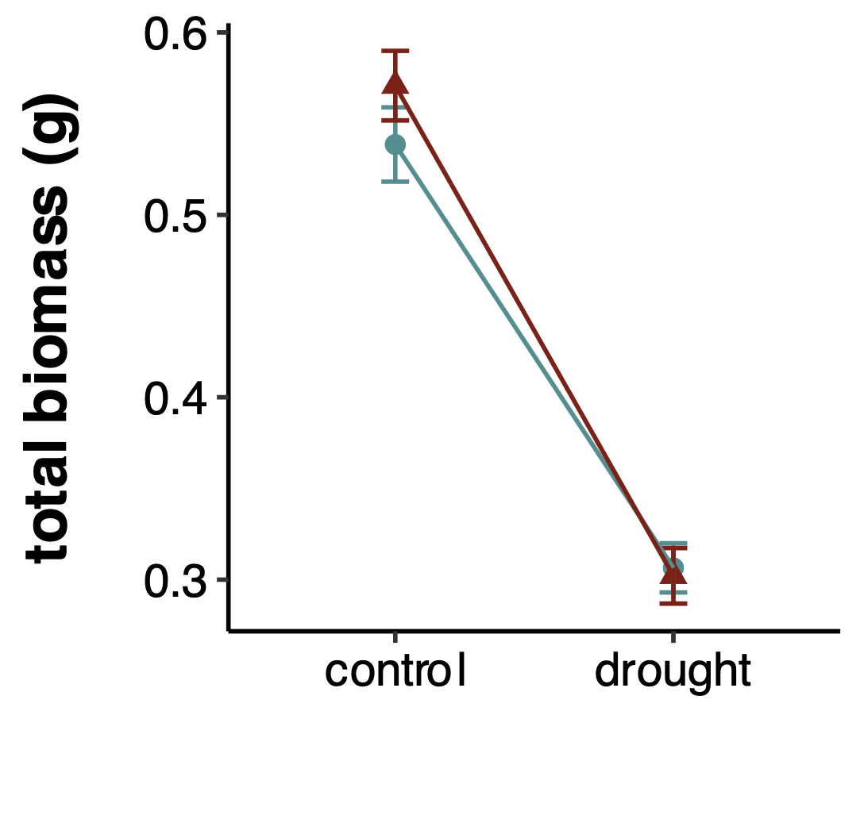
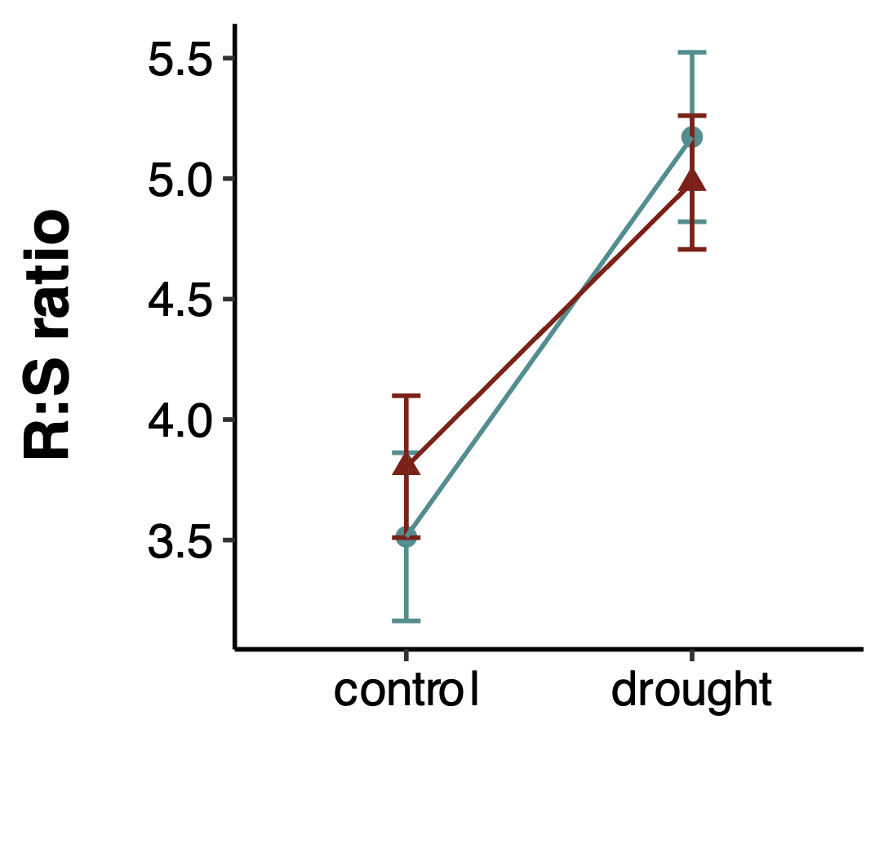
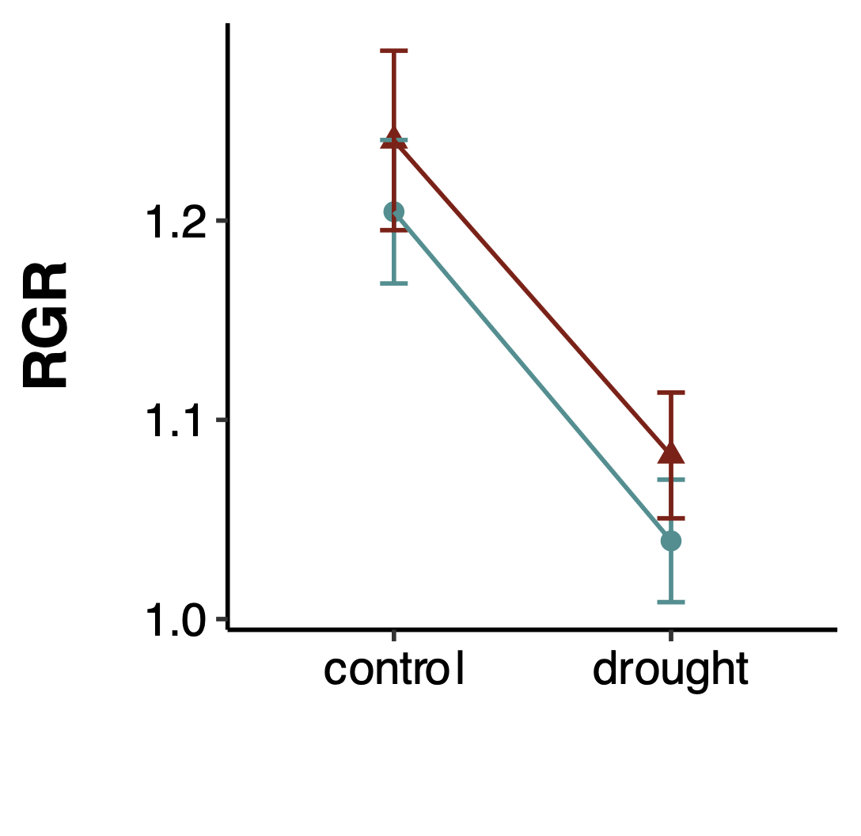
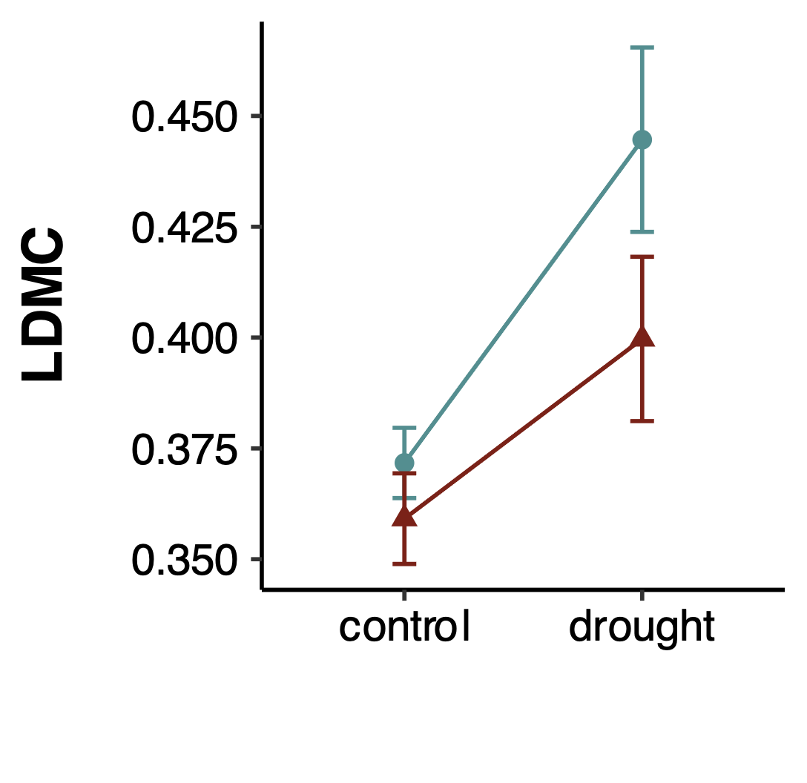
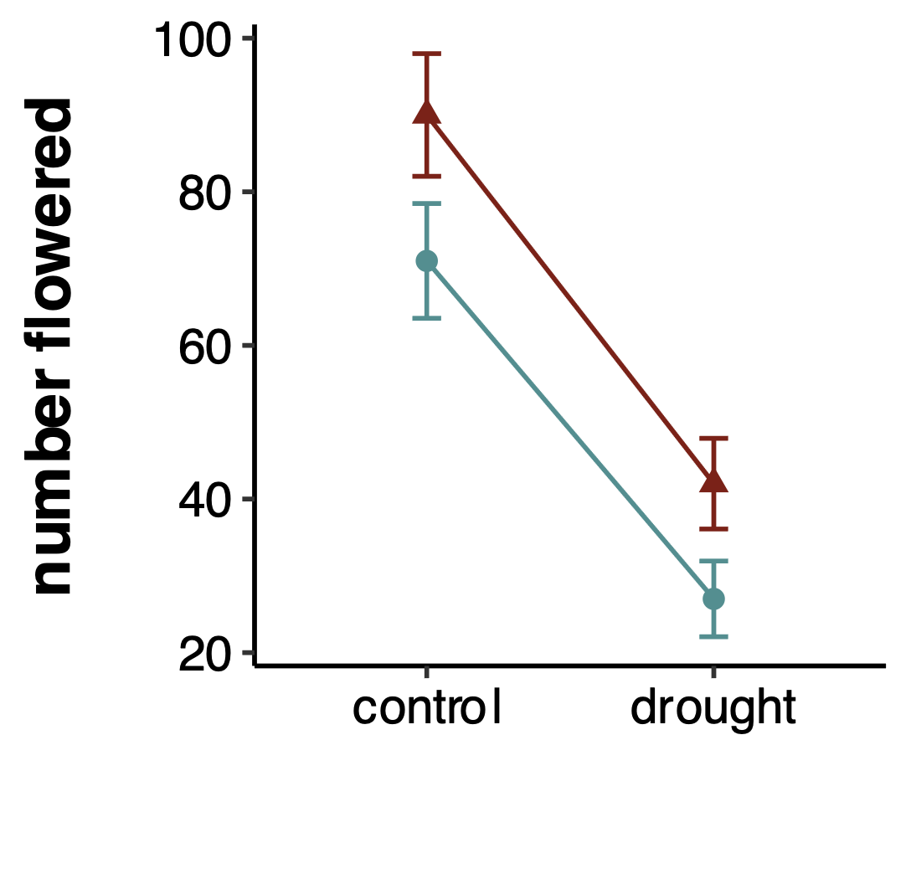
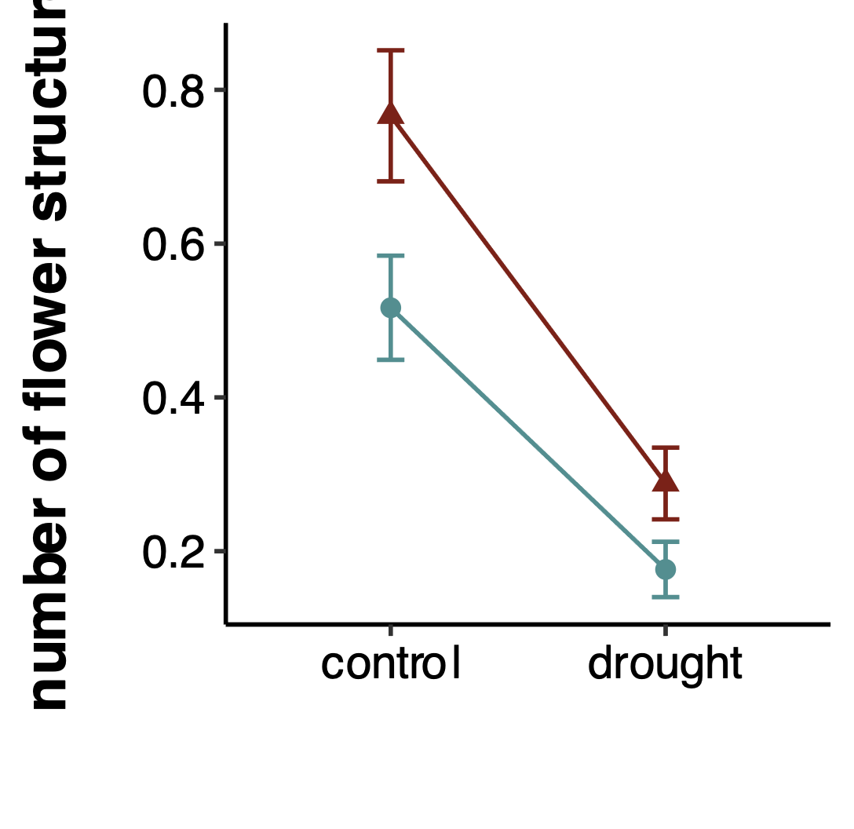
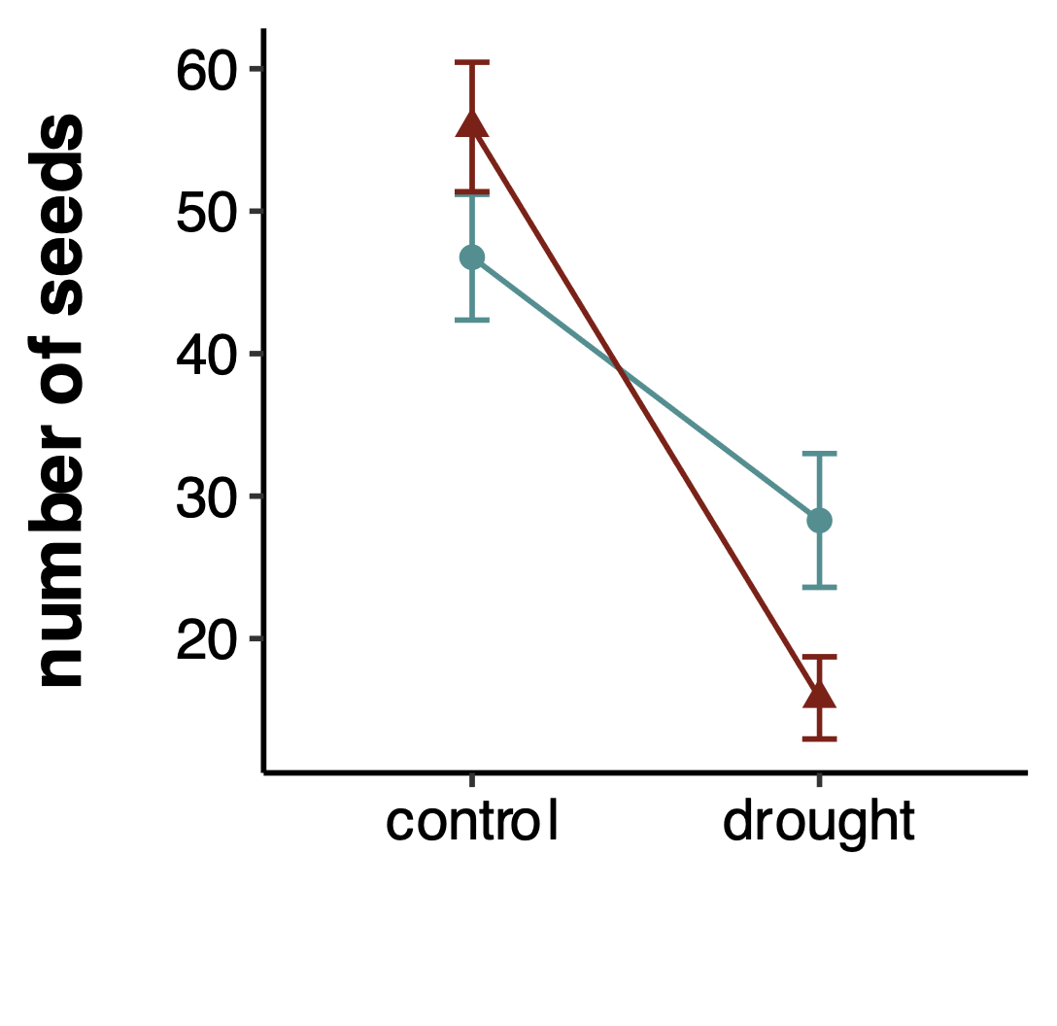
j)
a)
b)
c)
OT: **
PT: ns
OT x PT: **
OT: ***
PT: ns
OT x PT: ns
OT: ***
PT: ns
OT x PT: ns
OT: ***
PT: ns
OT x PT: ns
d)
e)
f)
parental treatment
control
drought
OT: **
PT: ns
OT x PT: ns
OT: ***
PT: ns
OT x PT: ns
OT: ***
PT: ns
OT x PT: ns
g)
h)
i)
OT: **
PT: **
OT x PT: ns
OT: ***
PT: **
OT x PT: ns
OT: *
PT: ns
OT x PT: **
offspring treatment
offspring treatment
offspring treatment
Notes:
Figure 3. Transgenerational plasticity and within generation plasticity across all eleven populations of P. patagonica for a) root biomass, b) shoot biomass, c) total biomass, d) R:S ratio, e) RGR, f) LDMC, g) number of plants that flowered, h) number of flowering structures per plant, i) seed number, and j) seed mass. Each line shows the norm of reaction for a trait for offspring of control watering (blue) vs. drought watering (red) maternal plants. Observed means +/- SE for 11 populations, with 4-12 replicates per population and treatment, are represented. Significance levels: ns= not significant, * = P < 0.05; ** = P < 0.01; *** = P < 0.001. OT: offspring treatment, PT: parental treatment. An interaction between OT and PT indicates transgenerational plasticity, while a significant OT represents within generation plasticity. See Table 2 for full results.

Slide 6
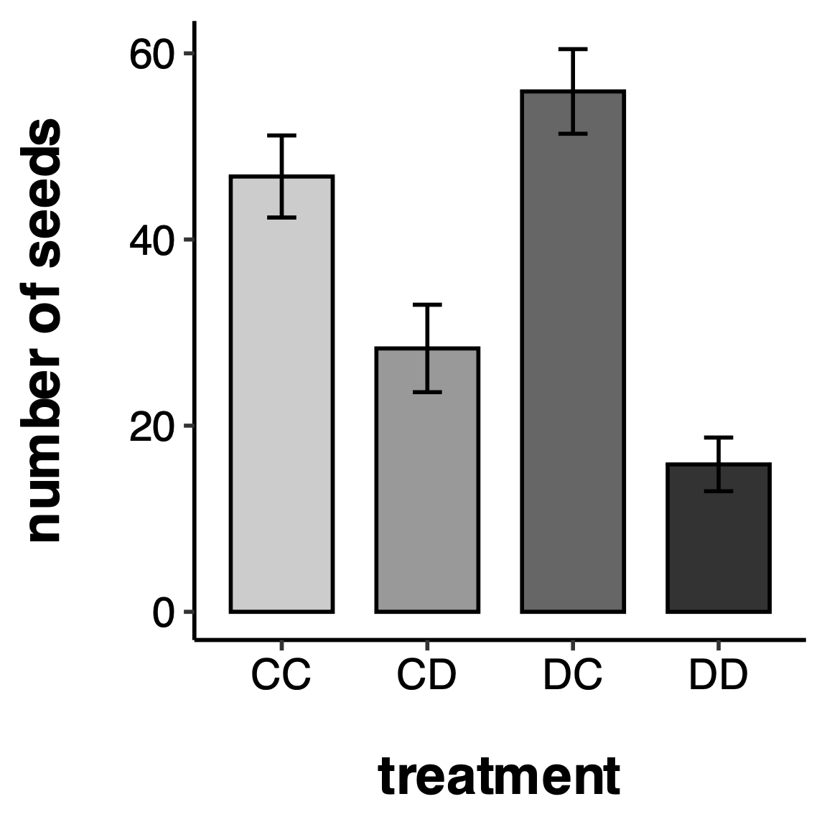
a
a
b
c
Notes:
Figure 4.

Slide 7
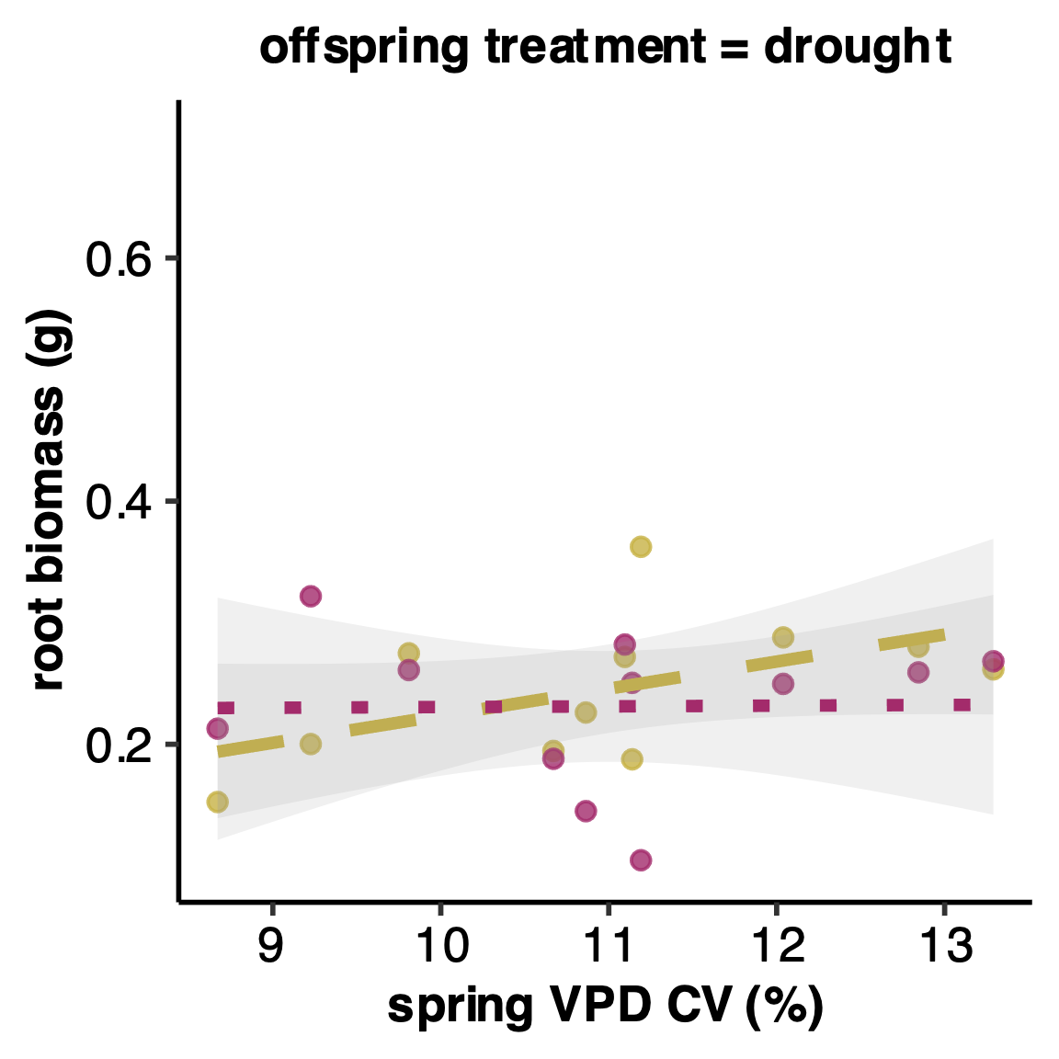
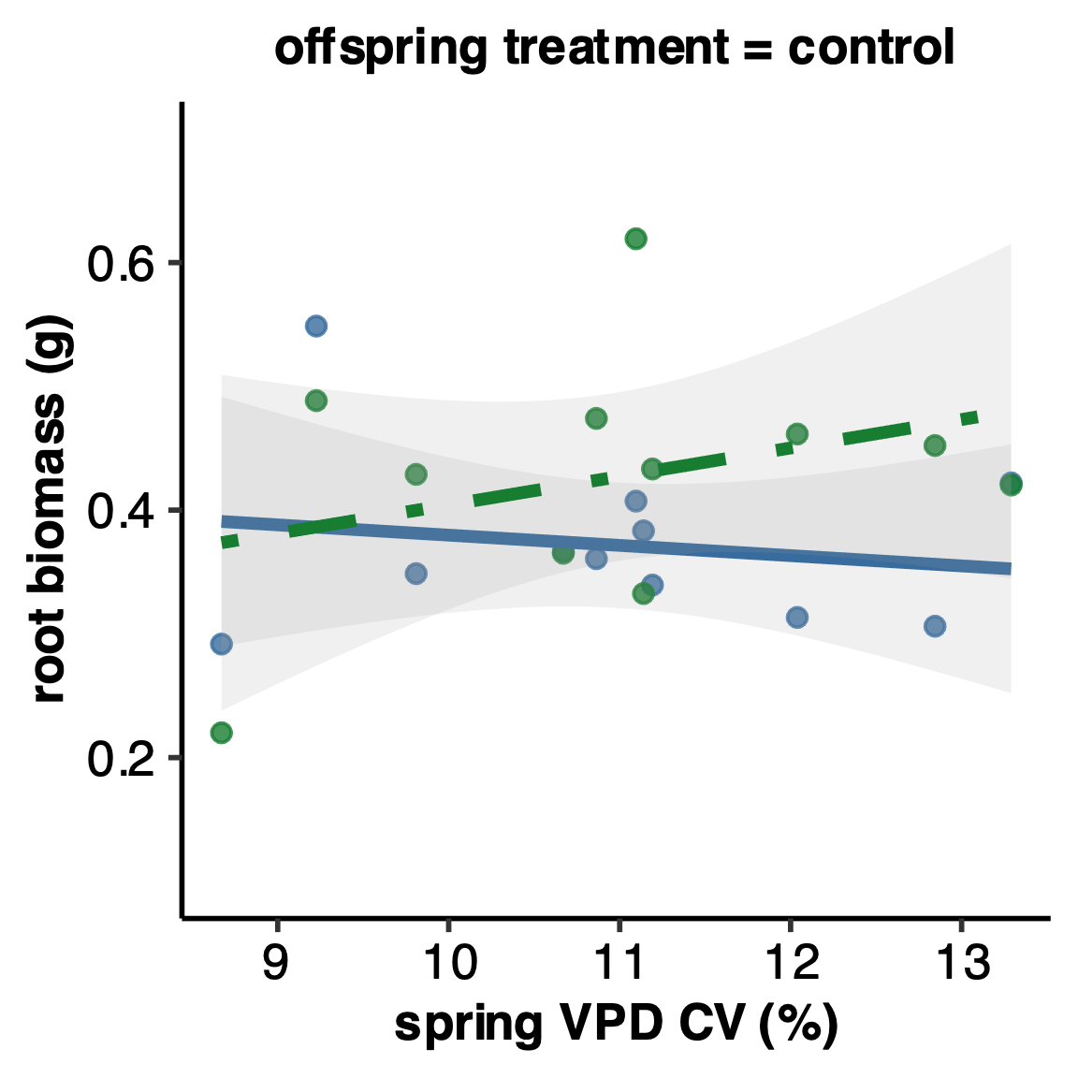
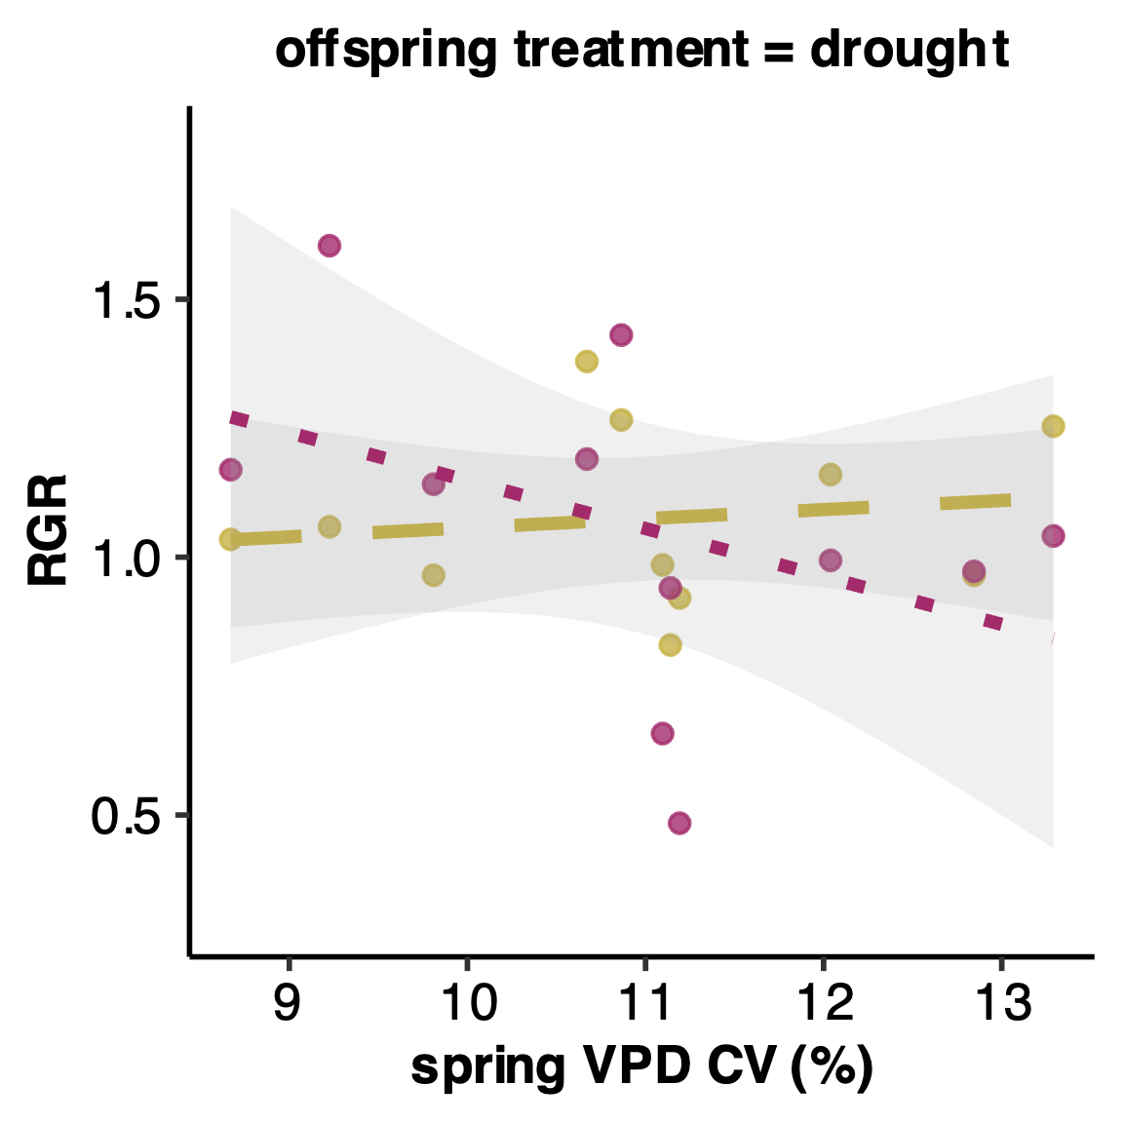
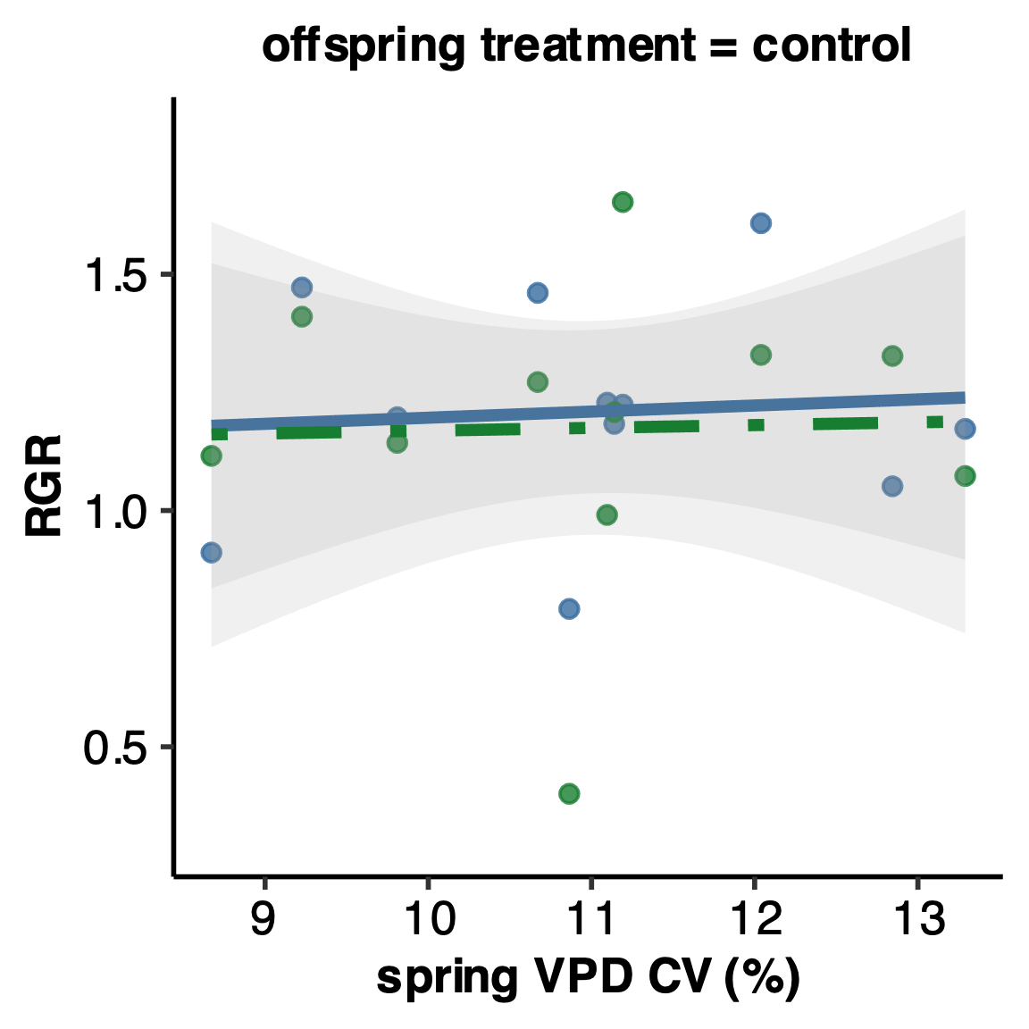
a)
CC
DC
CD
DD
b)

Slide 8
 | a) seed number | seed mass | mortality rate | flowering rate | b) spring VPD CV
RGR | -0.0604 | -0.093 | -0.129** | 0.007 | -0.034
root biomass | 0.105 | 0.121 | -0.051 | 0.336*** | -0.292***
Notes:
Table 3. Results of linear regressions testing for relationships between fitness traits and transgenerational RDPI (CC-DD) of a) performance traits and b) home site spring VPD CV in response to drought. Shown are the R²-values. P values = p. < 0.1; *p < 0.05; **p < 0.01; ***p < 0.001. Signiﬁcant terms are shown in bold; terms in italics are marginally signiﬁcant.

Slide 9
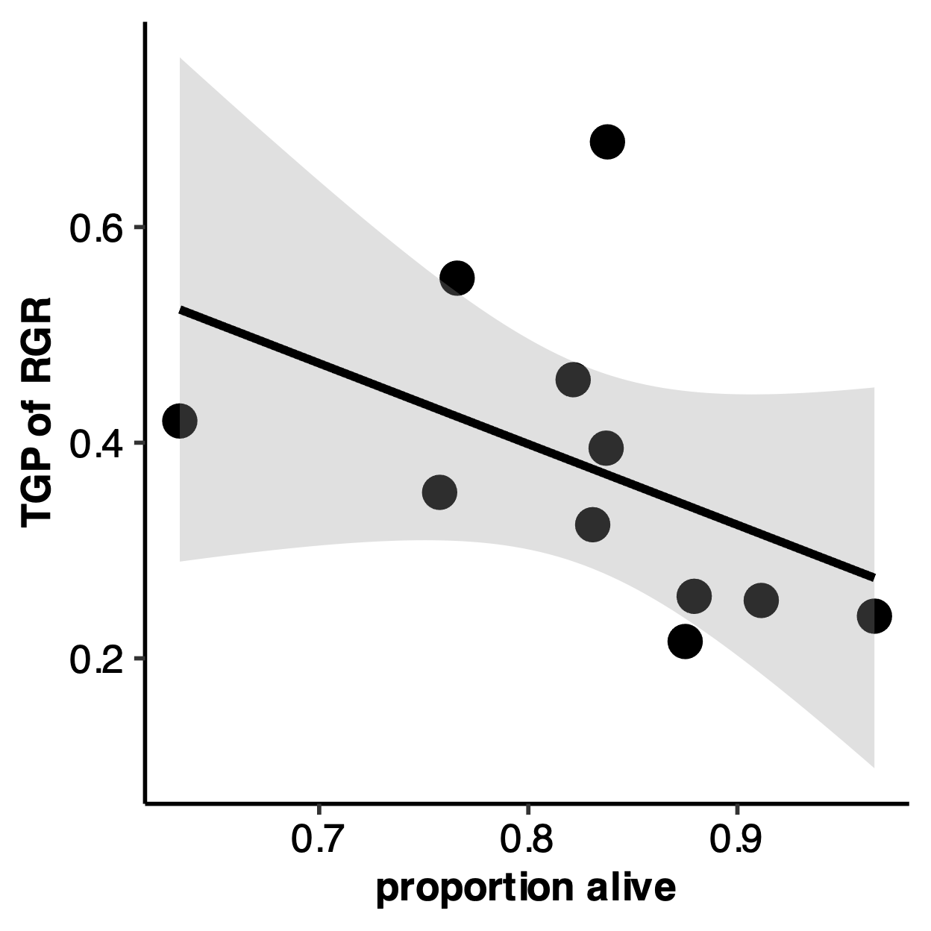
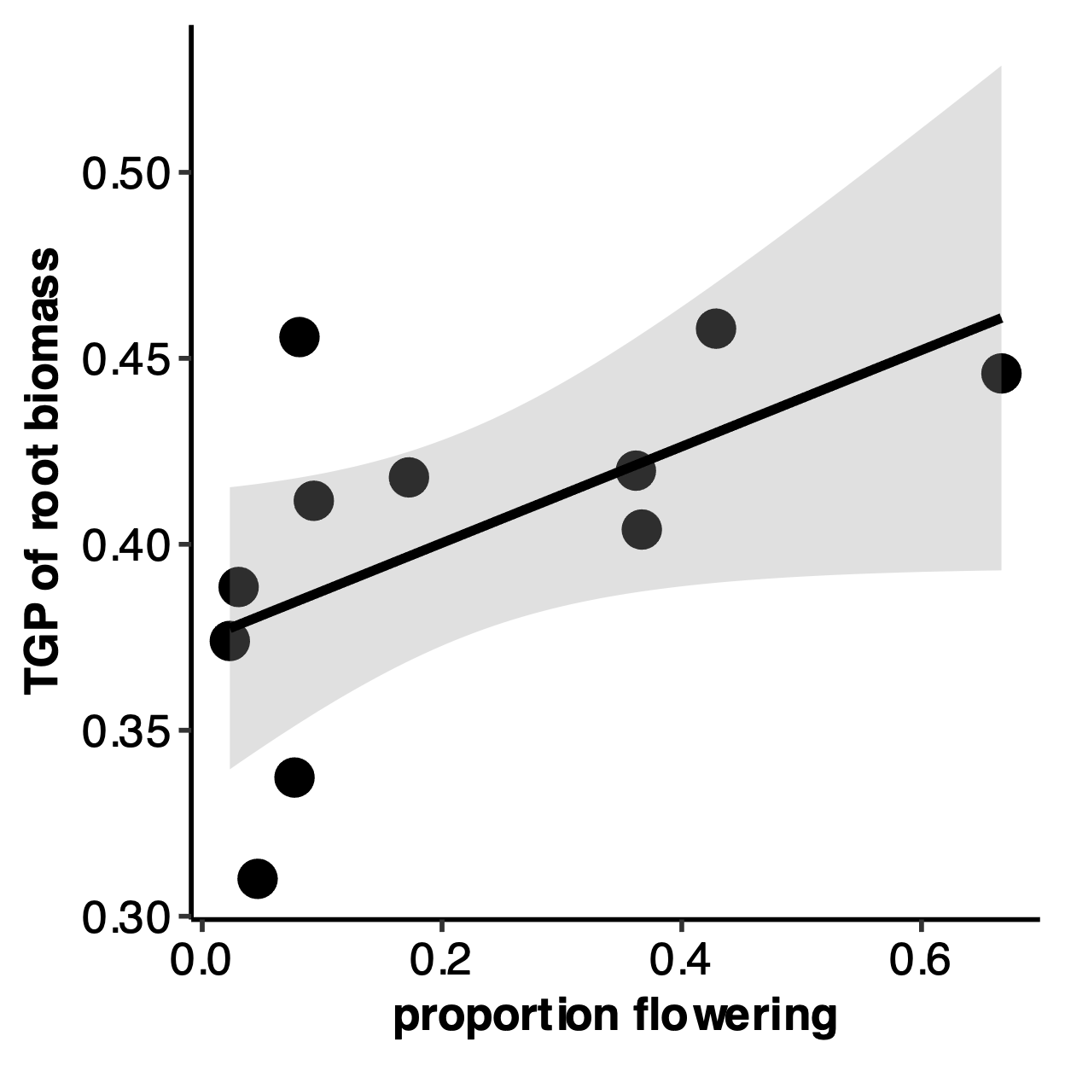
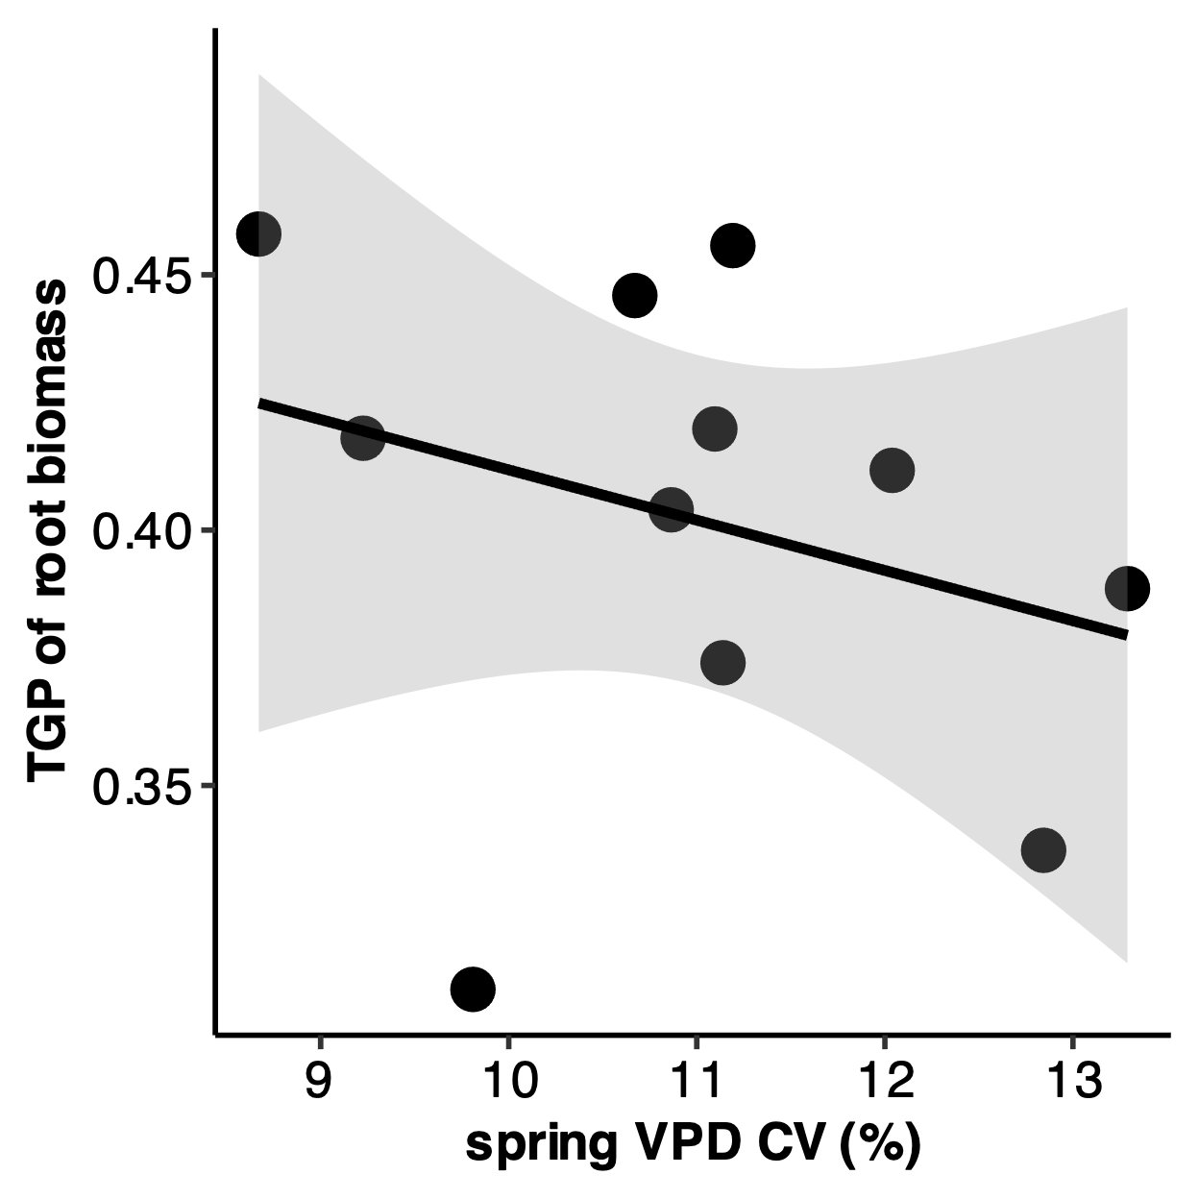
a)
R = -0.129, P = 0.0021
b)
R = 0.336, P = 2.2E-16
c)
R = -0.292, P = 2.2E-16
R = 0.111 , P = 0.0079
Notes:
Figure 5. Relationship between RGR plasticity (RDPI of CC-DD) and a) proportion alive, b) proportion flowered, and c) spring VPD CV for eleven populations of P. patagonica. Proportion alive was measured on day 50. Grey areas indicate 95% confidence intervals.

Slide 10
Evidence of transgenerational plasticity in response to water limitation
We found measurable phenotypic differences in two traits affected by offspring and parental treatments (Table 1; significant OT x PT term), confirming expression of transgenerational plasticity across all 11 populations of P. patagonica in response to water limitation, but only in traits related to reproduction. Across all populations, in dry treatments, plant offspring of water limited parents (DD ) produced 66% fewer seed than plant offspring of well-watered parents (CD) (difference significant at P <.0001). Offspring of parents grown in well-watered conditions grown in well-watered conditions (CC) produced less seed than offspring of drought stressed parents (DC), but this result was non-significant (Figure 3I). In addition, there was evidence of transgenerational effects in seed mass. In dry treatments, plants of water limited parents (DD) produced seed that was roughly 48% lighter in mass than seeds from plant offspring of well-watered parents (CD) (difference significant at P <.0001). Interestingly, in well-watered conditions, plants with parents who were water limited (DC) produced heavier seed than plants with parents who were well watered (CC), with seed weighing 20% heavier on average (difference significant at P = 0.0469) (Figure 3J).
Additionally, for number of plants that flowered, there were measurable phenotypic differences affected by offspring and parental treatments, but not their interaction (Table 1; significant OT term, significant PT term), suggesting independent effects of parental and offspring environment rather than interactive. Regardless of watering treatment in the parental generation, plants who experienced well-watered conditions in the offspring generation (CC, DC) flowered 57% more than plants who experienced water-limitation in the offspring generation (CD, DD) (P = 0.0001). However, comparing across parental treatment, plants from water limited parents (DC, DD) flowered 25% more often than plants from well-watered parents (CC, CD) (P = 0.0009) (Figure 3G).

Slide 11
OLD MANUSCRIPT

