Slide 1
Satellite Onboard Fault Attribution and Response (SOFAR)
Madeline Anderson

Slide 2
Motivation
Satellite resilience for on-orbit faults
Satellites may be compromised due to faults from radiation effects, cyberattacks, etc.
Multiple operators spend significant time attempting to diagnose the nature of faults, their root cause and their impact
Can be tedious to manually evaluate (sometimes large quantities, sometimes incomplete) downlinked data to make these determinations
Proposed Research
Develop and mature satellite onboard capabilities to autonomously perform these functions
Access to a comprehensive data set, not constrained by what gets transmitted to the operations center
Provide automatic detection and attribution (understanding of fault/cause)
Net result: ability to respond much more rapidly and effectively to all faults while reducing operator load

Slide 3
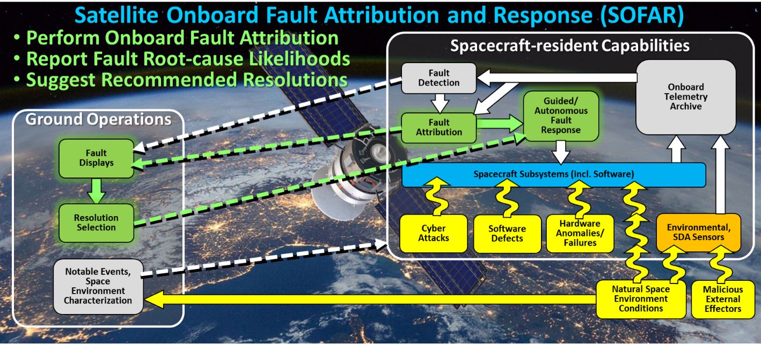

Slide 4
Telemetry Simulation Tool
Received datasets from previous missions (AFRL, DeMi, KSP, QuickScat) that included manifestation of multiple known faults
Upon analyzing the datasets, noticed that faults are extremely sparse and many datasets lack ground truth labels
Motivated the need for a data simulation tool that produces normal and faulting telemetry data inspired by real datasets to properly train and evaluate methods

Slide 5
Telemetry Simulation Tool
Tool accommodates simulation of non-faulting data and 11 known fault types with adjustable parameters
Randomness using mean and variance variables to simulate real data and prevent overfitting
Simulated Fault Scenarios
Ionizing Radiation Fault | Name: IRF_Z Radiation causes zeros for some variables | Name: IRF_S Radiation causes stale data (stuck until reset or power change) | Name: IRF_R Radiation causes garbage values (bit flips)
System Reset | Name: SR_C System reset causes jump in data (all variables, including onboard clock) | Name: SR_N System reset causes jump in data (all variables except clock in the case that clock is a ground clock)
Thermal Fault | Name: K_L Sensor loss causes NAN values (-999) | Name: K_F Sensor failure causes abnormally high/low, or garbage thermal values, or stale values | Name: K_C Nearby component failure causes abnormally low/abnormally decreasing thermal values, abnormally high/abnormally increasing thermal values | Name: K_H High temperatures over sensor maximum reading
Over/undercurrents | Name: I_O Mechanical failure overcurrent: high current values | Name: I_U Mechanical failure undercurrent: low current values

Slide 6
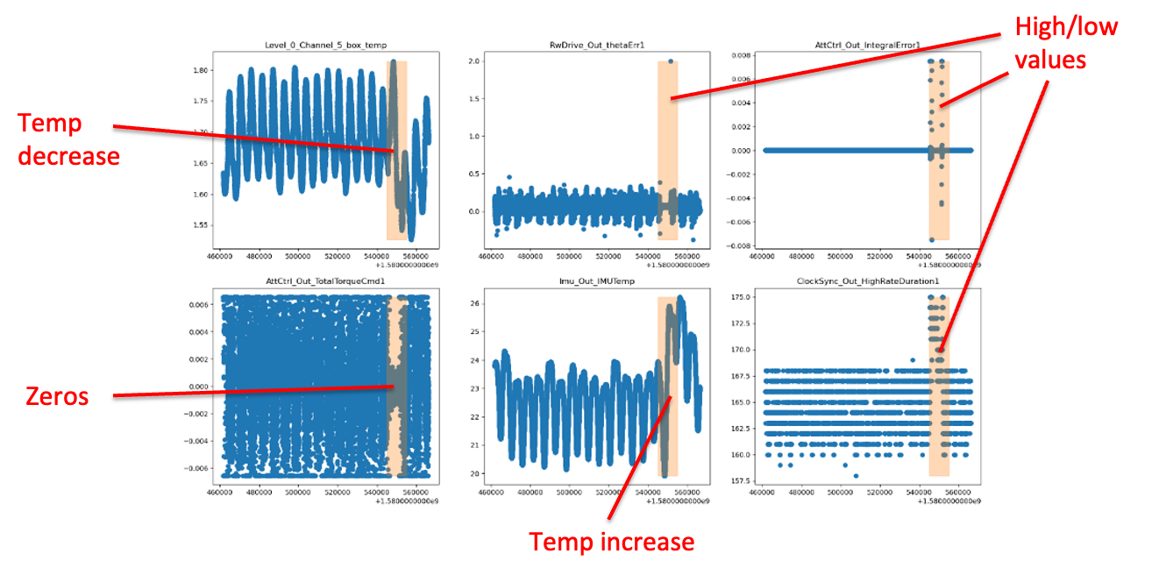
Mission Data Examples
STPSat-4: A power outage resulted in abnormal heating increases and decreases and loss of attitude control

Slide 7
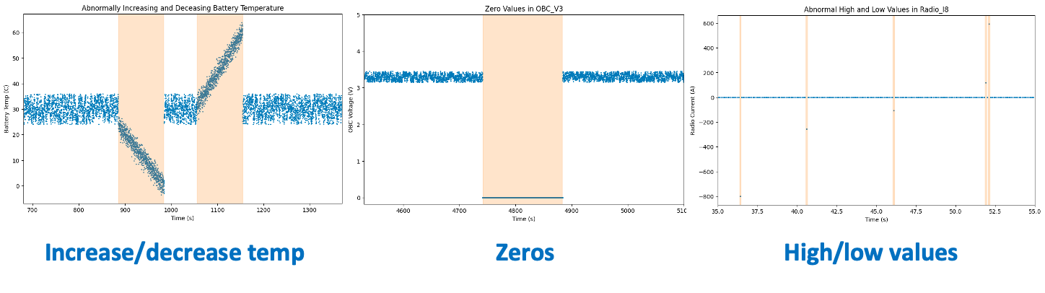
Mission Data Examples
Tool: similarly models abnormal increases/decreases in temperature, zero values, random high/low values

Slide 8
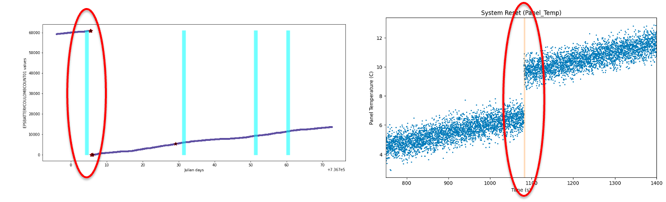
Mission Data Examples
SHARC: EPS system reset causes a jump in data values
Tool: Similarly models system resets, which exhibit abnormal jumps in data values
The jump in panel temperature, which normally increases at a steady rate when in the sun, indicates a system reset.

Slide 9
Fault Detection and Attribution Algorithmic Strategies
2-step joint fault detection and attribution approach
Step 1: Representation learning ensemble
Autoencoder (AE)
Kalman Filter (KF)
Gaussian Mixture Model (GMM)
Long Short Term Memory (LSTM)
PCMCI Causal Discovery
Step 2: Decision tree classifier
Gradient Boosted Decision Tree (XGBoost)

Slide 10
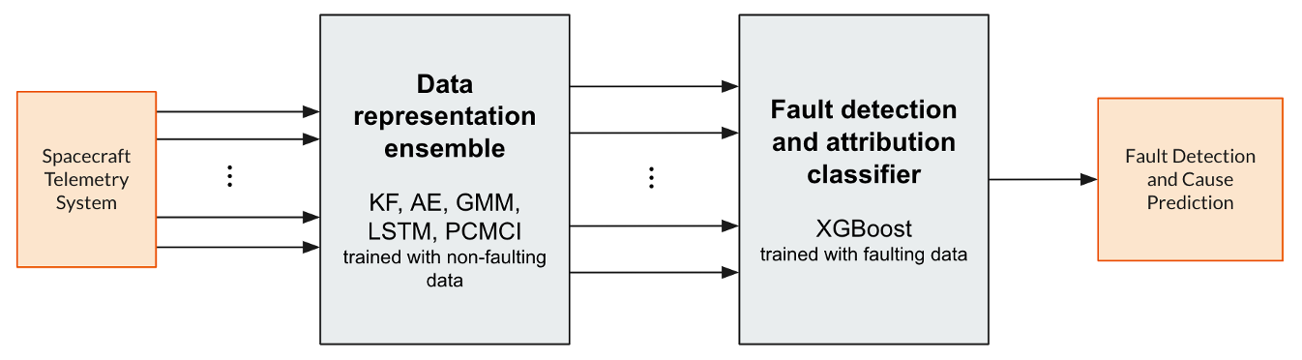
Algorithmic Approach Overview
Goal: detect faults and predict likelihood of possible attributions

Slide 11
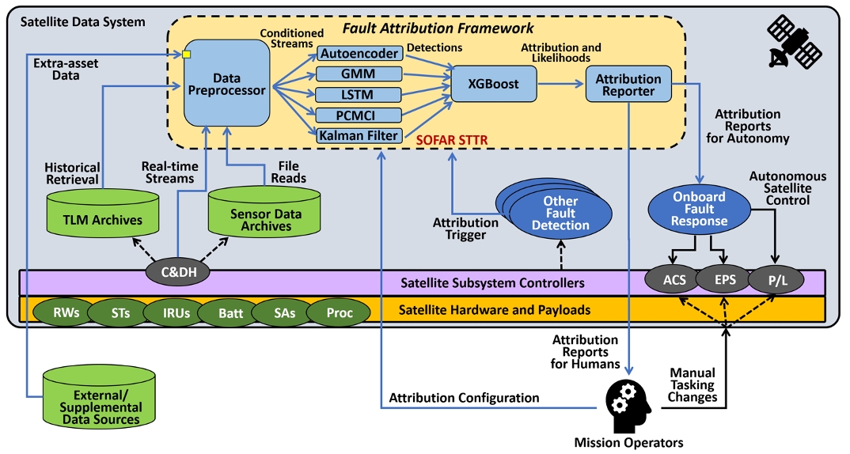
Solution Framework within Satellite System

Slide 12
Algorithmic Approach Overview
Goal: detect faults and predict likelihood of possible attributions

Slide 13
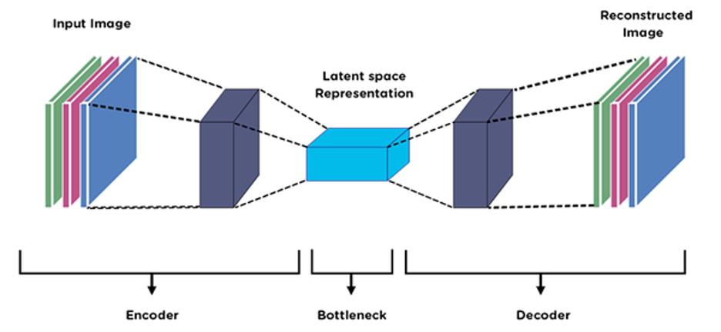
Representation Learners: Autoencoder
Unsupervised learning algorithm that learn a lower dimensional representation of data using the hidden layers by performing data reconstruction
Anomalies may appear in the reconstruction error, which compares the output of the forward model with the original input
Prototype steps:
Train AE on normal non-faulting data
Inference: Extract the reconstruction error for each signal at each time step
Large reconstruction error may indicate anomalies

Slide 14
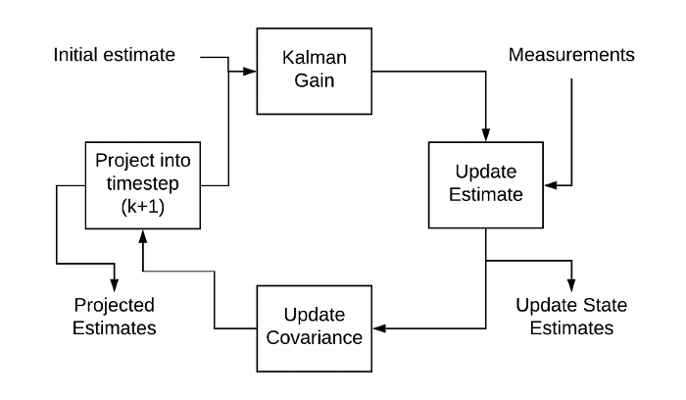
Representation Learners: Kalman Filter
An estimation algorithm that can model noisy sensor data and provide state estimates by modeling the sensor output as a linear combination of the recorded measurement, expected mean and covariance
Prototype steps:
Learn the linear relationship of each signal over time using an autoregressive model and embed it into the Kalman Filter
Inference: pass data through KF and extract the residual error after each update, which measures the distance between observed and expected values
Large residual error may indicate potential anomalies

Slide 15
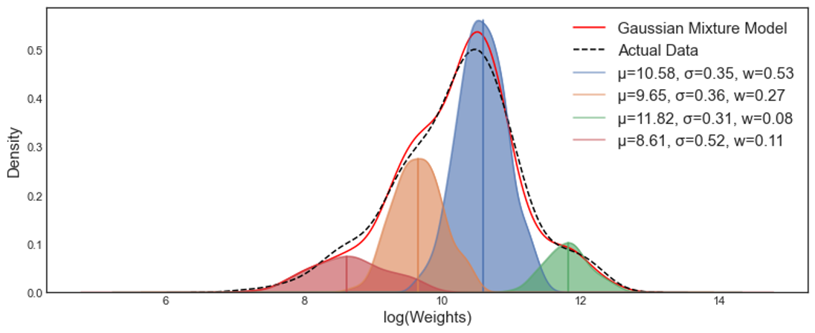
Representation Learners: Gaussian Mixture Model
A probabilistic unsupervised model that represents data as a mixture of Gaussian distributions in which the number of components is predetermined
Prototype steps:
Fit the GMM to normal, non-faulting data
Inference: use learned model to score data observations based on the likelihood of the observation under the learned model
Observations with low likelihood may be anomalous cases

Slide 16
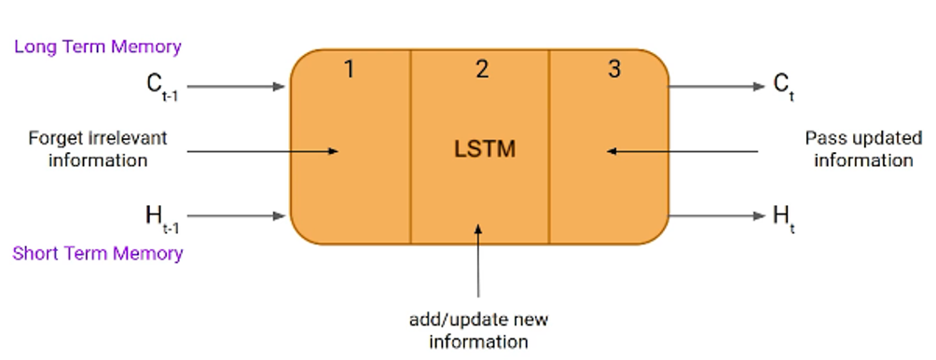
Representation Learners: Long Short Term Memory
Type of recurrent neural network (RNN) that captures long-range dependencies in sequential data using gating mechanisms
An LSTM network consists of many LSTM “cells” in which each cell processes data through an input gate, forget gate, and output gate
LSTMs can learn representations of sequential data that maintains a notion of order and model sequential data of varying lengths
Prototype steps:
Train LSTM using normal non-faulting data
Inference: Pass data through LSTM network and extract the mean squared error (MSE) loss at each time step
Anomalous data may result in higher loss because the predicted value differs from the true observation

Slide 17
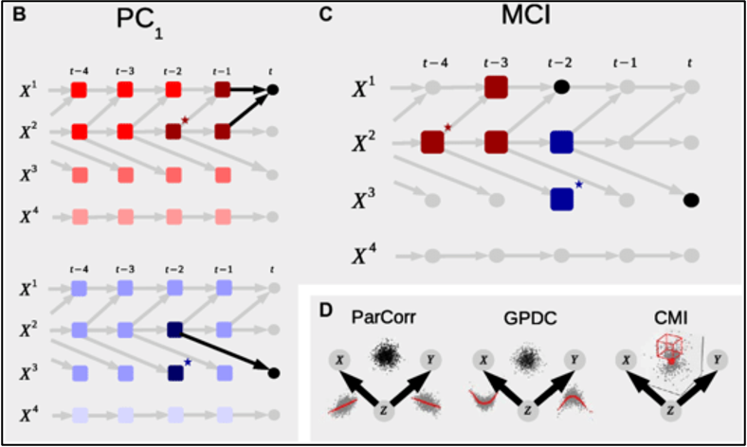
Representation Learners: PCMCI Causal Discovery
Causal network discovery algorithm for time series data
Estimates causal parents using a two-step process
PC algorithm for initial parent selection
Momentary conditional independence (MCI) algorithm for further pruning
Prototype steps:
Use PCMCI to evaluate the strongest causal parents of each signal at each time step, which can capture dependencies in the data across a flight system

Slide 18
Algorithmic Approach Overview
Goal: detect faults and predict likelihood of possible attributions

Slide 19
Classifier: XGBoost
Supervised learning method called Extreme Gradient Boosting, a form of Gradient Boosted Decision Trees
During training, modifies hierarchical decision trees using log-loss
Benefits:
Flexibility for datasets with continuous/discrete variables, different scales/units, and can support missing data
Very fast and accurate
Prototype steps:
Train the XGBoost model on the outputs of the 5 representation learners (AE, KF, GMM, LSTM, PCMCI) and raw data generated by the simulation tool to classify a sample as either non-faulting or one of 11 possible fault cases
Training data generated by telemetry simulation tool

Slide 20
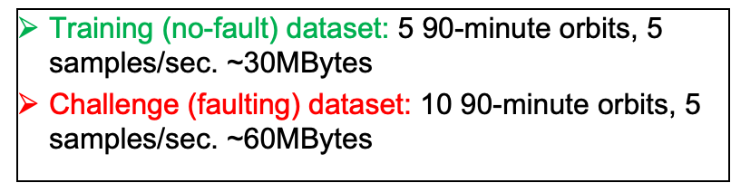
Training Data
Number of individual fault cases in training and test set
 | Train | Test
No fault | 71653 | 18019
IRF_R | 2197 | 563
IRF_S | 7213 | 1706
IRF_Z | 2292 | 561
K_H | 3704 | 937
K_F | 3509 | 861
K_L | 2458 | 602
K_C | 5173 | 1280
I_O | 1894 | 462
I_U | 4943 | 1265
SR_0 | 40 | 13
SR_J | 45 | 7
Representation learners are trained using simulated normal data
The classifier (XGBoost) is trained using both normal and faulting simulated data

Slide 21
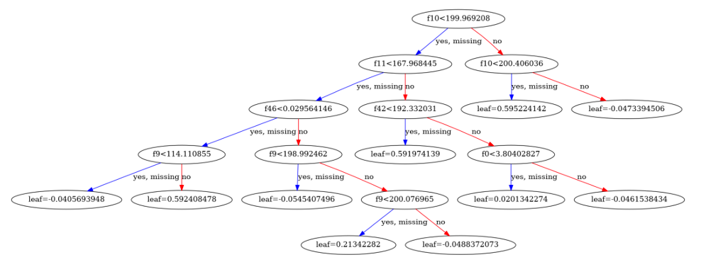
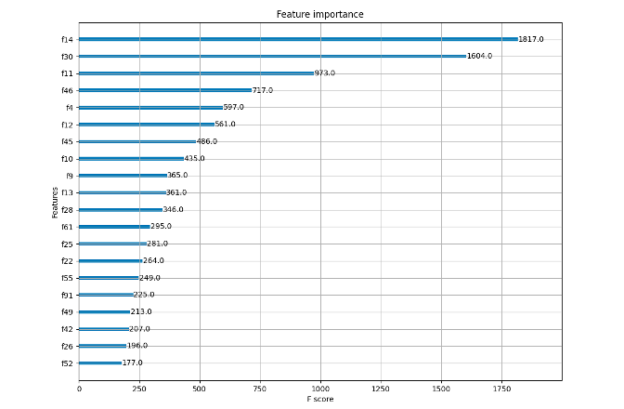
Results: Examining XGBoost Model
Learned tree hierarchy
First 6 levels
First feature split Battery Temperature
Second feature split Solar Panel Temperature
Assess feature importance
Used to decide which features are most important for distinguishing faults, and which features aren’t as important
Most important: Clock, KF residual error clk, AE reconstruction error of Solar Panel Temperature

Slide 22
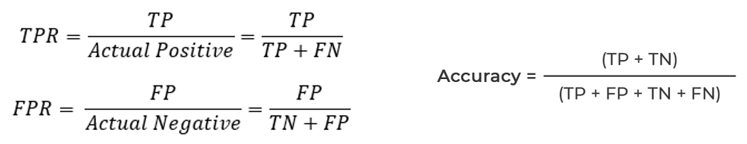
Evaluation Metrics
To quantify model performance, we evaluate the detection and attribution accuracy, true positive rate (TPR) and false positive rate (FPR) for each individual faulting case and for the combined system, including
The ability to detect faults using TPR, FPR, and overall accuracy
The ability to attribute faults using TPR, FPR, and overall accuracy
The ability to attribute faults on a per-fault basis including
Ionizing Radiation
System Resets
Thermal Faults
Over/Undercurrent

Slide 23
Overall Performance
Overall Performance
Combined fault detection and attribution accuracy of both non-fault and faulting cases | 99.89%
Combined fault detection and attribution accuracy of only faulting cases | 99.79%
Detection accuracy | 99.94%
Detection TPR | 99.88%
Detection FPR | 0.039%
Average attribution accuracy | 99.97%
Average attribution TPR | 99.85%
Average attribution FPR | 0.023%
Combined fault detection and attribution accuracy measures the number of correct fault detections and attributions to one of 11 fault cases
Evaluated for the entire dataset (both non-fault and faulting cases) and for only faulting cases
Overall detection performance: indicates the algorithm’s ability to distinguish the presence and absence of a fault
Overall attribution performance: measures the algorithm’s ability to attribute faulting data to the correct cause/description

Slide 24
Per-Fault Performance
Per-Fault Performance
 | Attribution accuracy | Combined detection and attribution accuracy | Attribution TPR | Attribution FPR
IRF_R | 99.90% | 99.11% | 98.75% | 0.013%
IRF_S | 99.98% | 99.88% | 100.0% | 0.031%
IRF_Z | 99.98% | 99.73% | 100.0% | 0.026%
K_H | 99.96% | 99.84% | 100.0% | 0.041%
K_F | 99.96% | 99.77% | 99.65% | 0.000%
K_L | 99.98% | 99.83% | 100.0% | 0.026%
K_C | 99.93% | 99.65% | 99.92% | 0.072%
I_O | 100.0% | 100.0% | 100.0% | 0.000%
I_U | 99.96% | 99.84% | 100.0% | 0.043%
SR_0 | 100.0% | 100.0% | 100.0% | 0.000%
SR_J | 100.0% | 100.0% | 100.0% | 0.000%
Investigated per-fault performance metrics to evaluate the consistency of the algorithm across different fault types
For each of the 11 fault cases, we evaluate:
Attribution accuracy: Measures the algorithm’s ability to correctly attribute the fault given fault detection
Combined detection and attribution accuracy: Measures the algorithm’s ability to both detect and attribute the fault
Attribution TPR and FPR: Measures rate of true and false negatives throughout
Across all 11 fault cases, high attribution accuracy, high combined detection and attribution accuracy, high attribution TPR, and low attribution FPR indicate that the prototype can learn and identify various diverse known fault types

Slide 25
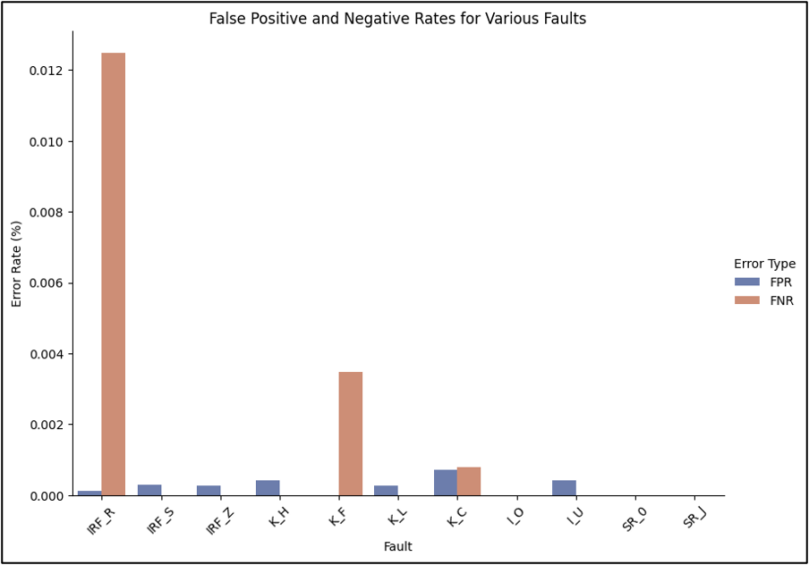
Per-Fault Error Rates
Graph shows a comparison of error rates, including FPR and FNR, for each fault case
Low error rates across all fault types, with a maximum error rate of only 0.013%

Slide 26
Computing Performance Benchmark Tests
Training and evaluation times were run on both desktop and flight-like hardware to characterize performance
Ran for 115,000 time steps, 15 telemetry variables, and 1.7 million total data points
Platform | RAM Size | Memory Usage | CPU | Threads | Training Time | Evaluation Time
Desktop | 32 GB | <100 Mb | Intel i7 2.60GHz | 12 | 17m 40s | 0.9s
Raspberry Pi | 1.8 GB | <100 Mb | Cortex-A72 1.8GHz | 4 | 67m 51s | 3.0s
Note that pre-trained models should not require onboard training

Slide 27
Key Contributions
Development of a novel telemetry simulation tool that provides a controlled benchmarking dataset for training and evaluation of fault detection and attribution approaches, addressing sparsity and lack of ground truth
Our prototype can both detect and attribute faults with high accuracy, high true positive and low false positive rates using simulated telemetry data
Across all 11 fault cases, evaluated metrics indicate that the prototype is highly capable of learning and identifying various diverse fault types
XGBoost model leverages the data representations from the ensemble methods to efficiently learn patterns in faulting and non-faulting data

Slide 28
Limitations and Future Work
While the XGBoost model is highly accurate in our demonstration, it is a supervised method that may not perform well for unseen data, which may require the use of unsupervised techniques
Using Bayesian networks to infer causality of faults across spacecraft system and components
Further investigate which representation learners are most useful and why
Opportunities to further enhance telemetry simulation tool
Model data more realistically (e.g. using generative networks)
Add additional fault types for more complex scenarios and provide more detailed attribution descriptors
Tying framework into larger autonomous planning system
Infer impact and urgency of fault
Decision-making: plan actions to address and mitigate faults
Apply to real datasets
Test representation learners individually, see if prototype could be simplified

Slide 29
Questions?

