Slide 1
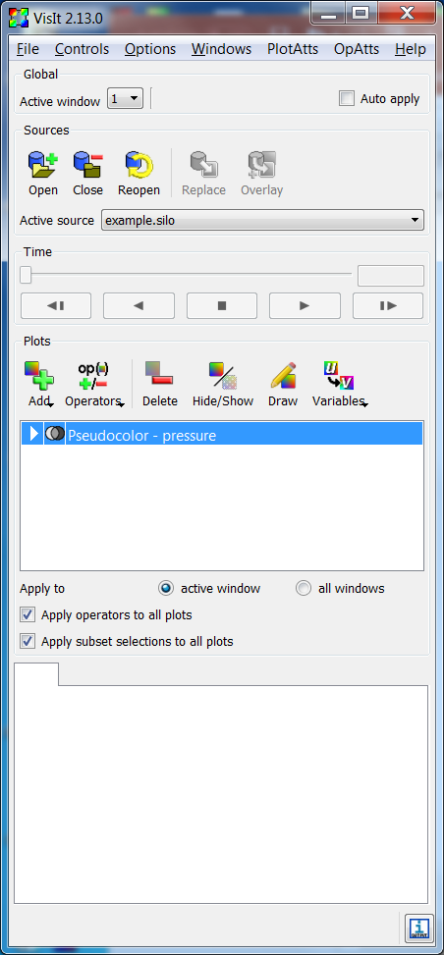
Pulldown menus
Active window
selector
Active source
selector
Plot & Operator
Selection area
Active
plot list
Notepad area
Output indicator
Status bar

Slide 2
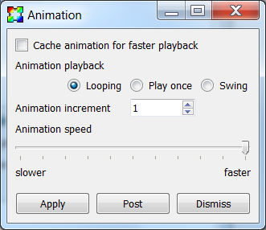
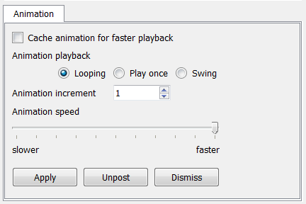
Unposted window
Posted window
Post button
Unpost button

Slide 3
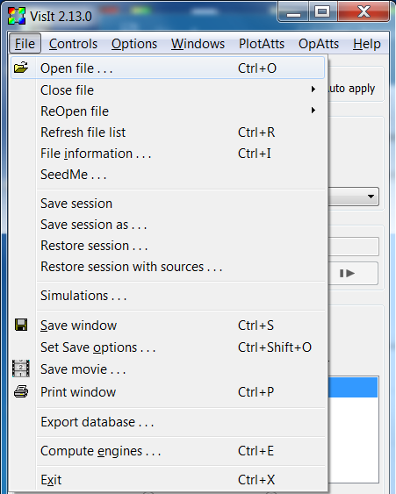
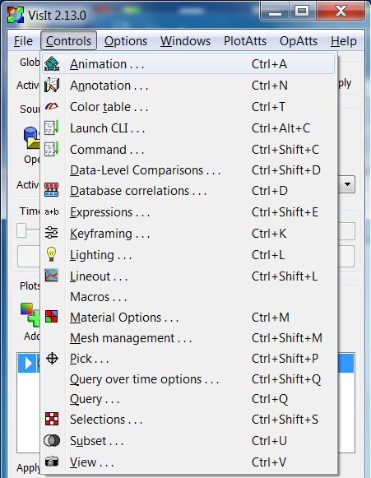
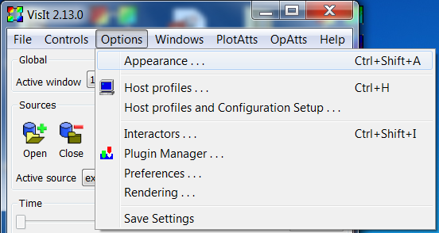
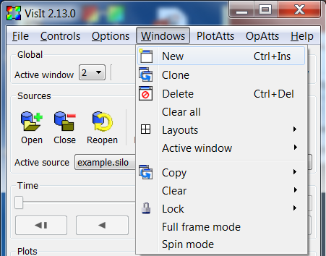
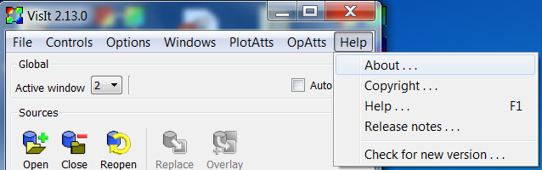
File menu
Controls menu
Options menu
Windows menu
Help menu

Slide 4


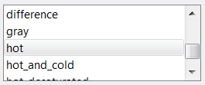


button
Usage: The button is referred to by the text on the button.
E.g. To create a new color table click on the **New** button.
check box
Usage: The check box is referred to by the text to the right
of the check box. E.g. To group tables by category check the
**Group tables by Category** check box.
label
Usage: The label is referred to by the text in the label. E.g.
Click on the color table menu next to the **Continuous**
label.
list
Usage: Lists don’t typically have labels associated with
them, so the name is chosen to be descriptive of the list.
E.g. The **Color table** list.
menu
Usage: The menu is referred to by the text to the left of the
menu. E.g. To enable linear smoothing select **Linear**
from the **Smoothing** menu.
option
Usage: The option is referred to by the name in the menu
and the word “option” isn’t included. E.g. To enable cubic
smoothing select the **Cubic Spline** option from the
**Smoothing** menu.

Slide 5
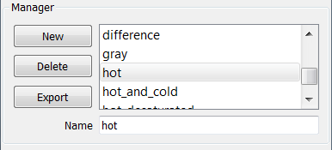
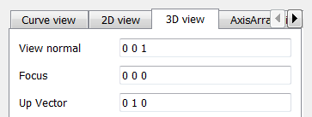
panel
Usage: The panel is referred to by the text in the box
surrounding the panel. E.g. The **Manager** panel has
controls for managing color tables.
radio box
Usage: The radio box is referred to by the text to the left
of the radio buttons. E.g. Select the **Continuous** radio
button from the **Color table type** radio box.
spin box
Usage: The spin box is referred to by the text to the left of
the spin box. E.g. Set the number of colors by changing the
value in the **Number of colors** spin box.
tab
Usage: The tab is referred to by the text at the top of the
tab. E.g. The controls for setting the 3D view are located in
the **3D view** tab.
text field
Usage: The text field is referred to by the text to the left
of the text field. E.g. Enter the name of the new color table
in the **Name** text field.

