Slide 1
PRIM vs. CART

Slide 2
Primary objective of PRIM and CART
Determine ranges of input space that develop certain output spaces
Input: X
Function: f(Y|X)
Output: Y
Subgroup discovery algorithm
Example: probability of survival based on patient and treatment
PRIM and CART would highlight multiple ideal pathways with a range of desired survival probabilities
This is instead of just ONE treatment plan
Ideal for identifying subgroups of patients that respond or don’t respond to certain treatments

Slide 3
PRIM: Patient Rule Induction Method
Goal: Identify a box (B) in input space that results in the mean of the output variable being larger than that of the population
Iteratively discards “unpromising regions” based on all data
Gradually “zooms in” to regions with y values of interest
When assessing B, each variable is considered in isolation
Removes observations until a user-specified minimum, ideally ending in a high support and high mean subgroup

Slide 4
CART: Classification and Regression Trees
Goal: Identify a set of partitions in input space that results in the mean of the output variable being at least twice than that of the population
Does not regard the minimum size of resulting groups
Requires less user interaction

Slide 5
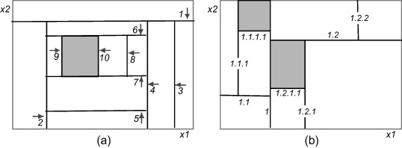
Visualization
PRIM vs. CART

Slide 6
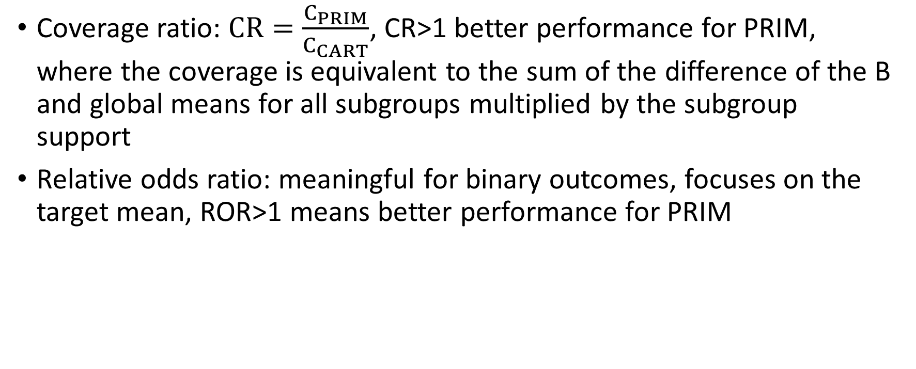
Metrics of Success
Coverage ratio: $CR=\frac{C_{PRIM}}{C_{CART}}$, CR>1 better performance for PRIM, where the coverage is equivalent to the sum of the difference of the B and global means for all subgroups multiplied by the subgroup support
Relative odds ratio: meaningful for binary outcomes, focuses on the target mean, ROR>1 means better performance for PRIM

Slide 7
Discussion
In an example, when seeking the single best subgroup, PRIM failed to find a large subgroup with ordinal variables and CART had superior performance based on the metrics of success
Another paper found that PRIM can be superior in complex situations (few observations, multiple subgroups) and is more flexible
If using PRIM:
Make accommodations for ordinal variables
Improve trade-off between number of peeled observations and the subsequent increase in quality of the subgroup
Extend search for alternatives with a beam search
F-PRIM?
All additional steps do increase the complexity of search process and algorithm time

Slide 8
References
[1] A. Abu-Hanna, B. Nannings, D. Dongelmans, and A. Hasman, “PRIM versus CART in subgroup discovery: When patience is harmful,” Journal of Biomedical Informatics, vol. 43, no. 5, pp. 701–708, Oct. 2010, doi: 10.1016/j.jbi.2010.05.009.
[2] A. Ott and A. Hapfelmeier, “Nonparametric Subgroup Identification by PRIM and CART: A Simulation and Application Study,” Computational and Mathematical Methods in Medicine, vol. 2017, p. e5271091, May 2017, doi: 10.1155/2017/5271091.

