Slide 1
Process Flow Diagram
A. Stakeholder Considerations
Inputs: what does the stakeholder care about?
Outputs: upper and lower bounds to guide scenario development and initial set of strategies, ranking of concerns
Robust Decision Making
1. Decision Structuring
XLRM Matrix
Inputs: stakeholder consultations
Outputs: uncertainties, levers available, relationships between uncertainties and levers (identifying models), and metrics of success
2. Strategy Generation and Evaluation
MDT
Inputs: base microgrid and expansion parameters
Function: explores various options within bounds for new microgrid based on output metrics
Outputs: initial set of microgrid strategies/policies, mission assurance
REopt
Inputs: initial set of microgrid strategies from MDT
Function: optimize microgrid performance throughout an entire year based on grid connected economics and outage scenarios
Outputs: various metrics of success
CEEP TBD
4. Tradeoff Analysis
5. Develop New Strategies
Cost-Benefit Analysis
Inputs:
Function:
Outputs:
Inputs: any adjusted concerns or bounds
Function: revisit scenario development ensuring internal consistency (plausibility) and diversity amongst scenarios
Outputs: a new set of scenarios to generate more system configurations
B. Visualizing Uncertainty, Plotly Julia
Inputs: optimization results with metrics of success
Outputs: parallel coordinates, violin plots, matching sets, continuous error bands, dynamic adaptive policy pathways
3. Vulnerability Assessment
Exploratory Modeling, LHS
Inputs:
Function:
Outputs:
Scenario Discovery, PRIM
Inputs:
Function:
Outputs:
Identify Robust Strategies
Figure: RDM Method
Adapted from Karla et al. 2014 and Marchau et. al. 2019
Notes:
CEEP TBD
Vulnerability assessment: exploratory modeling (taking one strategy and simulating it under various future states of the world), results from exploratory modeling and inform scenario discovery (when does it pass/when does it fail), PRIM (scenario discovery tool)
Tradeoff analysis: cba, qualitative, no super specific tool…are there other methods?

Slide 2
Scenario Development, uncertainties
Wildfires
Air quality affecting solar resource availability
Not currently represented in REopt, but may have implications on larger scale generation when outages are not
Obstruction of transportation of essential fuels, operational equipment, and maintenance
Acquire or develop approximate data to generate probabilities of whether extra fuel for generators can be acquired (via closed roads)
Weather event
Energy system impact(s)
Data
Decreased geothermal and hydroelectric generation
Solar generation (preferably hourly)
Air quality data (preferably hourly): Ozone, Sulphur dioxide, and carbon monoxide
Increased load
MEWS? (Can these increases in load be compared to that of heat waves?)
Apply transformations to existing load

Slide 3
REopt inputs
- Electricity rate
- Normal load
Energy impacts from wildfires
- Critical load
- PV system sizing
- Battery system sizing
- Solar resource
- Changes in load patterns
-
-

Slide 4
Wildfire outages

Slide 5
Stakeholder Concerns

Slide 6
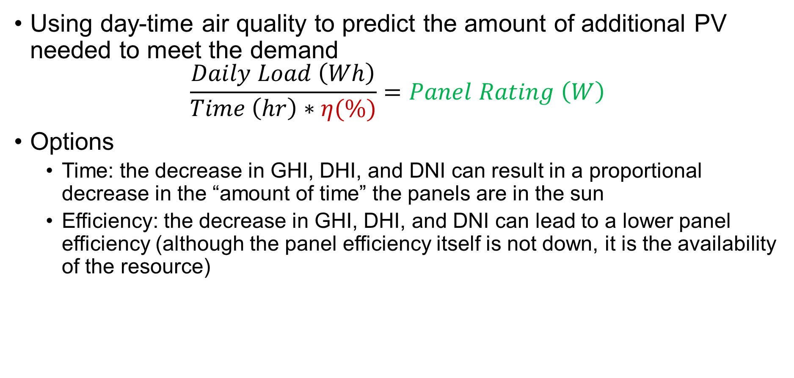
Machine Learning
Using day-time air quality to predict the amount of additional PV needed to meet the demand
$$\frac{Daily Load \left(Wh\right)}{Time \left(hr\right)∗η(\%)}=Panel Rating \left(W\right)$$
Options
Time: the decrease in GHI, DHI, and DNI can result in a proportional decrease in the “amount of time” the panels are in the sun
Efficiency: the decrease in GHI, DHI, and DNI can lead to a lower panel efficiency (although the panel efficiency itself is not down, it is the availability of the resource)

Slide 7
"Capacity factor" refers to how often a power plant runs and thus how much power it produces relative to its total potential (capacity)

