Slide 1
MEWS: validation, development, and application ideas
Madeline Macmillan

Slide 2
Validation, part 1
Run MEWS on more historical data to project/simulate present day (or recent historical) data
Compare data to actual records, looking primarily at frequency and severity (hindcasting!)
Or, similarly, validation against other regional climate models
→Are there other projections, like that of IPCC 2021, with which to compare?
→A blind spot for me, do we have any starting points?

Slide 3
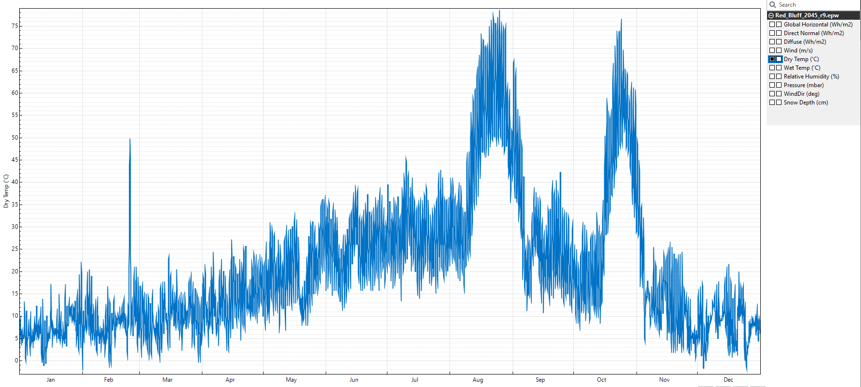
Validation, part 2
75 C = 167 F
Hottest temp ever recorded: 134 F
Investigating internal consistency (plausibility) such as alignment with rainy/sunny/cloudy days, upper and lower bounds, scenario diversity…
Numerical validation

Slide 4
Development
Other extreme weather events, keeping in mind EPW parameters
→including cold snap projections in MEWS
→Wildfires
Wind*
Humidity
Temperature*
GHI, DNI*
An area I am currently exploring to some degree!
*A parameter that may also have implications on energy system sizing

Slide 5
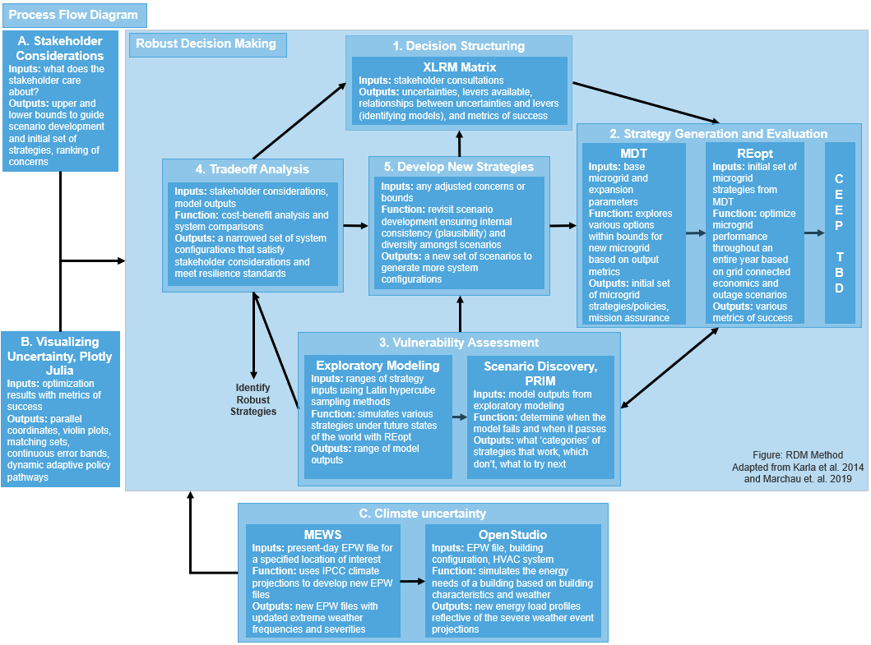
Application
Big picture: robust decision making under deep uncertainty
→One of the uncertainties to be considered in this analysis is climate
→This application and analysis will explore how considering climate uncertainty will affect system sizing when faced with the threat of outages (resilience events)

