Slide 1
Ph.D. Roadmap
Madeline Macmillan

Slide 2
Key Pillars

Slide 3
Decision making under deep uncertainty (DMDU)
Knightian uncertainty: multiple possible future worlds without known relative probabilities
Multiple divergent, but equally valid, world views, including values used to define criteria of success
Decisions which adapt over time and cannot be considered independently
What does this look like when optimizing community resilience?
Component availability, demand changes, severe weather patterns, climate, cost of energy
System availability, unmet load, lifecycle cost, emissions, lifespan, responsiveness, durability against damage
Deployment of energy generation and climate, hardening techniques and severe weather frequency

Slide 4
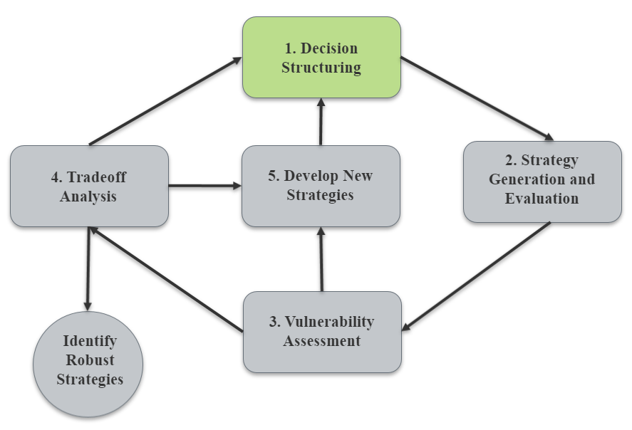
Robust decision making (RDM)
Analytic cycle to develop robust strategies for a given system
Iterative process to increase robustness
Ideal for decisionmakers dealing with deep uncertainty
Figure: RDM Method​
Adapted from Karla et al. 2014 and Marchau et. al. 2019​

Slide 5
Future States of The World
Using the Internal consistency and Diversity Scenario Development evaluation framework to guide the construction of an array of future scenarios to model
Key components:
Internal consistency: coherent, plausible, and focused descriptions
Diversity: within each scenario and across sets of scenarios
Supplemented by Monte Carlo simulations, these future states of the world will show if and how the community is resilient to several uncertainties

Slide 6
Reopt + ERMA
REopt
Considers grid economics and power outages to optimize the system to meet the load
Does not incorporate various states of the world – the results depend on a lot of assumptions
ERMA
Kodiak use case is a candidate with several potential threats and a unique system

Slide 7
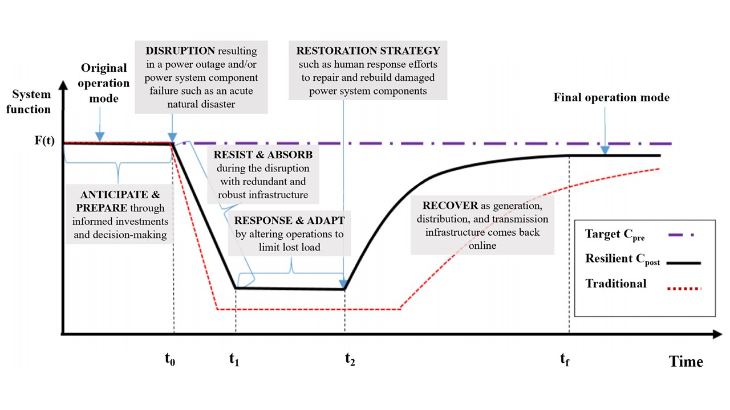
Optimizing COMMUNITY Resilience
Limited energy resilience considerations in community models and planning
Potential for co-optimization
What are the effects of considering resilience within the optimization?

Slide 8
Identifying a Novel Contribution

Slide 9
Objectives
Enhancing modeling capabilities to consider various resilience scenarios to better inform the decision making for communities
Understanding the avoided consequences (primarily economic) when considering resilience in community planning
Analyzing the differences in results to gain a better idea of resilient technologies and their abilities to plan robust infrastructure that will stand the test of time and climate change
Modeling of climate scenarios for resilience assessments
Testing the new process and model formulation on the Kodiak use case

Slide 10
Next Steps (needs updating)

Slide 11
Identifying Gaps
There are few applications of energy resilience assessments on community systems using popular and accessible models
Most resilience assessments do not consider various states of the world and make several limiting assumptions
Effects of robust decision making under deep uncertainty on system policies and other metrics (LCC, emissions, etc.) has not been explored in resilience assessments

Slide 12
Model Selection
Ideal characteristics
Easily accessible
Widely used by various stakeholders
MILP optimization
Can be appended to consider stochastic frameworks and/or Monte Carlo simulations
REopt

Slide 13
Model Development
More iterative process
A set of metrics to evaluate the system
Options to tweak system upon metrics evaluation
Fewer assumptions made
More collaboration with REopt team is needed to identify and discuss areas

Slide 14
Monte Carlo Simulations
Various states of the world and the probability of the system to meet set criteria such as minimizing unmet load, emissions, LCC
Simulate an array of outages under these states to develop a range of survivability
Stop iterative process and simulations once the outage survivability or avoided economic losses reaches a specified confidence interval?

Slide 15
Scenario Development
Emphasis on diverse states of the world
Peripheral scenarios: projecting a disruption to the status quo which cannot be attributed to or predicted by historical data
Climate change as a guide
Levers
Natural threats
Energy sector transition
Climate patterns
Demand

Slide 16
Application and Testing
Understand the differences in system characteristics with and without iterative process
Apply a resilience framework to compare the systems and impact of the new robust method

