Slide 1
Process Flow Diagram: Robust Decision Making
A. Stakeholder Considerations
Inputs: what does the stakeholder care about?
Outputs: upper and lower bounds to guide scenario development and initial set of strategies, ranking of concerns
Robust Decision Making
1. Decision Structuring
XLRM Matrix
Inputs: stakeholder consultations
Outputs: uncertainties, levers available, relationships between uncertainties and levers (identifying models), and metrics of success
2. Strategy Generation and Evaluation
MDT
Inputs: base microgrid and expansion parameters
Function: explores various options within bounds for new microgrid based on output metrics
Outputs: initial set of microgrid strategies/policies, mission assurance
REopt
Inputs: initial set of microgrid strategies from MDT
Function: optimize microgrid performance throughout an entire year based on grid connected economics and outage scenarios
Outputs: various metrics of success
CEEP TBD
4. Tradeoff Analysis
5. Develop New Strategies
Inputs: Reopt conducts CBA
Function:
Outputs:
Inputs: any adjusted concerns or bounds
Function: revisit scenario development ensuring internal consistency (plausibility) and diversity amongst scenarios
Outputs: a new set of scenarios to generate more system configurations
B. Visualizing Uncertainty, Plotly Julia
Inputs: optimization results with metrics of success
Outputs: parallel coordinates, violin plots, matching sets, continuous error bands, dynamic adaptive policy pathways
3. Vulnerability Assessment
Exploratory Modeling
Inputs: ranges of strategy inputs using Latin hypercube sampling methods
Function: simulates various strategies under future states of the world with REopt
Outputs: model outputs
Scenario Discovery, PRIM
Inputs: model outputs from exploratory modeling
Function: determine when the model fails and when it passes
Outputs: what ‘categories’ of strategies that work, which don’t, what to try next
Identify Robust Strategies
Figure: RDM Method
Adapted from Karla et al. 2014 and Marchau et. al. 2019
Notes:
CEEP TBD
Vulnerability assessment: exploratory modeling (taking one strategy and simulating it under various future states of the world), results from exploratory modeling and inform scenario discovery (when does it pass/when does it fail), PRIM (scenario discovery tool)
Tradeoff analysis: cba, qualitative, no super specific tool…are there other methods?
What varies between 2 and 3 when dealing with uncertainties
Stakeholder consultations/expert judgements
REOpt in BOTH 2 and 3 and 4 (map of levers and uncertainties to metrics)

Slide 2
1. Decision Structuring
XLRM Matrix
Inputs: stakeholder consultations
Outputs: uncertainties, levers available, relationships between uncertainties and levers (identifying models), and metrics of success
Uncertainties Weather/natural disaster frequency | Levers Hi
Relationships between uncertainties and levers Hi | Metrics of success Hi
Notes:
CEEP TBD
Vulnerability assessment: exploratory modeling (taking one strategy and simulating it under various future states of the world), results from exploratory modeling and inform scenario discovery (when does it pass/when does it fail), PRIM (scenario discovery tool)
Tradeoff analysis: cba, qualitative, no super specific tool…are there other methods?
What varies between 2 and 3 when dealing with uncertainties
Stakeholder consultations/expert judgements
REOpt in BOTH 2 and 3 and 4 (map of levers and uncertainties to metrics)

Slide 3
What is a robust strategy?
Strategy meets the most metrics of success over the uncertainties of concern
Dependent on the stakeholder!!
Or meets metrics within a certain margin of error

Slide 4
Scenario Development, uncertainties
Wildfires
Air quality affecting solar resource availability
Not currently represented in REopt, but may have implications on larger scale generation when outages are not
Obstruction of transportation of essential fuels, operational equipment, and maintenance
Acquire or develop approximate data to generate probabilities of whether extra fuel for generators can be acquired (via closed roads)
Weather event
Energy system impact(s)
Data
Decreased geothermal and hydroelectric generation
Solar generation (preferably hourly)
Air quality data (preferably hourly): Ozone, Sulphur dioxide, and carbon monoxide
Increased load
MEWS? (Can these increases in load be compared to that of heat waves?)
Apply transformations to existing load

Slide 5
REopt inputs
- Electricity rate
- Normal load
- VoLL
- Capital costs
Energy impacts from wildfires
- Maintenance and operational equipment delays
- Air quality
- Increased erosion into bodies of water used in generation processes
- Decreased hydroelectric and geothermal generation capacity
- Critical load
- System sizing (PV, battery, generator)
- Changes in load patterns during critical period
- Fuel availability
- PV generation

Slide 6
Wildfire outages
Leveraging historical data
NSRDB solar data
Actual and clear sky solar irradiance from 1998-present
Can compare to understand differential
ML can identify pattern with air quality or fire size or fire duration or temperature
May need HPC access for larger data requests
Zeroing in on specific events, test in a few different states?
California
2015-2021 to encompass some of the worst fire years by acres burned
Camp, Tubbs, North Complex, Dixie, Creek
Oregon
Colorado

Slide 7
Snowstorms/freezes
Reduced solar generation
Not currently represented in REopt, but may have implications on larger scale generation and would affect the duration of outages
Obstruction of transportation of essential fuels, operational equipment, and maintenance
Acquire or develop approximate data to generate probabilities of whether extra fuel for generators can be acquired (via closed roads)
Weather event
Obstructs delivery of gas (due to freezing temperatures)
61% of the time there was little to no production due to snow-covered panels
Effects of cloud cover on solar generation
Dramatically increased load
With Texas as an example, the new peak was 11% higher than the previous peak
Snow days experience a 54% reduction in solar production ratio compared to non-snow days
Data
Energy system impact(s)

Slide 8
REopt inputs
- Electricity rate
- Normal load
- VoLL
- Capital costs
Energy impacts from freezes
- Delay in maintenance and operational equipment
- Natural gas shortages
- Critical load
System sizing (PV, battery, generator)
- Changes in load patterns during critical period
- Fuel availability
- PV generation

Slide 9
Freeze/snowstorm outages
May be more interesting because connections are generally not lost during freezes and snowstorms, more common during wildfires and hurricanes
Load changes are known, and it is more often a problem of supply and demand
Leveraging historical data
NRSDB solar data
Actual and clear sky solar irradiance from 1998-present
Can compare to understand differential
May need HPC access for larger data requests
Zeroing in on specific events, test in a few different states?
California
2015-2021 to encompass some of the worst fire years by acres burned
Camp, Tubbs, North Complex, Dixie, Creek
Oregon
Colorado

Slide 10
Hypothetical Customer #1
Stakeholder type:
Year(s): 2017-present
Location: Butte County, CA
Relevant natural disaster: wildfire
Building characteristics
Primary mission:
Size:
Concerns:
Slkdfj
Slkdjf
Sldkjf

Slide 11
Stakeholder Concerns

Slide 12
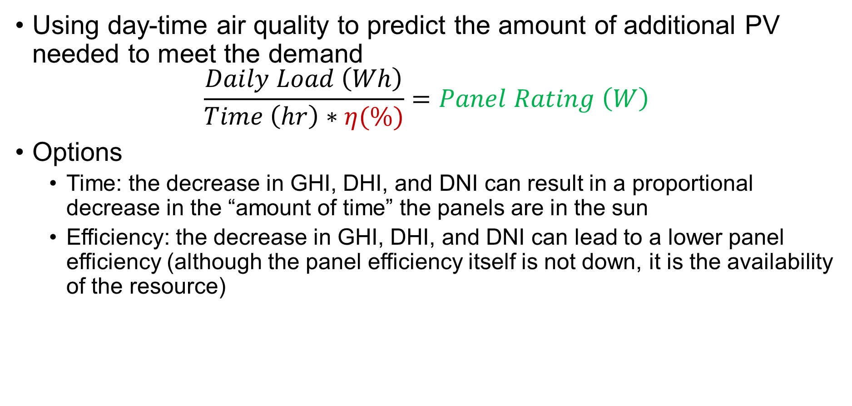
Machine Learning
Using day-time air quality to predict the amount of additional PV needed to meet the demand
$$\frac{Daily Load \left(Wh\right)}{Time \left(hr\right)∗η(\%)}=Panel Rating \left(W\right)$$
Options
Time: the decrease in GHI, DHI, and DNI can result in a proportional decrease in the “amount of time” the panels are in the sun
Efficiency: the decrease in GHI, DHI, and DNI can lead to a lower panel efficiency (although the panel efficiency itself is not down, it is the availability of the resource)

Slide 13
MEWS and EnergyPlus
Combining a multi-scenario extreme weather simulator and building energy modeling to develop a diverse array of future climate states of the world for the next 40 years
Based on a TMY for the specified location

Slide 14
Customer #2
Stakeholder type:
Year(s): 2017-present
Location: Butte County, CA
Relevant natural disaster: wildfires
Building characteristics:
Primary mission:
Size:
Concerns:
Slkdfj
Slkdjf
Sldkjf

