Slide 1
Comparison of Matplotlib and tableau
Madeline Warndorf
12/7/2018
EMSE 6992

Slide 2
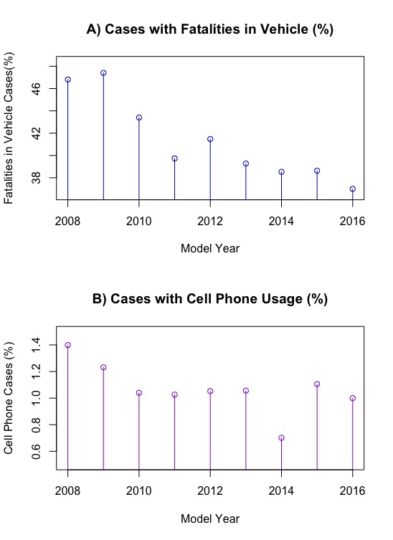
Goal
The data was collected from the National Highway Traffic Safety Administration’s (NHTSA) Fatal Accident Report System (FARS).
Goal: To compare Python Matplotlib plots to the graphs produced in Tableau.
Complexity
Appearance

Slide 3
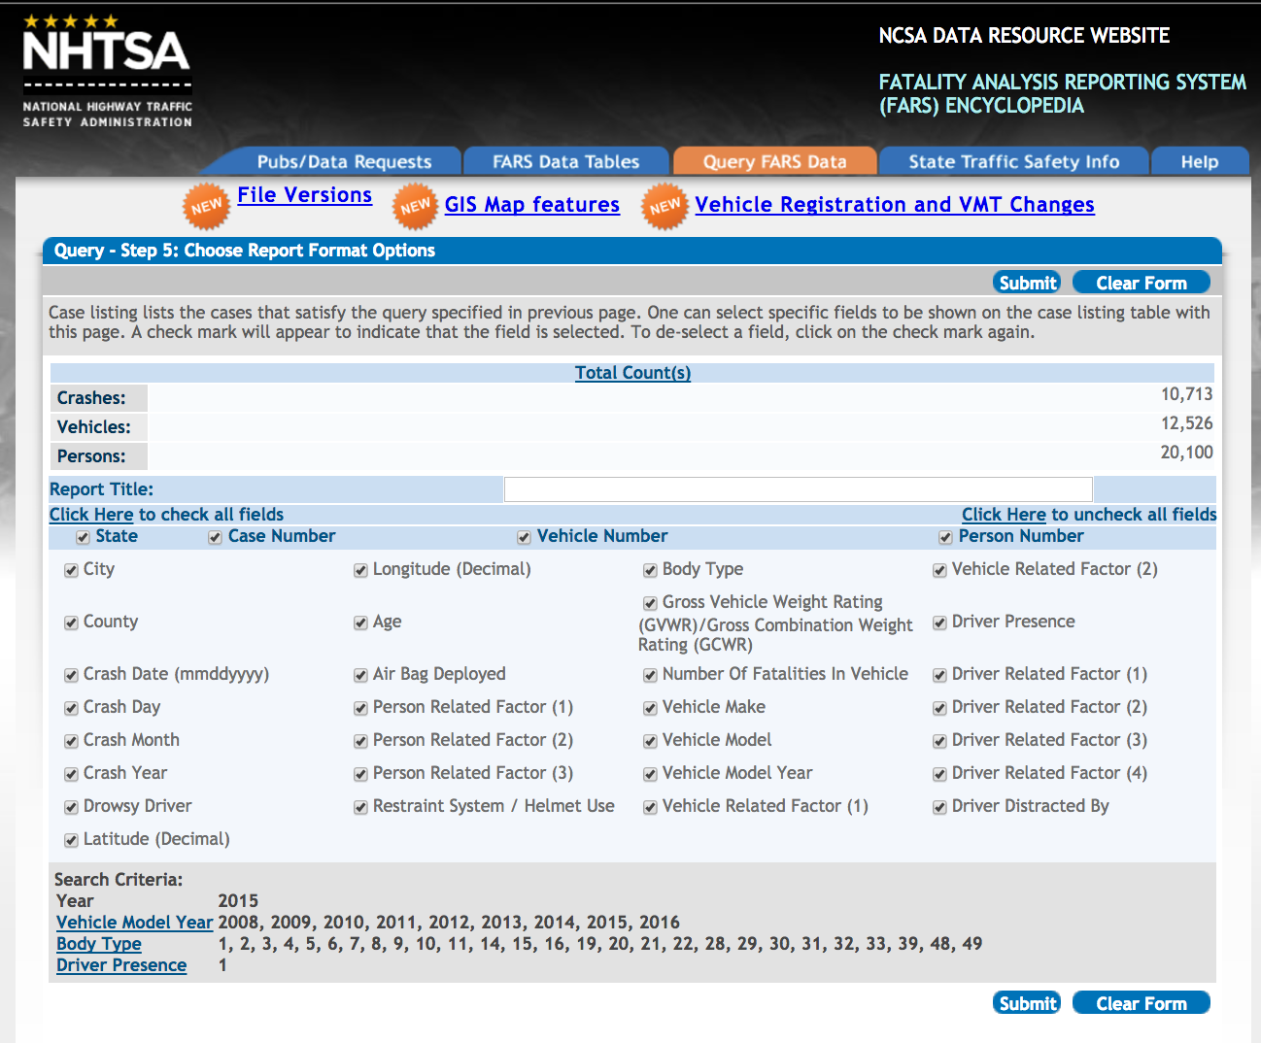
The Original Data
Case Year: 2016
Vehicle must be a 2008 through 2017 model year.
Passenger car or light truck vehicle (LTV)
Excluding service vehicles, motorcycles, and three-wheeled vehicles
The driver must be present.
This ensured that there was a driver.
The dataset had 33 features with 23,930 entries.
Data was downloaded as a CSV.
https://www-fars.nhtsa.dot.gov/QueryTool/QuerySection/SelectCriteria.aspx
Notes:
Image: https://www-fars.nhtsa.dot.gov/QueryTool/QuerySection/SelectCriteria.aspx

Slide 4
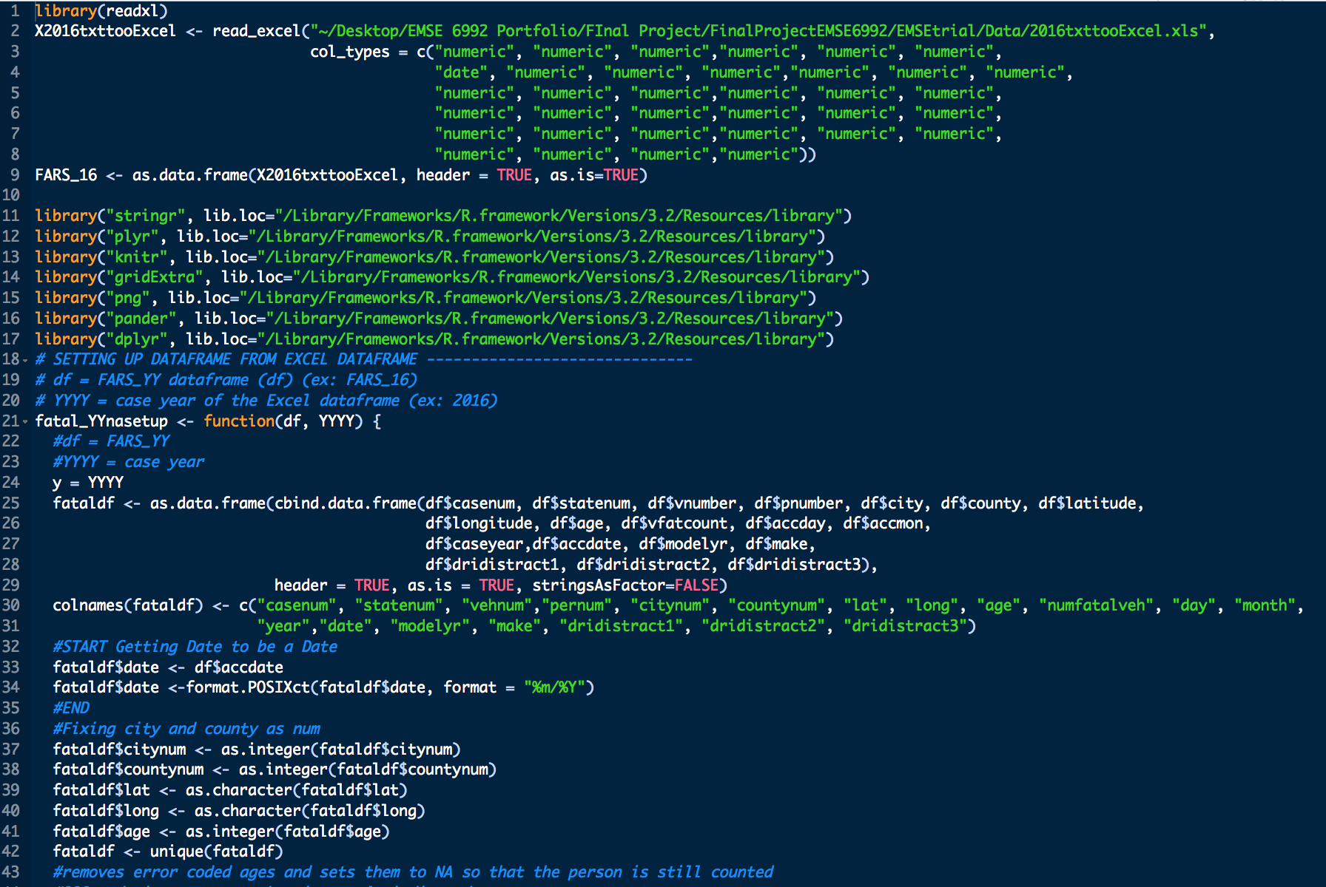
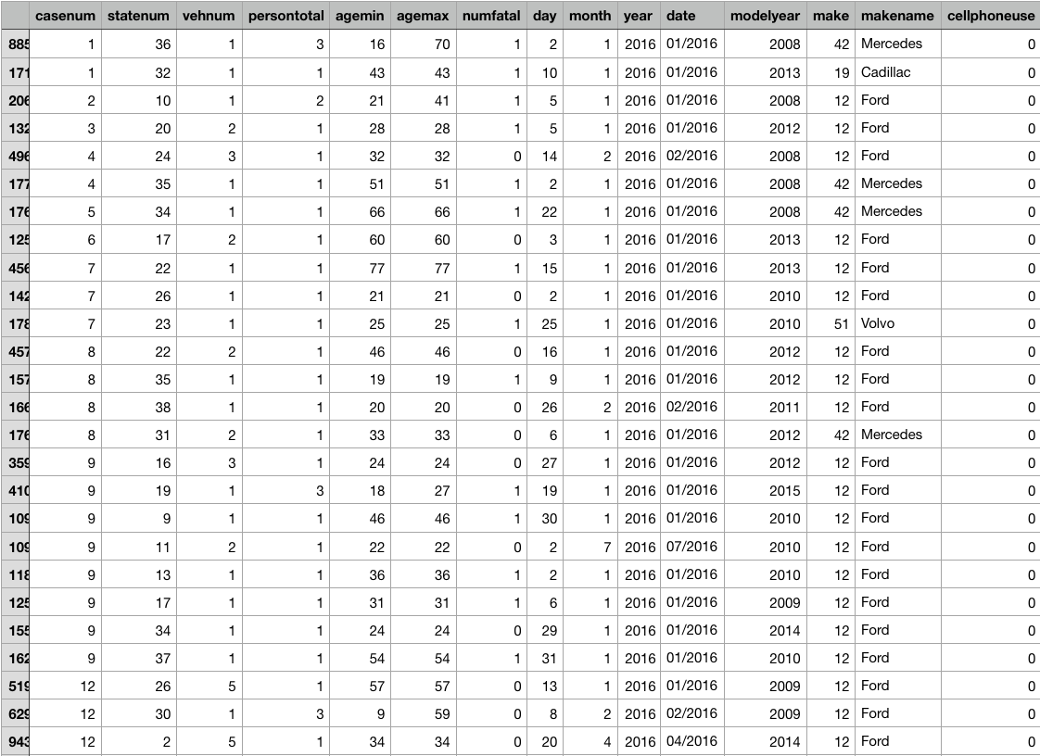
Methodology
Removed unnecessary features.
Found the number of people involved in each vehicle per case number and state.
Recorded the minimum age and maximum age of the people in the vehicle.
Recoded new variable: cellphoneuse.
If the accident involved cellphone use 1, else 0.
Limited the dataset to only have entries involving a Ford, Cadillac, Mercedes, or Volvo.
Notes:
https://github.com/madelinew/HON400Thesis

Slide 5
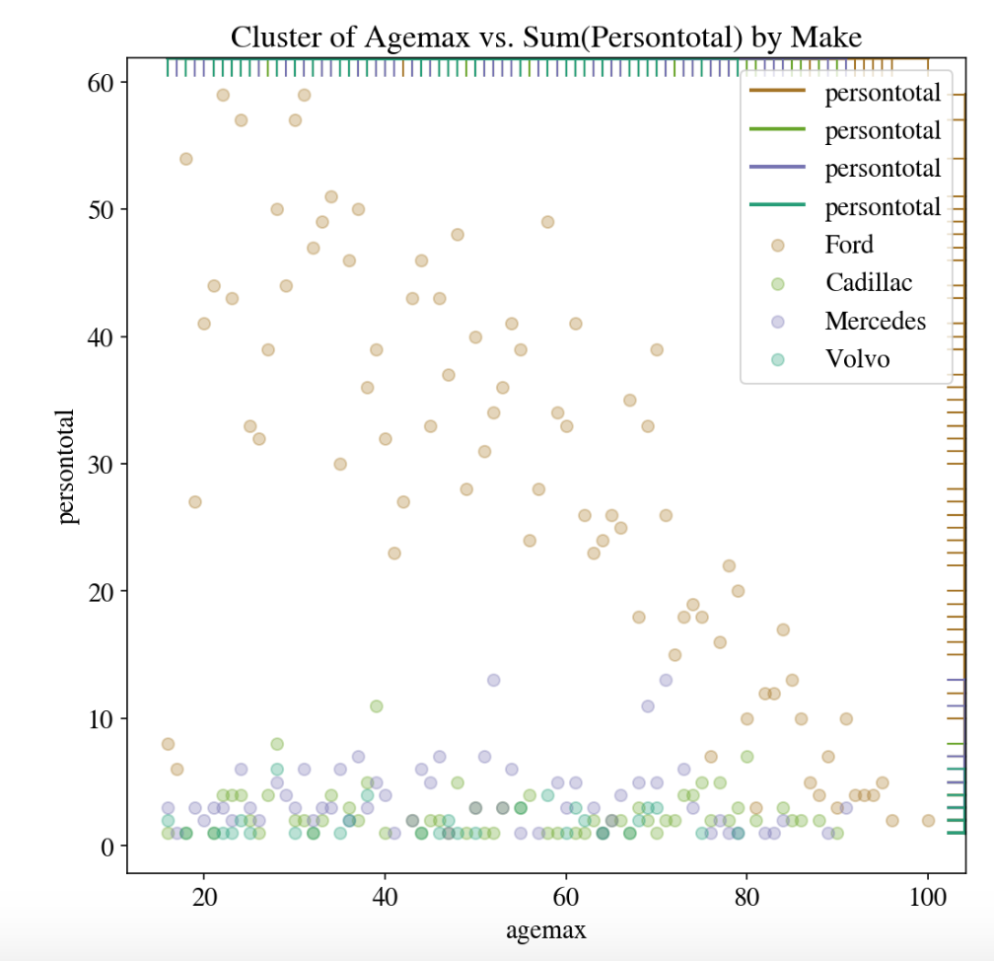
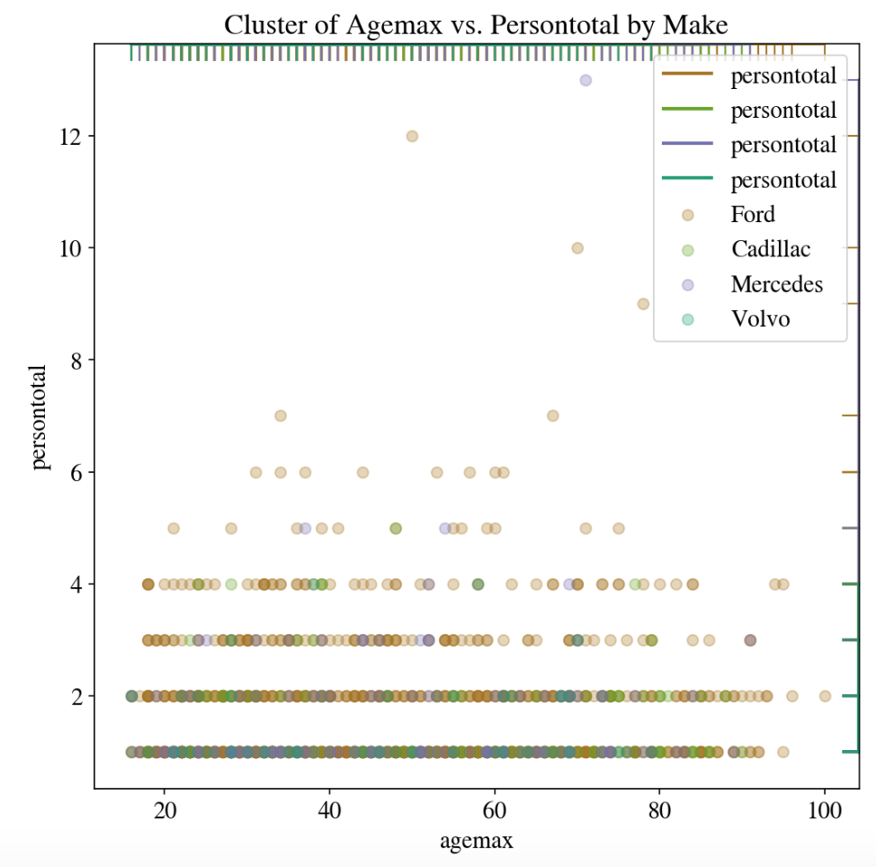
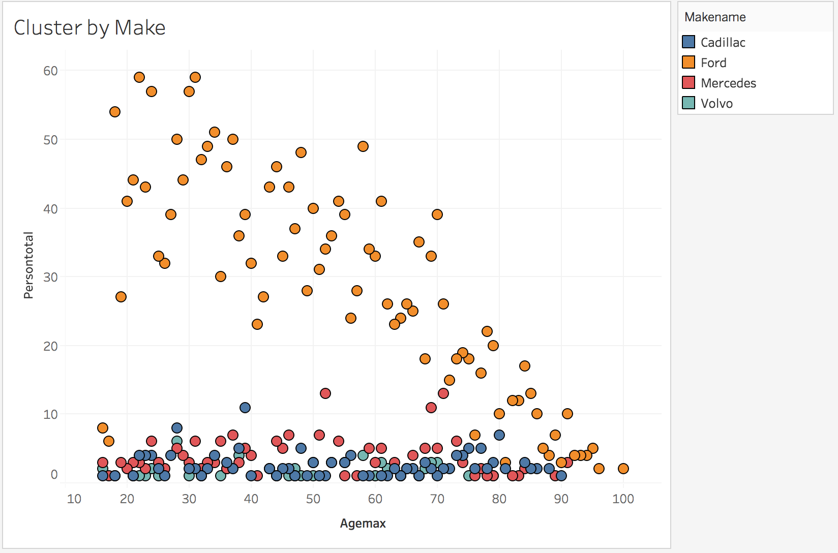
Cluster graphs
Matplotlib
Tableau
Was able to visualize it by the sum(Persontotal)

Slide 6
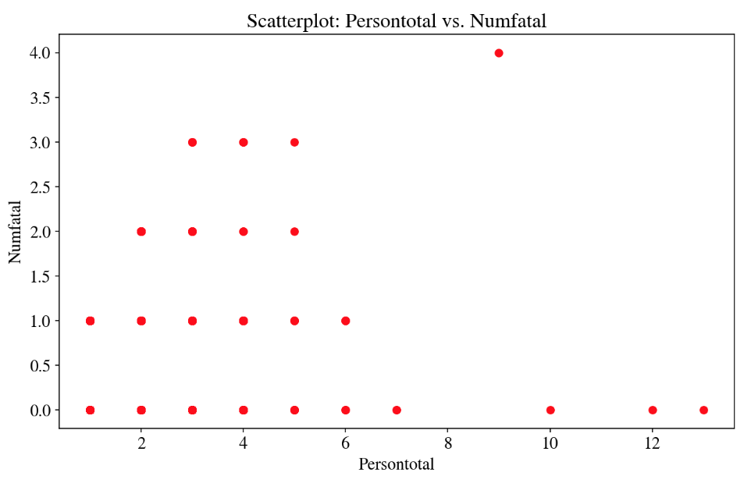
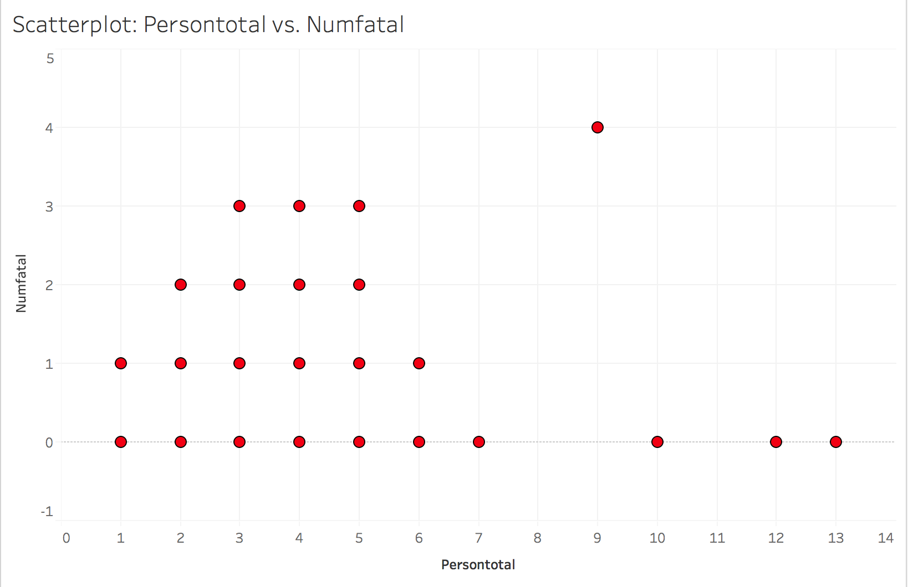
Scatterplots
Matplotlib
Tableau

Slide 7
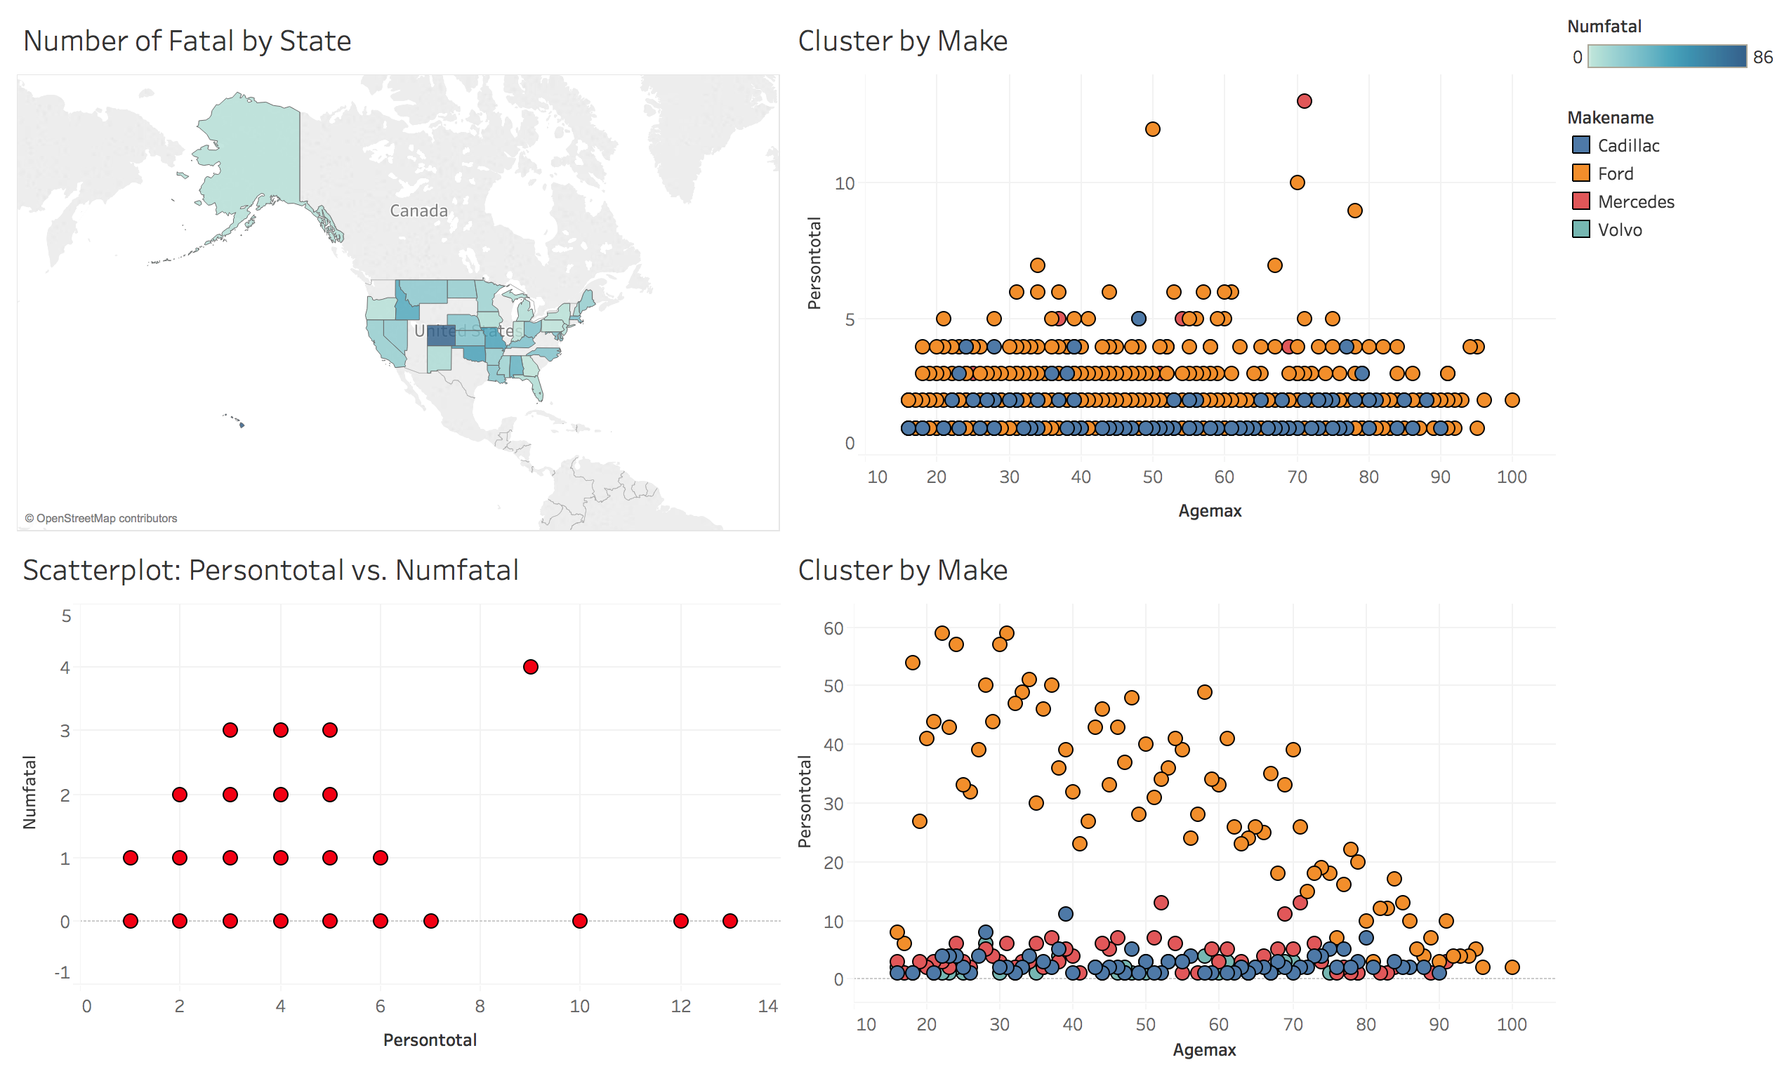
Conclusion
Tableau
Easy to make beautiful.
Really have to know Tableau to be able to create certain analytical graphs (Linear Regression).
Clean ”drag and drop” method to create simple graphs.
Offers different ways to look at the data on the graph quickly.
Matplotlib
Takes awhile to make graphs visually appealing.
Offers an extremely wide range of graphs that can be easily coded.

