Slide 1
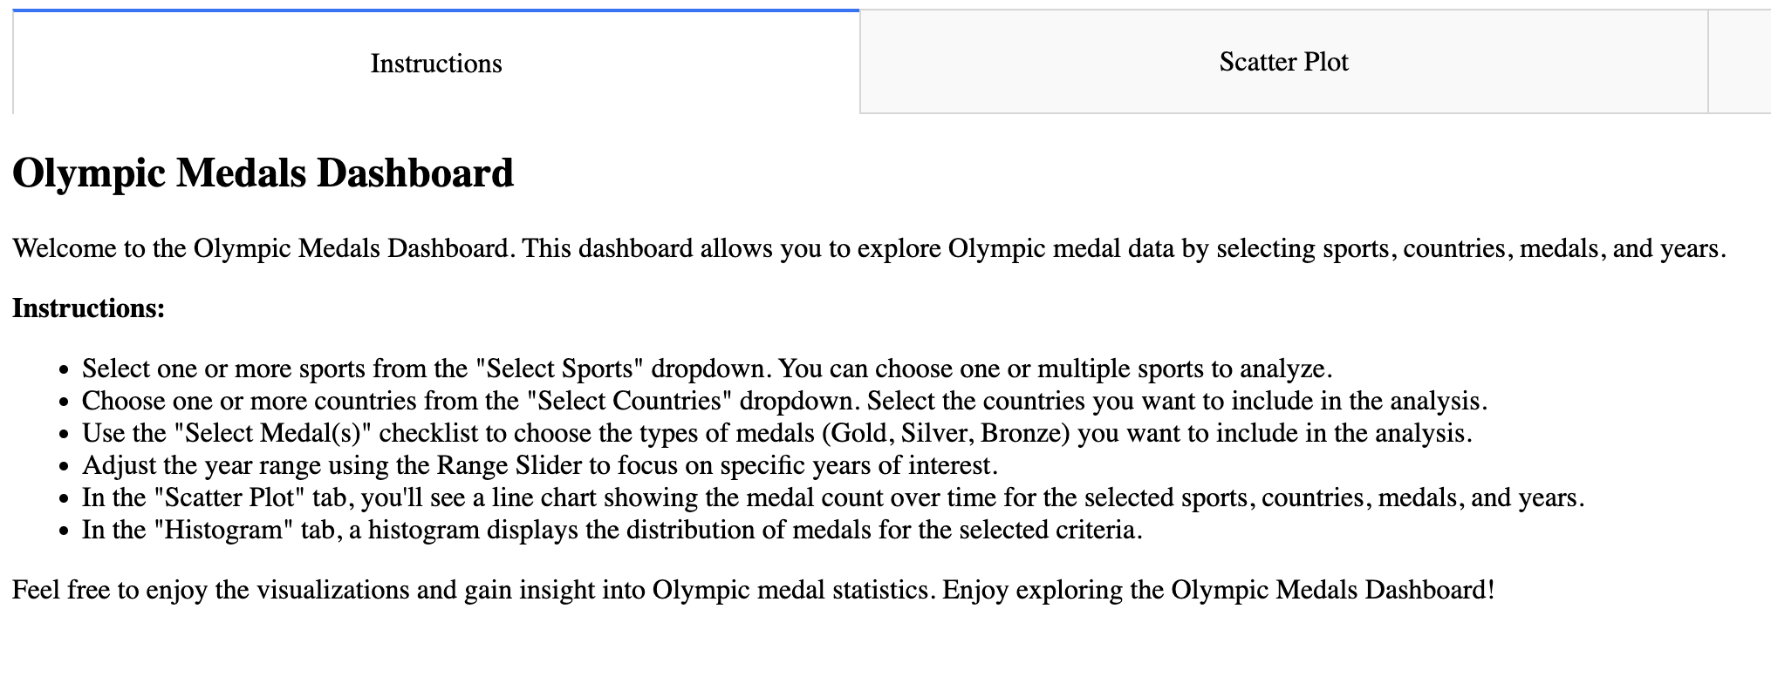
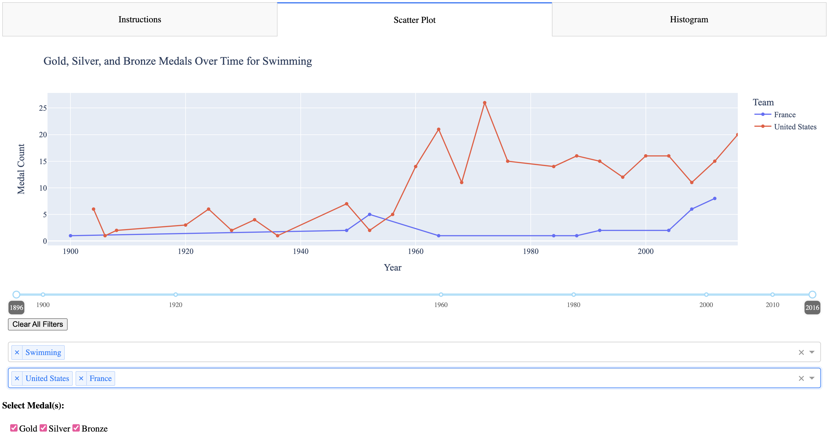
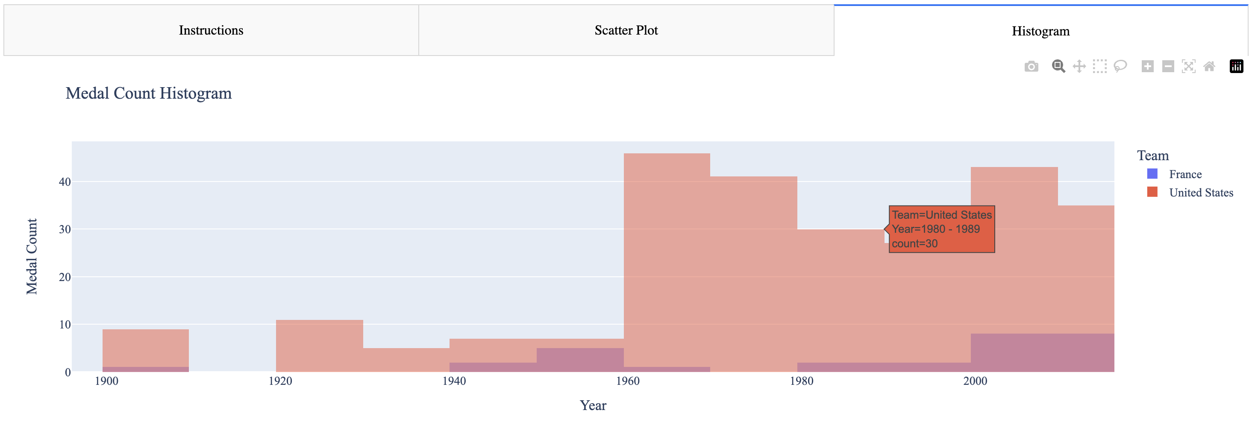
Olympic Medals Dashboard Madelyn Redick and Sahana Dhar Northeastern University
The Olympic Medals Dashboard makes it easy for users to filter, visualize, and explore Olympic medal data, enabling them to gain valuable insights from the dataset. Whether users are interested in the performance of specific countries, sports, or the evolution of medals won over time, this dashboard provides a user-friendly interface to analyze the data conveniently.
Dash Components:
Dropdown to select multiple sports and countries
Checklist to select medal type
Year Range Slider
- Scatterplot/Histogram- for distribution analysis
- Markdown cell with dash instructions (not displayed)
- Clear all button

