Slide 1
LEARNING ANALYTICS · CEIT 720
Beyond a Single Outcome
Evaluating behavioral learner profiles in OULAD against academic success, engagement, and course completion
Batuhan C. Madenci
Intelligent Systems Engineering · Graduate Education Institute
Bursa Technical University

Slide 2
MOTIVATION
Profiles are usually judged against one outcome
Clustering is widely used to find learner profiles in trace data.
But on OULAD, profiles are typically validated against a single outcome — most often academic performance (grade / pass-fail).
Engagement is usually a clustering input, not an outcome tested afterward.
Course completion / withdrawal is rarely evaluated as its own dimension — even though dropout risk matters independently of grades.
THE GAP
A structure that looks meaningful against performance may not be meaningful against engagement or retention.
No OULAD study tests one profile set against all three outcomes at once.
Beyond a Single Outcome · OULAD learner profiles
2

Slide 3
RESEARCH QUESTIONS
Four questions, three outcome dimensions
What distinct behavioral profiles emerge from VLE interaction and assessment data?
RQ1
Do the profiles differ in academic success (assessment scores)?
RQ2
Do the profiles differ in engagement (VLE clicks, active days)?
RQ3
Do the profiles differ in course completion and withdrawal?
RQ4
Beyond a Single Outcome · OULAD learner profiles
3

Slide 4
DATA
Open University Learning Analytics Dataset (OULAD)
32,593
22
10.6 M
CC-BY 4.0
student–module
registrations
module
presentations
daily VLE
interactions
open license
(Kuzilek+ 2017)
Four tables drive the analysis:
studentInfo final course outcome + demographics studentVle daily clickstream logs
studentAssessment submissions + scores assessments assessment metadata
Beyond a Single Outcome · OULAD learner profiles
4

Slide 5
FEATURE ENGINEERING
Four behavioral features, two key decisions
Feature | Construct
total_clicks | Engagement volume
active_days | Engagement consistency
submission_rate | Assessment participation
mean_score | Academic attainment
① Exclude exams
Final-exam scores are largely missing → would bias submission_rate. Captured instead via final_result (RQ4).
② Informative zeros, not deletion
Missingness is concentrated in withdrawals (29% no VLE, 54% no assessment). Deleting would erase the very students RQ4 studies — so absence is encoded as zero.
K-medoids on z-standardized features · Euclidean dissimilarity · no outlier removal (robust by design)
Beyond a Single Outcome · OULAD learner profiles
5

Slide 6
METHODS
Two learning-analytics methods
1 · Clustering
2 · Group comparisons
K-medoids (PAM), FasterPAM implementation
Real data points as centers → robust to heavy-tailed clickstreams
k selected by Average Silhouette Width (ASW)
Elbow & BIC/AIC rejected (mismatched to dissimilarity methods)
Kruskal–Wallis H — continuous outcomes (RQ2, RQ3)
ε² effect size; Dunn post-hoc with Bonferroni
χ² test of independence — course outcome (RQ4)
Cramér's V effect size
With N ≈ 32,600 everything is "significant" → we read effect sizes, not p-values.
Beyond a Single Outcome · OULAD learner profiles
6

Slide 7
RQ1 · SELECTING K
ASW ties at k = 2 and k = 4 — we choose k = 4
Why not k = 2?
k=2 (0.496) and k=4 (0.496) are statistically indistinguishable (Δ ≈ 0.0003).
k=2 collapses to a single engaged / disengaged split — too coarse for RQ3 & RQ4.
k=4 keeps silhouette quality and gives the resolution the questions need.
Beyond a Single Outcome · OULAD learner profiles
7

Slide 8
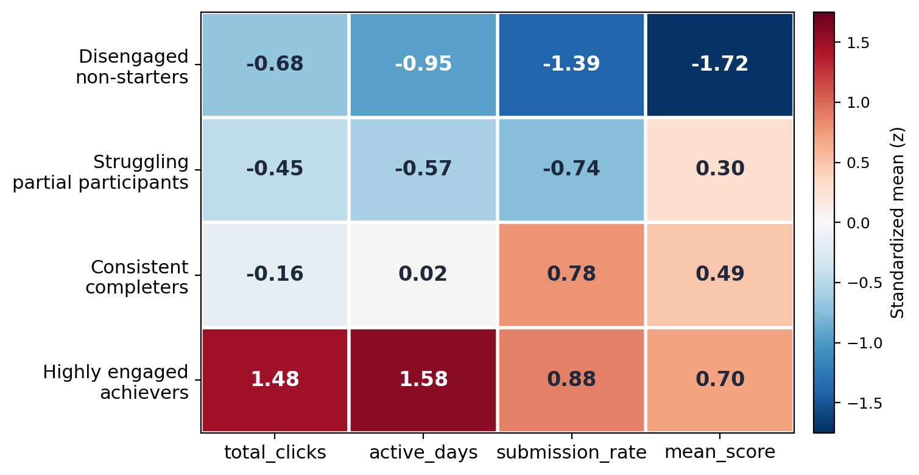
RQ1 · PROFILES
Four distinct, well-separated learner types
Disengaged non-starters 7,302 · minimal activity, near-zero submission
Struggling partial participants 6,779 · low effort, moderate scores when they submit
Consistent completers 11,802 · lean browsing, high submission & solid scores
Highly engaged achievers 6,710 · top on every feature
Beyond a Single Outcome · OULAD learner profiles
8

Slide 9
RQ2 & RQ3
Profiles differ on every continuous outcome
RQ | Outcome | Statistic | p | Effect
RQ2 | Mean score | H = 18,931 | < .001 | ε² = 0.58
RQ3 | Total clicks | H = 25,121 | < .001 | ε² = 0.77
RQ3 | Active days | H = 26,604 | < .001 | ε² = 0.82
Large effects
All six cluster pairs differ on every outcome (Dunn, p < .001).
These features were clustering inputs — so this confirms separation rather than discovering it.
Beyond a Single Outcome · OULAD learner profiles
9

Slide 10
RQ4 · EXTERNAL VALIDATION
Behavioral profiles predict course outcome
χ² = 25,278
p < .001
Cramér's V
0.51
a large effect
Beyond a Single Outcome · OULAD learner profiles
10

Slide 11
KEY FINDING
Withdrawal and failure are distinct pathways
Disengaged non-starters
Struggling partial participants
80%
45% fail 52% withdraw
withdraw — without failing. They never meaningfully start.
They do engage and submit some work — a follow-through gap, not absence.
→ early / pre-enrolment outreach
→ mid-course follow-through support
A single performance outcome would merge both into one "unsuccessful" group and hide that they need different interventions.
Beyond a Single Outcome · OULAD learner profiles
11

Slide 12
KEY FINDING
Engagement is not the same as attainment
Consistent completers reach 91% of the achievers' mean score with only 25% of the clicks.
Lean path
Intensive path
938
3,725
avg clicks → score 74
avg clicks → score 81
Consistent completers (largest group)
Highly engaged achievers
Diminishing returns — dashboards that flag low-click students would misclassify the efficient completers.
Beyond a Single Outcome · OULAD learner profiles
12

Slide 13
LIMITATIONS
What bounds these claims
Features are not orthogonal (r = 0.84) — four profiles span ~two latent axes.
RQ4 is only partly external: outcome correlates with score; withdrawal is the cleanest independent signal.
k chosen on a sample; full cohort assigned by nearest medoid (an approximation to full PAM).
Registrations pooled across 22 module presentations of differing structure.
Cross-sectional — cannot say when disengagement occurs.
Future work: temporal / sequence models · module-level modeling · cross-dataset replication · intervention studies.
Beyond a Single Outcome · OULAD learner profiles
13

Slide 14
CONCLUSION
A multi-outcome evaluation framework
Four robust profiles
External validity
Disengaged · struggling · completers · achievers — fully separated.
Behavior predicts course outcome (V = 0.51), never used in clustering.
Withdrawal ≠ failure
Engagement ≠ attainment
Two risk pathways a single-outcome view would merge.
High scores reached via lean or intensive routes alike.
The contribution is methodological, not a new algorithm.
Beyond a Single Outcome · OULAD learner profiles
14

Slide 15
Thank you
Questions & discussion
Batuhan C. Madenci · github.com/madencican/oulad-learner-profiles

