Slide 1

Box Office Predictions
a CHED Production

Slide 2

Challenge: Predict the Worldwide Box Office Revenue
Dataset: 7300+ Movies
Data Points: Cast, Crew, Plot Keywords, Budget, Posters, Release Dates, Languages, Production Companies, and Countries
Award Criteria: Evaluated on Root-Mean-Squared-Logarithmic-Error (RMSLE) between the predicted value and the actual revenue
Footnote: CHED team also submitting analysis in contest hosted by Kaggle. The competition will conclude May 30, 2019 at 11:59 PM UTC. Kernel Swag goes to the top three most upvoted kernels.

Slide 3

ESTABLISHING SHOT
TASK TOOLS TARGET
Clean Data: Python & Pandas Parse grouped data into singular columns, organize and output to clean CSV file
Line Charts: Tableau Compare variables to revenue over fixed period of time
Scatterplots: Python & Pandas Create a scatterplot for each pair of attributes in the data to identify structured relationships between the variables
Power Points: Python & Pandas Apply a weight to the individual variable (var = Actor, Production Company, Key Word) based on number of times each appeared in a record from the dataset; then calculating the Power Points of each movie by summing the weighted numbers of each, respective variable per record (movie)

Slide 4
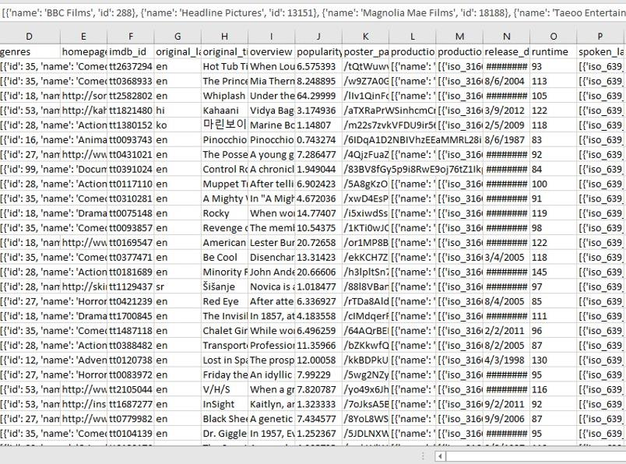
Data Cleaning
Challenges
Many columns held lists of information that had to be parsed out
Some of the data was in other languages
Large number of non-alphanumeric characters

Slide 5
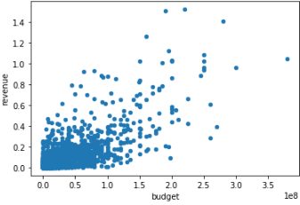
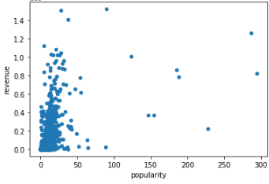
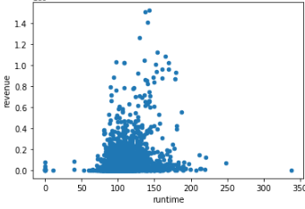


Production Design
We used scatterplots to identify relationships between pairs of attributes.
What we learned:

Slide 6

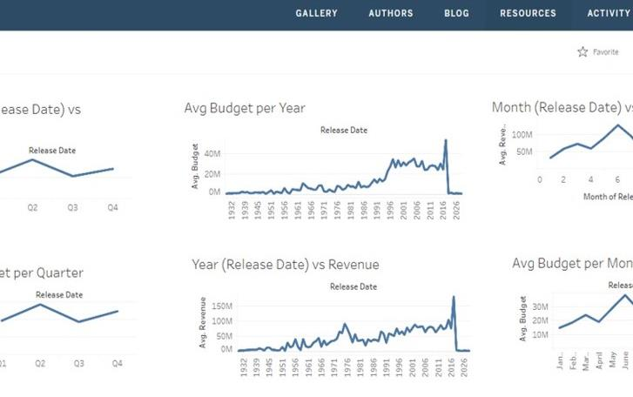
TABLEAU PUBLIC
For Quick Data Comparisons
We used Tableau Public to compare data points to the revenue by using line charts to identify similarities in time-based trends

Slide 7
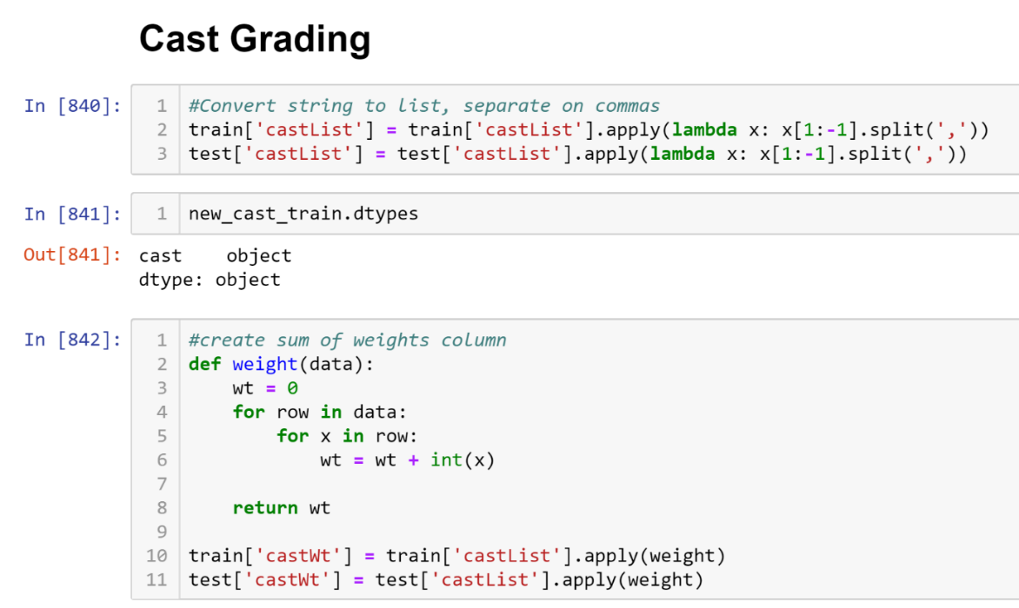

Power
Points

Slide 8
ML Model #1
ML Model #2
ML Model #3
Description
Train vs Test Analysis
Description
Train vs Test Analysis
Description
Train vs Test Analysis

Slide 9

Advance Screening
Demo

Slide 10




Slide 11

Credits

