Slide 1

POUR TASTE
A Poor Wine Buyer’s Analysis
Elizabeth Brown
Erin Ford
Dylan Grimm

Slide 2
Project Summary
Project Description: With no experience as Sommeliers or Oenophiles, we would like to study wine data. Our project is to examine the relationships between wine prices, reviews, regions, provinces, points, and variety.
Research Questions:
What are the top 5 to 10 wines under $20 in this dataset?
Which regions or countries have the most wineries and which have the best reviews and prices.
What vintages are most prevalent in the dataset? On average can older vintages be found at the same prices as newer vintages?
What is the relationship between point value and price? Can you find a highly-rated wine with a low price tag?
Is there a correlation between the type of wine that a drinker prefers and the price that they will pay for a bottle? Are some varieties that are more expensive than others?

Slide 3
Regions / Countries with Top Rated Wines
If shopping for a bargain wine, which countries or regions are most likely to be “better”?

Slide 4
Regions / Countries Vs. Price
What countries typically have the most expensive wines? Does this correlate with ratings?

Slide 5
Vintages
Stripping a specific value from strings

Slide 6
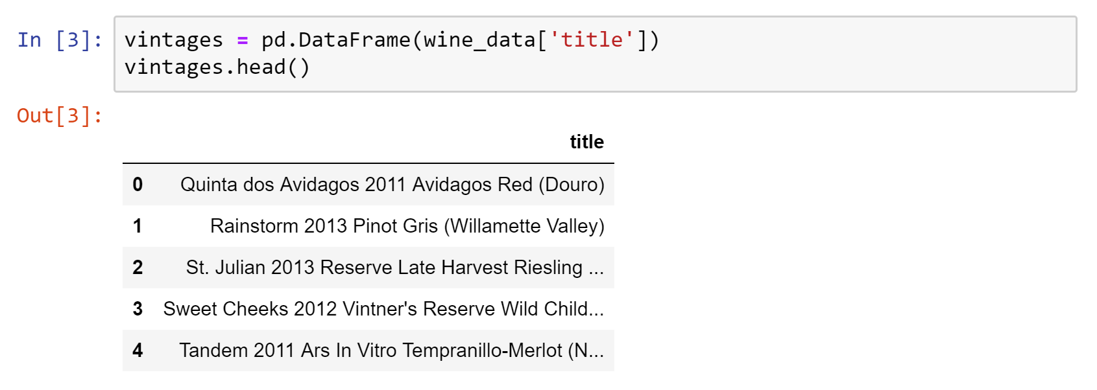
Dataframe Cleanup
Issues:
The year or vintage is buried in a text string
Location in the string varies

Slide 7
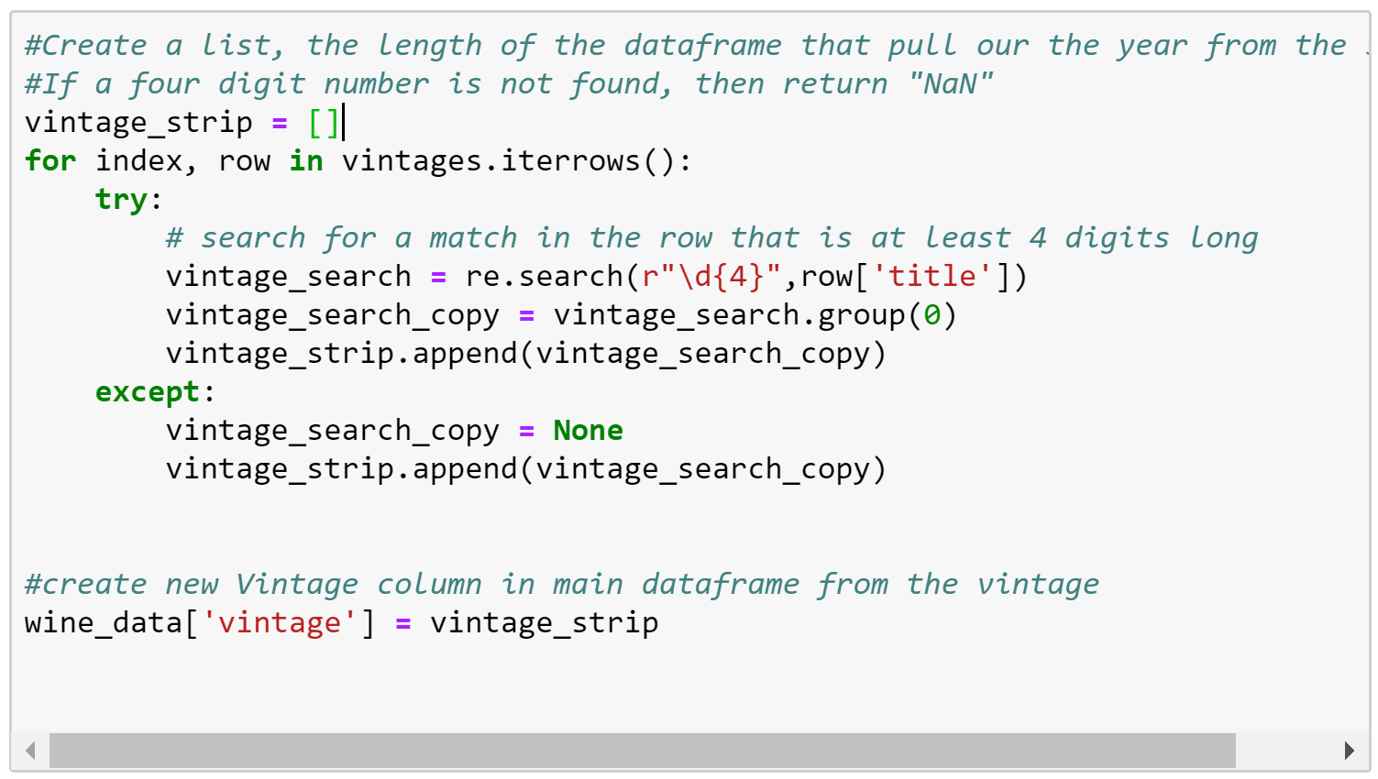
Iterrows and regular expressions
Result:
Four digit strings representing year
dtype = object
Issues Encountered with Method:
Object not sortable
Had to convert to an integer
Due to “NaN” or null / missing values, it wanted to default to a float.

Slide 8
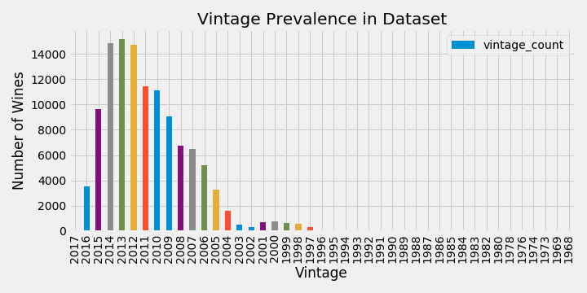
What vintages are most prevalent?
“…today's wine lover is well advised to buy fine wines, cellar them in a cool space for five years—10 years, tops—and then drink them… ”
The bulk of the data is found between 2005 to 2016. This is a range of 12 years.
The most prevalent wines in the dataset are from 2012 – 2014.
Based on this research, we should not be worried that we won’t find a “good” wine that hasn’t aged for over 10 years…
“Of all the wines produced, more than 90% are designed to be consumed within a couple of years after they are produced. ”

Slide 9
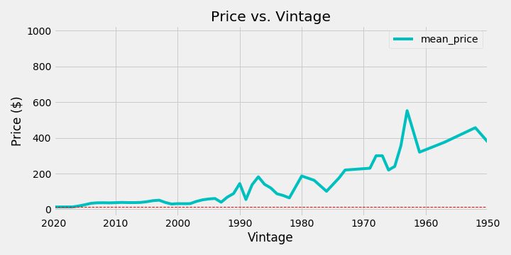
How does price vary over time or vintage?
Are “aged” wines more expensive?
Wine price appears to be higher as the wine has aged. On average, older wines are more expensive.
However, this is not an accurate predictor of price.
“In general, more expensive wines are usually designed to become better with age. Most inexpensive wines do not benefit from aging.”

Slide 11
Top Cheap Wines ($20 or under)
Top Wines By Variety
There were some ties for top points, so other options are available

Slide 12
Data for this presentation available here:
https://www.kaggle.com/zynicide/wine-reviews#winemag-data-130k-v2.csv

