Slide 1

POUR TASTE
A Poor Wine Buyer’s Analysis
Elizabeth Brown
Erin Ford
Dylan Grimm

Slide 2
Project Summary
Project Description: With no experience as Sommeliers or Oenophiles, we would like to study wine data. Our project is to examine the relationships between wine prices, reviews, regions, provinces, points, and variety.
Research Questions:
What are the top 5 to 10 wines under $20 in this dataset?
Which regions or countries have the most wines and wineries and which have the best reviews and prices.
What vintages are most prevalent in the dataset? On average can older vintages be found at the same prices as newer vintages?
What is the relationship between point value and price? Can you find a highly-rated wine with a low price tag?
Is there a correlation between the type of wine that a drinker prefers and the price that they will pay for a bottle? Are some varieties that are more expensive than others?

Slide 3
Country and Regions
Grouping the data by Country and Region

Slide 4
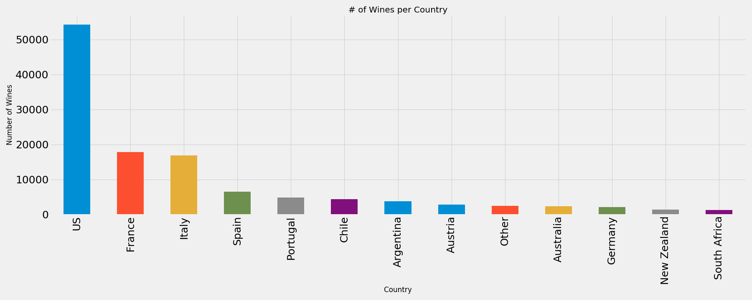
# of Wines per Country
- Originally 42 total countries, countries w/
less than 1000 wines made were put into
“Other” so we could view all data
- The US significantly outproduces other countries at 54,265, France 17,776, Italy
16,914, and Spain 6,573

Slide 5
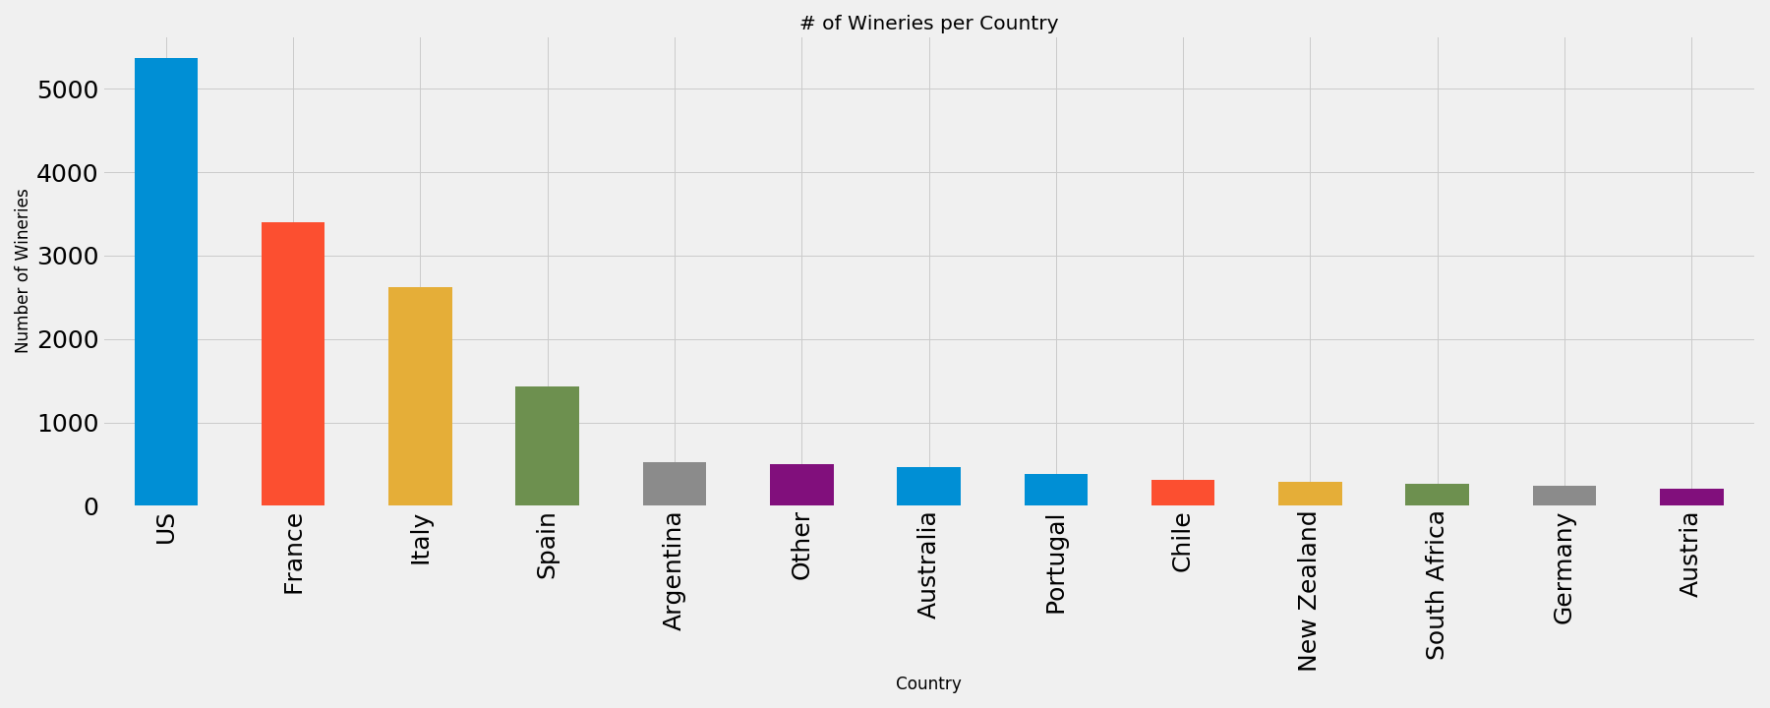
# of Wineries per Country
- Continued with the “Other” country reference
- The US continued to lead with 5,368, France at 3,400, Italy 2,629, and Spain 1,428

Slide 6
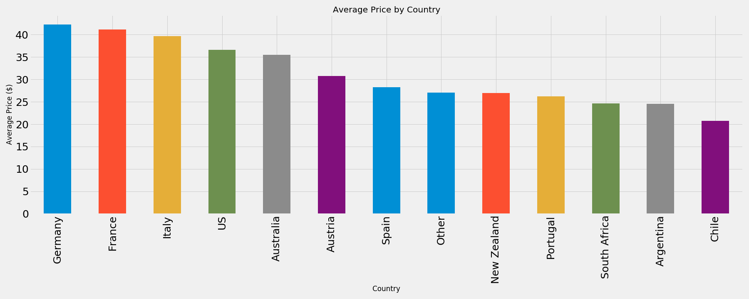
Average Price by Country
- European wines were primarily more expensive than other regions
- Following we will have to see if a high average price grants a higher point value

Slide 7
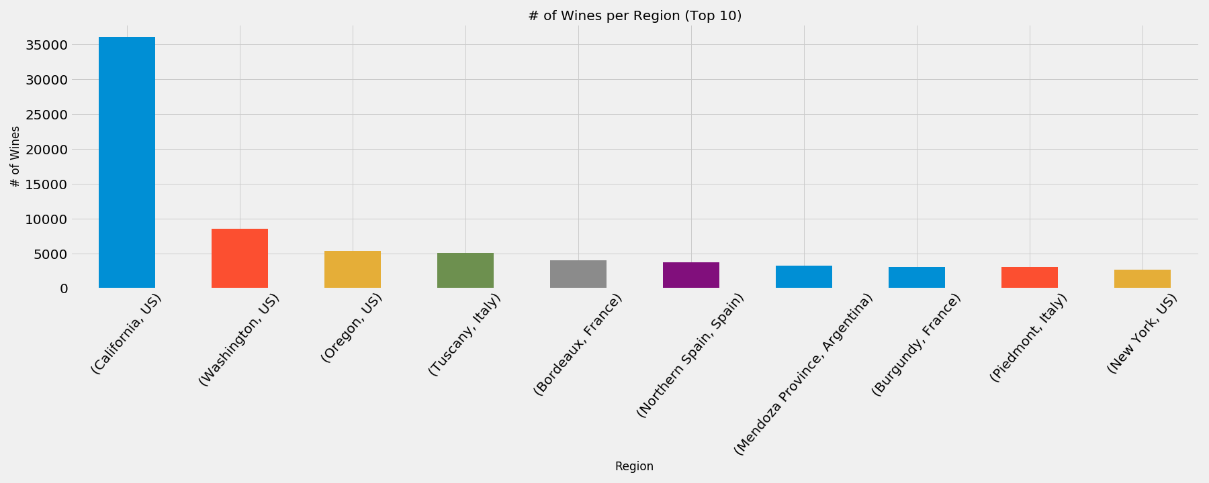
# of Wines per Region (Top 10)
- The US had 4 top producing regions, Italy with 2, France with 2, Spain with 1 and Argentina with 1

Slide 8
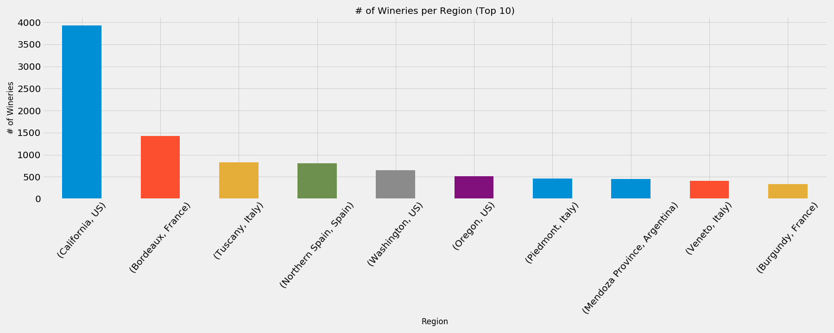
# of Wineries per Region (Top 10)
- The US had 3 regions with the most wineries, Italy with 3, France with 2, Spain with 1 and Argentina with 1

Slide 9
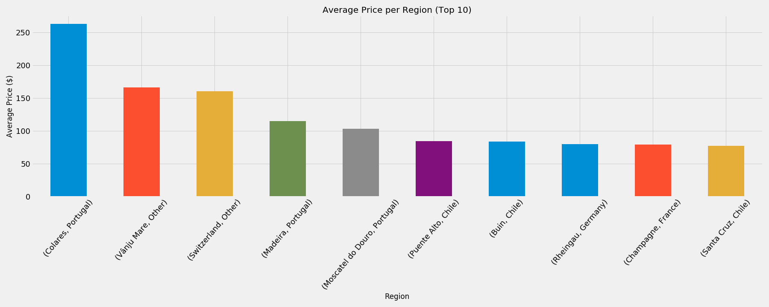
Average Price per Region (Top 10)
- The highest priced regions had 3 in
Portugal, 3 in Chile, 2 in Other, 1 in France
and Germany

Slide 10
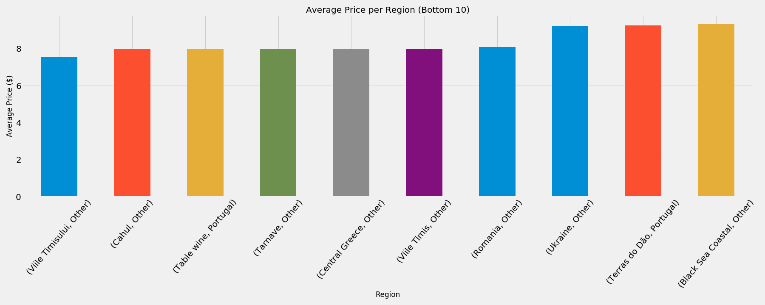
Average Price per Region (Bottom 10)
- The lowest priced wines had 8 in Other and 2 in Portugal

Slide 11
Vintages
Stripping a specific value from strings

Slide 12
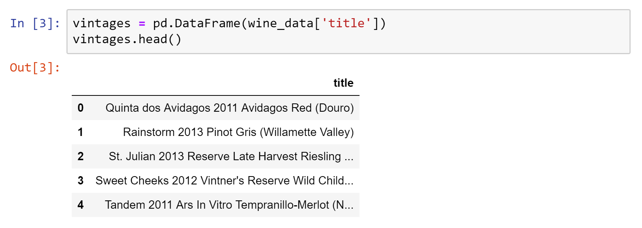
Dataframe Cleanup
Issues:
The year or vintage is buried in a text string
Location in the string varies

Slide 13
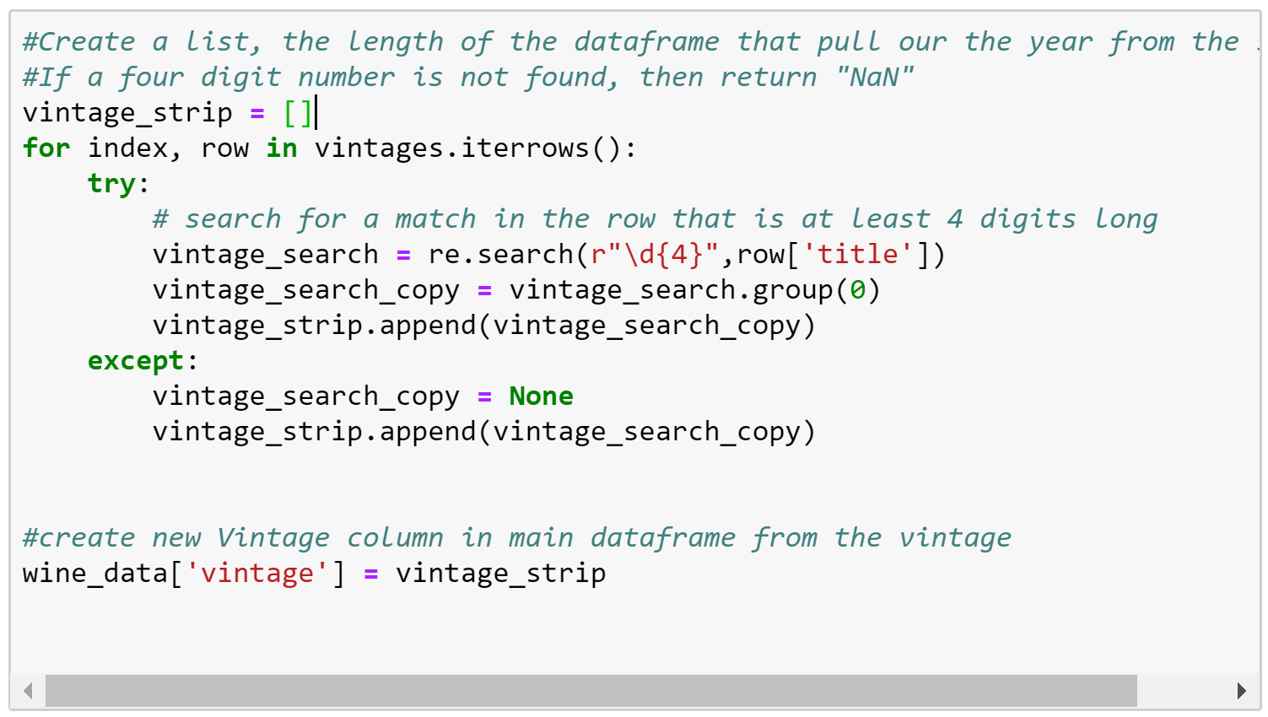
Iterrows and regular expressions
Result:
Four digit strings representing year
dtype = object
Issues Encountered with Method:
Object not sortable
Had to convert to an integer
Due to “NaN” or null / missing values, it wanted to default to a float.

Slide 14
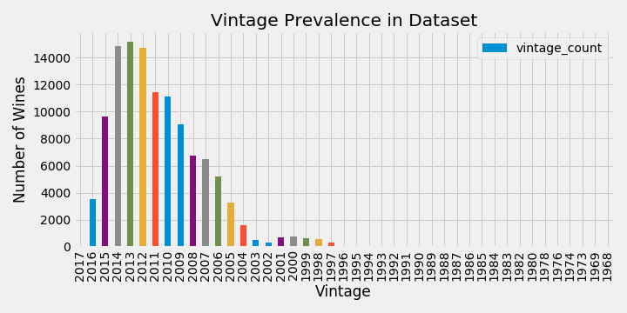
What vintages are most prevalent?
“…today's wine lover is well advised to buy fine wines, cellar them in a cool space for five years—10 years, tops—and then drink them… ”
The bulk of the data is found between 2005 to 2016. This is a range of 12 years.
The most prevalent wines in the dataset are from 2012 – 2014.
Based on this research, we should not be worried that we won’t find a “good” wine that hasn’t aged for over 10 years…
“Of all the wines produced, more than 90% are designed to be consumed within a couple of years after they are produced. ”

Slide 15
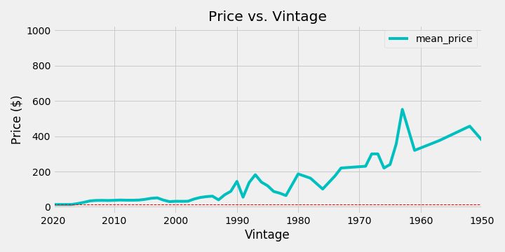
How does price vary over time or vintage?
Are “aged” wines more expensive?
Wine price appears to be higher as the wine has aged. On average, older wines are more expensive.
However, this is not an accurate predictor of price.
“In general, more expensive wines are usually designed to become better with age. Most inexpensive wines do not benefit from aging.”

Slide 16
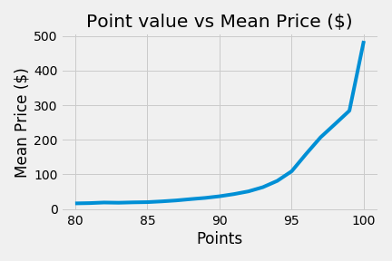
Price vs Points
What is the relationship between price and point value?
Does a wine buyer have to settle for a lesser wine if they’re on a budget?
As expected, the average price of wine increases when point value is high.
It should be noted that there are no wines lower than 80 points in our dataset. Is this because this list was compiled by a wine magazine and only picks the best?

Slide 17
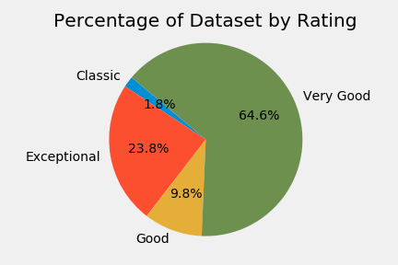
Exploring our dataset by rating
Wines are grouped by their points
80-84 wines are above average to good
85-90 wines are good to very good
90-94 wines are superior to exceptional
95-100. Wines are benchmark examples or classic

Slide 18
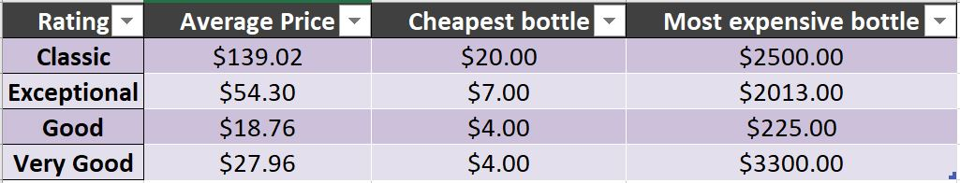
Rating vs Price
You don’t have to break the bank for a decently rated bottle of wine! There is a price range for every type of oenophile.

Slide 19
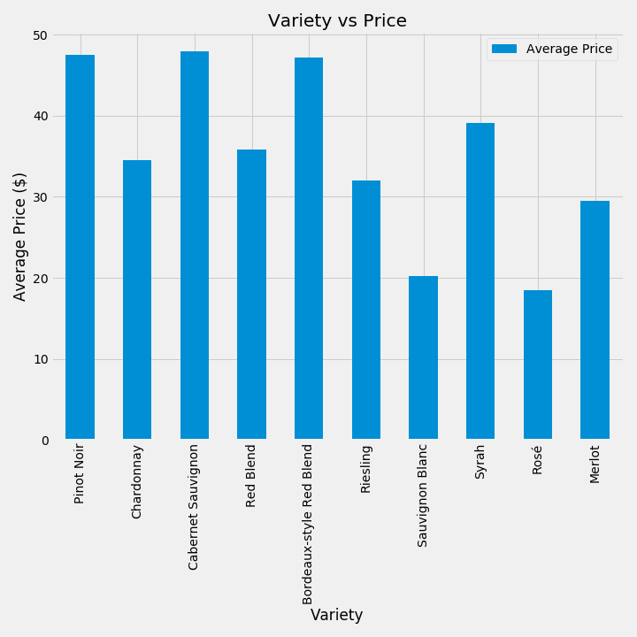
Price vs Variety
Does the variety of wine you prefer make a difference on the sticker price?
Our dataset represents 697 separate varieties of wine.
I narrowed the field down to the top 10 varieties that are most numerous in the dataset and calculated the average price for each variety.

Slide 20
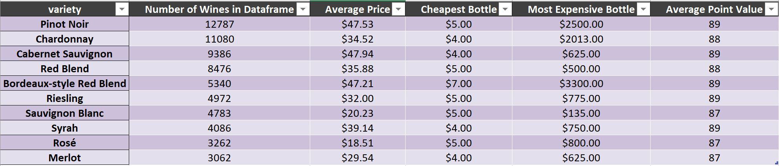
Variety Statistics

Slide 21
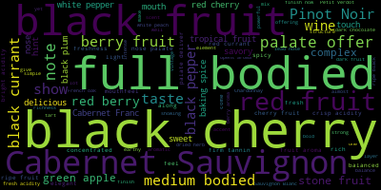
What words are used most frequently in wine reviews?
WordCloud is a technique to show which words are the most frequent among a given text.
Using the “Description” column of our dataset, we wanted to explore what words were most frequently used in describing the wines.
I installed a specific package to sort through the descriptions, and based on their frequency in the column, generate a “WordCloud” with the 100 most commonly used words.
The size of the word in the “Cloud” correlates with the frequency of the word’s use in the column.
Using the “stopwords” parameter, I specifically removed words like “The” and “Wine” from the list, since they would most likely be used in nearly every review.

Slide 22
Top Cheap Wines ($20 or under)
Top Wines By Variety
There were some ties for top points, so other options are available

Slide 23
Data for this presentation available here:
https://www.kaggle.com/zynicide/wine-reviews#winemag-data-130k-v2.csv

Slide 24
Appendices

Slide 25
Appendix 1 – Country Data

Slide 26
Appendix 2 – Regional Data (Top 20)

