Slide 1
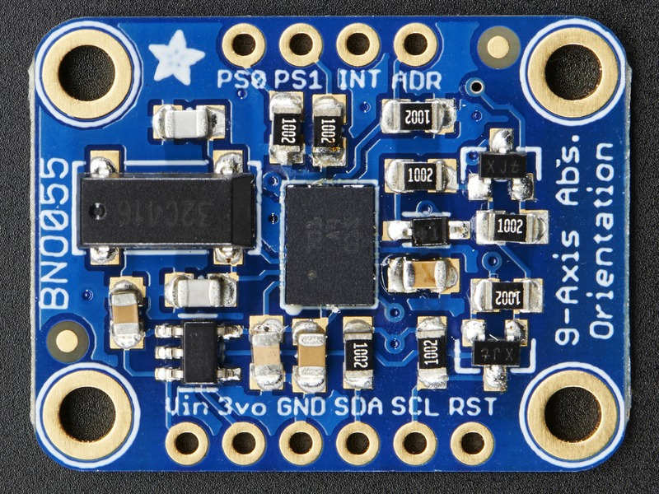
HIGH (3.3 V)
LOW (GND)
Tx
GPIO-14 (#8)
3.3 V
GND
Rx
GPIO-15 (#10)

Slide 2
8
7
6
5
/SS
NC
MISO
EOC
PORT B
PORT A
SDA/
MOSI
SCL/
SCLK
GND
Vs
1
2
3
4

Slide 3
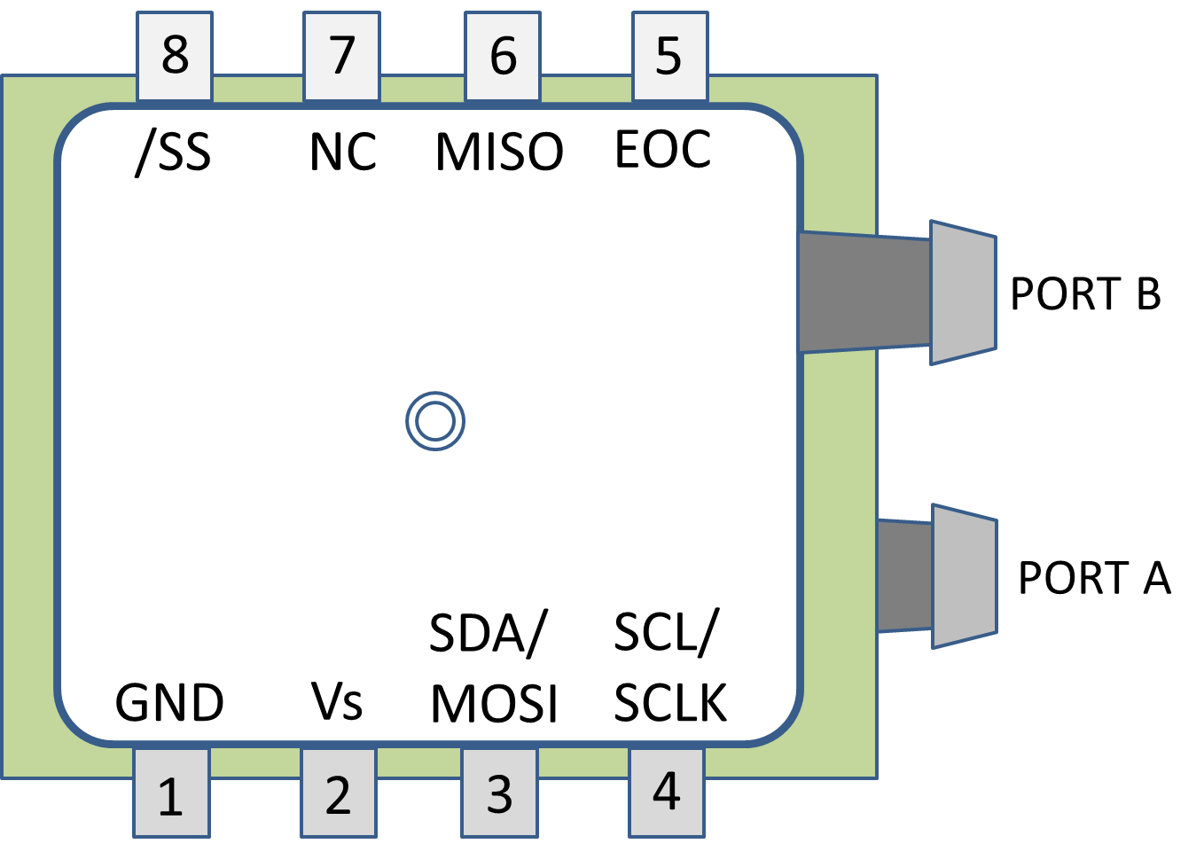
DLHR-L10D Connected via SPI
SPI_CE0
GPIO-08 (#24)
SPI_MISO
GPIO-09 (#21)
GPIO-17 (#11)
SPI_CLK
GPIO-11 (#23)
GND
3.3 V
SPI_MOSI
GPIO-10 (#19)

Slide 4
DLHR-L10D Connected via I²C
GPIO-18 (#12)
I2C-SCL
GPIO-03 (#5)
GND
3.3 V
I2C_SDA
GPIO-02 (#3)

