Slide 1


CS407 · PRINCIPLES OF MACHINE LEARNING
Group 1: Baseline, Linear
Regression & Elastic Net
Presented by Mason DeWitt, Prithvi Ghale, and Elena Van
1

Slide 2
Modeling Problem
GOAL
MODEL FLOW
Predict a student's exam score given four numeric predictor variables.
Hours
Studied
Attendance
Percent
PREDICTORS
Sleep
Hours
Assignments
Completed
Number of hours studied
Percentage of class attendance
Number of hours slept per night
Machine Learning Model
Number of assignments completed
Unique ID of each student record was excluded​
Since a student's exam score is a continuous numerical value, this is a regression problem​
Exam_Score

Slide 3
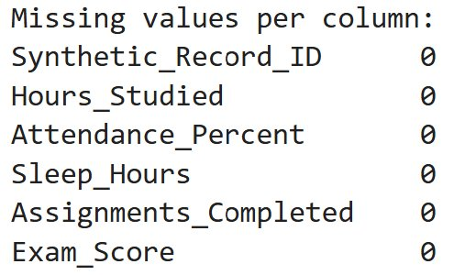
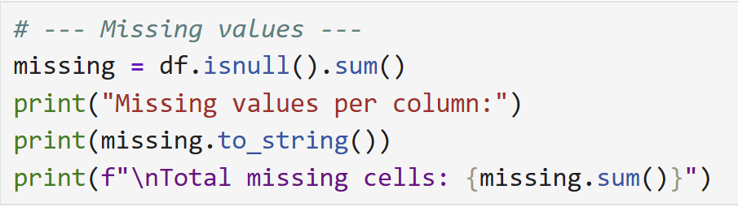
Data Quality
80
6
0
0
records
fields
missing values
duplicate IDs
FINDINGS
The dataset contains 80 records and 6 fields
No missing values across all variables
No duplicated record IDs
The numerical variables were within reasonable ranges
No obvious unusual observations were identified
No records were removed before modeling from the clean baseline dataset

Slide 4
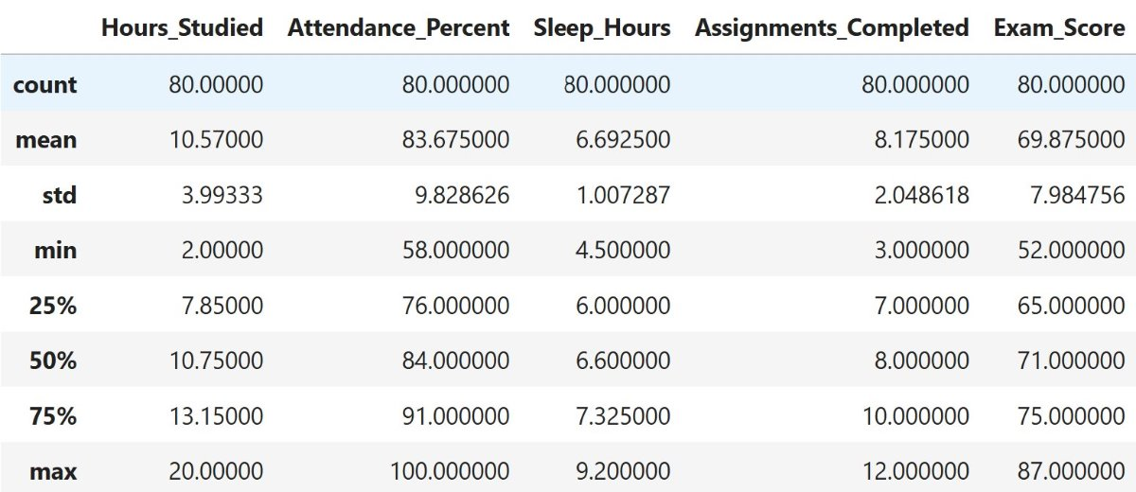
Summary Statistics
Summary statistics generated with dataframe.describe()​

Slide 5
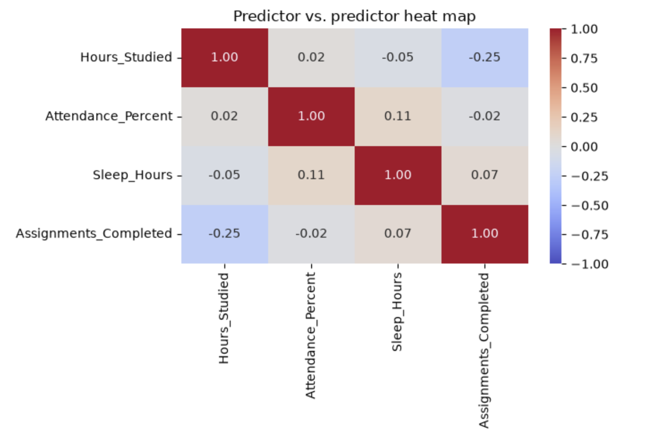
Relationships in the Data
PREDICTOR VS. PREDICTOR RELATIONSHIPS
Correlation is represented by a number ranging from -1 to 1
Closer to +1 indicates a strong positive relationship
Closer to -1 indicates a strong negative relationship
Closer to 0 indicates a weak linear relationship
No two predictor variables have a strong correlation.
Heat map generated with seaborn

Slide 6
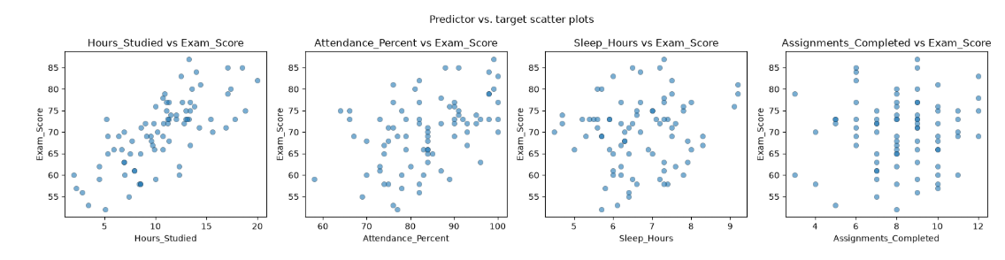
Relationships in the Data
PREDICTOR VS. TARGET RELATIONSHIP
Predictor Hours_Studied had the strongest positive correlation with target Exam_Score at approximately 0.72
High correlation is represented by a cloud shaped like a diagonal line
Time dedicated to the class predictors are the most correlated with the target
Scatter plots generated with matplotlib

Slide 7
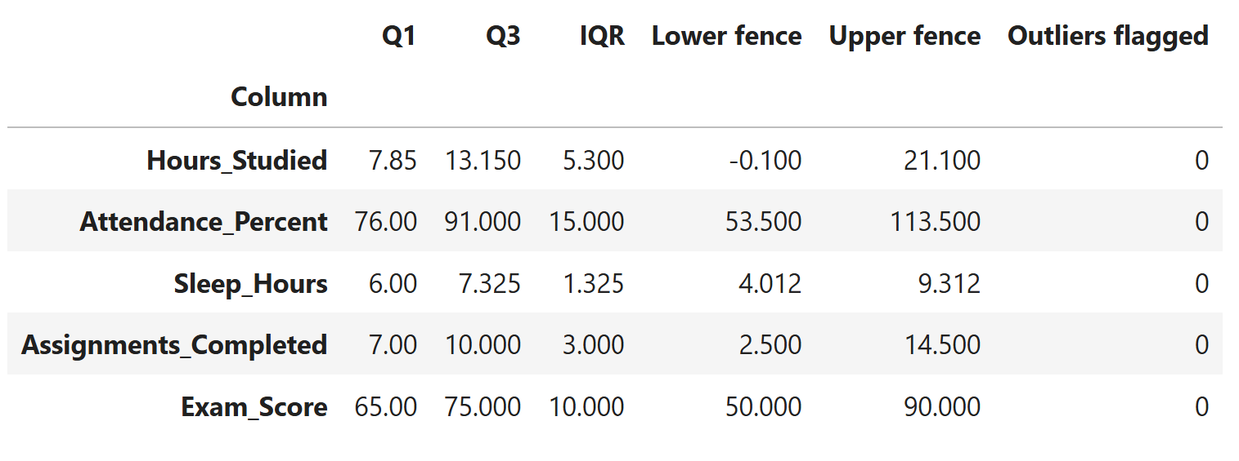
Outliers in the Data
An outlier is a data point that sits far away from the rest of the data
Outliers in the data are discovered by utilizing IQR (InterQuartile Range). The value of IQR is determined by subtracting Q1 (Quartile 1, 25th percentile) from Q3 (75% percentile)
To calculate the fences (upper and lower bounds of acceptable values):
Lower fence = Q1 – 1.5 x IQR
Upper fence = Q3 + 1.5 x IQR​
Our baseline dataset contained no outlier values across all variables

Slide 8
Unscaled Linear Regression
The fitted model was approximately:
Exam Score = 9.225 + 1.584(Hours Studied) + 0.345(Attendance) + 0.942(Sleep) + 1.067(Assignments)
INTERPRETATION
The model uses all four predictors to estimate Exam_Score
The larger the coefficient, the more linear correlation its respective predictor has to the target
Hours_Studied had the greatest coefficient in the unscaled model
Holding the other predictors constant, one additional hour studied was associated with about a 1.58-point increase in predicted exam score
Group 1: Baseline · 7

Slide 9
Standardized Regression and Elastic Net
STANDARDIZED RANKING
1. Hours_Studied
Standardization placed all predictors on the same scale, making the coefficient sizes easier to compare
Elastic Net selected an l1_ratio of 0.5 and an alpha of approximately 0.043.
2. Attendance_Percent
3. Assignments_Completed
Elastic Net slightly reduced the coefficient sizes.
None of the coefficients were reduced to zero.
4. Sleep_Hours
The predictor ranking stayed the same after applying Elastic Net
Notes:
An l1 ratio of 0.5 means Elastic Net used an even mix of Ridge and Lasso, and the alpha of about 0.043 means the regularization strength was fairly small.
On this slide, we standardized the predictors so they were all on the same scale. That makes it easier to compare the coefficient sizes fairly.
After standardizing, Hours Studied ranked first, Attendance Percent was second, Assignments Completed was third, and Sleep Hours was fourth.
Then we used Elastic Net. Elastic Net selected an l1 ratio of 0.5, which means it used a balanced mix of Ridge and Lasso. It also selected an alpha of about 0.043, which means the amount of shrinking was pretty small.
Because of that, Elastic Net slightly reduced the coefficient sizes, but none of them went all the way down to zero.
The main result is that the predictor ranking stayed exactly the same after applying Elastic Net.

Slide 10
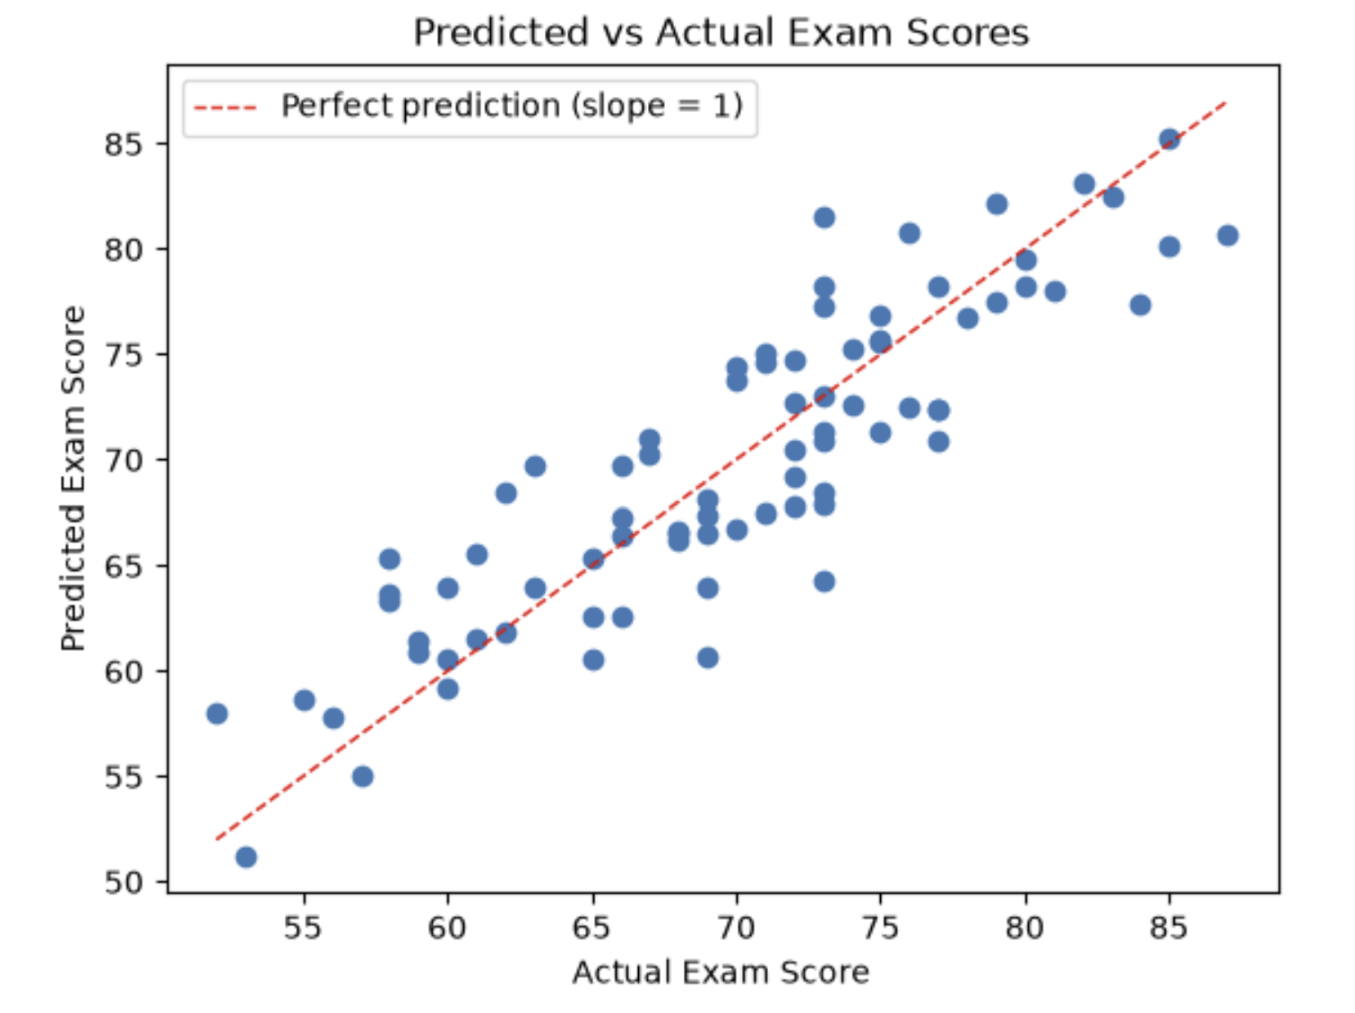
Model Evaluation
All three models produced very similar results.
Elastic Net had a slightly lower MAE, but the difference was very small.
Standardizing Linear Regression did not change its prediction performance.
An R² of about 0.75 shows that the models explained a substantial amount of variation in exam scores.
Elastic Net had a slightly lower MAE, but the difference was extremely small. Standardizing Linear Regression also did not change its prediction performance.
Model
MAE Mean
(SD)
RMSE Mean
(SD)
R² Mean
(SD)
Unscaled LR
3.084 (0.459)
3.766 (0.507)
0.753 (0.065)
Standardized LR
3.084 (0.459)
3.766 (0.507)
0.753 (0.065)
Elastic Net
3.078 (0.474)
3.769 (0.502)
0.753 (0.063)
Elastic Net had a slightly lower MAE, but the difference was extremely small. Standardizing Linear Regression also did not change its prediction performance.
Predicted vs. Actual Exam Scores
Notes:
On this slide, we compared how well the three models performed.
We looked at unscaled Linear Regression, standardized Linear Regression, and Elastic Net.
The main result is that all three models performed very similarly.
For MAE, which tells us how far off the predictions were on average, all three models were around 3 points.
RMSE is another error measurement that gives more weight to bigger mistakes, and that was also almost the same for all three models.
For R-squared, all three models were around 0.75. That means the models explained about 75 percent of the variation in exam scores.
Elastic Net had a slightly lower MAE, but the difference was extremely small, so we would not say it clearly performed better.
The graph on the left shows predicted scores compared with actual scores. The closer the dots are to the diagonal line, the closer the prediction was to the real exam score.
So overall, standardizing the Linear Regression model did not change its prediction performance, and Elastic Net also gave almost the same results.

Slide 11
Conclusion
Which relationships and coefficient rankings are stable in the baseline data?
Hours_Studied remained the strongest predictor.
The ranking stayed the same: Hours_Studied > Attendance_Percent > Assignments_Completed > Sleep_Hours
The same ranking appeared in standardized Linear Regression and Elastic Net.
Elastic Net slightly shrank the coefficients but did not remove any predictors.
Found out that all three models had very similar cross-validation performance, so Elastic Net did not give us a meaningful improvement over regular Linear Regression for this clean baseline dataset.
Limitation:
The dataset is synthetic and relatively small, so the findings may not generalize to real students.
Non-Causal Interpretation:
More study hours were associated with higher exam scores, but this does not prove that studying more directly causes higher scores.
Notes:
The clearest result was that Hours Studied stayed the strongest predictor.
The ranking also stayed the same, with Hours Studied first, Attendance second, Assignments Completed third, and Sleep Hours fourth.
We saw that same ranking in both standardized Linear Regression and Elastic Net.
Elastic Net made the coefficients a little smaller, but it did not remove any predictors.
We also found that all three models had very similar cross-validation performance, so Elastic Net did not really give us a meaningful improvement over regular Linear Regression for this clean baseline dataset.
One limitation is that our dataset is synthetic and fairly small, so we cannot assume the same results would apply to real students.
And lastly, more study hours were associated with higher exam scores, but that does not mean studying more directly caused the higher scores.”

Slide 12
Conclusion
Extra question: Why is Linear Regression and Elastic Net performed so similarly?
Linear Regression and Elastic Net performed so similarly because the baseline dataset is clean and the predictors are not strongly correlated with each other. The Linear Regression was already performing well. Elastic Net only applied a small amount of regularization, so it did not change the coefficients or predictions. This is why the models had very similar MAE, RMSE, and R² values.
Notes:
The clearest result was that Hours Studied stayed the strongest predictor.
The ranking also stayed the same, with Hours Studied first, Attendance second, Assignments Completed third, and Sleep Hours fourth.
We saw that same ranking in both standardized Linear Regression and Elastic Net.
Elastic Net made the coefficients a little smaller, but it did not remove any predictors.
We also found that all three models had very similar cross-validation performance, so Elastic Net did not really give us a meaningful improvement over regular Linear Regression for this clean baseline dataset.
One limitation is that our dataset is synthetic and fairly small, so we cannot assume the same results would apply to real students.
And lastly, more study hours were associated with higher exam scores, but that does not mean studying more directly caused the higher scores.”

