Slide 1
CAMPUS DELIVERY ROBOT
A ROS-Based Smart Mobility System
Smart Mobility Engineering
Group Project · 7 Members
Submission Date: 29 May 2026

Slide 2
Agenda
01
02
Project Objective
System Architecture
03
04
Operational Flow
Member Contributions
05
06
ROS Functions Coverage
Demo & Recording
07
08
Testing Strategy
Q&A
2 / 17

Slide 3
01 · Project Objective
Last-mile autonomous delivery on a university campus
What we are building
A simulated TurtleBot3 that delivers packages between buildings
Triggered by either a voice command or an advanced Click CLI
Plans a path with move_base, avoids obstacles and pedestrians
Opens its delivery box on arrival, then returns to home dock
Records every session to a rosbag for later replay
7
10
Team Members
ROS Packages
14+
4
ROS Functions
Pytest Modules
3 / 17

Slide 4
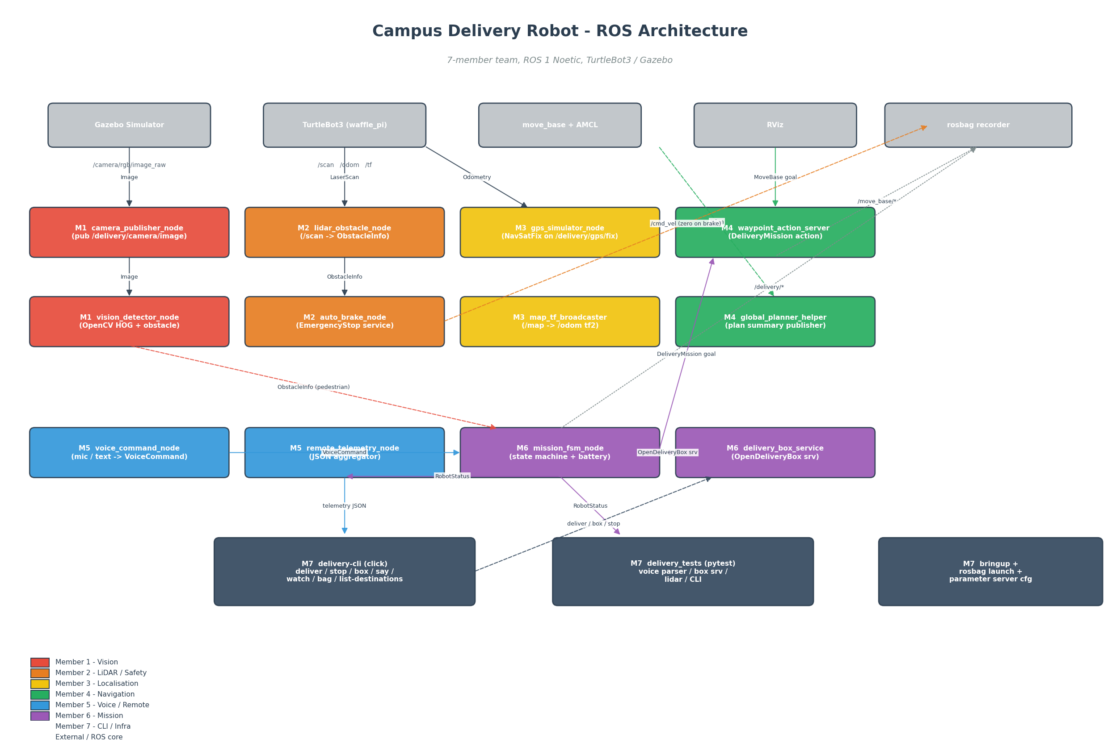
02 · System Architecture
10 ROS packages · 7-member vertical slices · ROS 1 Noetic
4 / 17

Slide 5
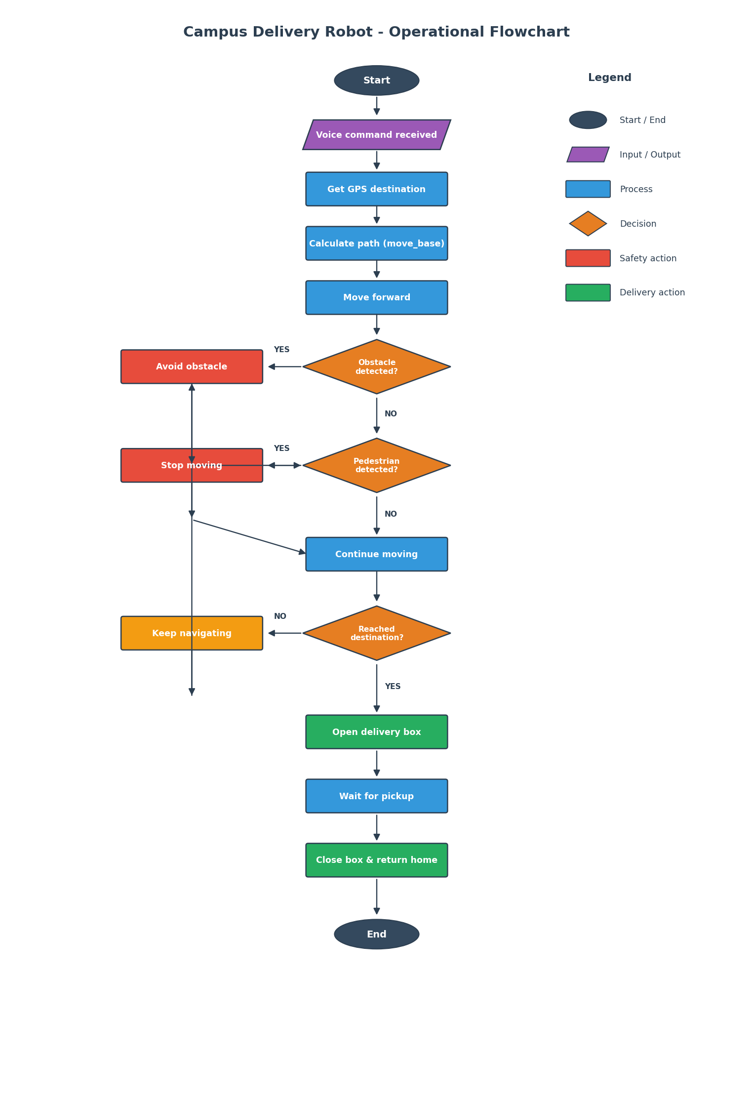
03 · Operational Flow
Deterministic state machine - one branch per FSM state
Highlights
Voice or CLI command kicks off a mission
Camera + LiDAR check independently for safety
Pedestrians trigger a soft stop; objects trigger hard brake
Mission ends with delivery box open then return home
5 / 17

Slide 6
04 · Member Contributions
Every member owns at least 2 ROS functions
M1
M2
M3
M4
Vision Perception
LiDAR & Safety
Localization & TF
Navigation
camera_publisher · vision_detector
lidar_obstacle · auto_brake (service)
gps_simulator · map_tf_broadcaster
waypoint_action_server · plan_helper
M5
M6
M7
Voice & Remote
Mission Control
CLI, Tests, Infra
voice_command · remote_telemetry
mission_fsm · delivery_box_service
click CLI · pytest · bringup launch
6 / 17

Slide 7
M1 · Vision Perception
Package: delivery_perception_vision
camera_publisher_node
ROS Concepts
Publisher
Publisher
Throttled republisher with resize + JPEG compression for the remote monitoring app.
Subscriber
Custom Message
vision_detector_node
Subscriber + Custom-msg Publisher
OpenCV HOG pedestrian detector + contour fallback. Emits ObstacleInfo messages.
7 / 17

Slide 8
M2 · LiDAR & Safety
Package: delivery_perception_lidar
lidar_obstacle_node
ROS Concepts
Subscriber + Publisher
Service Server
Distills /scan into a single closest-forward ObstacleInfo for everyone else.
Publisher
Subscriber
auto_brake_node
Service Server
Advertises EmergencyStop service; halts the robot when an obstacle crosses threshold.
8 / 17

Slide 9
M3 · Localization & TF
Package: delivery_localization
gps_simulator_node
ROS Concepts
Publisher
tf2
Synthesises NavSatFix from /odom with Gaussian noise. Looks realistic in rosbag.
Publisher
Subscriber
map_tf_broadcaster_node
tf2 Broadcaster + Subscriber
Keeps /map -> /odom alive; re-seeded by RViz 2D Pose Estimate.
9 / 17

Slide 10
M4 · Navigation & Planning
Package: delivery_navigation
waypoint_action_server_node
ROS Concepts
Action Server
Action Server
DeliveryMission action wrapping move_base. Streams distance-remaining feedback.
Action Client
Parameter Server
global_planner_helper_node
Subscriber + Publisher
Compresses move_base global plans into a lean JSON summary.
10 / 17

Slide 11
M5 · Voice & Remote Interface
Package: delivery_voice_remote
voice_command_node
ROS Concepts
Publisher + grammar
Custom Message
Mic or text input -> VoiceCommand. Regex grammar maps natural language to commands.
Publisher
Multi-Subscriber
remote_telemetry_node
Multi-Subscriber + Publisher
Aggregates 4 topics into a single JSON telemetry topic for the dashboard.
11 / 17

Slide 12
M6 · Mission Control & Delivery
Package: delivery_mission
delivery_box_service_node
ROS Concepts
Service Server
Service Server
OpenDeliveryBox service with simulated actuator delay. Latched state topic.
Action Client
FSM
mission_fsm_node
Action Client + State Machine
Brain of the robot. Drives FSM: voice -> deliver -> arrive -> box -> return home.
12 / 17

Slide 13
M7 · CLI, Tests, Infrastructure
Package: delivery_cli · delivery_tests · delivery_robot_bringup
delivery-cli (click)
ROS Concepts
Advanced CLI
Click CLI
deliver, stop, resume, box, say, status, watch, bag, list-destinations subcommands.
pytest
roslaunch
rosbag
delivery_tests + bringup
pytest + roslaunch
4 pytest modules, top-level launch, rosbag launch, parameter server config.
13 / 17

Slide 14
05 · ROS Functions Coverage
Every concept in the project brief is exercised somewhere
ROS Concept | Where it lives
Publisher | camera_publisher, gps_simulator, lidar_obstacle, telemetry, ...
Subscriber | vision_detector, auto_brake, mission_fsm, remote_telemetry
Custom Messages | ObstacleInfo, RobotStatus, VoiceCommand
Service (server) | auto_brake (EmergencyStop), delivery_box (OpenDeliveryBox)
Service (client) | mission_fsm, delivery-cli box / stop / resume
Action (server) | waypoint_action_server (DeliveryMission)
Action (client) | mission_fsm, delivery-cli deliver
Parameter Server | move_base_overrides.yaml, waypoints.yaml
tf2 | map_tf_broadcaster, navigation distance calc
rosbag (mandatory) | record_session.launch, delivery-cli bag
RViz | delivery_robot.rviz with map, plan, scan, image
roslaunch | 10 launch files including delivery_robot_full.launch
Click CLI (mandatory) | delivery_cli package with 9 subcommands
Pytest (mandatory) | 4 test modules: voice parser, CLI, box, LiDAR
14 / 17

Slide 15
06 · Demo & Recording
What you will see in the 25-minute demonstration video
1
2
3
4
5
Launch System
Start Recording
Dispatch Mission
Watch Telemetry
Replay rosbag
roslaunch delivery_robot_full
delivery-cli bag start
delivery-cli deliver library
delivery-cli watch
rosbag play demo.bag
Rosbag Capture Topic Set
/cmd_vel (control output)
/scan (LiDAR)
/odom (wheel odometry)
/tf, /tf_static
/camera/.../compressed
/delivery/status
/delivery/gps/fix
/delivery/perception/* (vision + LiDAR)
/delivery/voice/commands
/move_base/NavfnROS/plan
15 / 17

Slide 16
07 · Testing Strategy
Pytest scenarios for fast iteration; rostest for integration
Unit Tests
Integration Tests
pytest · no ROS master needed · seconds to run
rostest · roslaunch starts the node, pytest hits it
test_voice_parser.py — 11 assertions on the grammar
test_cli.py — Click CliRunner exercises --help / --version, bag list
Stubs out rospy + delivery_msgs so it runs in a plain virtualenv
test_delivery_box_service.test — service round-trip + idempotency
test_lidar_obstacle.py — synthetic /scan with known closest point
--with-ros flag lets the same file run as plain pytest when desired
16 / 17

Slide 17
Thank you
Questions?
github.com/<your-team>/campus_delivery_robot

