Slide 1
Gradient / Layout EX
장건희

Slide 2
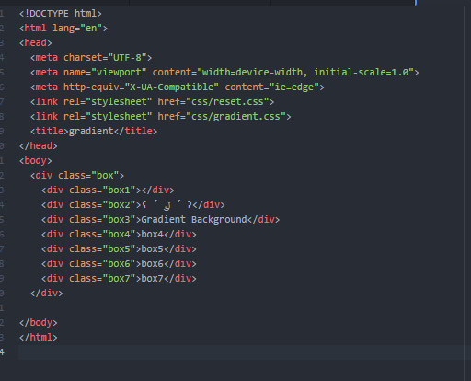
Gradient - HTML

Slide 3
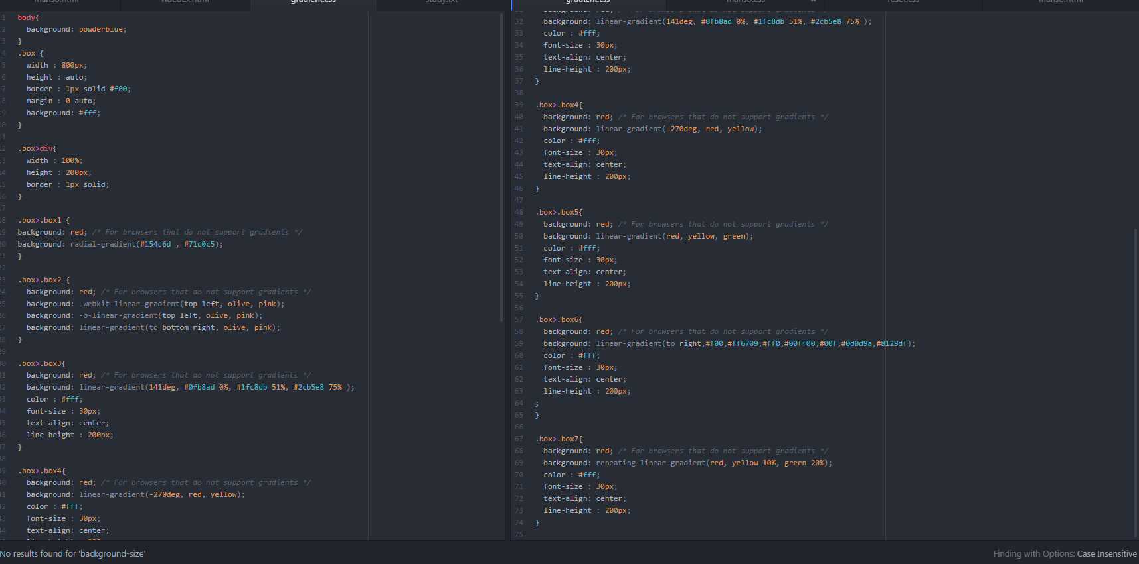
Gradient - CSS

Slide 4
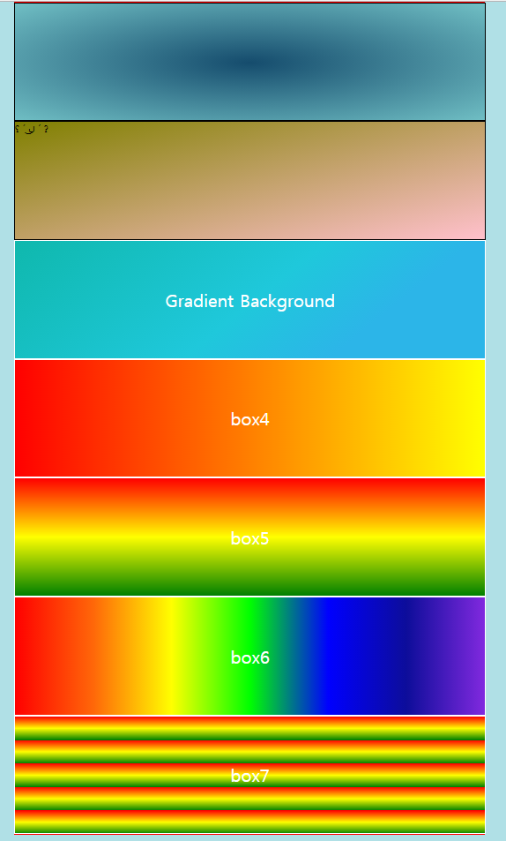
Gradient – in browser

Slide 5
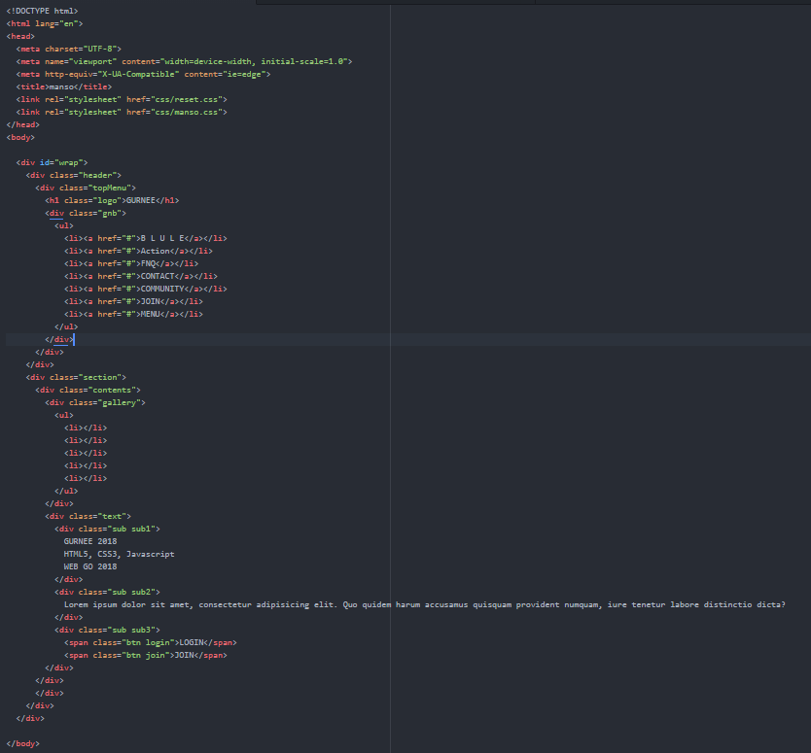
Layout - HTML

Slide 6
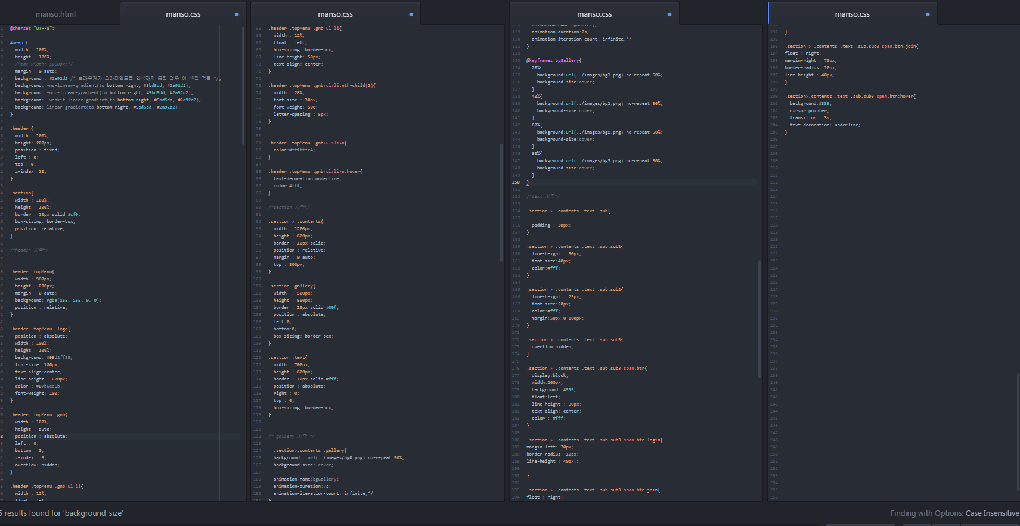
Layout - CSS

Slide 7

Layout – in browser

