Slide 1
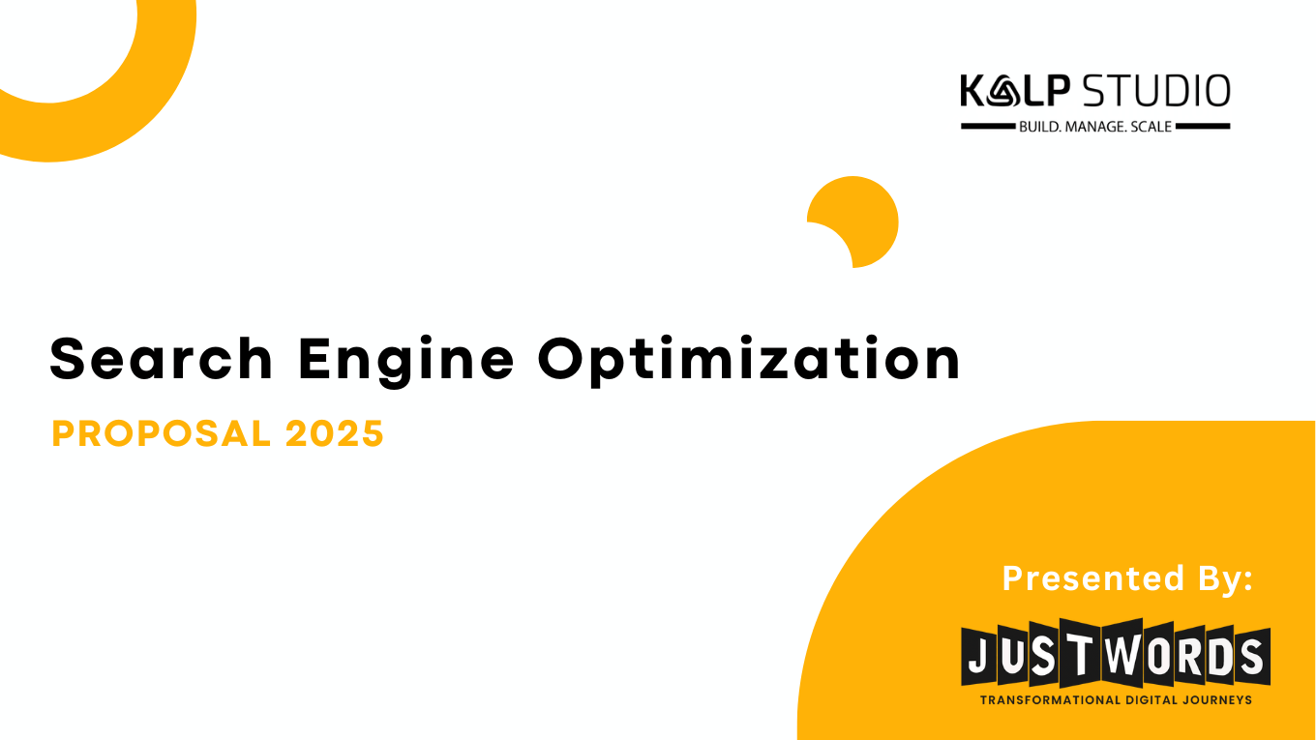
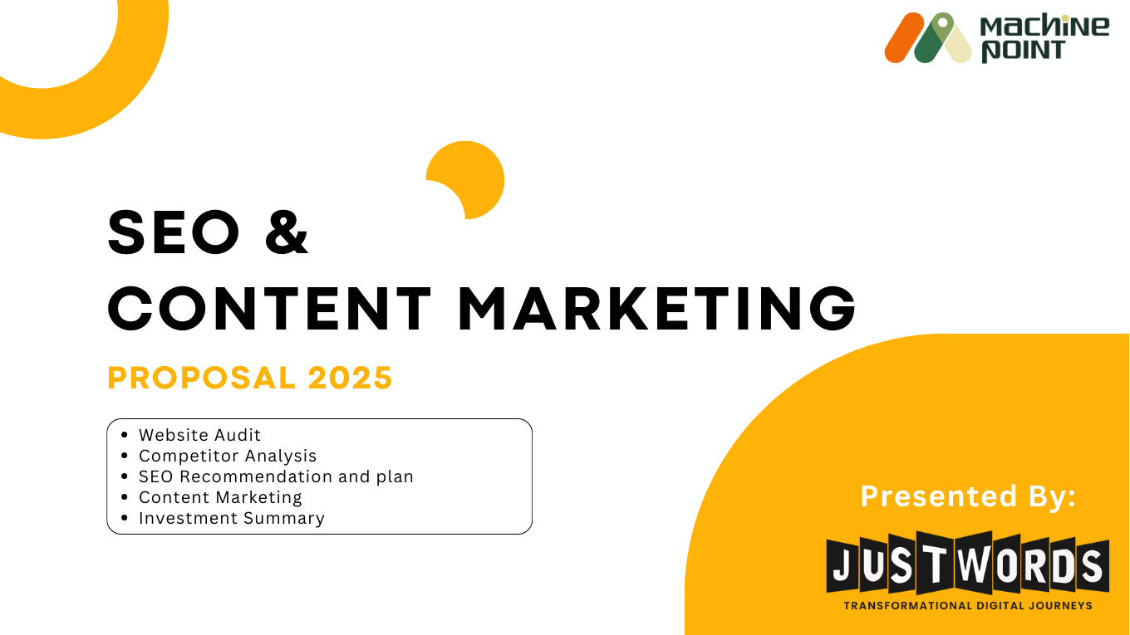

1

Slide 2
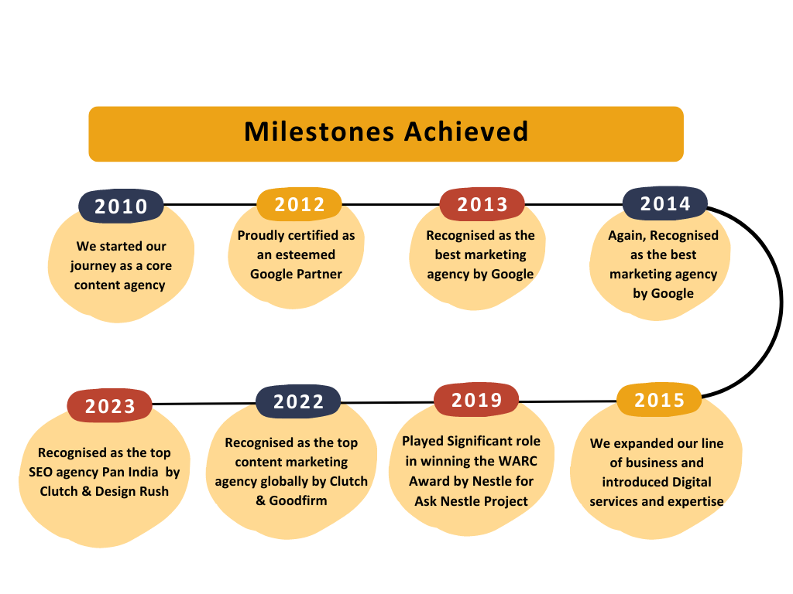
Who are we?
At Justwords we transform digital journeys for our customers by keeping content at the center for any marketing strategy

Slide 3
OUR VISION AND MISSION STATEMENTS
VISION: To create “Value” for our customers, our employees; and other stakeholders, which finally impacts the larger society in a positive way
MISSION: Our mission is to help businesses do better business by delivering outstanding marketing solutions, and being obsessively customer-focused and quality-focused

Slide 4
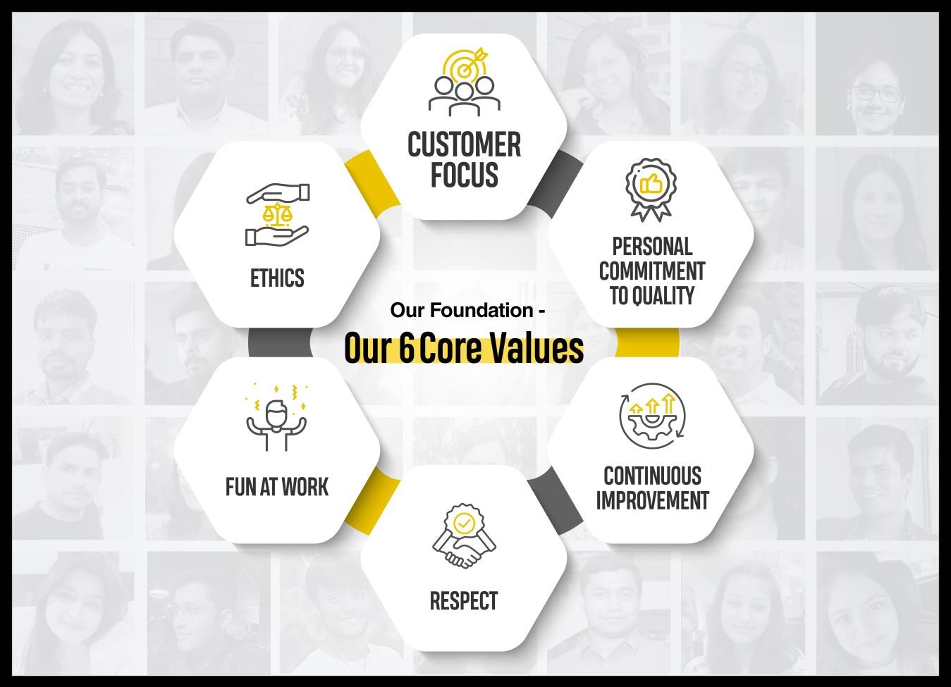
Our 6 core VALUES
CUSTOMER FOCUS: Do your best to keep our Customers happy. Customers are the reason for our business and Customer’s perception is reality
PERSONAL COMMITMENT TO QUALITY: Do brilliant work and make sure you have tried your best
CONTINUOUS IMPROVEMENT: Never stop learning, experimenting and exploring
FUN AT WORK: Always enjoy what you are doing.
ETHICS: All your actions should be backed up with full integrity
RESPECT: You are supposed to respect everyone as they are

Slide 5












Our Content Creation Services
Linguistic Content Creation
BFSI
SEO Content Creation
Premium Content Creation
Off Page Articles
Off Page Blogs
Quora Answers
On Page SEO Blogs
Micro Blogs
Profile Descriptions
SEO On Page Supporting Pages
Thought Leadership Articles
Product and Service Based Transactional Blogs
E Book
White Paper
Case Studies
Podcast scripts
Video scripts
Infographic content
Product Descriptions
Social Media Copies
Ad Copies
Translation
Content creation from scratch for the below languages –
Hindi, Bengali, Assamese, Odia, Marathi, Tamil, Telugu,
International Languages as per requests
Health
Ed-Tech
Travel
Editing & Proof reading
Visual Content
Content Reviewing
Quality Improvement
SEO friendly
Spelling and Grammatical issue fixation
Restructuring of sentences
Brand Tonality check
Fact checking
Social Media Static Post, Carousel, gifs
Infographic
Emailer
Newsletter
Video (Animated and white board)
Marketing collaterals (fliers, banners, brochures, PPT decks)
EBook, White paper, Case study designs
Lifestyle
Technology
Manufacturing

Slide 6






Our 360° Digital Marketing Services
BFSI
SEO – Content Marketing Led
KW & Competitor Research
On-Page & Off-Page SEO (Technical + Content)
Link Building Strategy
Paid Guest Posting
Content Marketing
Content Strategy
Content Creation & Optimization
Content Distribution
Health
Ed-Tech
Impactful Social Campaigns
Monthly Content Calendar
Campaign Planning
Brand/Profile Page Handle
Online Reputation Management
Link Building Services
Guest post Outreach
High Value Premium Content Creation
Digital PR
DO-Follow links
Travel
Lifestyle
Stellar Websites
Design, Develop/Revamp
Mobile and SEO Friendly
CMS
Website Maintenance
Designs and Videos
Event Banner/Standee Design
Video editing
Brochure/Flyer Design
Magazine/Newspaper Ads
Technology
Manufacturing

Slide 7
















Some of Our Esteemed Clients: Others

Slide 8


Motivating words from our CUSTOMERS
Content looks great on the
platform. We have significantly
stepped up on this front and I
am really proud of the kind of
content that we have for every
stage of the motherhood
journey. Special thanks you to
you and team for really going
out of your way on multiple
occasions and helping out with
work that was way beyond what
we had originally set out to do.
Nestle
(helped them to build up their content hub Ask Nestle)
We have been associated with Justwords for some time now. Over this time, they have built a deep understanding about our brand and value proposition. Their content marketing work for us has been effective and they actually deliver on the talk. The team is pro-active and delivers high quality work within the timelines - so yes, happy with their work and would definitely recommend!
HERO FINCORP
(managed their 360° Digital Marketing campaign)
Thanks to Justwords, the client’s web traffic grew ten times in terms of social presence. The partnership also led to a five times increase in traffic, and three times more leads. The team maintained a collaborative and smooth workflow. They went above and beyond to deliver for the client.
Genus Innovations
(managed their 360° Digital Marketing campaign)

Slide 9




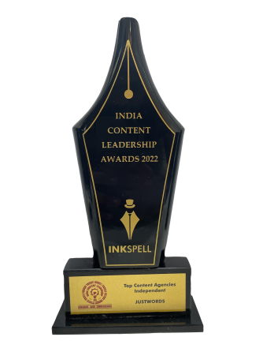

Awards & Recognition

Slide 10
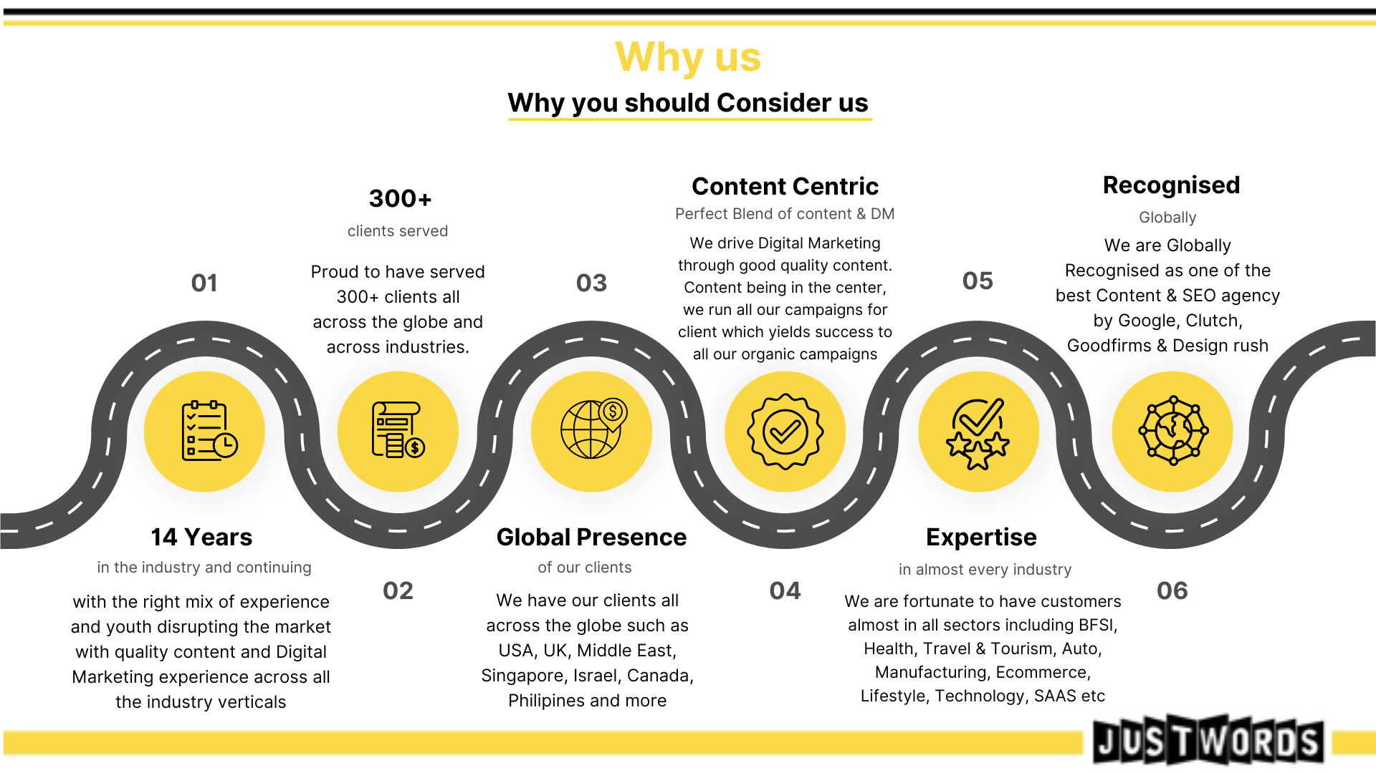

Slide 11
Search Engine Optimisation Living Shapes

Slide 12
Premise
About Living Spaces:
Living Shapes represents the seamless fusion of 40 years of legacy craftsmanship and contemporary design innovation. Operating out of a modern 20 lakh sq. ft. facility with a workforce of over 10,000 skilled artisans, we deliver high-quality, durable furniture that meets global standards. With a turnover of over 500 crores and 5+ lakh orders fulfilled in the past year alone, our commitment to quality and consistency speaks for itself.
Through Living Shapes, we extend this tradition to homes across India—offering premium, ready-to-ship furniture that elevates any space. Our curated collection spans sophisticated living, dining, bedroom, bar, office, and outdoor pieces—each crafted to enrich the individuality of your living environment.
Need of the hour :
Improve its digital presence on search engine
Increase organic website traffic
Create compelling content on the website which helps them in reducing bounce rate and increase conversions

Slide 13
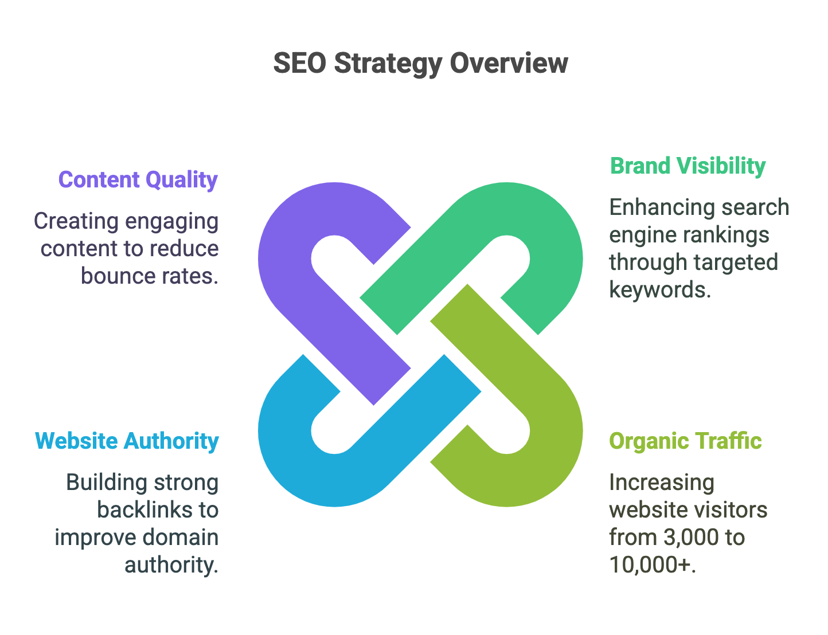
Objective
Enhance Brand Visibility on Search Engine Ranking Pages – Target various keywords which are having intent as Informational, Navigational & Commercial/Transactional
Increase organic traffic – As per SEMRush current organic traffic is around 1,400. Increasing in organic traffic more than current..
Improve Website Authority - Creating good quality relevant strong backlinks which will eventually help us in keywords ranking as well as improve website’s domain authority.
Improve website Page Copies – Create content which resemble with the target audience and helps in reducing bounce rate and improve conversions

Slide 14
Website Audit

Slide 15
Technical Analysis
Particulars | Details | Comments
Domain Age | {{DomainAge}}
Domain Expiration Date | {{DomainExpiry}}
Backlinks (SEMRush) | 380 Backlinks | Highly Need to increase the backlink count to establish authority and increase DA
Desktop Score | {{DesktopScore}} | Highly Need to improve the score of the website on desktop device for a good user experience
Mobile Score | {{MobileScore}} | Need to improve the score of the website on mobile device for a good user experience
Core Web Vitals (Desktop) | FCP: 0.8 s LCP: 2.8 s INP: 207 CLS: 0 Speed Index: 2.5 s | Need to optimise the website for better performance on desktop device
Core Web Vitals (Mobile) | FCP: 3.2 s LCP: 10.4 s INP: 420 CLS: 0 Speed Index: 4.0 s | Need to optimise the website for better performance on mobile device

Slide 16
Domain Age: {{ $json["domainAge"] }}
Domain Expiration Date: {{ $json["domainExpiry"] }}
Backlinks (SEMrush): {{ $json["backlinks"] }}
Desktop Score: {{ $json["desktopScore"] }}
Mobile Score: {{ $json["mobileScore"] }}
Core Web Vitals (Desktop):
FCP: {{ $json["desktopFCP"] }},
LCP: {{ $json["desktopLCP"] }},
INP: {{ $json["desktopINP"] }}
Core Web Vitals (Mobile):
FCP: {{ $json["mobileFCP"] }},
LCP: {{ $json["mobileLCP"] }},
INP: {{ $json["mobileINP"] }}

Slide 17
On Page Analysis Overview
Issue Name | Issue Type | Issue Priority
H1: Missing | Issue | Medium
Images: Over 100 KB | Opportunity | Medium
Canonicals: Canonicalised | Warning | High
Response Codes: Internal Client Error (4xx) | Issue | High
Pagination: Pagination URL Not in Anchor Tag | Issue | High
Response Codes: Internal Blocked by Robots.txt | Warning | High
Page Titles: Over 561 Pixels | Opportunity | Medium
Page Titles: Over 60 Characters | Opportunity | Medium
Response Codes: Internal No Response | Issue | High
Page Titles: Below 30 Characters | Opportunity | Medium
Canonicals: Non-Indexable Canonical | Issue | High

Slide 18
Issue Name | Issue Type | Issue Priority
Schema Mark Up in Product and Blogs pages: Missing | Opportunity | Medium
Domain Authority Issues: lacking authoritative backlink profile | Issue | High
Unoptimized meta descriptions across product pages | Warning | High
Basic title tag optimization without location targeting | Issue | High
Minimal blog content for industry leadership | Issue | High
Lack of furniture buying guides and design inspiration content | Opportunity | Medium
No verified Google My Business presence | Opportunity | Medium
Lack of local keyword targeting for regional searches | Opportunity | Medium

Slide 19
OFF Page Analysis Overview
Particulars | Details | Comments
Total Backlinks | 380 | Need to increase the backlink count to establish authority and increase DA
Domain Authority (DA) / Authority Score (AS) | 12 / 12 | Need to post more blogs and increase backlink count to establish authority and increase DA
Referring Domains | 97 | Need to increase the referring domains to signal Google that more sites are referring to our website
Anchor Text Distribution | 104 | To be verified by Lead
Toxic Backlinks | 4 | N/A
Link Diversity | Text 80% - 304 Image 20% - 76 Frame 0% - 0 Form 0% - 0 | Looks good
Do-follow V/s No-follow ratio | 1.18:1 | The ratio looks good

Slide 20
Competitor Analysis

Slide 21
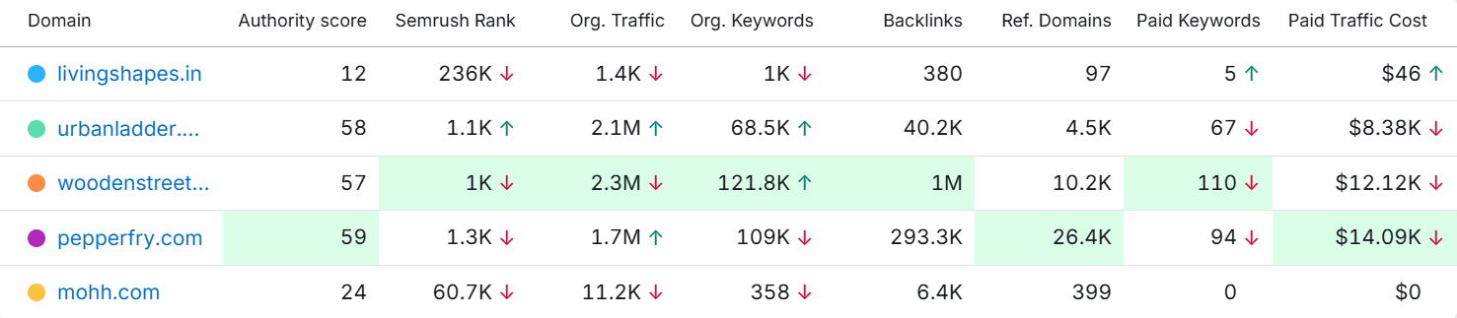
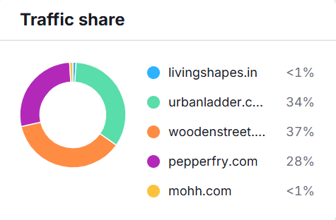
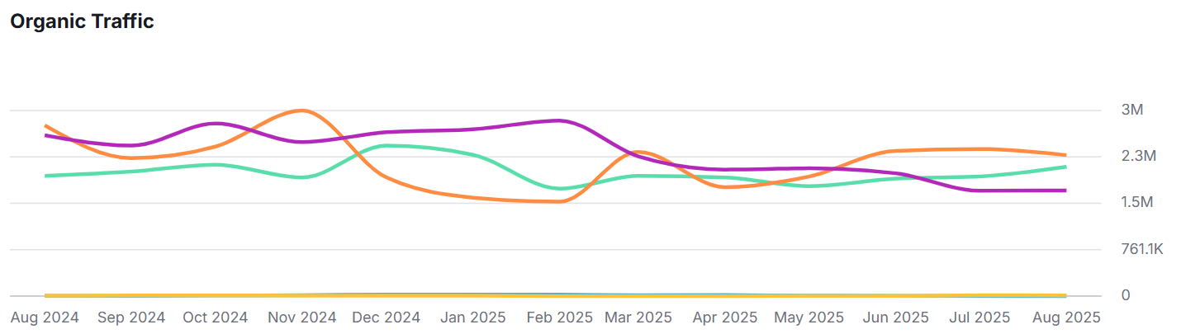
Competitor’s Analysis – Website

Slide 22
Here’s Our Recommendation

Slide 23
Search Engine Optimisation
Recommendations
Suggested – No of Keywords – 25 Keywords
Targeting 25 keywords which will further cover a keywords universe of 200+ contextually.
These keywords will be a combination of awareness, navigational & transactional

Slide 24
Cornerstone SEO Strategy
We will start by conducting a comprehensive SEO audit of the website to identify and address all existing issues. Following this, we will focus on 25 carefully selected keywords to initiate the optimization process. Our next steps will include: • Creating a keyword mapping strategy aligned with the most relevant pages on the website. • Developing high-quality content for off-page relevant to the finalized keywords. • Improving website speed, specially on desktop performance.
• Start fixing technical errors in the website to improve website health. • Establishing a strong link-building strategy, prioritizing the acquisition of high-quality do-follow backlinks, as the website currently lacks any. • Enhancing on-page content across all target pages—including the homepage—to boost user engagement. • Launching and regularly updating a blog section with engaging, niche-relevant content to attract and retain organic traffic.

Slide 25
Keywords Suggestion
Keywords | Search Volume | Keyword Difficulty | Keyword Intent | Position Type
modern office table | 2400 | 15 | Commercial | To be verified by Lead
2 seater sofa for bedroom | 590 | 18 | Commercial | To be verified by Lead
floor lamps online india | 320 | 18 | Transactional | To be verified by Lead
3 and 2 seater sofa | 880 | 15 | Commercial | To be verified by Lead
office table chair | 9900 | 19 | Commercial | To be verified by Lead
modern coffee table | 1000 | 19 | Transactional | To be verified by Lead
modern floor lamps | 480 | 19 | Transactional | To be verified by Lead
2 seater fabric sofa | 210 | 21 | Commercial | To be verified by Lead
modern 3 seater sofa | 480 | 21 | Transactional | To be verified by Lead
office furniture sofa | 140 | 21 | Transactional | To be verified by Lead
office table | 74000 | 21 | Commercial | To be verified by Lead
table vase | 590 | 21 | Transactional | To be verified by Lead
3 seater luxury sofa | 390 | 22 | Transactional | To be verified by Lead
lighting floor lamps | 320 | 22 | Transactional | To be verified by Lead
arm chair online | 320 | 22 | Commercial | To be verified by Lead
office table and chair | 9900 | 23 | Commercial | To be verified by Lead

Slide 26
Keywords Suggestion
Keywords | Search Volume | Keyword Difficulty | Keyword Intent | Position Type
modern coffee table India | 210 | 23 | Transactional | To be verified by Lead
wooden office table | 2900 | 25 | Commercial | To be verified by Lead
buy floor lamp | 260 | 25 | Transactional | To be verified by Lead
arm chairs | 880 | 25 | Transactional | To be verified by Lead
floor lamps for living room modern | 1300 | 26 | Transactional | To be verified by Lead
floor lamps online | 1300 | 27 | Transactional | To be verified by Lead
leather bed | 1300 | 27 | Transactional | To be verified by Lead
upholstered bed | 5400 | 29 | Informational | To be verified by Lead
stylish coffee table | 170 | 30 | Transactional | To be verified by Lead

Slide 27
Monthly Deliverables
SEO PACKAGE
Deliverables (Monthly except Research & Analysis which are one time activity) | Numbers of Keywords
 | 25
Research & Analysis / SEO set-up
On-Page Analysis and Suggestions | Yes
Back-links Analysis (past link-building activities, disavow) | Yes
Duplicate Content Analysis | Yes
Content Analysis for Targeted Keywords | Yes
Competitor Analysis (As per Justwords Standard Format) | Yes
Keywords research (One Time at the starting and bi-annually) | Yes
Website Audit Report (As per Justwords Standard Format) | Yes
On Page Audit & Optimization
Meta Tags Optimization(Title & Description) - max nos of pages per month as per requirement | 30
Content Optimization with headings, keywords & interlinking - max nos. of pages per month as per requirement | 15
Anchor Text Optimization (If required) -- max nos. of pages per month | 15
Heading Tag Optimization - max nos. of pages per month | 15
Image Optimization (If Required) - max nos. of images per month | 15
Optimization of Robots.txt & Google Bot Crawl (If Required) | Yes
Creation and registration of sitemap.xml | Yes
Google Analytics & Search Console Setup (Goal Set up) | Yes
Keywords Mapping | Yes
Sharing of Baseline Analytics Report (Starting point of Traffic/Leads, Keyword Rank, DA/DR, Spam Score, Referring Domain, Backlinks) | Yes
Website Speed and Page Load Optimization suggestions along with report | Yes
Mobile Optimization Suggestion along with report | Yes

Slide 28
Internal Linking Restructuring & Optimization - max nos. of pages per month | 15
Redirection (Check & Implement) | Yes
Canonical Issues (Check & Implement) | Yes
SEO Friendly URL analysis and Rewriting (Check & Implement) | Yes
Breadcrumb Navigation (Analysis & Suggestions) | Yes
Fix W3C Mark-up & CSS Validation Errors (suggestions) | Yes
Server Response code analysis | Yes
Schema mark-up/Google Data highlights (All important schema) [To be completed maximum within the 1st quarter] | Yes
Fix Crawl Errors & Broken Links [To be completed maximum within the 1st quarter] | Yes
Creations of Blog Publishing schedule/Content Calendar | Yes
Content Research & Development
Website Blog Topics Research per month | Yes
Website Blogs Creation (Will be charged extra based on requirement) | Yes
Content Creation for Free Guest Post and other Offpage Requirements (Blogs/Articles/Q & A) - Max nos. of content pieces | 10
Off Page (Link Building Activities)
Manual Search Engine Submission | Yes
Free Guest Posting (Creation & Distribution) – web 2.0 | 5
Article Submission (content creation + distribution) (Offpage) | 4
Q/A Sites Participation (Quora) | 2
Creation of Accounts in Social Media Platforms for SEO Purpose | Yes
Suggestion and Execution of Website Blogs & Webpages in Social Media | Yes
Website Blogs Social Bookmarking/Syndication | Yes
Business Listing - Max nos. | 4
Analytics Set-up and Reporting
Google Analytics Report | Yes
Google Keywords Ranking Report | Yes
SEO activity & Back-links Work Report | Yes
Monthly Consulting (with our SEO expert) | No

Slide 29
Tools We Use In Our Project to Bring Success
sl no | Purpose | Tools
1 | Website Technical Audit | Screaming Frog, Page Speed Insights, SEMRUSH, Google Search Console, W3C Validator
2 | Website Traffic Analysis & Tracking | Google Analytics, Google Search Console, Google Tag Manager
3 | Keywords Research | Google Keywords Planner, Google Trends, SEMRush
4 | Topic Research | SEMRush, Answer the Public, Google Queries, Google Trends
4 | Keywords Tracking & Competitor Analysis | SEMRush
4 | User Behavior & Heatmap Tracking | Hotjar
5 | Monthly Report Creation | Google Looker Studio
6 | Project Management Tool | Bitrix 24 & Asana
7 | Content Quality Checks | CopyScape & Zero GPT

Slide 30
Investment Summary

Slide 31
Monthly Organic Investment Summary
sl no | Particulars | Description | Timeline | Dependency | Frequency | Cost (INR) | Type
1 | Search Engine Optimisation – 25 Keywords | On Page Optimisation (suggestions) + Off Page Activities (content creation + Publishing) | 30 Days | Finalisation of Keywords, Access to Google Analytics and Search Console | 25 Keywords | 30,000 | Recurring
 |  | Paid Guest Posting – 05 (Content + Publishing) |  | Approval on the websites |  | 25,000 | Recurring
2 | Content Creation & Content Marketing | Website Premium Blogs (5000 words per month) 4 to 5 blogs per month | 30 Days | Approval on blog topics, content | 5000 words | 12500 | Recurring
 |  | Website Content + Product Descriptions | As in when required | Content suggestion approval, Product Descriptions | Per word | 2.50 per word | As in when required

Slide 32
Terms & Conditions:
Price Basis - The prices are mentioned for monthly services & are exclusive of any taxes and duties if applicable (for overseas invoices currently there are no taxes and duties applicable).
Delivery – Will be followed as per schedule mentioned in the above packages.
The above package is only limited to Amity University Project.
Payment Terms – Invoices will be raised before starting the work on quarterly (03 months) basis. The Payment should be released within 2 working days from the date of invoice.
Content Revision – Maximum of 2 rounds of revision will be made available for any on page content creation
For additional web page content creation or product descriptions– We will charge you separately @ INR 2.50 per word
Core web Vital Fixation of the website is not included in the package as this is a separate task. We will let you know once we understand the amount of work that needs to be done once we do the audit of your website.

Slide 33
Few Case studies for reference..
12

Slide 34
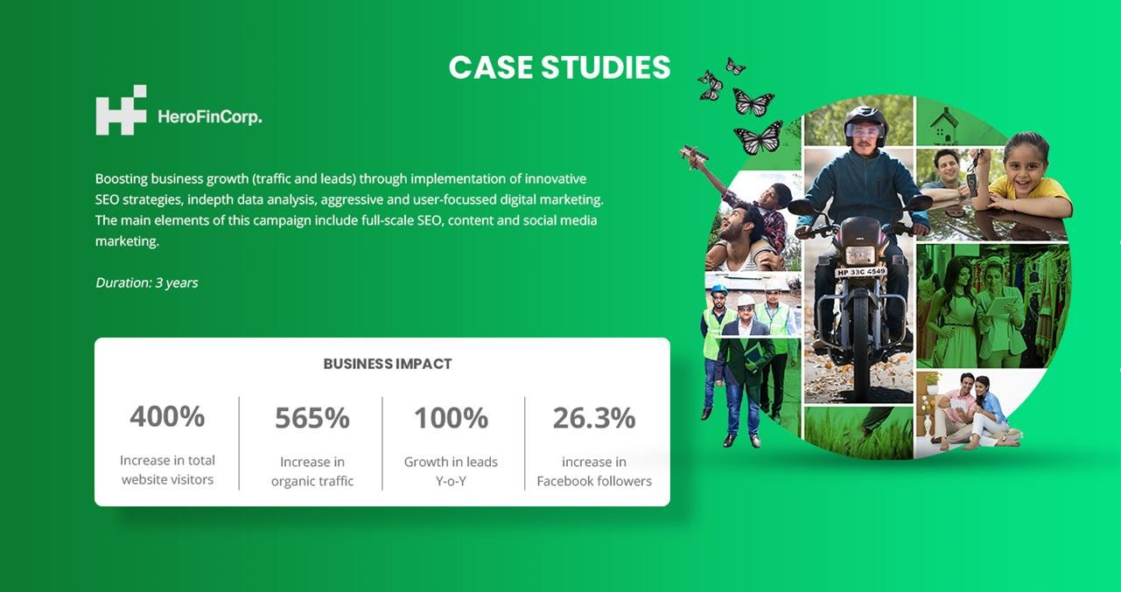

Slide 35
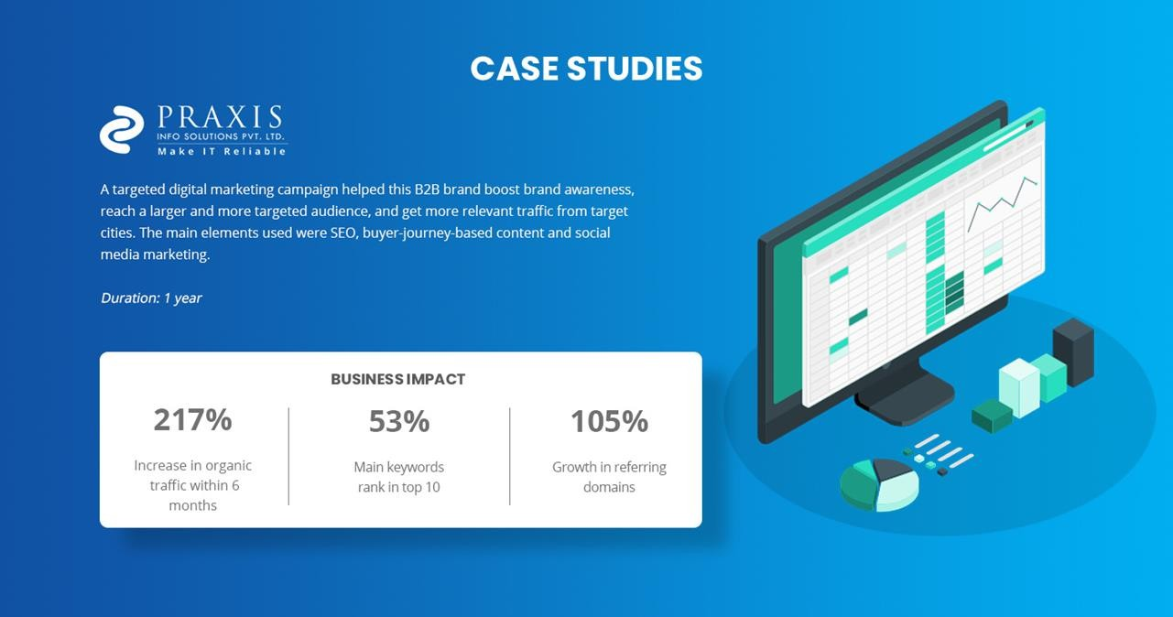

Slide 36
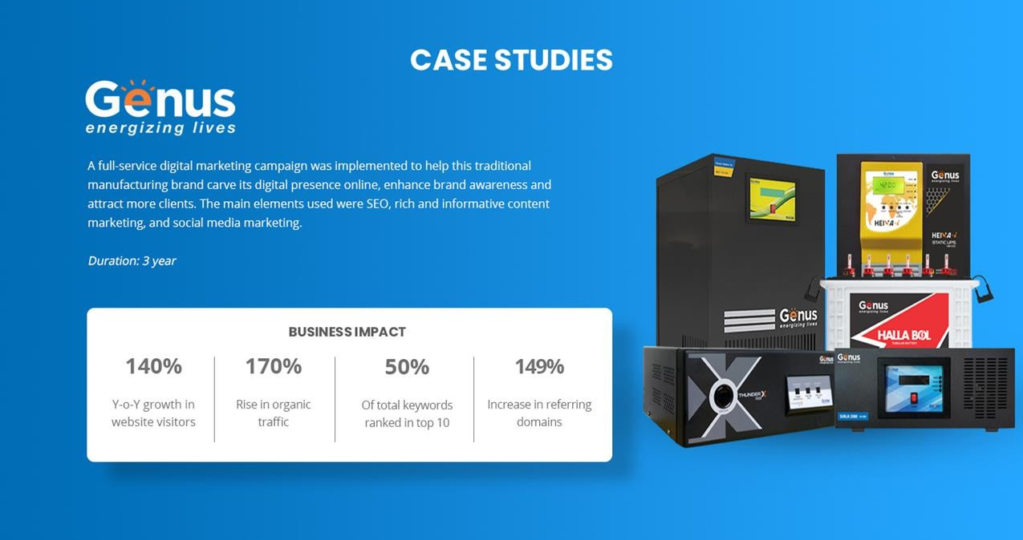

Slide 37
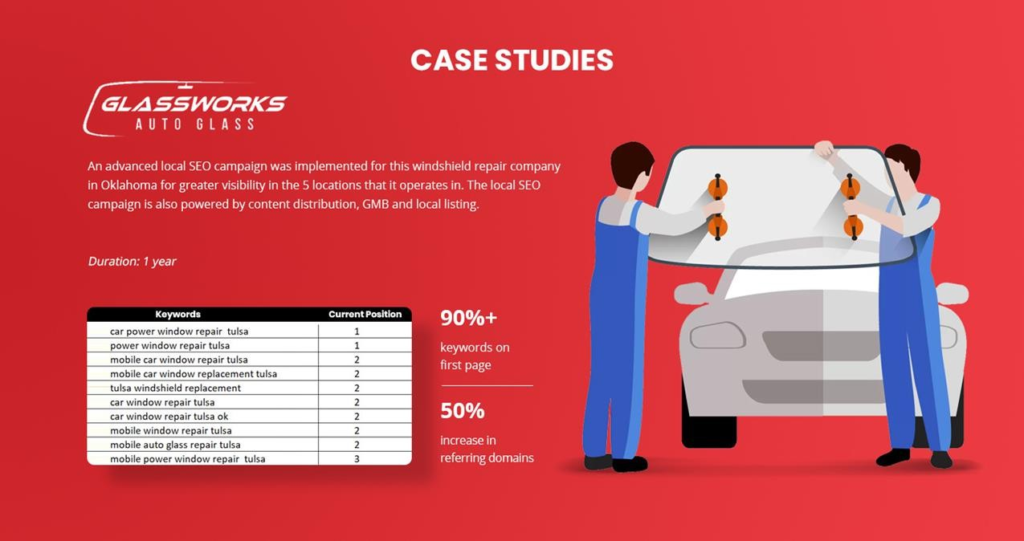

Slide 38
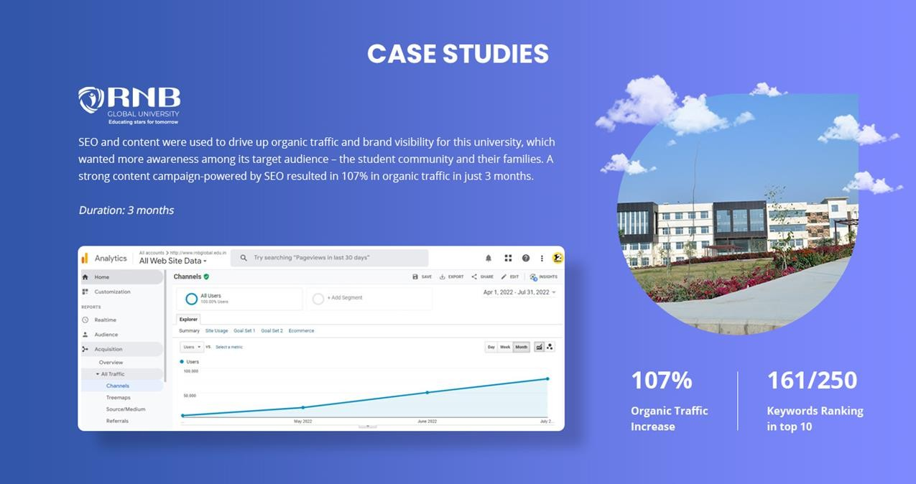

Slide 39
Look forward to partnering with you in your digital journey May we have your valuable feedback please?

Slide 40
Thank You
32

