Slide 1










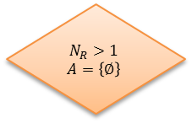

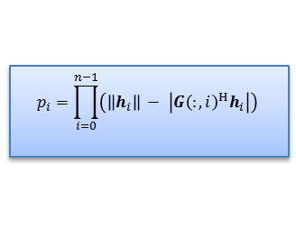











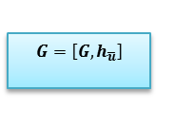
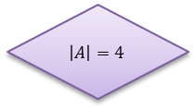


$$Input channel matrices$$
$$N_{R}>1$$
$$A=\left\{∅\right\}$$
$$h=h^{T}$$
$$Y$$
$$N$$
$$QR$$
$$H=U D V^{H}$$
$$h={\left(U^{H}H\right)}^{T}$$
SVD of channel
$$\left\|h_{i}\right\|$$
$$\overline{u}= \max_{i∈U\backslash A}\left\|h_{i}\right\|$$
$$\left|A\right|= N_{T}$$
$$N$$
$$Y$$
$$A=A∪\left\{\overline{u}\right\}$$
$$end$$
$$PIPD$$
$$Algorithm$$
$$Greedy$$
$$SP$$
$G=\left[G\right.,\left.h_{\overline{u}}\right]$
$$p_{i}=\prod_{i=0}^{n−1}{\left(\left\|h_{i}\right\| − \left|{G\left(:,i\right)}^{H}h_{i}\right|\right)}$$
stacking channel vectors
$$G=\left[G, \frac{h_{\overline{u}}}{\left\|h_{\overline{u}}\right\|}\right]$$
Product of vector projection difference
$$N\left(A\right)=I_{N_{T}}−G{\left(G^{H}G\right)}^{−1}G^{H}$$
null space evaluation
$$\overline{u}= \max_{i∈U\backslash A}\left\|p_{i}\right\|$$
$$[m,n]=size(G)$$
$$\overline{u}= \max_{i∈U\backslash A}\left\|N\left(A\right)h_{i}\right\|$$
metric calculation
$$\left|A\right|=4$$
$$N$$
$$Y$$
$$N\left(A\right)=I_{N_{T}}−G{\left(G^{H}G\right)}^{−1}G^{H}$$
$$h_{i}=N\left(A\right)h_{i},∀i$$
$$G=[ ]$$
null space evaluation
projection onto null space

