Slide 1
Blog Platform Project

Slide 2
Introduction Project Overview Spring Boot Maven Dependencies Postman and APIs Eclipse

Slide 3

Introduction
Good afternoon, ladies and gentlemen. Today, I am thrilled to present to you a project that has been in the works for months – the Blog platform project! In this presentation, we will cover everything from the basics of Spring Boot to the importance of Maven dependencies, Postman and APIs, and Eclipse. We will dive deep into each topic, exploring their significance and how they contribute to the success of the Blog platform project.

Slide 4
Project Overview
The Blog platform project is an ambitious undertaking that aims to create a powerful tool for bloggers and content creators. The goal of the project is to provide a robust, scalable, and user-friendly platform that can meet the needs of bloggers from a variety of backgrounds and industries. To achieve this goal, the project team has focused on developing a platform that leverages cutting-edge technologies and best practices in software development. The platform is built using Spring Boot, which provides a reliable and efficient framework for building web applications. Additionally, the project relies heavily on Maven dependencies to ensure that all components of the platform are properly integrated and tested.

Slide 5
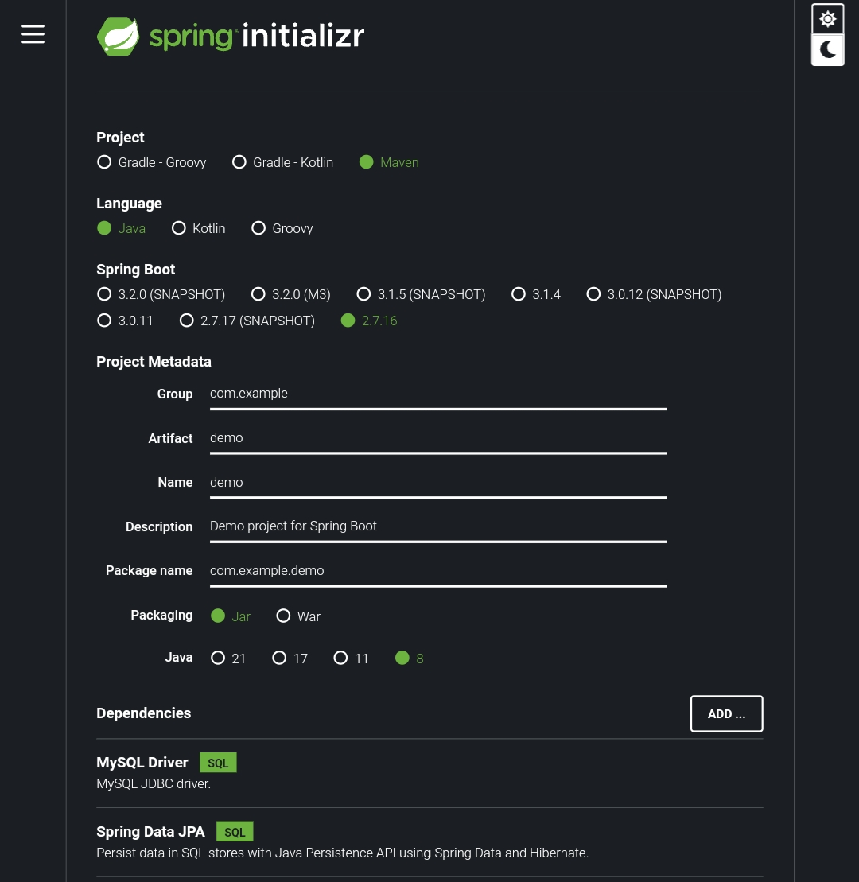
Spring Boot
Spring Boot is a powerful framework that simplifies the development of web applications in Java. It provides developers with a set of tools and conventions that make It easy to create standalone, production-grade Spring- based applications with minimal configuration. With Spring Boot, you can easily create RESTful web services, build microservices, and deploy your application to the cloud. One of the major benefits of using Spring Boot is its ease of use. With its auto-configuration feature, Spring Boot automatically configures your application based on the dependencies you include. This means that you don’t have to spend time configuring your application manually, which can save you a lot of time and effort. Additionally, Spring Boot provides a wide range of starter projects that help you get started quickly with common use cases such as web applications, data access, and security.

Slide 6
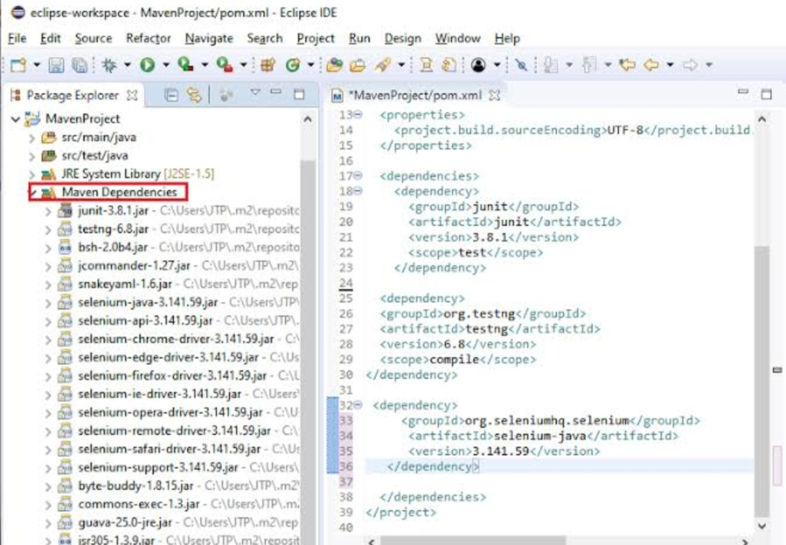
Maven Dependencies
Maven is a powerful tool that helps manage dependencies in the Blog platform project. Dependencies are external libraries or frameworks that the project relies on to function properly. Without these dependencies, the project would not be able to run at all. Maven simplifies the management of these dependencies by providing a centralized repository where developers can easily find and download the necessary libraries. It also handles conflicts between different versions of the same dependency, ensuring that the project runs smoothly without any issues.

Slide 7
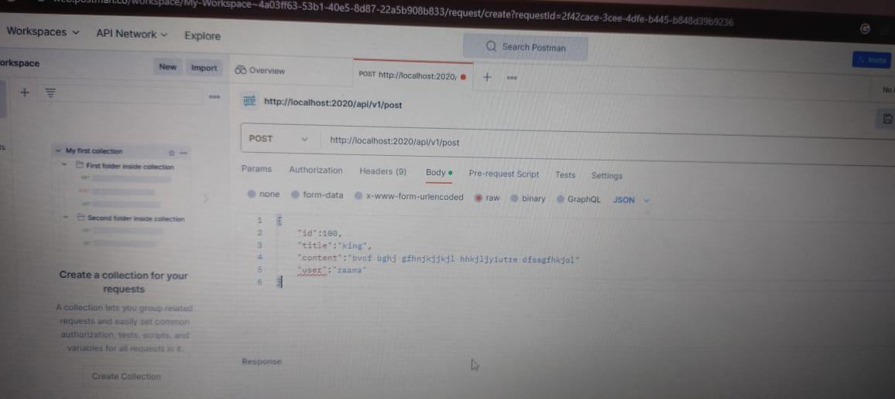
Postman and APIs
Postman is a popular tool used by developers to test and debug APIs. It allows developers to send requests to an API and receive responses, making it easy to test the functionality of an API. In the Blog platform project, Postman is used extensively to ensure that the APIs are working correctly and returning the expected data. APIs, or Application Programming Interfaces, are a set of protocols and tools used for building software applications. They allow different software systems to communicate with each other and exchange data. In the Blog platform project, APIs are used to allow the front- end of the application to communicate with the back- end. This allows users to perform actions such as creating a new blog post or commenting on an existing post.

Slide 8
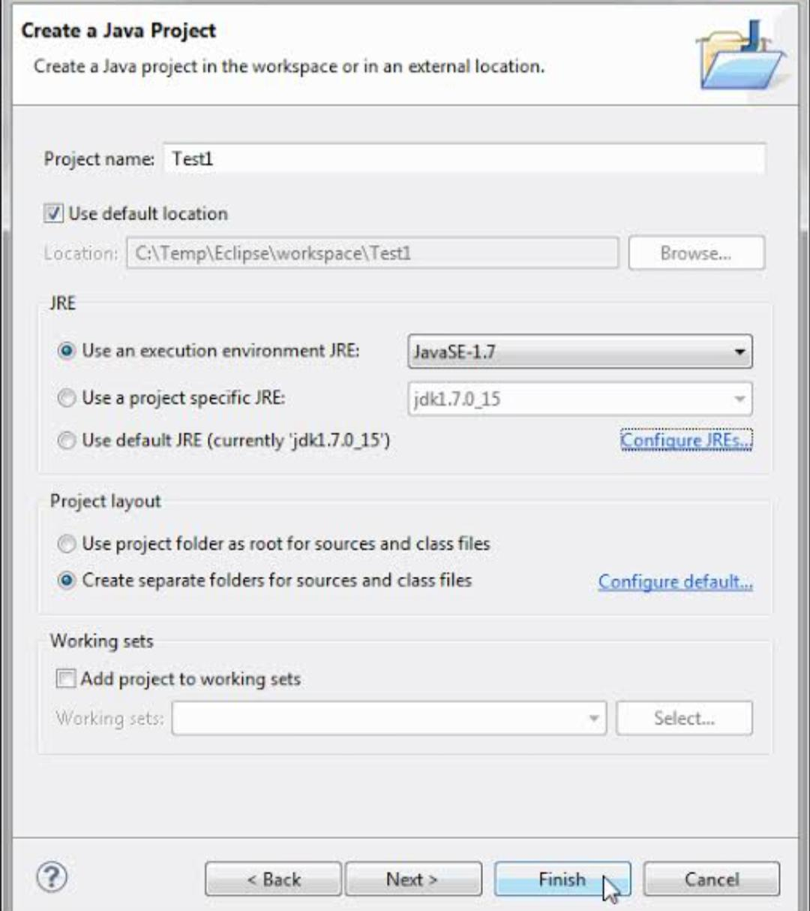
Eclipse
Eclipse is a widely used integrated development environment (IDE) that plays a critical role in the Blog platform project. It provides a powerful set of tools and features that allow developers to write, test, and debug code more efficiently and effectively. One of the key benefits of using Eclipse is its ability to Integrate with other tools and technologies, such as Maven and Git. This Integration allows developers to easily manage dependencies, track changes, and collaborate with other team members. Additionally, Eclipse’s robust code editor and debugging tools make it easier to identify and fix issues in the codebase.

Slide 9


Slide 10
Done by: B.Madhan Kishore (BBPBV051) R.Vinay Kumar (BBPBV052) V.Sathya Sai Danush Narayana (BBPBV053)

