Slide 1
NODE.JS + EXPRESS REST API WITH CRUD OPERATIONS FOR MANAGING RESOURCES.
S. MADHAN KUMAR B.E CSE (2021-2025) JEPPIAAR ENGINEERING COLLEGE

Slide 2
INTRODUCTION
Project Name: Book Management System.
Purpose: To create a RESTful API for managing books efficiently.
Technologies Used:
Backend: Node.js, Express.js
Database: PostgreSQL
API Testing: Postman
Key Features:
Create, Read, Update, Delete (CRUD) operations for books
Store book details: Title, Author, Quantity, Price
Easy to integrate with frontend applications

Slide 3
OBJECTIVE
Develop a RESTful API to manage book records efficiently.
Implement CRUD operations for books:
Create: Add new books
Read: View book details
Update: Modify existing book records
Delete: Remove books from the database
Store and manage book information including Title, Author, Quantity, and Price.
Provide a scalable and maintainable backend using Node.js and Express.js.
Enable easy integration with frontend applications and API clients like Postman.
Ensure data consistency and security while interacting with the database.

Slide 4
PROJECT STRUCTURE
book-crud-postgres/
│
├── backend/
│ ├── server.js # Entry point of the backend server
│ ├── db.js # Database connection configuration
│ ├── routes/
│ │ └── bookRoutes.js # Defines API endpoints for books
│ └── controllers/
│ └── bookController.js # Handles logic for CRUD operations
│
├── frontend/
│ ├── index.html # User interface for interacting with API
│ ├── style.css # Frontend styling
│ └── script.js # Frontend JavaScript for API calls
│
└── package.json # Project metadata and dependencies

Slide 5
SYSTEM WORKFLOW
1. Client Request:
User interacts with the frontend (index.html).
Requests can be Create, Read, Update, or Delete a book.
2. API Endpoint:
Request is sent to the Express.js server (server.js).
Routes defined in bookRoutes.js determine which controller handles the request.
3. Controller Logic:
bookController.js processes the request.
Validates input data and performs necessary operations.
4. Database Interaction:
Controller interacts with PostgreSQL via db.js.
CRUD operations are performed on the books table (Title, Author, Quantity, Price).
5. Response to Client:
Server sends back the response:
Success: Confirmation, book details
Error: Validation or database error messages

Slide 6
TECHNOLOGIES USED
Category | Technology Used | Purpose
Backend Framework | Node.js, Express.js | To build the RESTful API and handle HTTP requests/responses
Database | PostgreSQL | To store and manage book records (Title, Author, Quantity, Price)
Frontend | HTML, CSS, JavaScript | To create a simple user interface to interact with the API
API Testing Tool | Postman | To test and verify CRUD API endpoints
Package Manager | npm (Node Package Manager) | To install and manage project dependencies
Version Control | Git / GitHub | To manage source code and version control
Server Runtime | Node.js Environment | To execute JavaScript code on the server side

Slide 7
SETTING UP NODE.JS AND EXPRESS
Install Node.js: https://nodejs.org Set up a basic Express server:
Initialize project:
Create a new folder for backend and initialize npm:
Install dependencies:
Install Express and PostgreSQL client (pg):
const express = require('express');
const app = express();
const PORT = 3000;
app.use(express.json());
app.get('/', (req, res) => {
res.send('Book Management API is running');
});
app.listen(PORT, () => {
console.log(`Server running on http://localhost:${PORT}`);
});
mkdir myapi
cd myapi
npm init -y
npm install express body-parser pg

Slide 8
CONNECTING TO POSTGRESQL
Create db.js file
const { Pool } = require('pg');
// PostgreSQL connection configuration
const pool = new Pool({
user: 'your_username', // PostgreSQL username
host: 'localhost', // Database host
database: 'bookdb', // Database name
password: 'password', // password
port: 5432 // Default port
});
module.exports = pool;
Establish a connection between Node.js backend and PostgreSQL database.
Enable CRUD operations on the books table.
Enable to store the information about the resources in the DB.
Usage in Controllers: Import db.js in your controller to execute queries:
const pool = require('./db');
const result = await pool.query('SELECT * FROM books');

Slide 9
CREATING ROUTES – BOOKROUTES.JS
Routes map HTTP methods and URL paths to their respective controller functions.
Routes are responsible for handling incoming HTTP requests and sending responses.
Keeps backend organized and modular, making it easier to maintain and extend.
const express = require('express');
const router = express.Router();
const bookController = require('../controllers/bookController’);
// Get all books
router.get('/books', getBooks);
// Get a book by ID
router.get('/books/:id', getBookById);
// Add a new book
router.post('/books', createBook);
// Update a book by ID
router.put('/books/:id', updateBook);
// Delete a book by ID
router.delete('/books/:id', deleteBook);
module.exports = router;

Slide 10
CRUD OPERATIONS – bookController.js
Controllers contain the logic for handling API requests.
They interact with the database and return responses to the client.
Get all Books - READ
Retrieve all the books from the Database.
Returns JSON response to the client.
const getBooks = async (req, res) => {
try {
const result = await pool.query('SELECT * FROM books');
res.json(result.rows);
} catch (err) {
res.status(500).json({ error: err.message });
}
};

Slide 11
Create Book:
Updates book details by ID.
Update Book:
Adds a new book to the database
Returns the created book as a response.
Returns updated book or error if not found.
const createBook = async (req, res) => {
const { title, author, quantity, price } = req.body;
try {
const result = await pool.query(
'INSERT INTO books (title, author, quantity, price) VALUES ($1, $2, $3, $4) RETURNING *',
[title, author, quantity, price]
);
res.status(201).json(result.rows[0]);
} catch (err) {
res.status(500).json({ error: err.message });
}
};
const updateBook = async (req, res) => {
const { id } = req.params;
const { title, author, quantity, price } = req.body;
try {
const result = await pool.query(
'UPDATE books SET title=$1, author=$2, quantity=$3, price=$4 WHERE id=$5 RETURNING *',
[title, author, quantity, price, id]
);
if (result.rows.length === 0) return res.status(404).json({ message: 'Book not found' });
res.json(result.rows[0]);
} catch (err) {
res.status(500).json({ error: err.message });
}
};

Slide 12
CRUD OPERATIONS – bookController.js
Delete Books
Deletes a book by ID.
Sends success or error message.
Updates the Database
const deleteBook = async (req, res) => {
const { id } = req.params;
try {
const result = await pool.query('DELETE FROM books WHERE id=$1 RETURNING *', [id]);
// Exectuing the query
if (result.rows.length === 0) return res.status(404).json({ message: 'Book not found' });
// handling the errors
res.json({ message: 'Book deleted successfully' });
} catch (err) {
res.status(500).json({ error: err.message }); // returning the error message
}
};

Slide 13
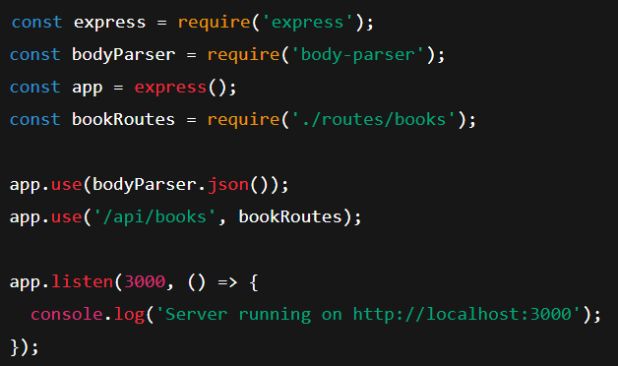
INTEGRATING ROUTES IN SERVER – server.js
Purpose:
To connect the route definitions (bookRoutes.js) to the Express server.
Ensures that all incoming requests to the API are handled correctly.
Provides a central entry point for the backend server.
express sets up the server.
bookRoutes contains all book-related endpoints.
// Parses incoming JSON requests
All routes in bookRoutes.js start with /api. Starts the backend server on port 3000.

Slide 14
INDEX.HTML (ENTRY POINT)
Key Features:
Form to add new books (Title,
Author, Quantity, Price).
Displays a list of books retrieved
from the API.
Buttons to Update and Delete
specific books.
Uses JavaScript (script.js) to send
API requests to the backend.
Sets up the root HTML structure for the application.
Acts as the main user interface for interacting with the Book Management API.
Allows users to perform CRUD operations visually

Slide 15
STYLES.CSS
SCRIPT.JS
Handles all interactions between the frontend and the backend API.
Sends API requests for Create, Read, Update, Delete (CRUD) operations.
Dynamically updates the book list table without reloading the page.
Provides visual styling for the Book Management frontend.
Makes the interface clean, readable, and user-friendly.
Styles forms, tables, buttons, and overall layout.

Slide 16
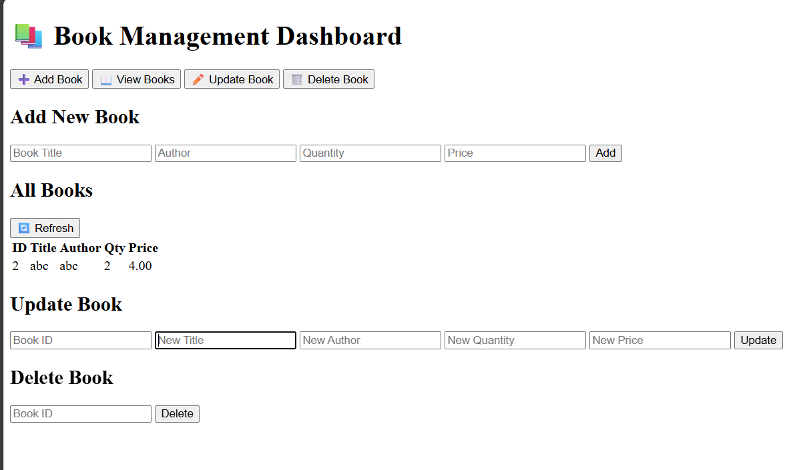
USER INTERFACE

Slide 17
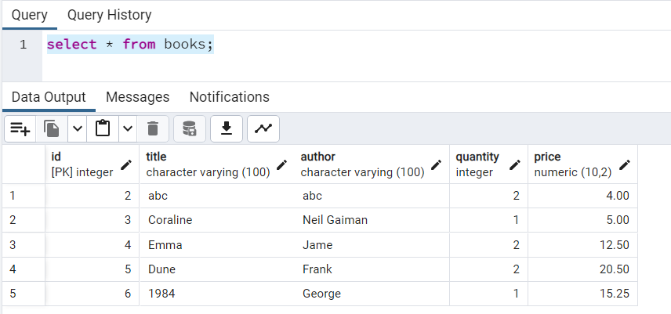
OUTPUT

Slide 18
IMPACT AND FUTURE ENHANCEMENTS
IMPACT
Developed a scalable REST API capable of handling CRUD operations efficiently.
Provided a foundation for full-stack application development with frontend and backend communication.
FUTURE ENHANCEMENTS
User Authentication & Authorization
Implement login and role-based access using JWT (JSON Web Tokens).
Restrict certain CRUD operations to authorized users only.
Search & Filter Functionality
Allow users to search books by title, author, or price range.
Add filtering and sorting for better usability.
Frontend Enhancement
Upgrade the current UI using React.js or Angular for better interactivity.
Add visual alerts or toast notifications for CRUD feedback.

Slide 19
CONCLUSION
Built a functional RESTful API using Node.js, Express.js, and PostgreSQL.
Implemented complete CRUD operations for managing books.
Followed a modular structure for better scalability and maintainability.
Integrated a simple frontend interface for easy interaction with the API.
Gained practical experience in backend development and database connectivity.
This project lays the foundation for building secure, efficient, and scalable web applications.

Slide 20
THANK YOU

