Slide 1
Factors Affecting Customer Lifetime Value of an Automobile Insurance Company
BUAN 6312 – Applied Econometrics and Time Series Analysis
Group-10
Amrutha Somashekhar
Nishanth Gopenathan
Sai Madhan Muthyam
Sai Sampath Patro Yellumahanti
Sriram Koushik Majeti
Vyshali Chintapalli

Slide 2
Introduction
Auto Insurance:
The Global Auto Insurance market is growing rapidly. It has a market value of $810 Billion in 2022.
North America accounts for 41.4% of the global market as of 2022.
Customer Lifetime Value:
It helps to estimate the total revenue that a customer is expected to generate over his relationship with the insurer.
This helps the Insurance companies to segment customers based on CLV values and make strategies to increase their profit
Stakeholders:
Insurance companies can use these findings to predict Customer Lifetime Values for various customers and make strategic decisions in implementing restrictions, pricing, marketing, and promoting their plans.

Slide 3
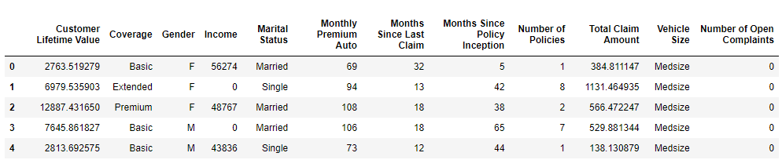
Data
Source :
The dataset utilized for the analysis is sourced from Kaggle : https://www.kaggle.com/datasets/ranja7/vehicle-insurance-customer-data/data
It has 24 variables and 9134 observations for each variable.
The columns that are inappropriate for the analysis are removed from the dataset.

Slide 4
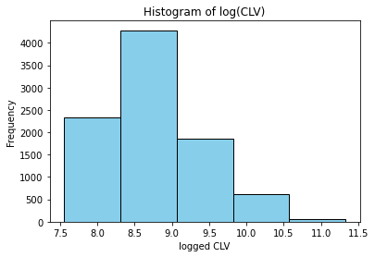
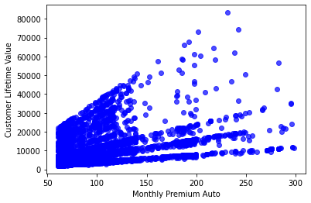
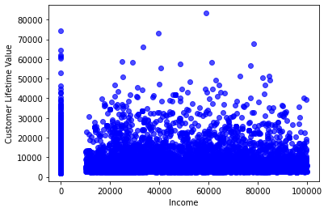
Data
Histogram of CLV
CLV vs MPA,
Correlation: 0.3963
CLV vs Income,
Correlation: 0.0244

Slide 5
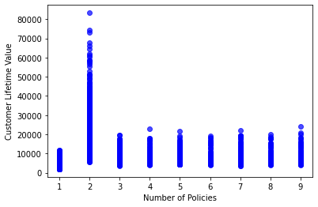
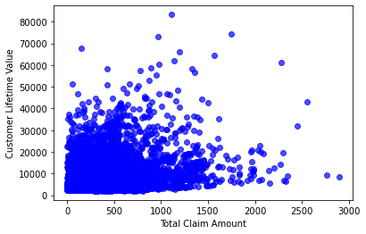
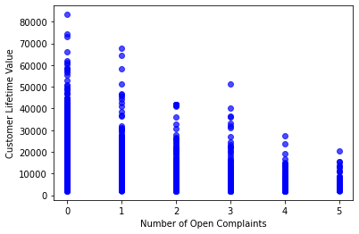
Data
CLV vs Number of Policies, Correlation: 0.0219
CLV vs TCA,
Correlation: 0.2265
CLV vs Number of Open Complaints,
Correlation: -0.0363
Correlation between CLV and numerical variables

Slide 6
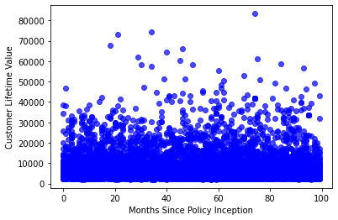
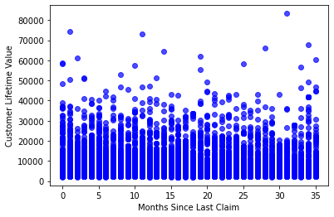
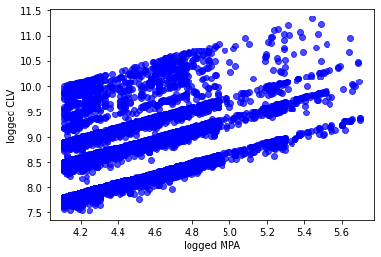
Data
CLV vs Months since Policy start, Correlation: 0.0094
CLV vs Months since last claim, Correlation: 0.0115
Log(CLV) vs Log(MPA),
Correlation: 0.4612
Correlation between CLV and numerical variables

Slide 7
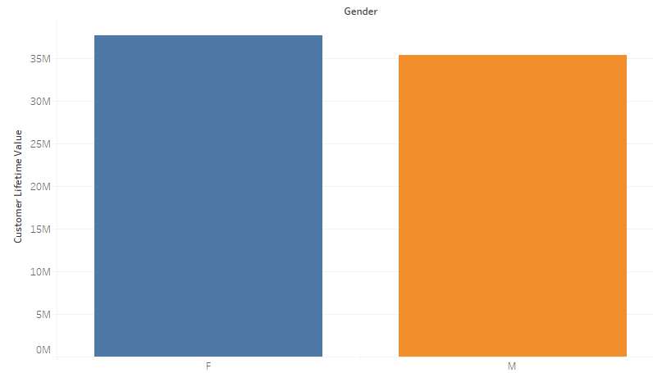
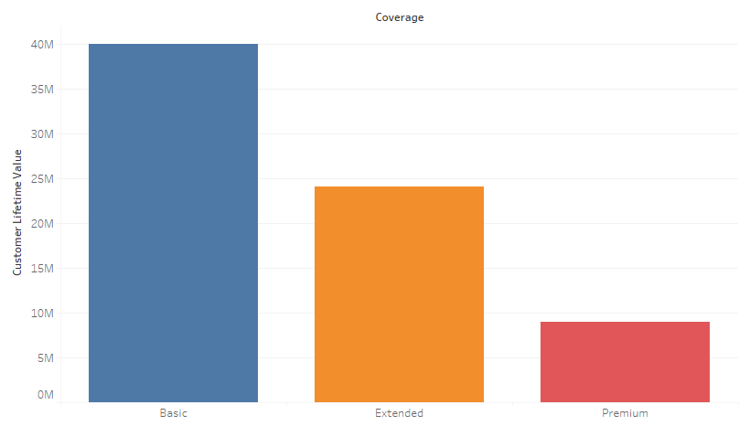
Data
CLV vs Gender
CLV vs Coverage
CLV distribution among Categorical variables

Slide 8
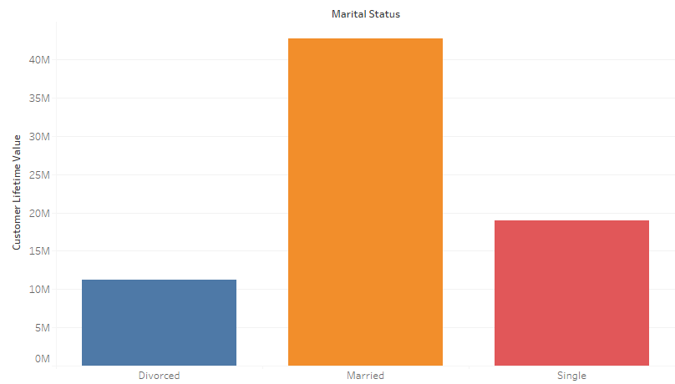
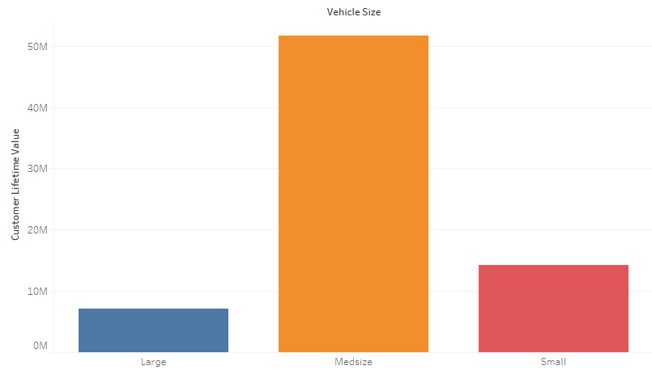
Data
CLV vs Marital Status
CLV vs Vehicle Size
CLV distribution among Categorical variables

Slide 9
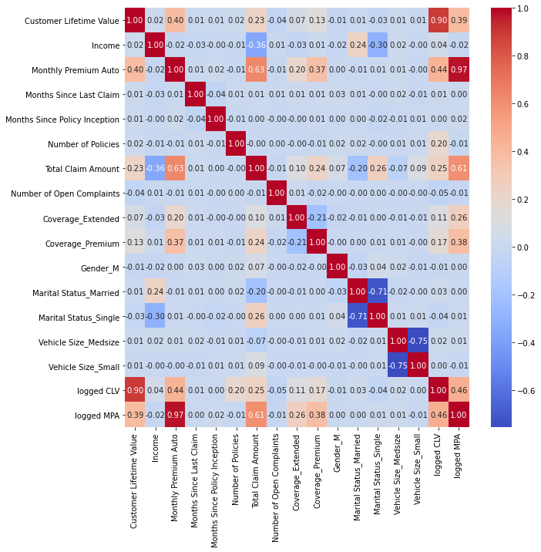


Data
Correlation plot between all variables
MPA and CLV values are logged to bring down their scale and compress their range

Slide 10
Methodology
Multiple Linear Regression:
log(CLV) = B1*log(MPA) + B2*log(TCA) + B3*NoP + B4*NoOC + B5*Marital.Status_Married + u
MPA – Monthly Premium Auto
TCA – Total Claim Amount
NoP – Number of Policies
NoOC – Number of Open Complaints
Marital.Status_ Married – 1 if married, 0 if not married

Slide 11
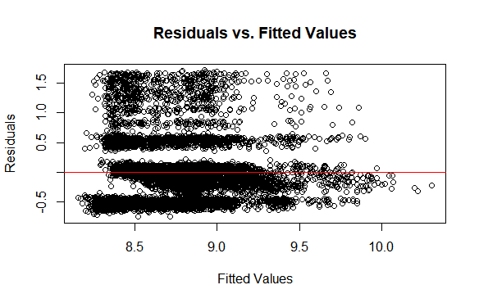
Methodology
Assumption MLR-1: Linear in Parameters
Fitted values are plotted against residuals. Around the line of zero, there is no pattern observed between fitted values and residuals. This proves that our model is Linear in Parameters

Slide 12

Methodology
Assumption MLR-2: Random Sampling
This is satisfied by the virtue of the data source and its cross-sectional nature.
Assumption MLR-3: No Perfect Collinearity
The Variance Inflation Factors for all the predictor variables in our model is less than 5. This proves that our model has no perfect collinearity

Slide 13
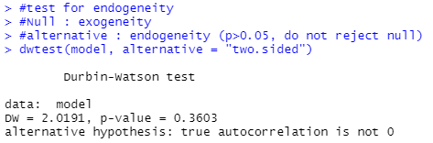
Methodology
Assumption MLR-4: Zero Conditional mean
It states that the error term has an expected value of zero, given the predictor variables.
Using the Durbin-Watson test, it is proved that there is zero conditional mean between the error term and variables of our model.
Additionally, each of the variables is plotted against residuals, to check for the patterns.

Slide 14
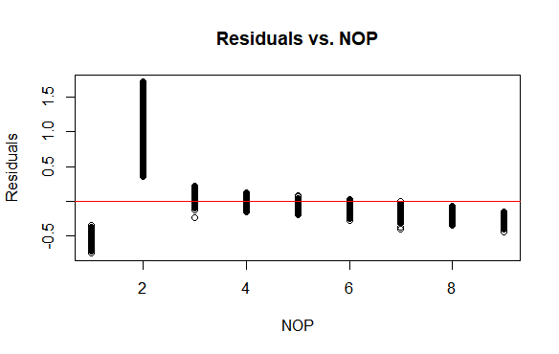
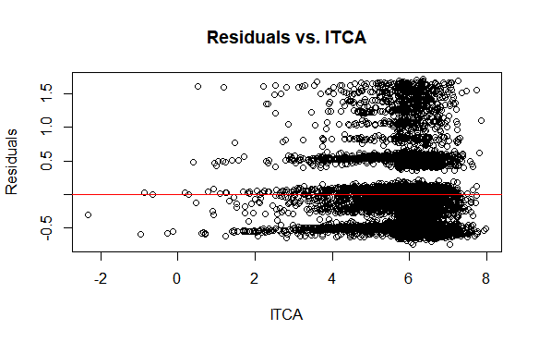
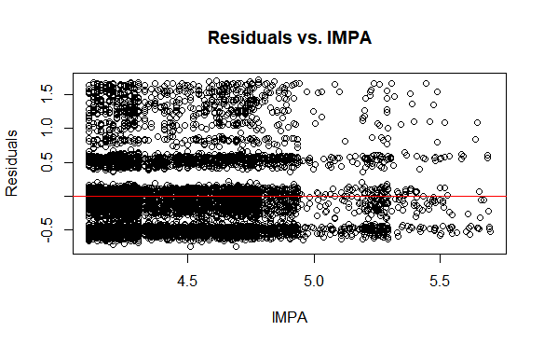
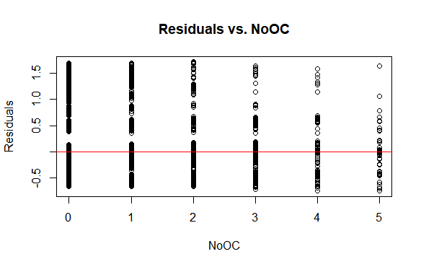
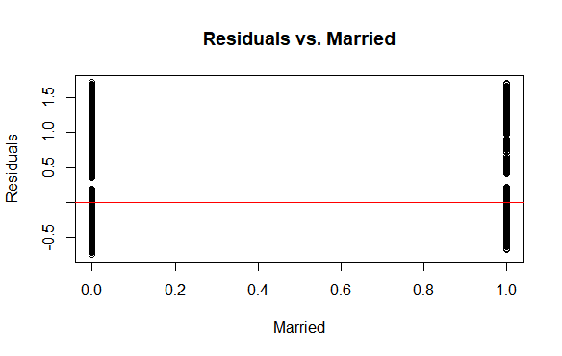

Slide 15
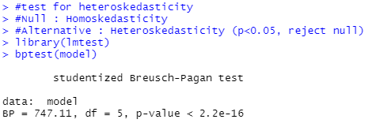
Methodology
Assumption MLR-5 : Homoskedasticity
It states that the variance of the error term is constant across all the levels of predictor variables.
Using the Breusch-Pagan test, it is proved that our model suffers from the Heteroskedasticity problem.

Slide 16
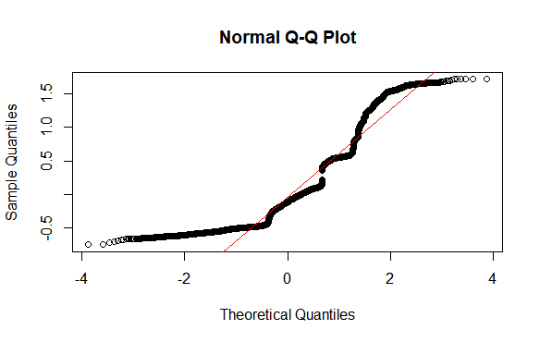
Methodology
Assumption MLR-6: Normality of errors
This states that the residuals of the equation are normally distributed with zero mean.
For this a Q-Q plot is plotted and it is found that the residuals deviate from the diagonal line, which proves that the residuals are not normally distributed.

Slide 17
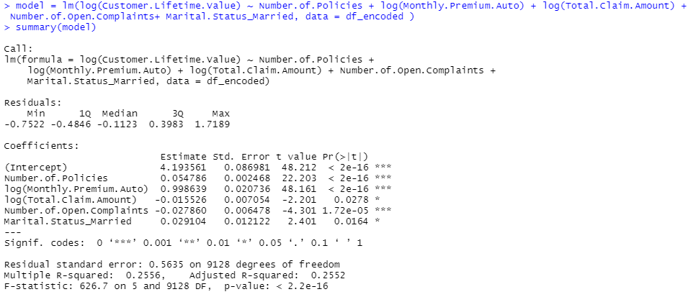
Results
log(CLV) = 4.194+ 0.999*log(MPA) – 0.016*log(TCA) + 0.055*NoP – 0.0279*NoOC + 0.0291*Marital.Status_Married

Slide 18
Results
log(CLV) = 4.194+ 0.999*log(MPA) – 0.016*log(TCA) + 0.055*NoP – 0.0279*NoOC + 0.0291*Marital.Status_Married
One percent increase in MPA, accounts for an average of 0.999 percent increase in CLV, holding all other variables constant
One percent increase in TCA, accounts for an average of 0.016 percent decrease in CLV, holding all other variables constant.
If NoP increases by 1, CLV increases by an average of 0.055 percent, holding all other variables constant
If NoOC increases by 1, CLV decreases by an average of 0.0279 percent, holding all other variables constant.
If a customer is married, CLV increases by an average of 0.0291 percent, holding all other variables constant.

Slide 19
Conclusion
Our model exhibits an R2 value of 0.2556, i.e. it explains 25.56% of the variation in the data.
The adjusted R2 value of 0.2552, which is very near to the R2 value indicates that the selected variables are strong predictors.
The p-values of all the coefficients are less than 0.05 which proves that they are statistically significant.
The problem of heteroskedasticity is due to the nonlinear relationship. It might also be due to omitted variable bias, where important variables like the driving experience, age, education, and alcohol consumption of customers play a significant role in predicting CLV, but they are not present in the data.
For further studies, advanced techniques like XG Boost, Random Forest, and Neural Networks, can improve the performance and give better results.

Slide 20
Thank
You

