Slide 1
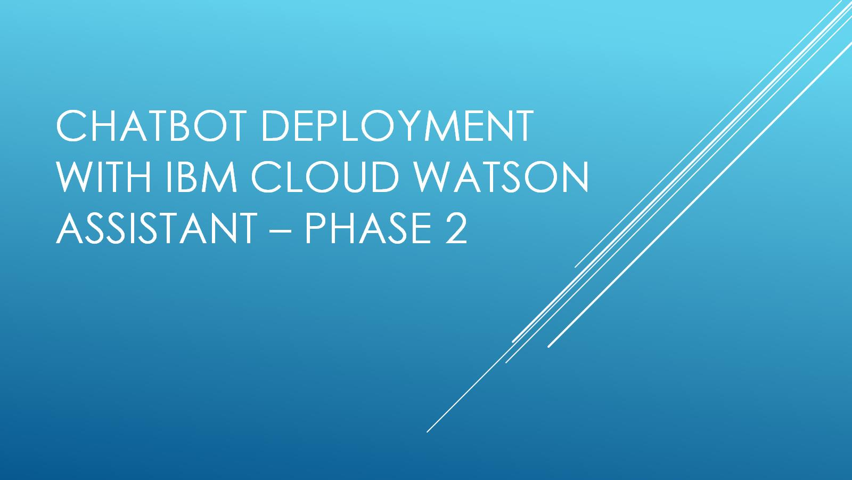
Chatbot deployment with IBM cloud watson assistant – phase 2

Slide 2
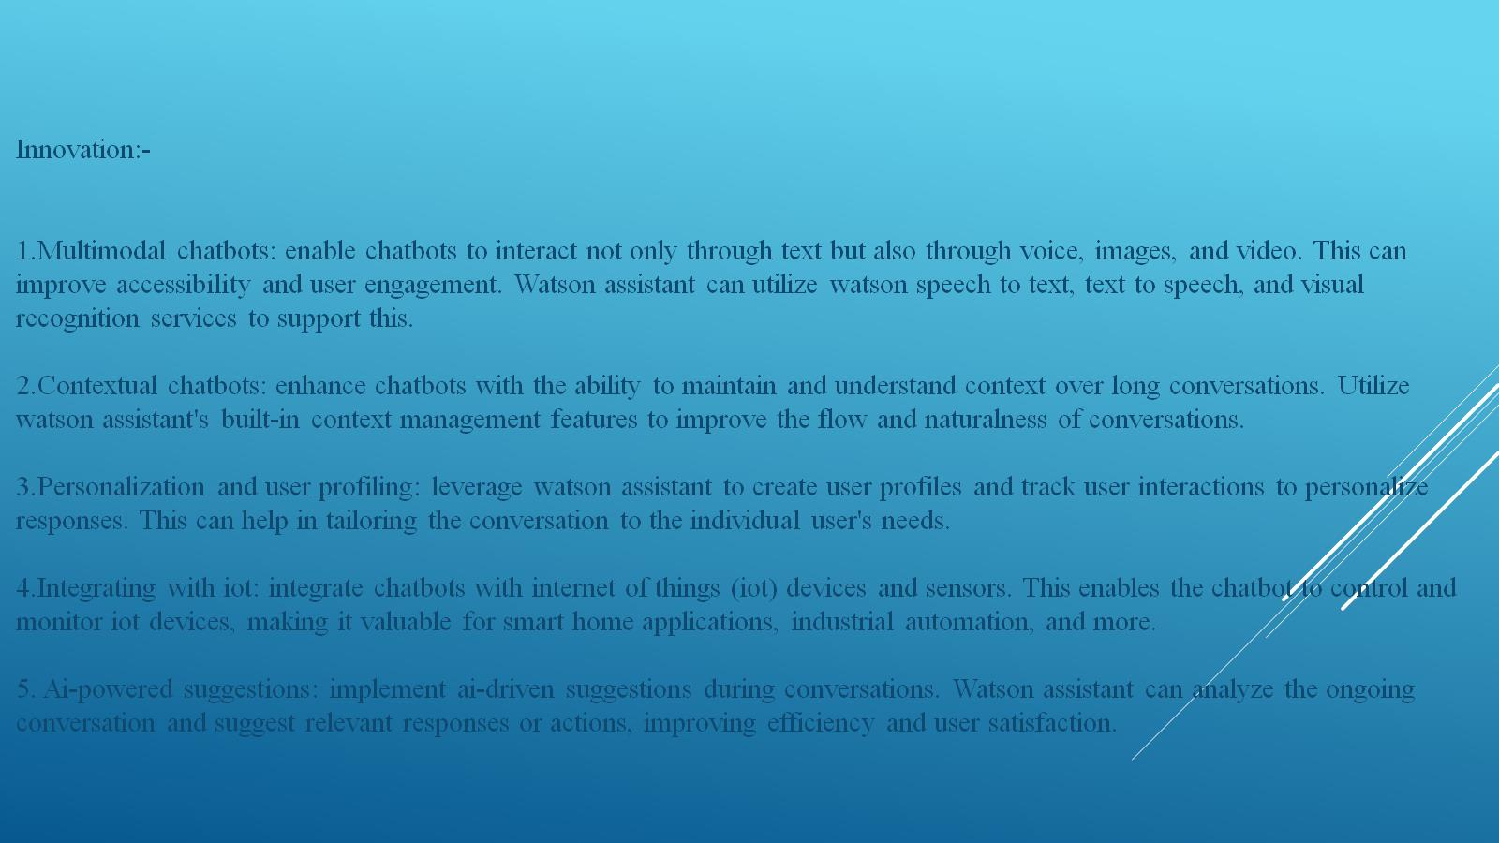
Innovation:- 1.Multimodal chatbots: enable chatbots to interact not only through text but also through voice, images, and video. This can improve accessibility and user engagement. Watson assistant can utilize watson speech to text, text to speech, and visual recognition services to support this. 2.Contextual chatbots: enhance chatbots with the ability to maintain and understand context over long conversations. Utilize watson assistant's built-in context management features to improve the flow and naturalness of conversations. 3.Personalization and user profiling: leverage watson assistant to create user profiles and track user interactions to personalize responses. This can help in tailoring the conversation to the individual user's needs. 4.Integrating with iot: integrate chatbots with internet of things (iot) devices and sensors. This enables the chatbot to control and monitor iot devices, making it valuable for smart home applications, industrial automation, and more. 5. Ai-powered suggestions: implement ai-driven suggestions during conversations. Watson assistant can analyze the ongoing conversation and suggest relevant responses or actions, improving efficiency and user satisfaction.

Slide 3
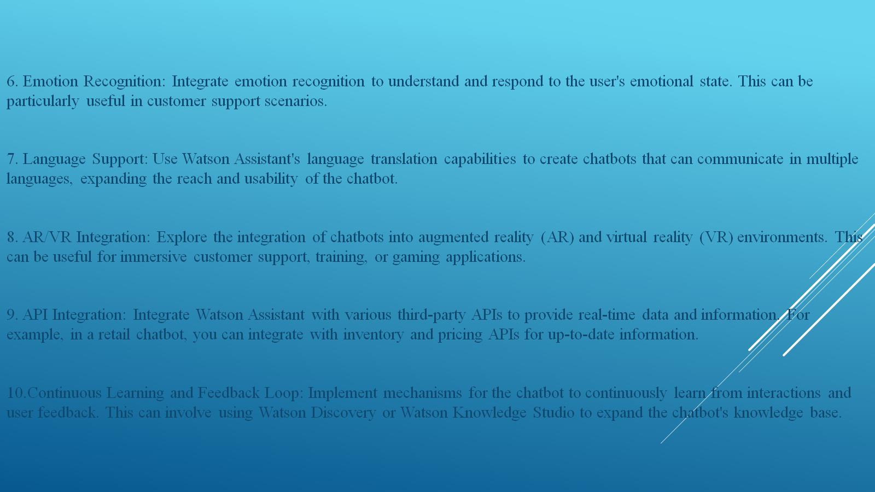

Slide 4

Workspace
Other Watson
services
Users
Interface
Back-end
Systems
Application

