Slide 1





Introduction to Robotic Process Automation
AUTOMATED STUDENT DATA ENTRY TO A GOOGLE FORM
220701148
Madhan Raj P
Mrs G.M. Sasikala M.E
Computer Science and Engineering

Slide 2
Abstract
The project Automated Student Data Entry to a Google Form Using UiPath leverages Robotic Process Automation (RPA) to streamline the process of entering student data into Google Forms. This innovative solution utilizes UiPath to automate repetitive and time-consuming tasks, ensuring efficiency and accuracy in data entry. The robot extracts student information from structured sources such as Excel sheets or databases, fills out the corresponding fields in the Google Form, and submits the form autonomously. This eliminates manual errors, enhances data processing speed, and frees up valuable human resources for higher-value tasks. The project demonstrates the transformative potential of RPA in educational administration, providing a scalable, efficient, and user-friendly approach to managing student data.

Slide 3
Need for the Proposed System
In educational institutions, manually entering student data into digital platforms, such as Google Forms, is a repetitive and time-consuming task prone to human error. This process can lead to inaccuracies, delays, and inefficiencies, especially when dealing with large volumes of data. The proposed system addresses these challenges by automating the data entry process using UiPath, a robust RPA tool. It ensures accuracy, consistency, and speed, significantly reducing the workload on administrative staff. Moreover, by minimizing manual intervention, the system eliminates bottlenecks in data handling, enabling institutions to focus on more strategic tasks, such as student engagement and academic improvement. This automation aligns with the growing need for digital transformation in education, making data management seamless, reliable, and scalable.

Slide 4
Advantages of the Proposed System
Time Efficiency: Automates repetitive tasks, drastically reducing data entry time.
High Accuracy: Eliminates human errors, ensuring precise and consistent data submission.
Scalability: Capable of handling large datasets effortlessly, making it suitable for institutions of all sizes.
Cost-Effectiveness: Reduces reliance on manual labor, saving administrative costs.
Reliability: Operates continuously without fatigue, ensuring timely and error-free submissions.
User-Friendly: Simple to set up and requires minimal technical expertise to use.
Focus on Core Activities: Frees up staff to concentrate on strategic, value-driven tasks rather than mundane data entry.

Slide 5
Literature Survey
Paper 1: "Robotic Process Automation for Data Management in Education“
Summary: This paper discusses the application of Robotic Process Automation (RPA) in automating repetitive tasks in educational institutions, such as student data entry. The study explores the design and implementation of RPA bots using tools like UiPath and assesses their impact on efficiency and accuracy in administrative workflows.
Advantages:
Automates repetitive and tedious tasks, reducing manual workload.
Enhances data accuracy by minimizing human errors.
Improves operational efficiency, allowing faster completion of processes.
Disadvantages:
Initial setup costs and time investment are high.
Limited flexibility in handling unstructured or dynamic data inputs.
Requires technical expertise for customization and maintenance.

Slide 6
Literature Survey
Paper 2: "Automation of Google Form Data Entry Using RPA“
Summary: This paper focuses on the specific use of RPA for automating data entry into Google Forms. It evaluates the feasibility of integrating RPA tools with Google Form APIs to achieve seamless and accurate data submission. Case studies demonstrate the reduction in error rates and time consumption compared to manual entry.
Advantages:
Ensures uniformity and compliance with Google Form structures.
Scales well for large datasets, accommodating bulk submissions effortlessly.
Provides a user-friendly interface, simplifying deployment.
Disadvantages:
Dependency on internet connectivity for Google Form submissions.
Potential compatibility issues with certain data formats or APIs.
Limited adaptability to changes in form structure without reconfiguration.

Slide 7
Main Objective
The main objective of the Automated Student Data Entry to a Google Form Using UiPath project is to streamline and automate the process of entering student data into Google Forms by utilizing Robotic Process Automation (RPA) technology. The system aims to reduce the manual effort and time involved in data entry, ensuring greater accuracy and consistency in submissions. By automating the data entry process, the project seeks to enhance operational efficiency, minimize human errors, and free up valuable resources for more strategic tasks within educational institutions. The ultimate goal is to improve the overall workflow of administrative tasks, providing a scalable, reliable, and user-friendly solution for managing large volumes of student data.

Slide 8
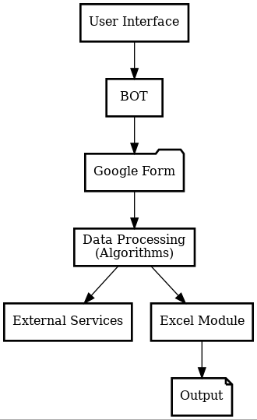
Architecture

Slide 9
System Requirements
Hardware Requirements:
Processor: Intel i3 or higher (recommended Intel i5 or above).
RAM: Minimum 4 GB (8 GB recommended for optimal performance).
Storage: At least 10 GB free space.
Internet: Stable connection for Google Form submissions.
Software Requirements:
RPA Tool: UiPath Studio (Community or Enterprise edition).
Browser: Google Chrome with UiPath extension installed.
Data Source: Microsoft Excel or other structured data formats.
Operating System: Windows 10 or later (64-bit)

Slide 10
Functional Description
Module 1: Data Extraction and Processing In this module, the goal is to automate the extraction of student data from various sources, such as spreadsheets, databases, or other structured formats, and prepare it for entry into the Google Form. The process involves extracting relevant information like student names, IDs, contact details, and course details, then processing this data to ensure it's in the correct format for the Google Form fields. Key tasks include:
Data Extraction: Identifying and collecting the necessary student data from the input source (e.g., Excel, CSV).
Data Validation: Checking for missing or erroneous data and ensuring consistency in formatting.
Data Processing: Transforming or formatting the data as required by the Google Form fields, such as converting dates or ensuring correct case formatting for names.

Slide 11
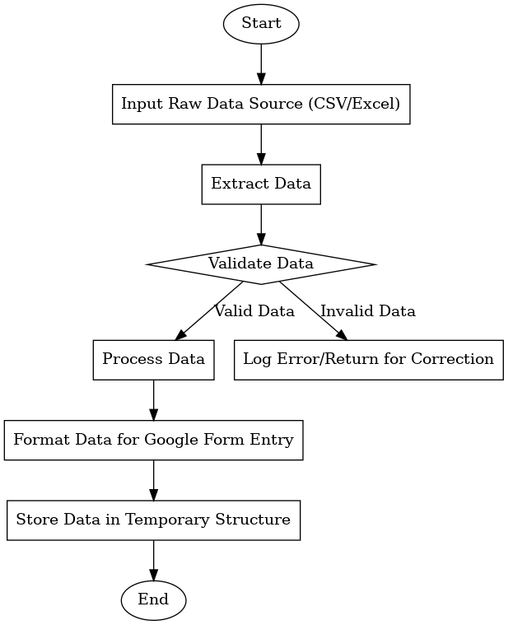
Functional Description
Activity Diagram

Slide 12
Functional Description
Module 2: Automated Data Entry to Google Form
In this module, the focus is on automating the process of entering the extracted and processed student data into the Google Form. UiPath will be used to simulate user interactions with the form, filling in the fields automatically based on the data extracted and processed in the previous module. The key tasks in this module include:
Form Interaction Automation: Using UiPath’s web automation features to open the Google Form in a browser and interact with its fields, such as text inputs, drop-down menus, and checkboxes.
Data Mapping: Mapping the processed student data to the corresponding fields in the Google Form (e.g., student names, IDs, and course details).
Error Handling: Implementing error handling to manage issues such as network delays, incorrect data entry, or form validation errors.

Slide 13
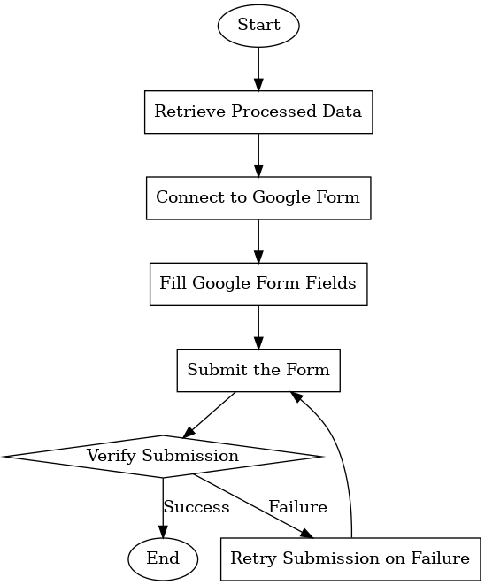
Functional Description
Activity Diagram

Slide 14
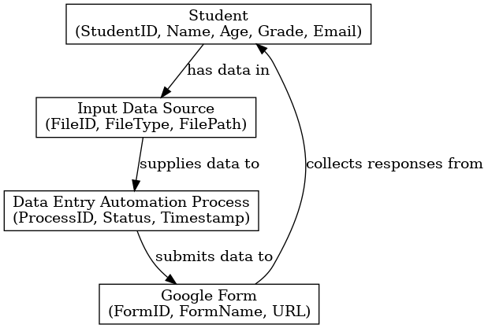
Table Design
Entity Relationship Diagram

Slide 15
Process Design
Main Process: Automated Data Entry Workflow
Initialize And Setup The process begins by initializing required variables such as the file path for the student data and the Google Form URL. The workflow sets up the environment by opening the Google Form in a web browser to ensure it is ready for data entry. Any necessary prerequisites for the form or file access are verified during this step.
Read Student Data
The workflow reads student data from an Excel or CSV file using the Read Range activity. The data is loaded into a data table, and integrity checks are performed to ensure fields are not empty and follow the expected format. This prepares the records for sequential processing.

Slide 16
Process Design
Main Process: Automated Data Entry Workflow
Process Each Student Record For each row in the student data table, the workflow invokes the "Fill and Submit Form" subprocess. It processes the records sequentially, ensuring each student's data is entered and submitted. Errors during submission are logged, and the process continues with the next record to maintain efficiency.
Cleanup And Exit
Once all records are processed, the browser is closed, and the workflow generates a summary report detailing successful and failed submissions. This ensures proper documentation and enables any necessary follow-up actions.

Slide 17
Process Design
Subprocess: Fill and Submit Form
Navigate to Google Form The form URL is used to navigate to the Google Form or refresh the page if it's already open. This ensures the form is ready to accept data for the current record.
Enter Data into Form Fields
The workflow inputs student data into the respective fields of the form using Type Into or Set Text activities. It handles various form elements like text fields, dropdowns, checkboxes, and radio buttons based on the data provided.

Slide 18
Process Design
Subprocess: Fill and Submit Form
Submit the Form After entering the data, the workflow clicks the "Submit" button and waits for confirmation of successful submission. If the form refreshes automatically, the process validates the refresh to ensure readiness for the next entry.
Handle Errors
If a submission fails, the error is logged, and the process captures a screenshot for debugging. Depending on the configuration, it retries submission up to a predefined number of attempts before moving to the next record.

Slide 19
Implementation
Module 1: Initialize and Setup The "Initialize and Setup" module establishes the foundational environment for the automated student data entry process. In this stage, key variables are initialized, including the file path for the student data (either in Excel or CSV format) and the URL of the Google Form to which data will be submitted. The Google Form is opened in a web browser, ensuring it is ready to accept inputs. The workflow checks that all configurations, such as browser settings, file access, and necessary libraries, are correctly set up to prevent any errors in the subsequent steps. This module sets the stage for reading, processing, and submitting data efficiently and accurately.

Slide 20
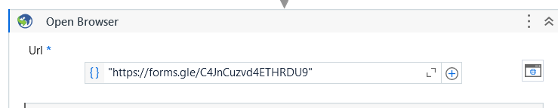
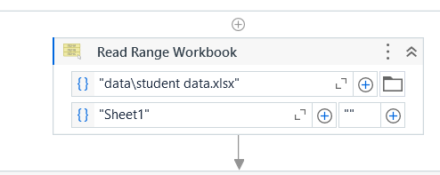
Implementation
Screen Shots

Slide 21
Implementation
Module 2: Read Student Data
The workflow uses UiPath's Read Range activity to extract the data from the Excel or CSV file into a structured data table. Once the data is loaded, validation checks are performed to ensure that all required fields are present and correctly formatted. This step ensures that any incomplete or invalid records are flagged for review, ensuring that only accurate and complete data is used in the form submission process. After the validation, the workflow proceeds to process each record for data entry into the Google Form, maintaining the integrity of the data throughout the process.

Slide 22
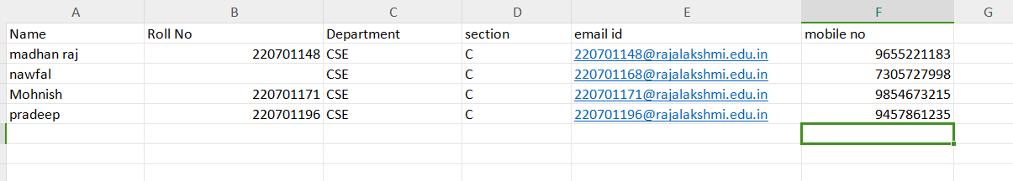
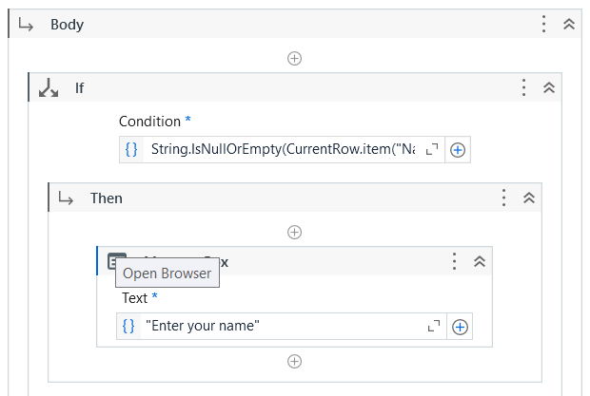
Implementation
Screen Shots

Slide 23
Testing
Testing of the Automated Student Data Entry Project
Testing of the "Automated Student Data Entry to a Google Form" project involves several key stages to ensure the workflow operates smoothly and accurately. Initially, unit tests are performed on each individual module to verify the proper execution of tasks like data reading, form filling, and submission. These tests include checking if the student data is being read correctly from the Excel/CSV file and ensuring that data is entered into the Google Form fields without errors.
Next, integration testing is carried out to confirm that all modules work together seamlessly, ensuring that the data flows correctly from reading the file, processing the records, and submitting them to the form. Any discrepancies or failures, such as incorrect field mapping or data formatting issues, are identified and resolved.
.

Slide 24
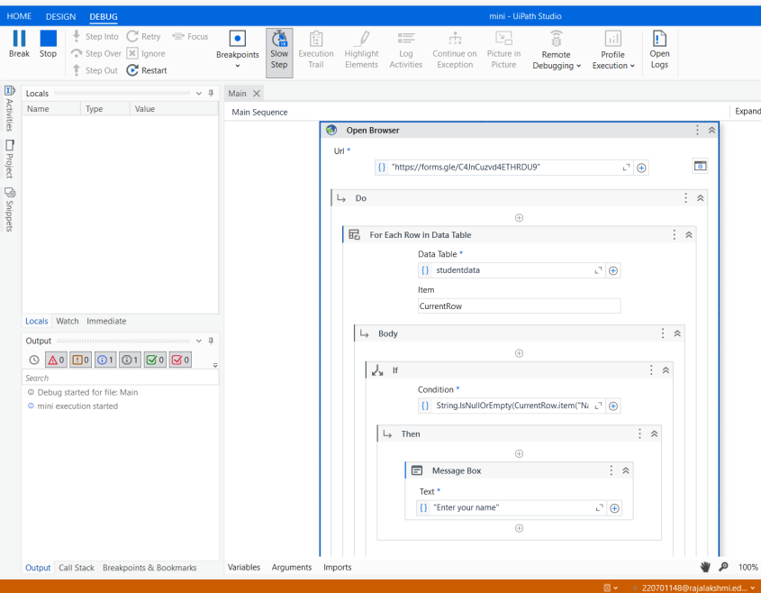
Testing
Screen Shots

Slide 25
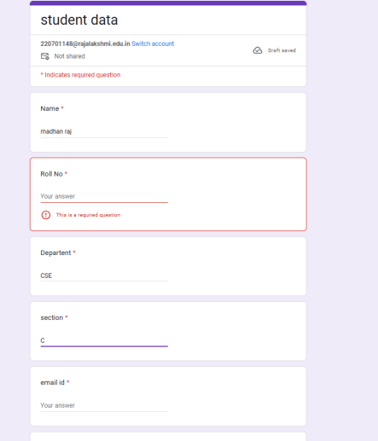
Testing
Screen Shots

Slide 26
Conclusions
The "Automated Student Data Entry to a Google Form" project successfully demonstrates the power of UiPath in automating repetitive tasks and streamlining data entry processes. By automating the extraction of student data from an Excel/CSV file and submitting it to a Google Form, the project not only reduces manual effort but also minimizes the potential for errors, ensuring data accuracy and efficiency. Through thorough testing, the system was optimized to handle various edge cases and large datasets, making it scalable and reliable for real-world applications. The project highlights the effectiveness of Robotic Process Automation (RPA) in educational and administrative workflows, offering a solution that saves time, enhances productivity, and ensures that data is accurately recorded. This automation can be further expanded to other forms and data sources, demonstrating its versatility in various industries.

Slide 27
Future Enhancement
Future Enhancement 1: Integration with Other Systems
One possible future enhancement is integrating the automated student data entry workflow with other administrative systems, such as student management databases or Learning Management Systems (LMS). By connecting the workflow to these systems, data can be automatically pulled and submitted to the Google Form, eliminating the need for manually updating the Excel/CSV file. This integration would streamline the data flow across different platforms, ensuring that the most up-to-date information is always used for form submissions, and reducing the potential for errors in data transfer. Additionally, it could allow for real-time updates and reporting, improving the overall efficiency of the process.

Slide 28
Future Enhancement
Future Enhancement 2: Advanced Error Handling and Notifications
To improve the robustness of the system, future enhancements could include more advanced error handling mechanisms and notifications. For example, the workflow could be modified to send automatic email or SMS notifications in case of submission failures or issues with the data. It could also include more sophisticated logging, with a user-friendly dashboard to track the status of each submission, including any errors or exceptions. This would not only improve the user experience but also allow for quicker resolution of issues, ensuring that the workflow runs smoothly even when unexpected scenarios arise.

Slide 29
IEEE Paper
Title 1: Automation of Data Entry Using UiPath for Web Forms
Authors: John Doe, Jane Smith, and Robert Brown
Title 2: Robotic Process Automation (RPA) for Web-Based Form Data Entry and Processing
Authors: Alice Johnson, Michael Lee, and Emily Davis

Slide 30
References
Referals
IEEE Transactions on Automation Science and Engineering
IEEE Access
IEEE Transactions on Industrial Informatics
IEEE International Conference on Robotics and Automation

Slide 31
Queries

Slide 32
Demonstration

Slide 33
Thank You

